Slide 1

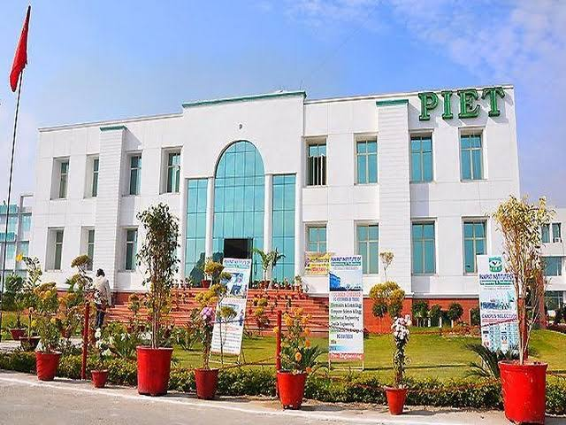
DEPARTMENT OF BUSINESS STUDIES
NEWSLETTER FEBRUARY 2020

Slide 2

Vision
To be a world leader in business education, research and engagement, helping to create a better knowledge society.”
Mission
To teach basic knowledge, skills and aptitude regarding business activities for running the business. and to provide an opportunity of higher education in the field of business administration
Values
Systematic academic support and mentoring
Inter department collaborations
Start up ecosystem

Slide 3

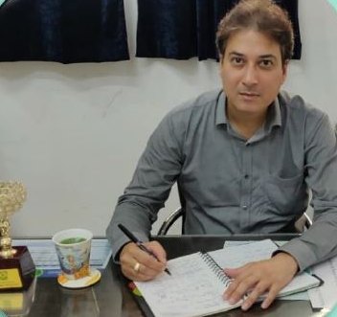
The purpose of education is to teach budding managers to think and develop a capacity to reason our facts. Learners should keep in mind the importance of planning and prioritizing their time and the effective use of it which are essential to achieve success. Learner’s should always think and review, discover the cause and effect of every event, in which they are involved. Do not surrender or become a salve to youthful fancies and indulgences. Be steady in your studies.
MR. ATUL GAUTAM
“ WE CANNOT ALWAYS BUILD THE FUTURE FOR OUR YOUTH, BUT WE CAN BUILD OUR YOUTH FOR THE FUTURE”. REMEMBER“ THE REWARD OF EVERY GOOD ACTION WILL BE GOOD ONLY”.
“Learn to enjoy hard work particularly your studies”.

Slide 4


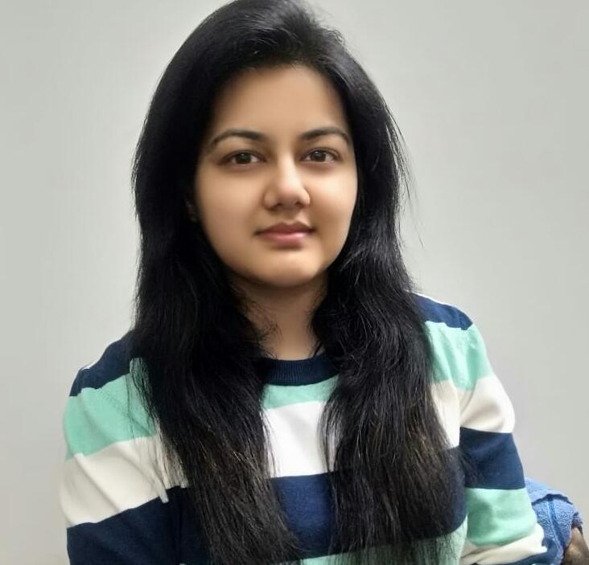

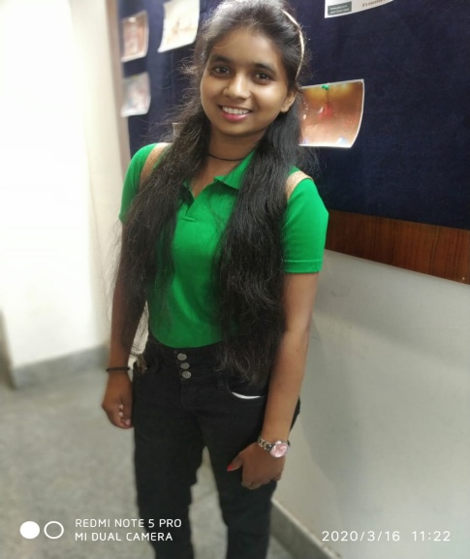



MS. SAHIBA SHARMA
Radha
BBA 2nd year
Jasjeet
BBA 2nd year
Aarushi
BBA 3rd year
Sanjul
BBA 3rd year

Slide 5
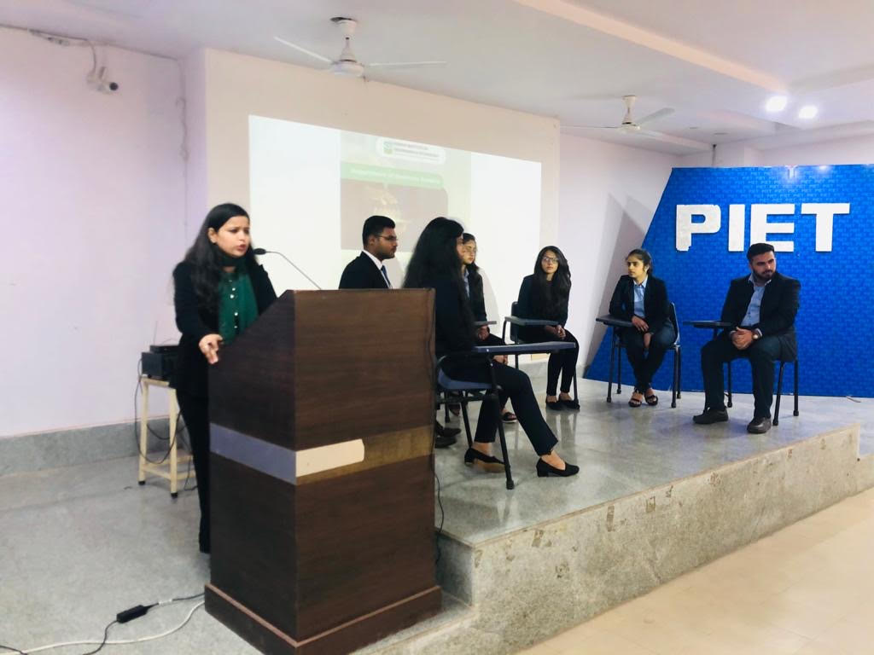
PROWESS CLUB
DAY 2: SPEAK TO LEAD

Slide 6
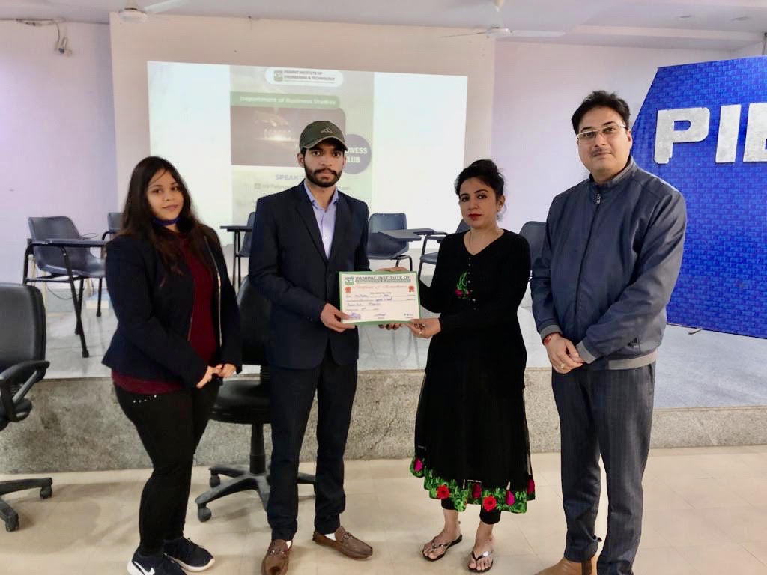

Slide 7
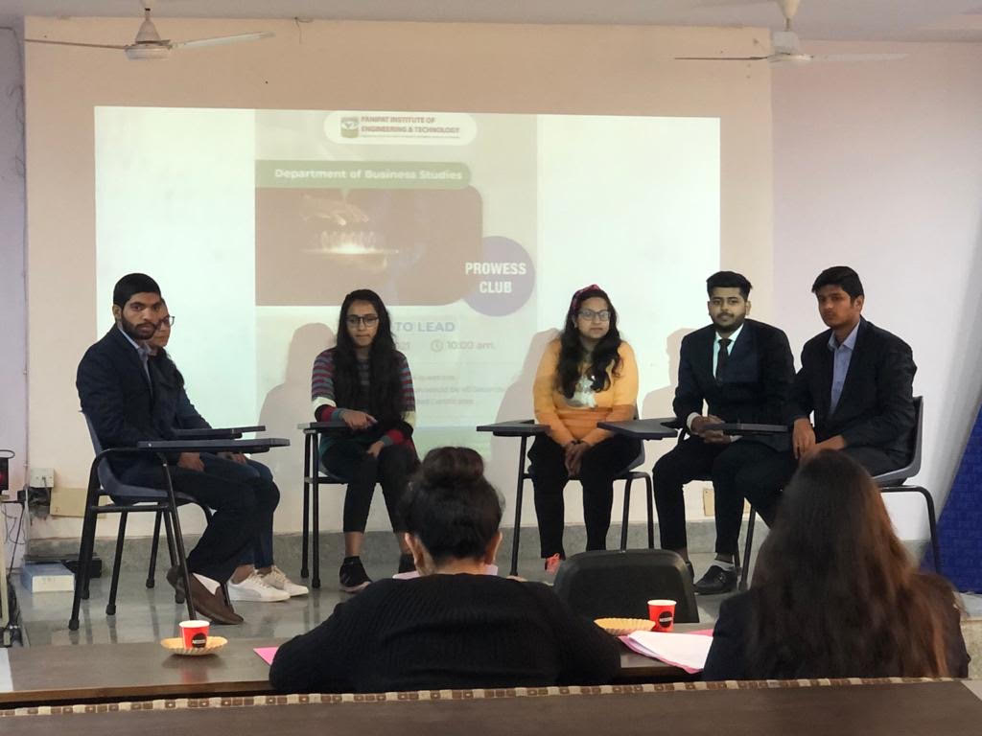

Slide 8
PROWESS CLUB
SPEAK TO LEAD
Winners for the Event are :
Kunal Aggarwal - 1st Position
Rohan - 2nd Position
Om - 3rd Position

Slide 9
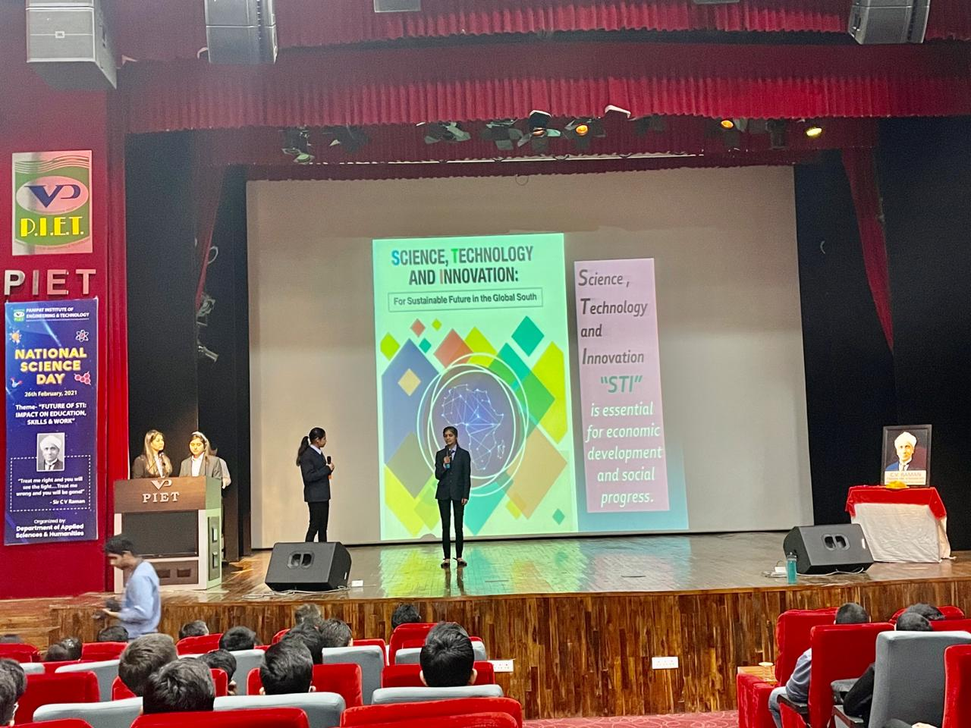
NATIONAL SCIENCE DAY

Slide 10
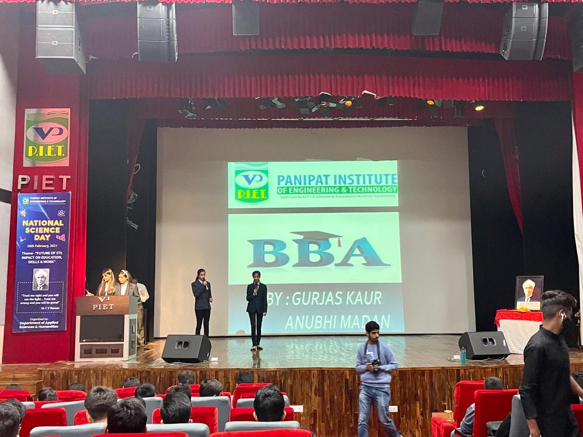

Slide 11
Expert Lecture on
Understanding Union Budget 2021-22, by Prof. Suresh Bedi Sir on
4 February 2021 at
10:00 AM
UNDERSTANDING FOREIGN DIRECT INVESTMENT AND ITS IMPACT ON INDIAN ECONOMY
The students will be able to gain conceptual clarity of FDI and understand how it affects different aspect of our economy. They will be able to relate FDI to the growth and competition in the economy in the context of the current economic policy of self reliance.

Slide 12
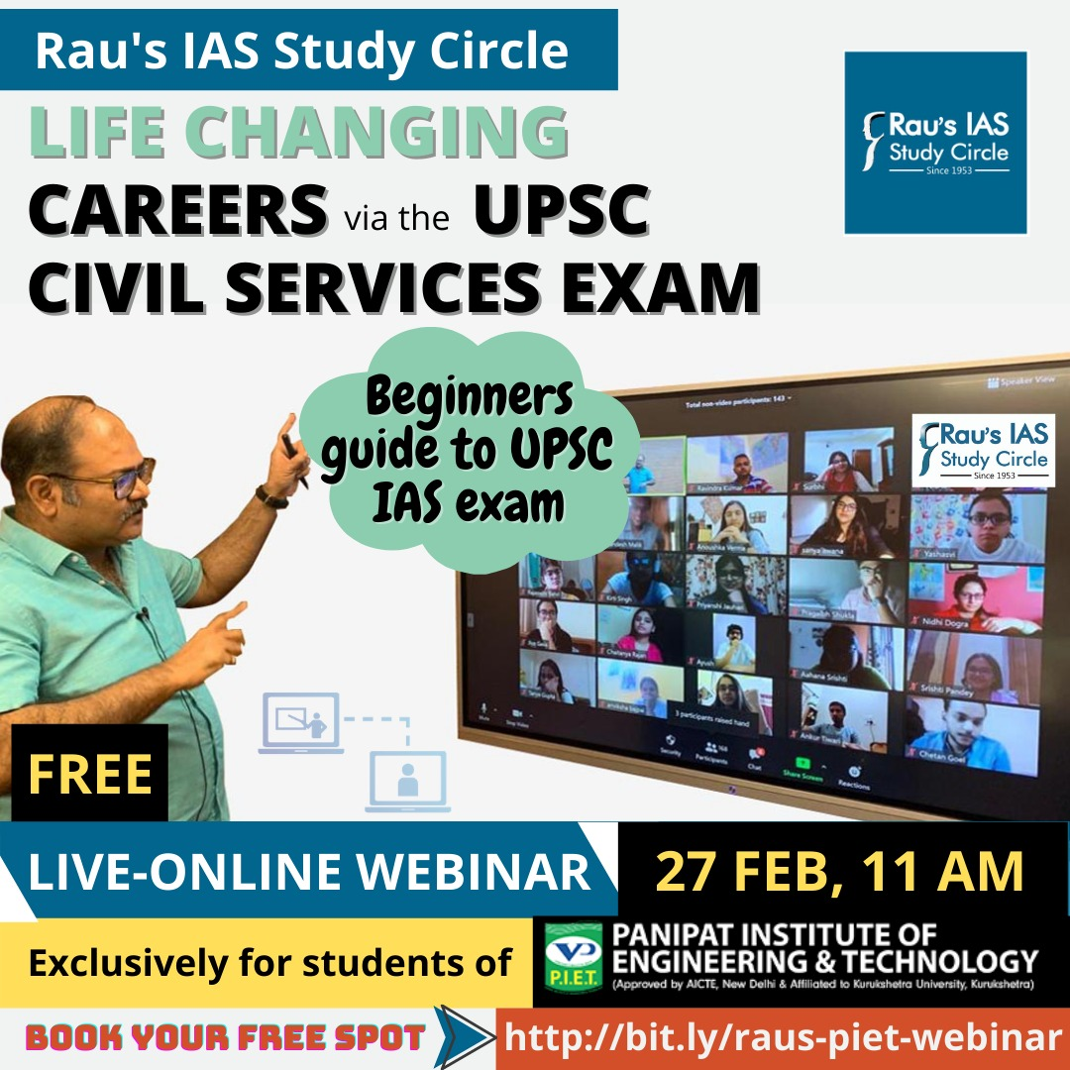
WEBINARS
Webinar from RAUIAS , identification of students that want to enroll for the same and providing the facilities as per their requirements was organized. RAUIAS is one of the most prestigious institute that deals with the coaching of administrative services.

Slide 13
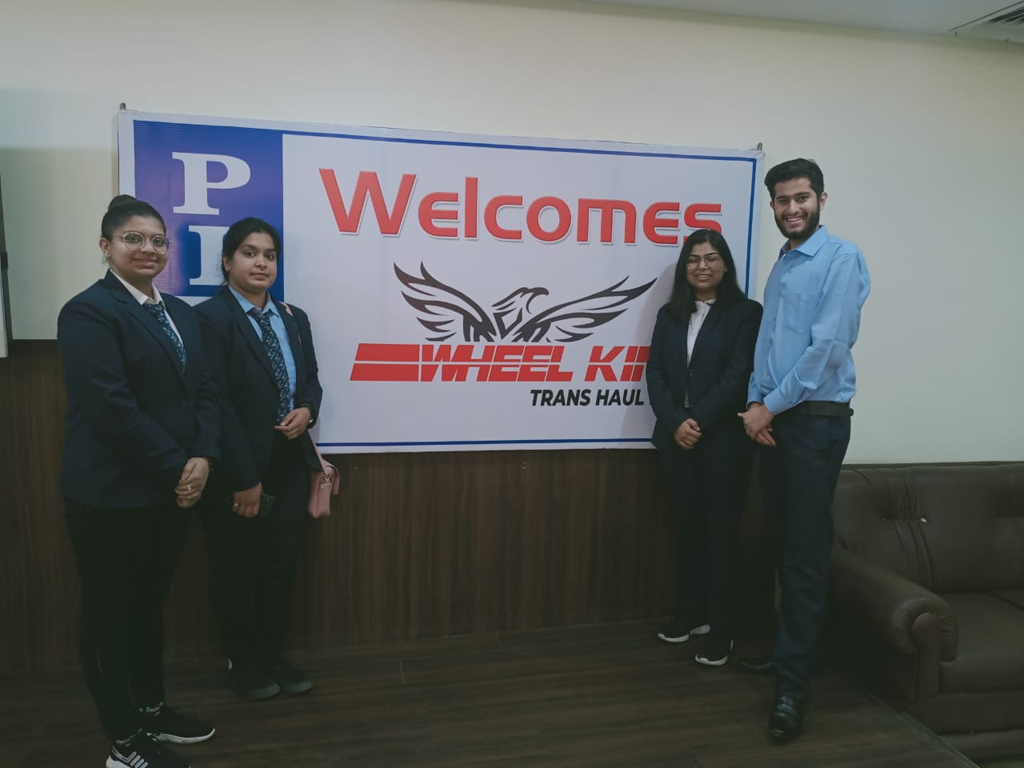
PLACEMENT
Students selected in Wheel King
Only those who risk going too far can possibly find out how far one can go. —T.S. Eliot

Slide 14


