Slide 1

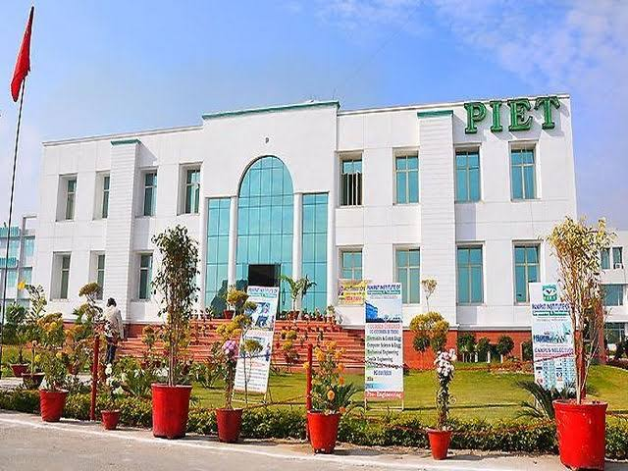
THIS IS YOUR PRESENTATION TITLE

Slide 2

INSTRUCTIONS FOR USE
EDIT IN GOOGLE SLIDES
Click on the button under the presentation preview that says "Use as Google Slides Theme".
You will get a copy of this document on your Google Drive and will be able to edit, add or delete slides.
You have to be signed in to your Google account.
EDIT IN POWERPOINT®
Click on the button under the presentation preview that says "Download as PowerPoint template". You will get a .pptx file that you can edit in PowerPoint.
Remember to download and install the fonts used in this presentation (you’ll find the links to the font files needed in the Presentation design slide)
VISION
To be a world leader in business education, research and engagement, helping to create a better knowledge society.
MISSION
To teach basic knowledge, skills and aptitude regarding business activities for running the business. and to provide an opportunity of higher education in the field of business administration
VALUES
Systematic academic support and mentoring
Inter department collaborations
Start up ecosystem
More info on how to use this template at www.slidescarnival.com/help-use-presentation-template
This template is free to use under Creative Commons Attribution license. You can keep the Credits slide or mention SlidesCarnival and other resources used in a slide footer.

Slide 3

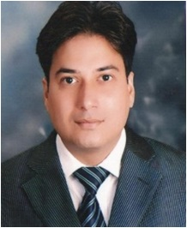
The purpose of education is to teach budding managers to think and develop a capacity to reason our facts. Learners should keep in mind the importance of planning and prioritizing their time and the effective use of it which are essential to achieve success. Learner’s should always think and review, discover the cause and effect of every event, in which they are involved. Do not surrender or become a salve to youthful fancies and indulgences. Be steady in your studies.
“ WE CANNOT ALWAYS BUILD THE FUTURE FOR OUR YOUTH, BUT WE CAN BUILD OUR YOUTH FOR THE FUTURE”. REMEMBER“ THE REWARD OF EVERY GOOD ACTION WILL BE GOOD ONLY”.
MR. ATUL GAUTAM

Slide 4

PANIPAT INSTITUTE OF ENGINEERING AND TECHNOLOGY
HAS ORGANISED HUMAN RIGHTS DAY 2021, AN AWARENESS PROGRAMME ON DECEMBER 10,2021.

Slide 5
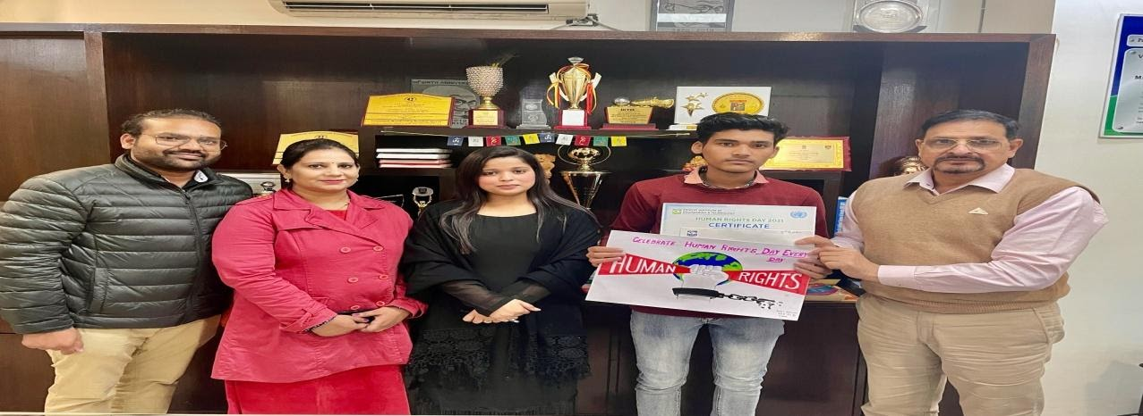
Students were asked to get the poster ready from their home and they showed their creativity, and the winners of the event are:
1st position : ANKIT

Slide 6
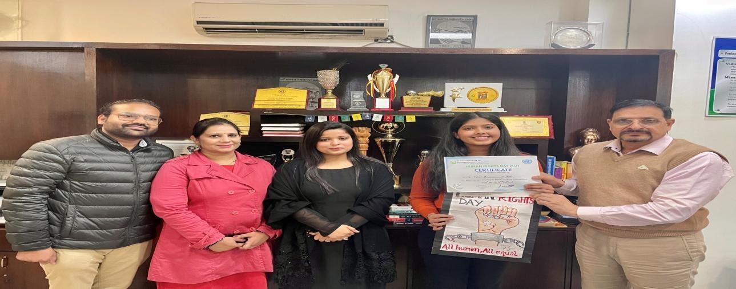
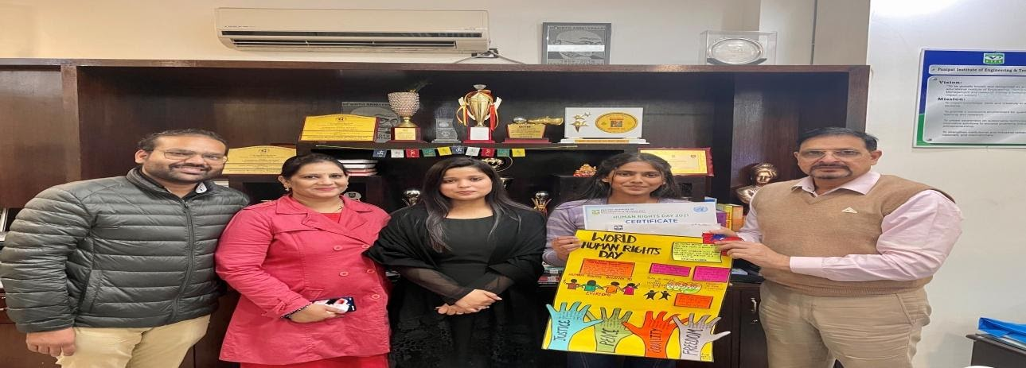
THIS IS A SLIDE TITLE
2ND POSITION : Palak Sharma
3RD POSITION : SWATI

Slide 7
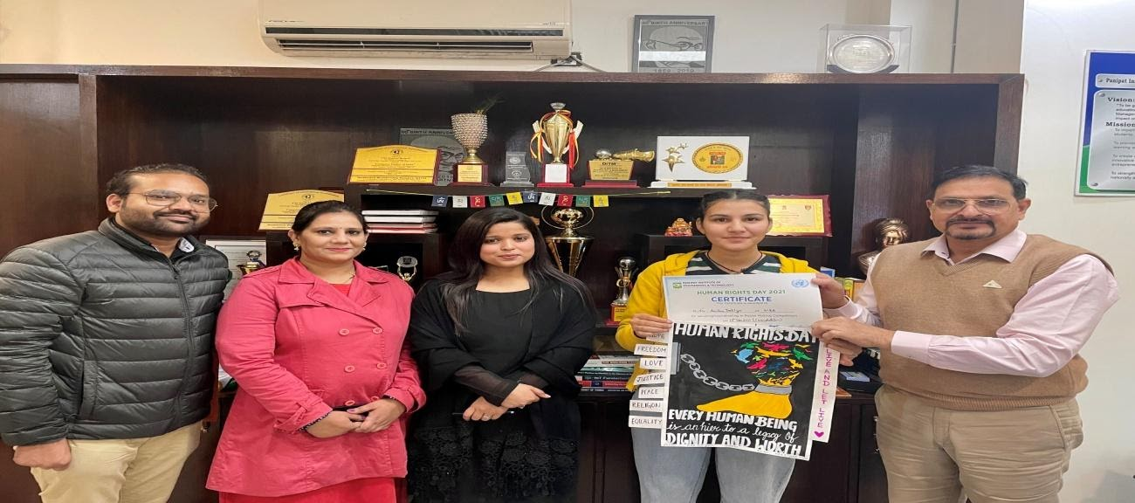
CONSOLATION : ANSHU

Slide 8
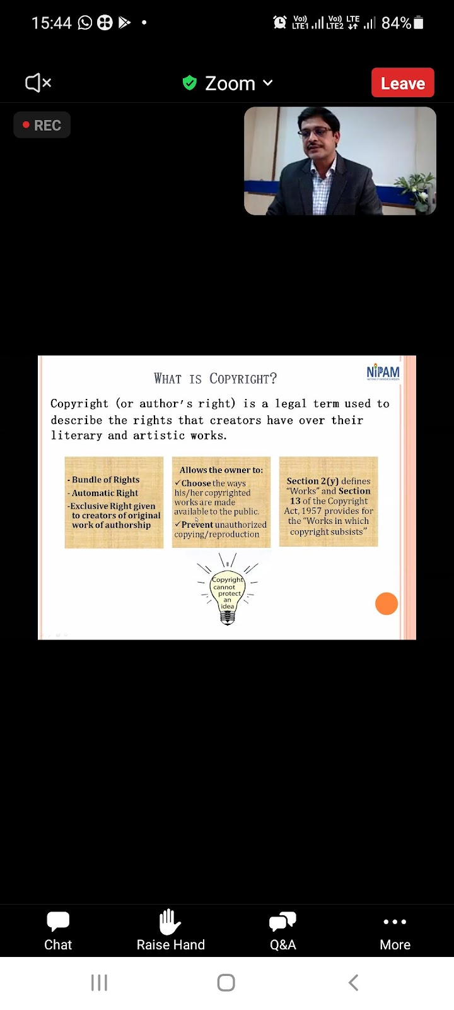
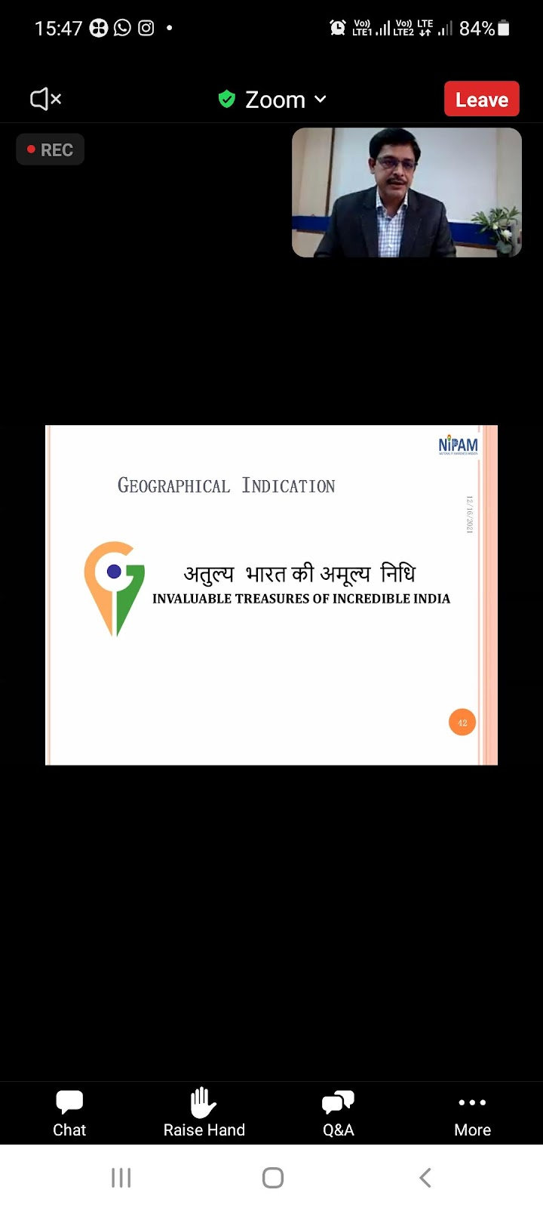
YOU CAN ALSO SPLIT YOUR CONTENT
Awareness Program on Intellectual Property By (NIPAM)

Slide 9
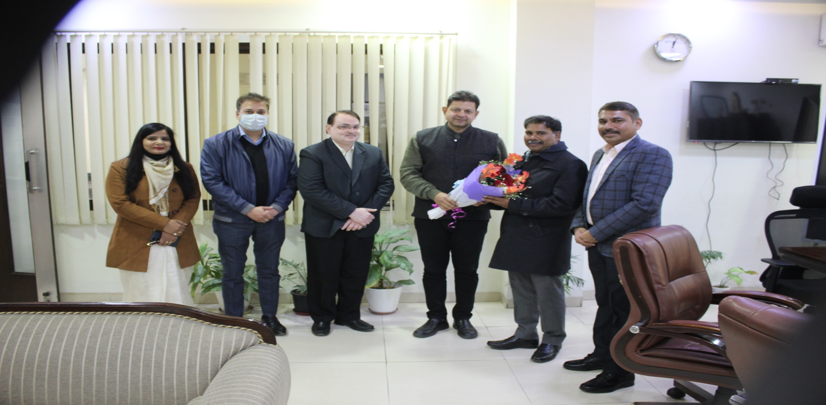
GUEST LECTURE ON HOW TO EXCEL IN ACADEMICS DURING THIS PANDEMIC

Slide 10
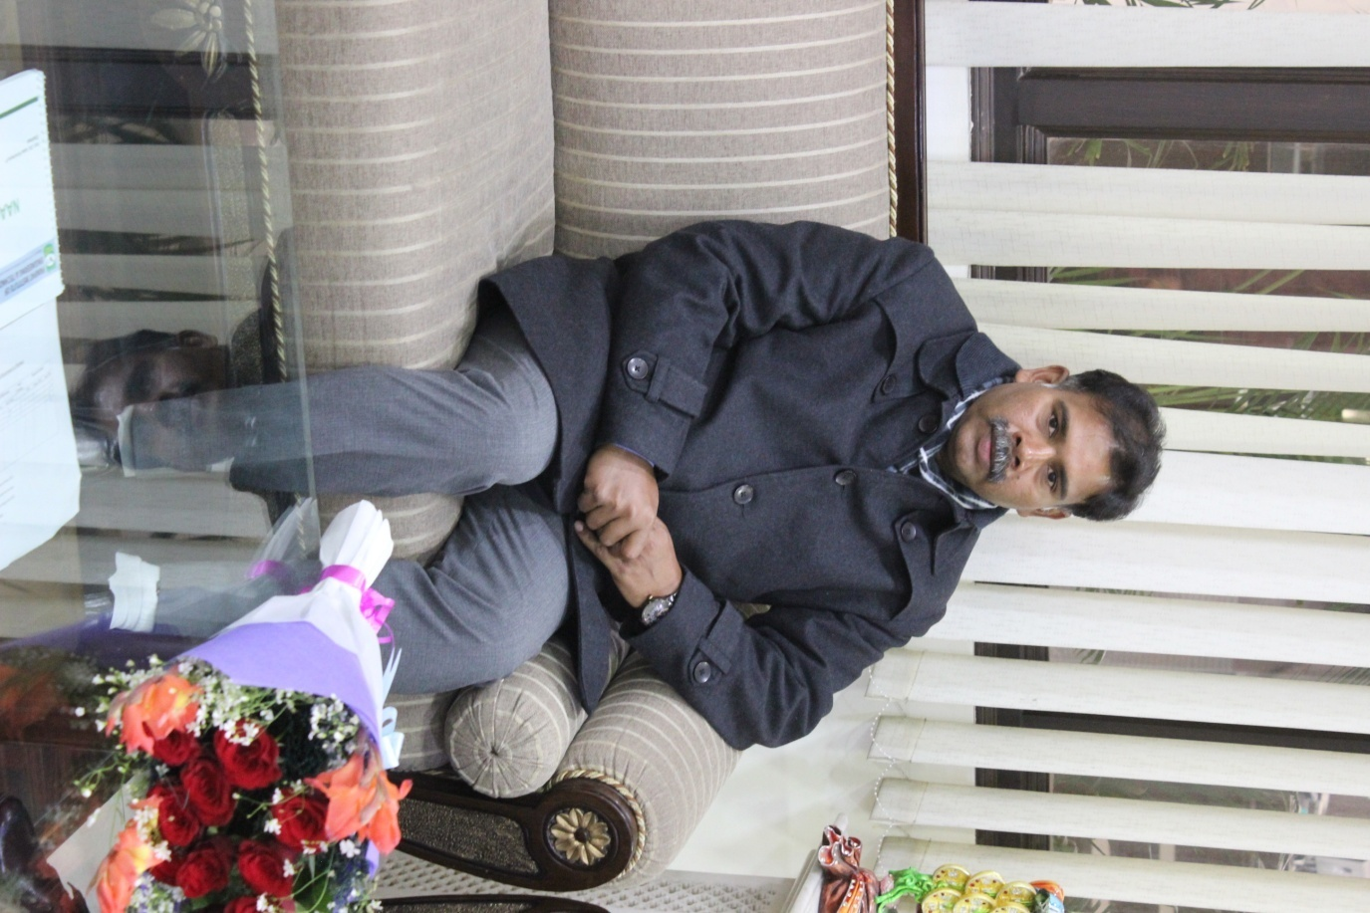
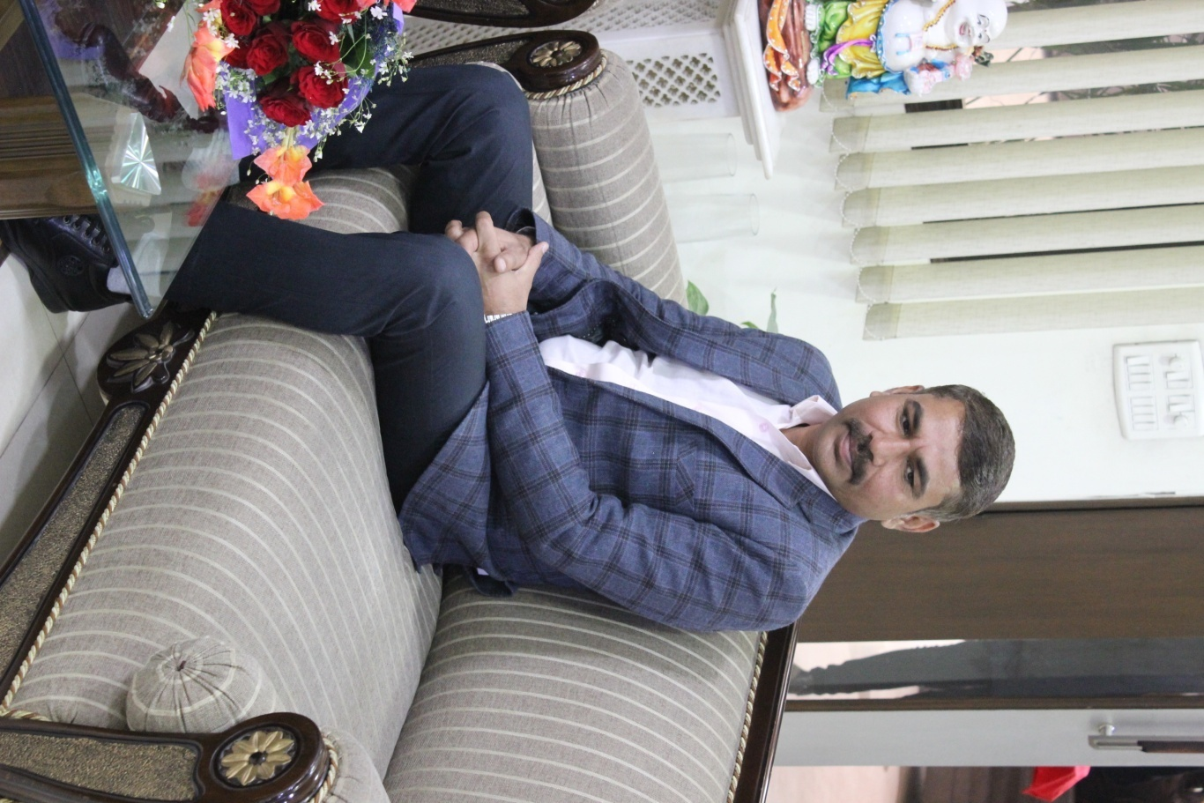
SOME GLIMPSE OF GUEST LECTURE

Slide 11
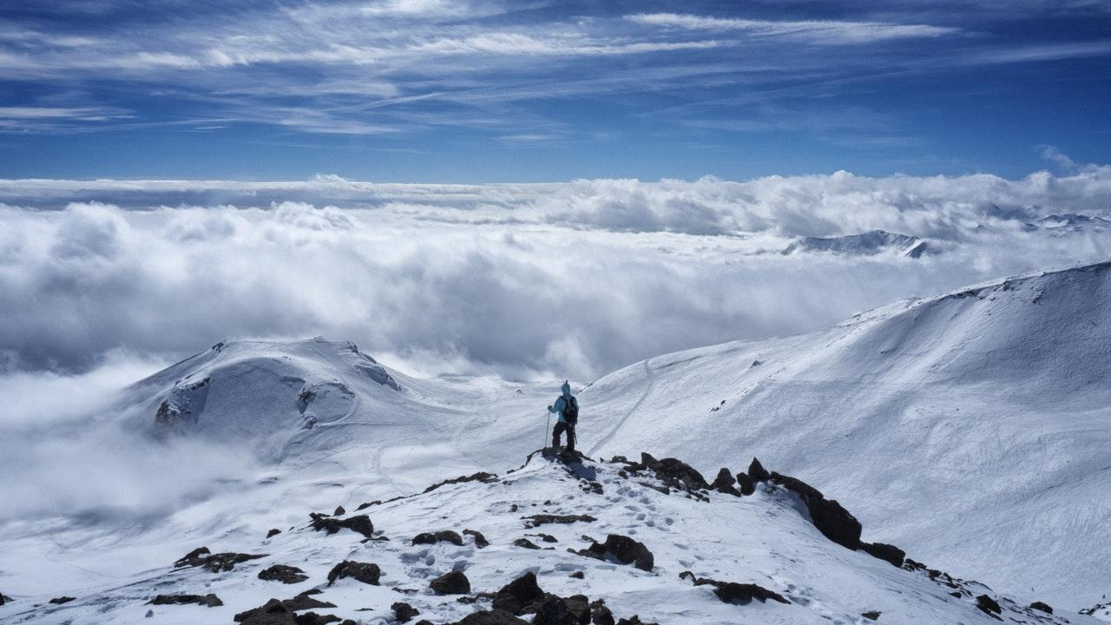
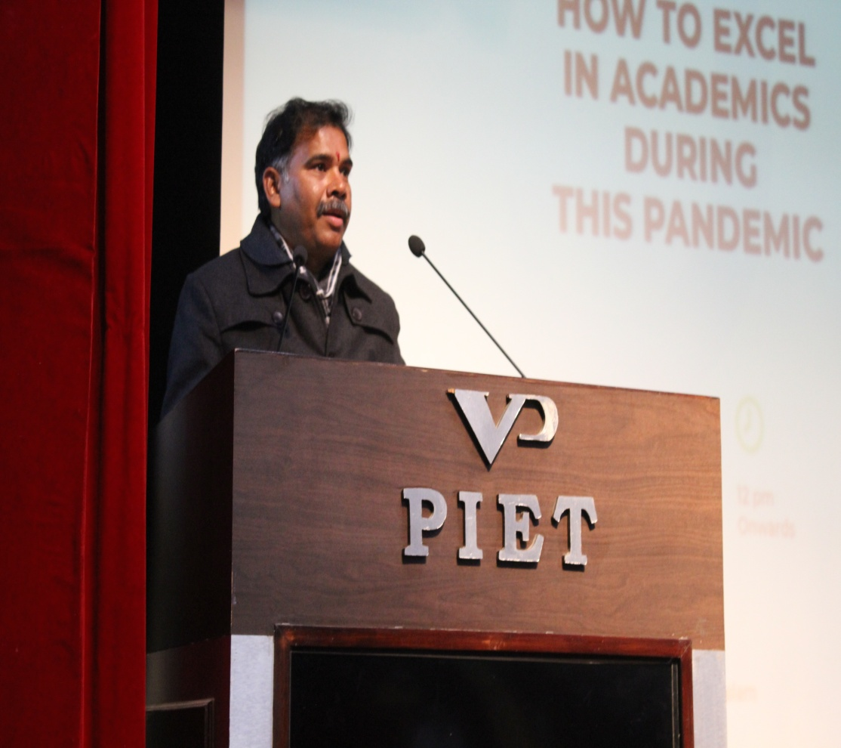
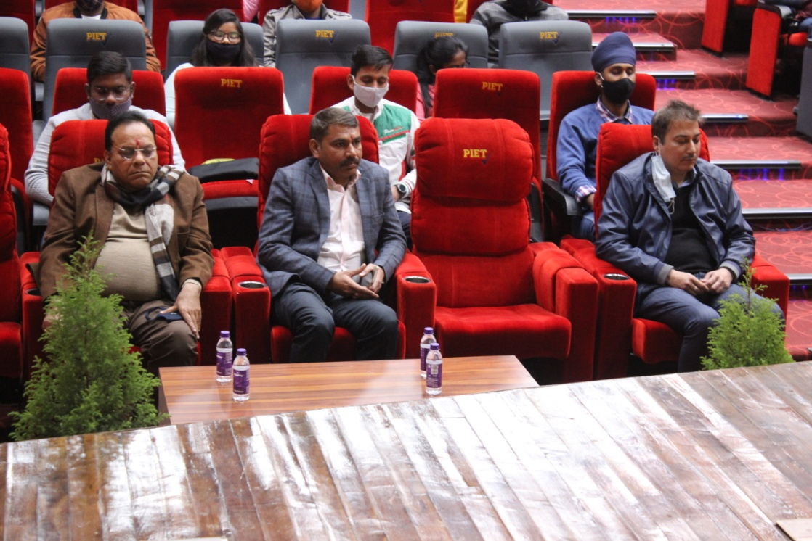

Slide 12
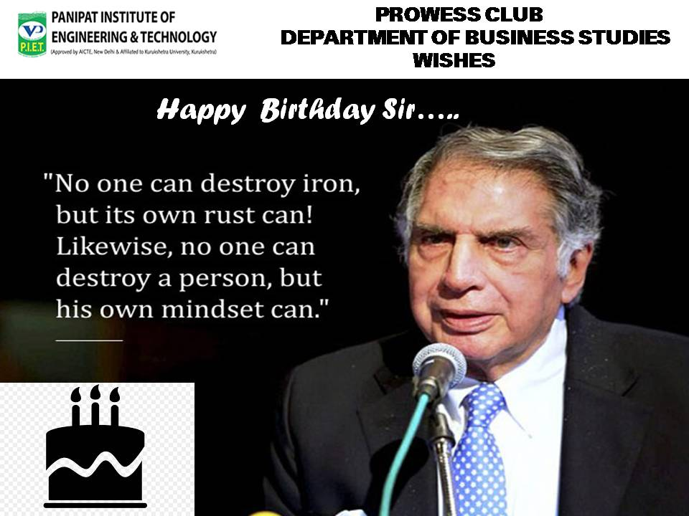
PROWESS CLUB DEPARTMENT OF BUSINESS STUDIES WISHES RATAN TATA SIR ON HIS BIRTHDAY

Slide 13
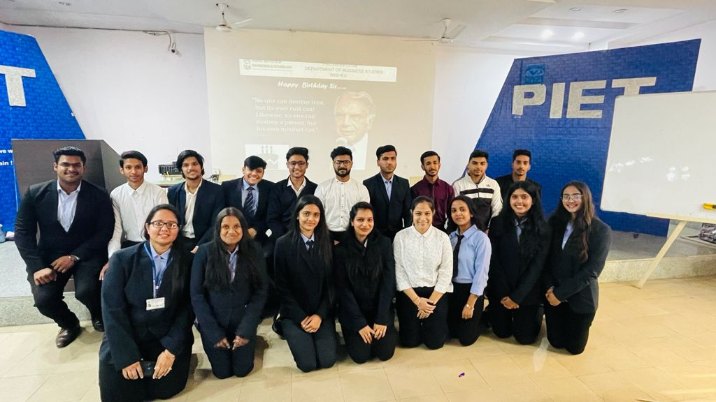
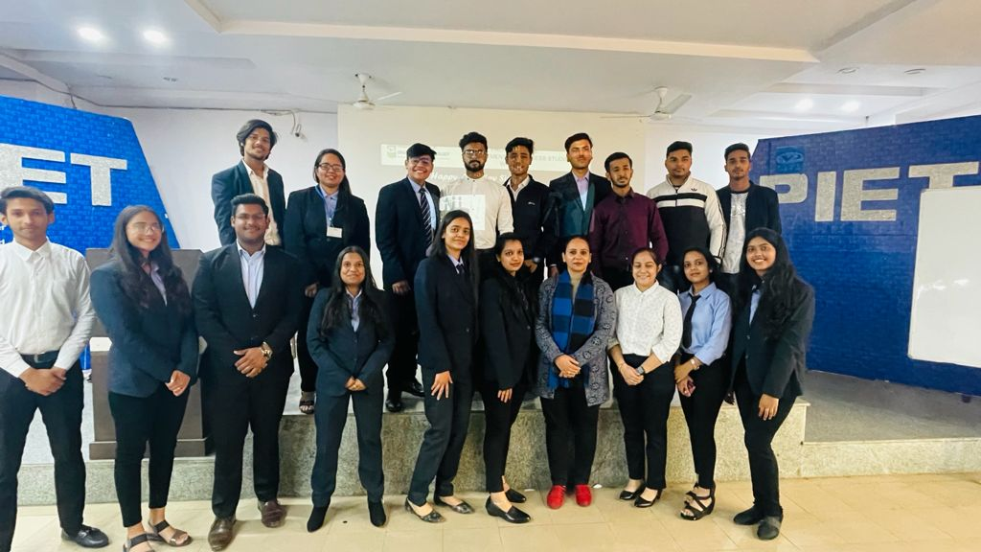
SOME GLIMPSE

Slide 14
RATAN NAVAL TATA !! A great and a humble personality ! Ratan Naval Tata is an Indian industrialist, philanthropist, and a former chairman of Tata Sons. He was also chairman of Tata Group, and continues to head its charitable trusts. 28 December 2021 ! We celebrated this auspicious day on the account of RATAN NAVAL TATA 84th glorious birthday ! There were three teams who were alloted to tell us about RATAN NAVAL TATA ! Every team did their job fantastically !! They told us about RATAN tata’s history his awards ,his life status and much more stuff ! The session was really very productive and gainful. We got to know so many things about tata ! There was an activity also held of quiz which boosted up everyone's mind ! Quiz session was sapid one . Everyone enjoyed that . We traveled a journey of Ratan Tata and the journey ended with much of the fruitful knowledge !

Slide 15

SOME ARTICLES BY OUR BRIGHT STUDENTS

Slide 16
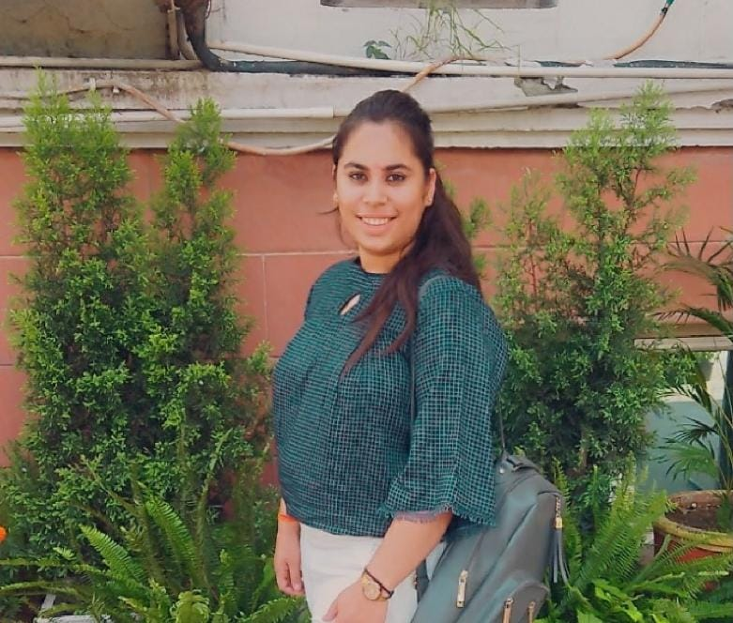
ARTICLE BY MUSKAN RAWAL
Digital marketing is a component of marketing that uses internet and online based digital technologies such as desktop computers, mobile phones and other digital media and platforms to promote products and services. It's development during the 1990s and 2000s changed the way brands and business use technology for marketing. As digital platforms became increasingly incorporated into marketing plans and everyday life ,and as people increasingly use digital services instead of visiting physical shops , digital Marketing campaigns employing combination of search engine optimization (SEO) ,advertising, e-books , and optical disks and games have become commonplace. The Extension to non -internet channels differentiates digital Marketing from online marketing. Digital marketing extends to non-internet channels that provide digital media, such as television, mobile phones (SMS and MMS) , callback and on- hold mobile ring tones.
DIGITAL MARKETING

Slide 17
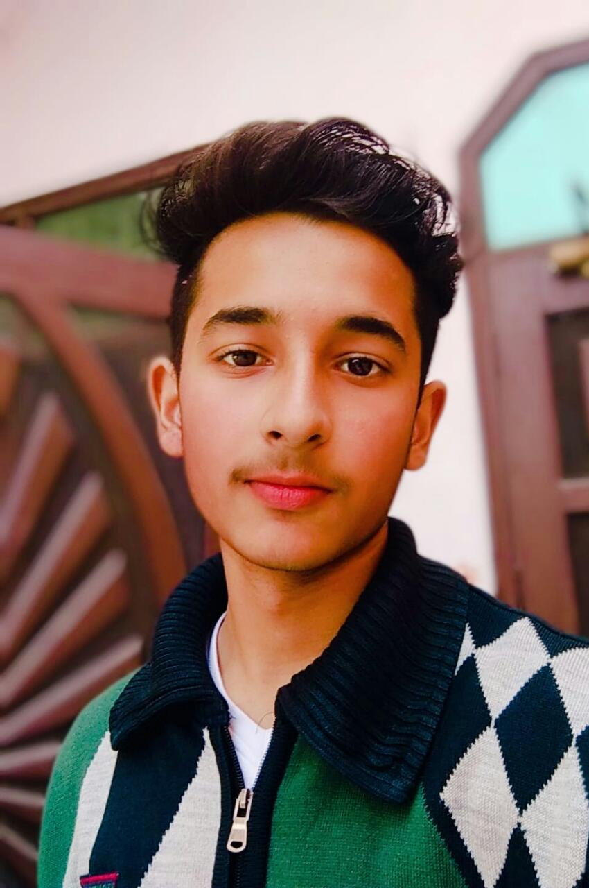
ARTICLE BY PARAMJEET
Social Media is one of the most fast-growing platform in our era. we are able to communicate with other people very easily by using Social media. Social media has enabled us to keep in touch with other friends who don’t live close to us. We are also able to know news in other parts of the world much easily by using social media. Some people whose voice was not heard before able to voice their openians through social media. We are able to build relationship with our friends Thus, we can say that social media is useful for us in many ways. Social media also have some harmful effect. Some people get addicted to social media such as facebook, instagram, whatsapp etc. This leads to a decrease in their productivity in their real life overseing social media lead to many eye problems . Thus we can say that social media has many harmful effect too and we should use with care and responsibilites.
SOCIAL MEDIA

Slide 18
