Slide 1





Slide 2
VOL 5
Issue 1

Slide 3
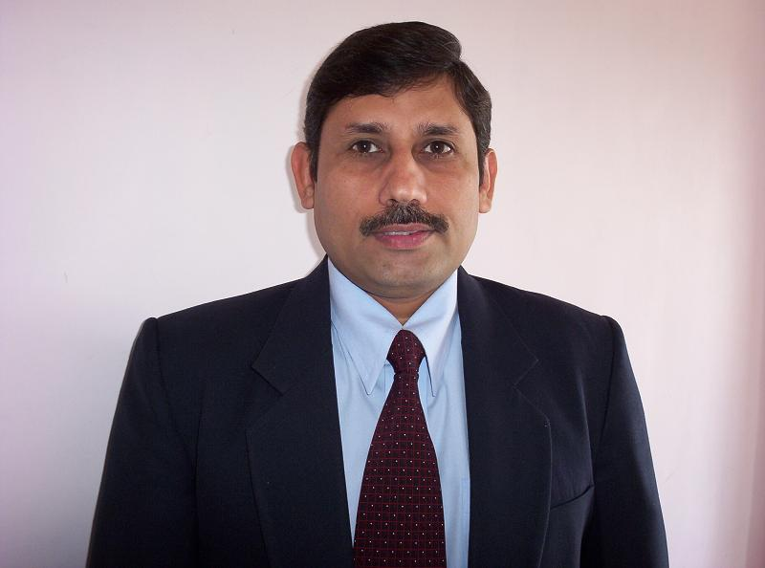
Mr. Yoginder Kataria
BBA – HOD
Message

Slide 4
It is with great pleasure that I welcome you to the 2018-2019 session through these pages. While writing this I feel very excited to serve all of you in my capacity as an HOD, which I realize is a big responsibility not only towards my students but their parents as well.
Looking back at our previous years I personally feel we have much more to do in the coming times to carry the name of PIET to still greater heights. For this our faculty team must continue to engage in the review and revision of our instructional programs and teaching methods. We should make it a point to celebrate our students’ success and also look for areas to increase student achievement in the university exams. At the same time cultural and athletic activities are also equally important and need focus. Time has come to build upon our success academically and continue the positive influence in the community.
I am looking forward to another amazing year in service to our students, parents and community.
Best Wishes
Dr. Yoginder S Kataria

Slide 5
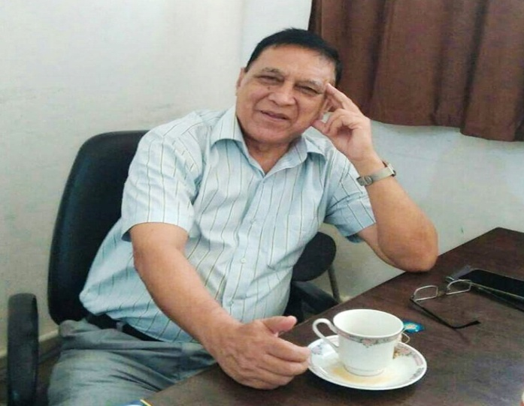
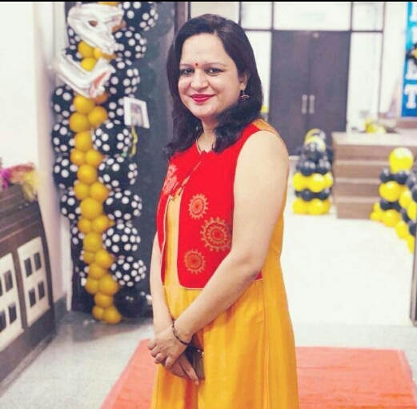
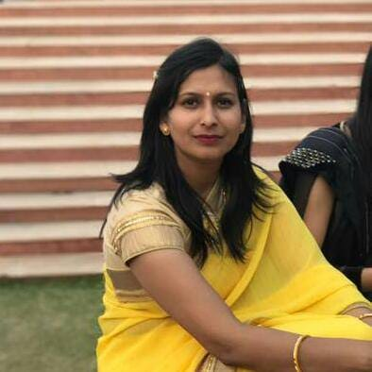
Editorial Team’s View
Dear Readers
A weak link is better than a strong memory. Nothing exemplifies it better than the nostalgic feeling one used to get when leafing through the dusty old pages of his/her college magazine. But sadly we are now in an era where we have lost the opportunity to feel a touch of the paper and pen. Everything today is virtual, something in the air, untouchable.
In whatever form it may be today, still one thing remains intact that it can still make a reader travel down the lanes of memory, giving rise to a surge of emotions of many hues and colours.
This first issue of Kshitiz, the e-mag for the current semester is going to give the same pleasure to all the brilliant minds which traverse through the portals of this temple of learning. I am happy to see the amount of enthusiasm of eminent faculty members of the college to contribute to the magazine. It really adds lot of value to our work as their messages travel across to the entire BBA family.

Slide 6
Not to be outdone, our students have devoted time and plunged into creating meaningful notice boards, heart-warming rangolis on special occasions, vivid cultural and informative performances. We all stand over- awed by their very enthusiasm which speaks of contribution of the teachers, filling these minds with positivity.
We proudly release this first issue of the magazine magazine in order to show to the outside world, and also to remind our ownselves that life is ongoing and the progress unstagnated. We intend to continue presenting the talent and creativity of our staff and students through ‘Kshitiz’ and I invite you to read and immerse yourself in the unfolding art and be exulted.
Jagmohan Malhotra
(Chief Editor)

Slide 7


Slide 8



Slide 9
16 July 2018 to 19 July 2018
BBA orientation programme was organised between 16th and 19th July. While the two day session was handled by Mr. Surya, the Managing Director of Confluence, the other two days were entirely handled by 2nd year students and faculty members.
The fresher's were exposed to the strengths of the BBA course and the advantages of doing it at PIET. It was a wonderful learning on various management aspects where the students participated actively in question answer session.
The other two days were full of fun and frolic and latent talent hunt. The new comers exhibited their skills on the stage and enjoyed to the optimum.
Cultural Committee :
Ms. Samriti
Ms. Namita
Ms. Monika

Slide 10
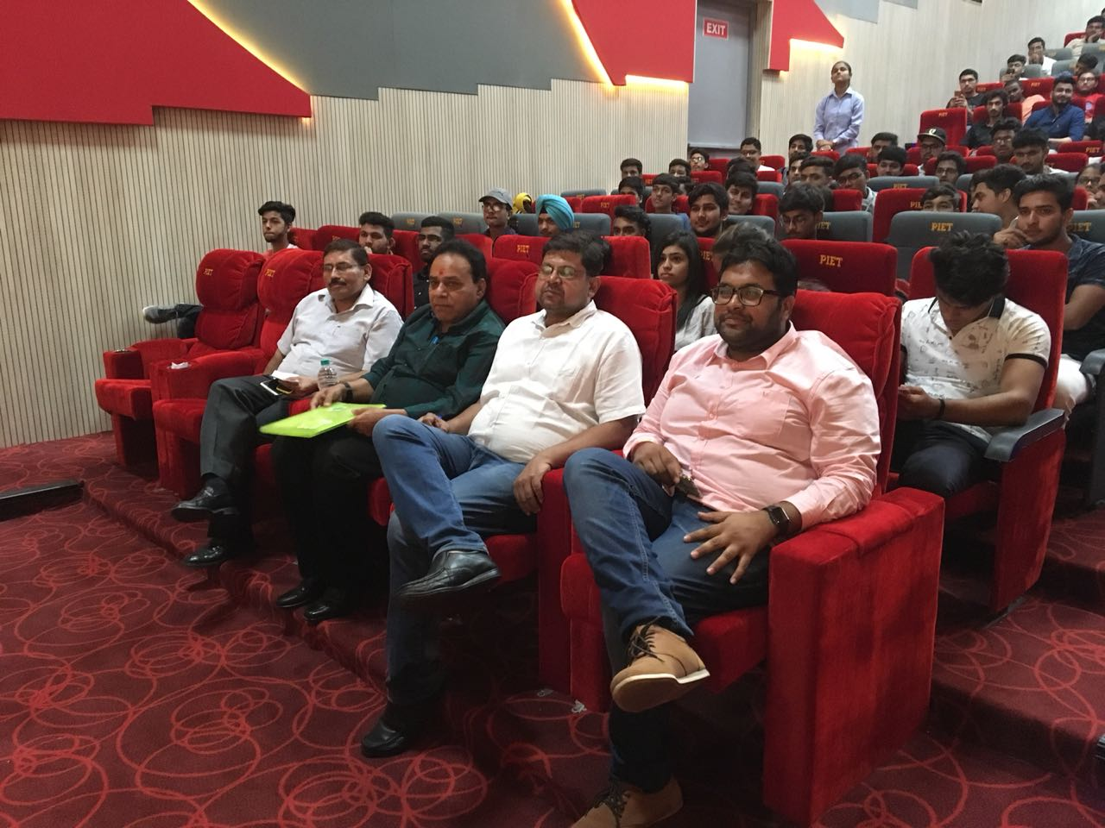
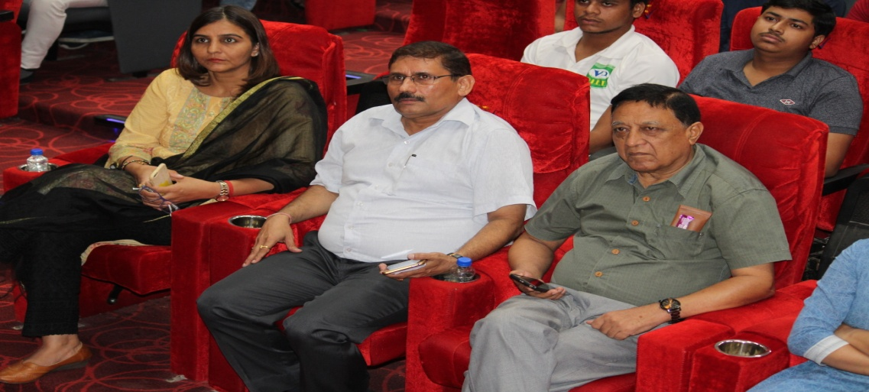
Worthy management and audience engrossed in breath taking performances of the fresher's.

Slide 11
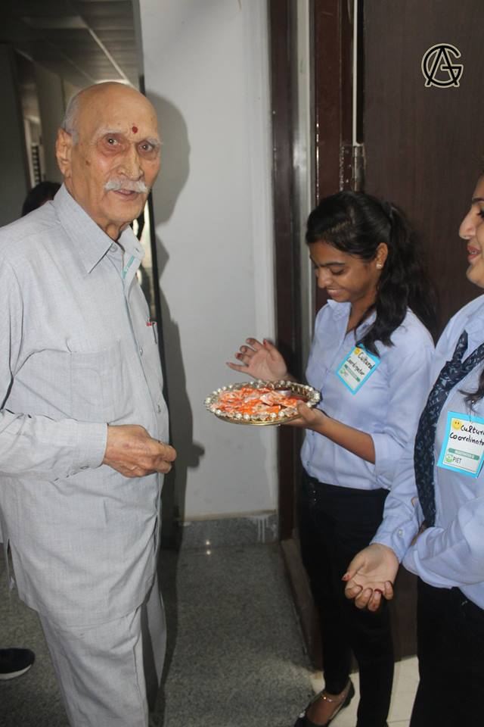
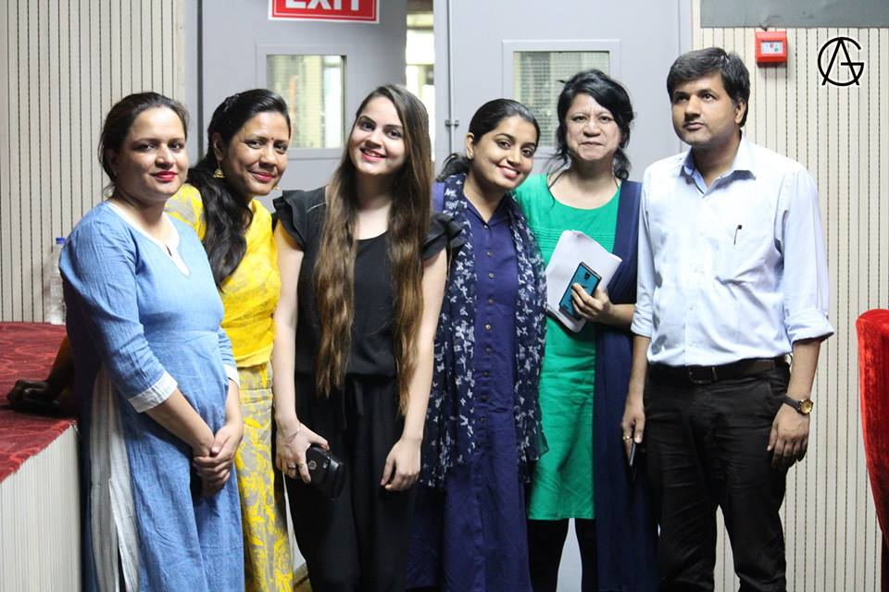
The welcome team paying due respect to Shri S K Khanna sir on his arrival.

Slide 12
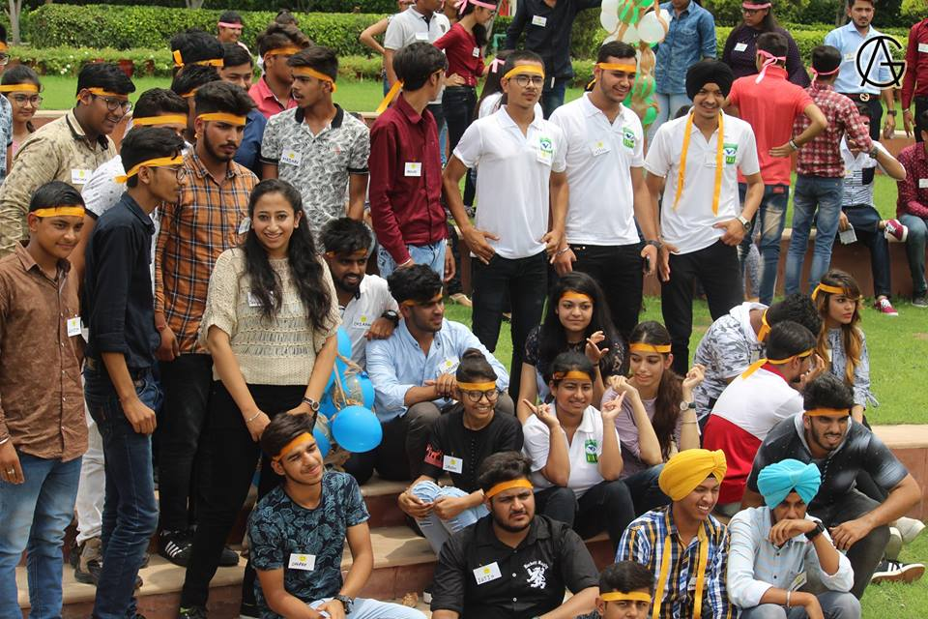
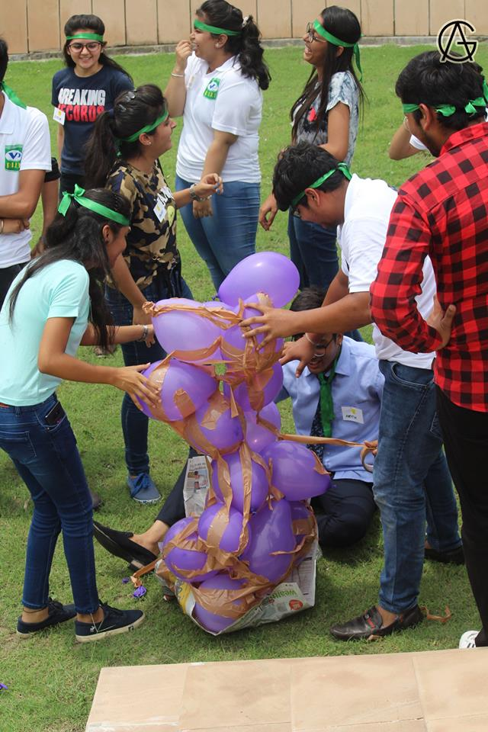
Students teams selected by Mr. Surya participating in the pyramid making game, a team work activity.

Slide 13
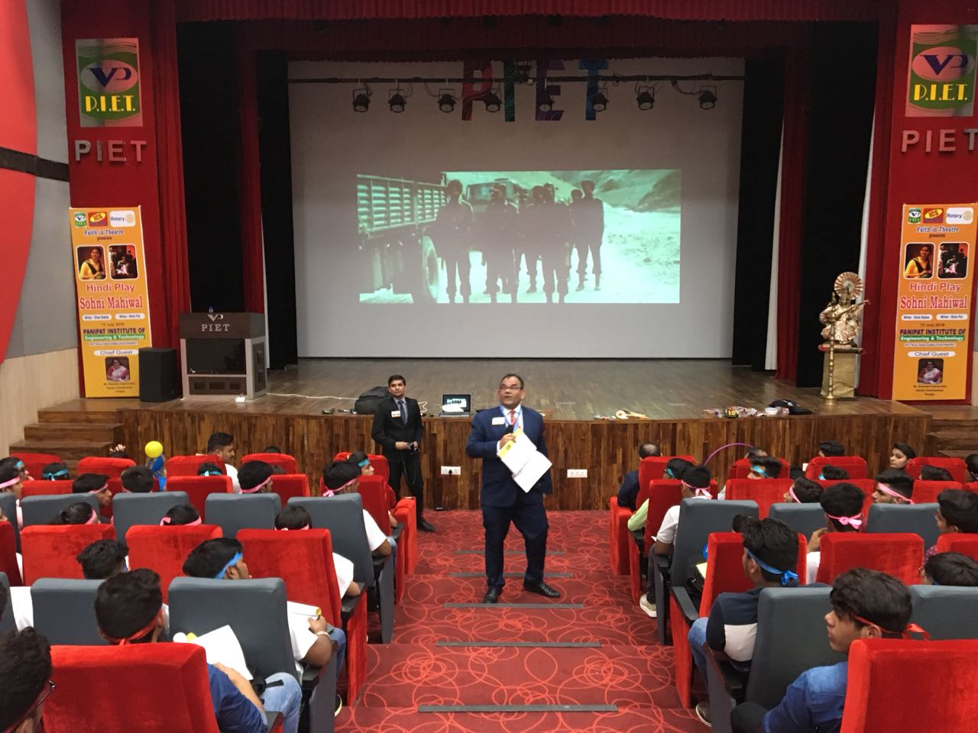
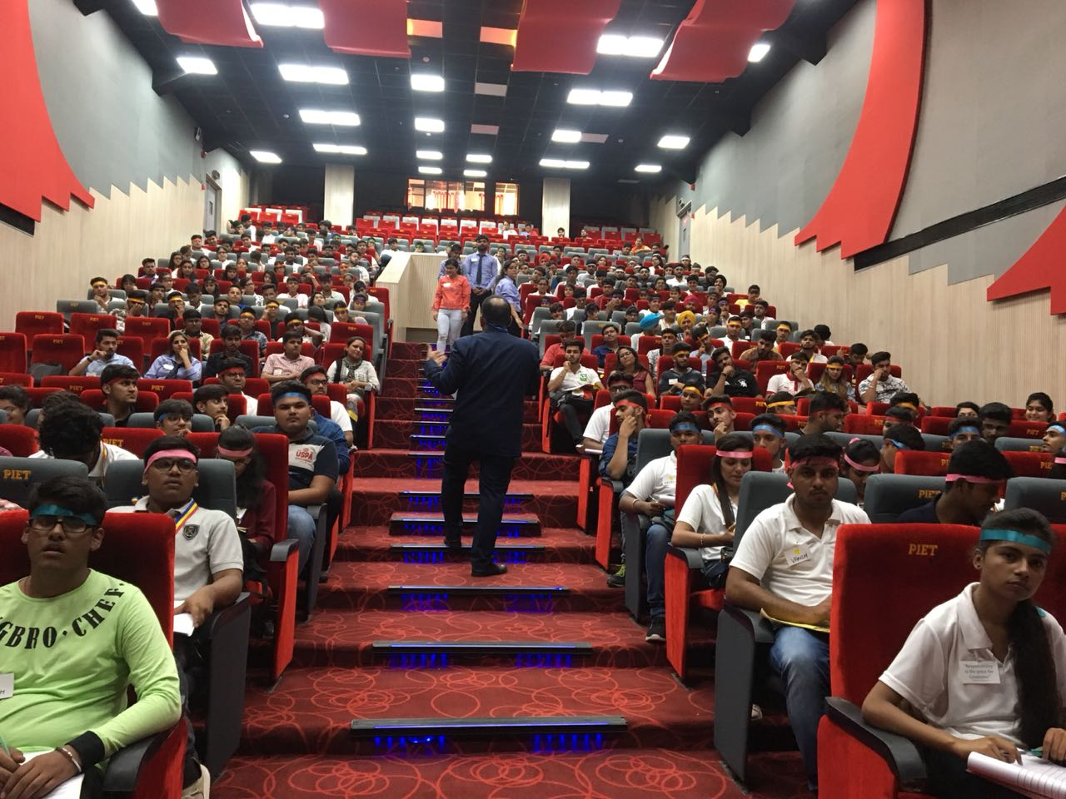
Mr. Surya’s session in progress.

Slide 14
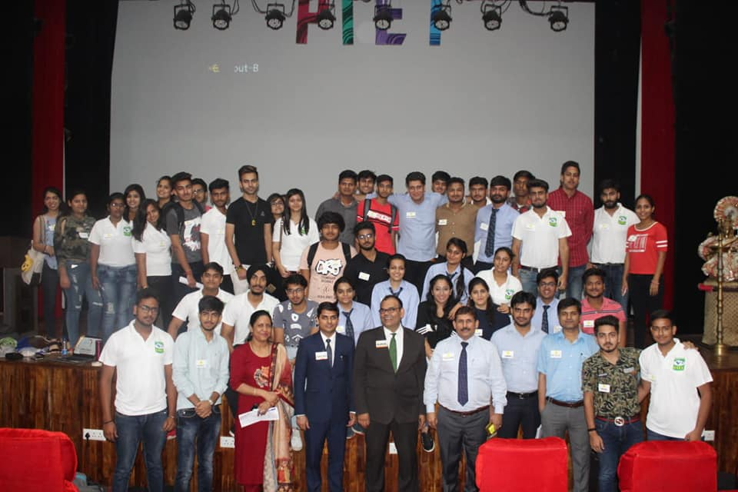
Anchors on board and below posing for a group photograph.

Slide 15
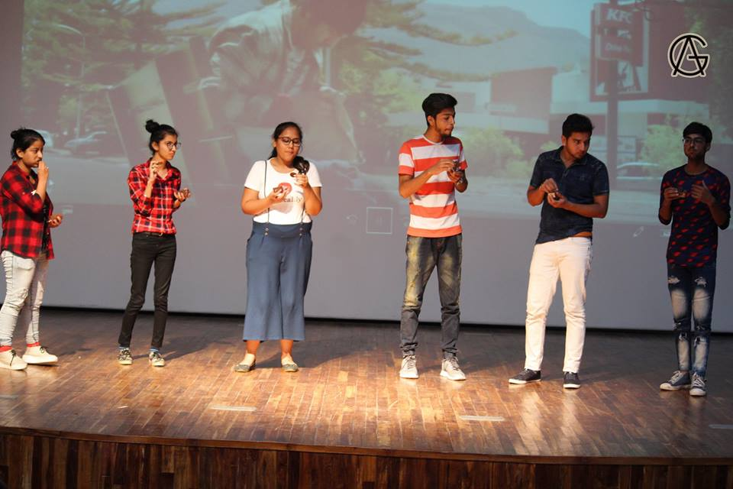
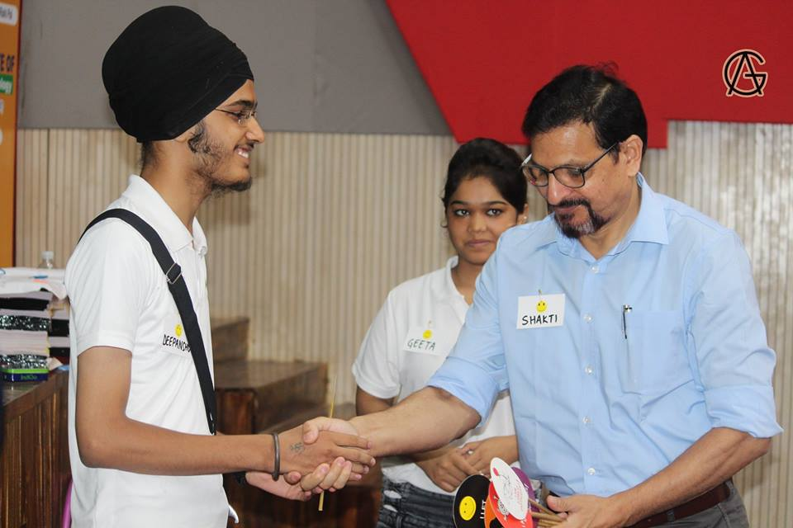
The active participants being felicitated by Director sir.

Slide 16
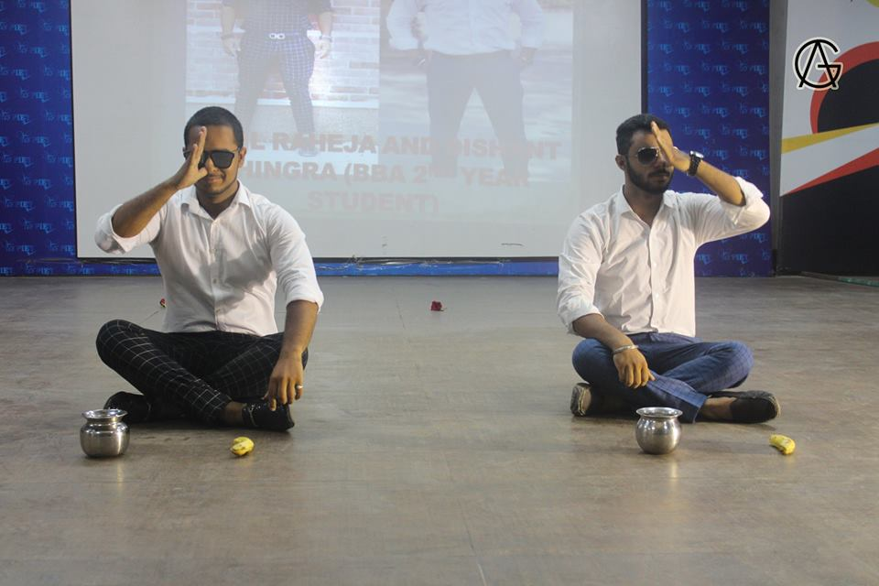
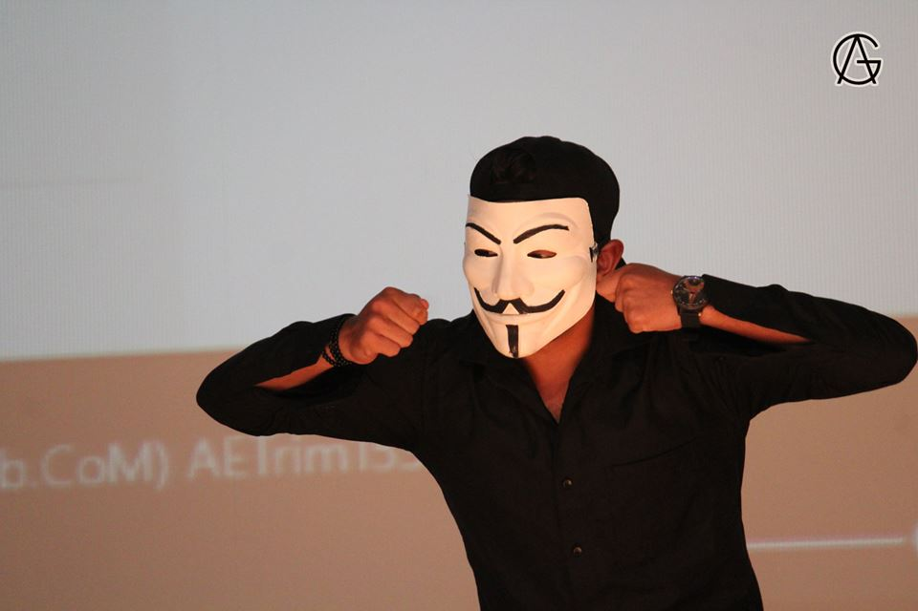
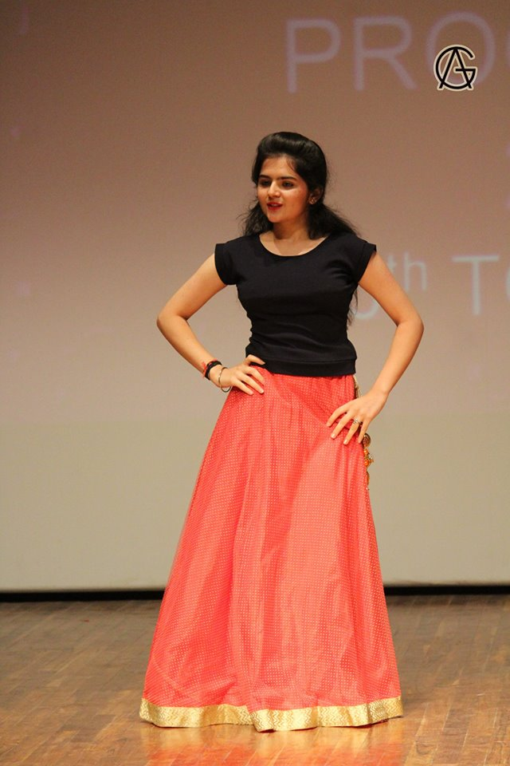
Memorable performances by 1st year students.

Slide 17
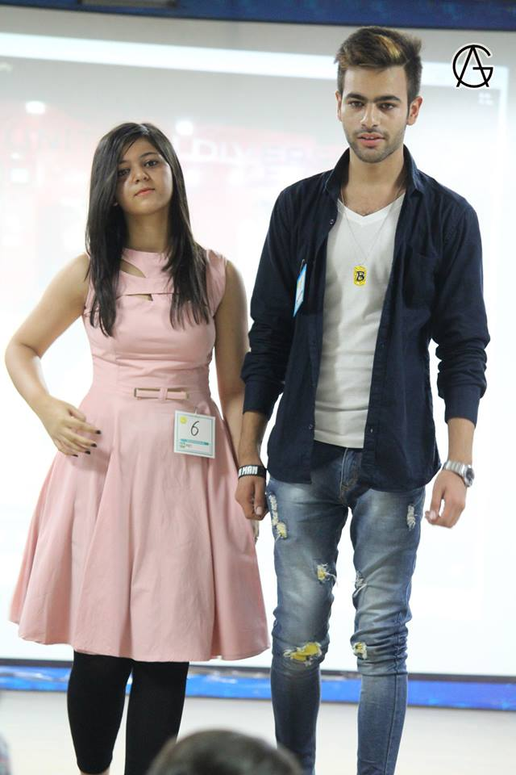
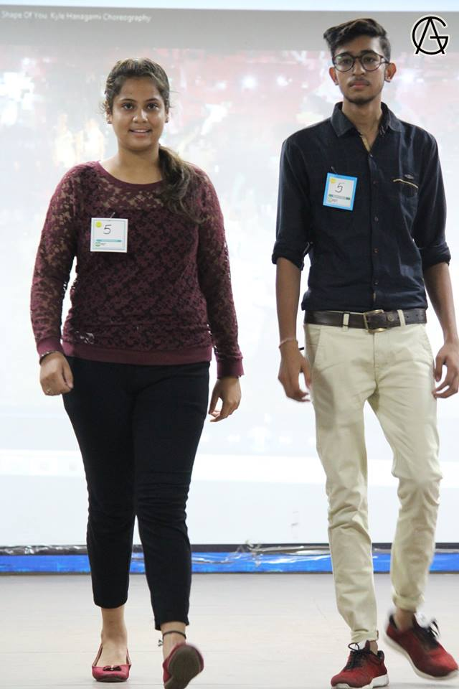
The most coveted event of the youngsters, Ramp Walk.

Slide 18
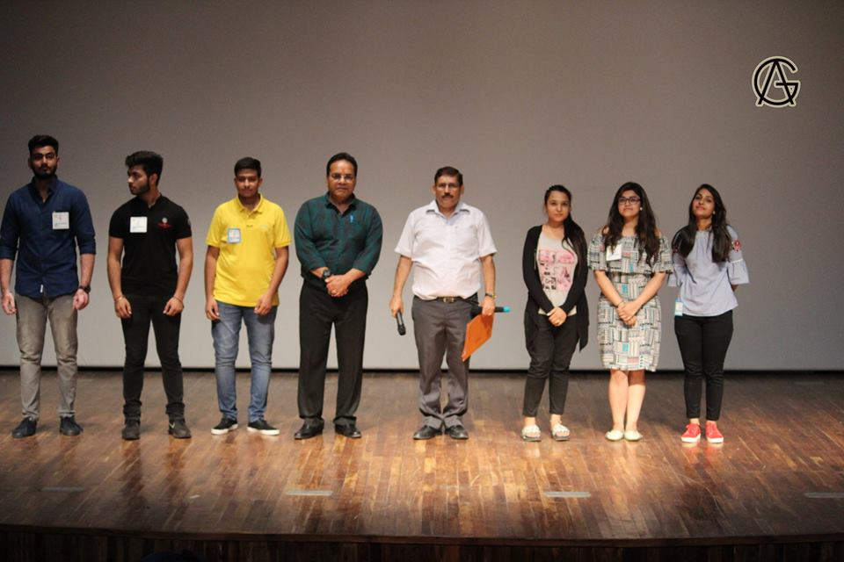
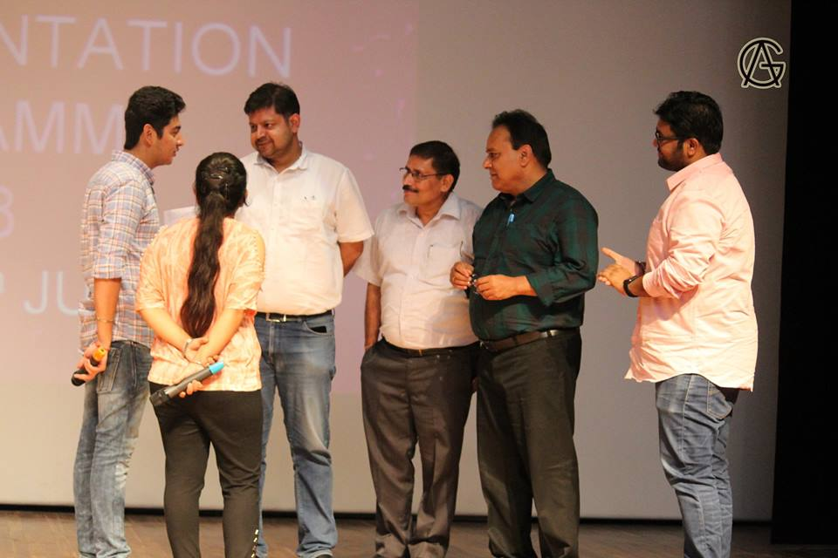
Anchors interacting with Mr. Rakesh Tayal sir.

Slide 19
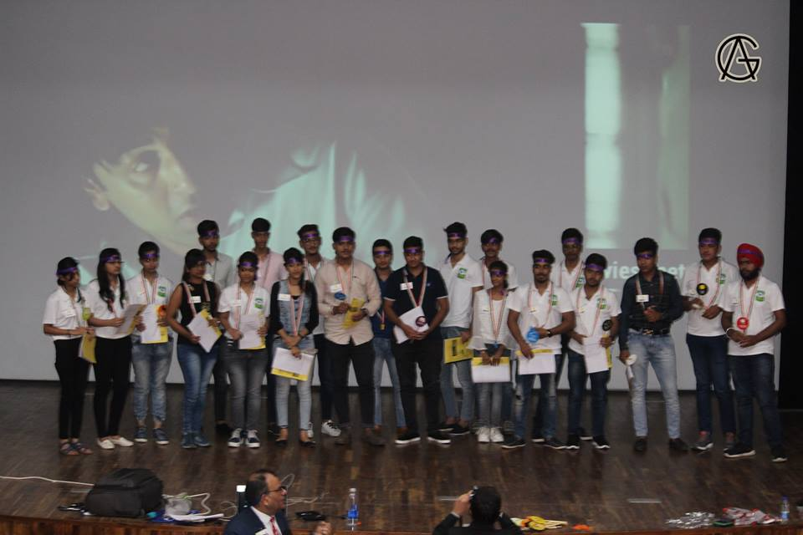
End of the picture

Slide 20
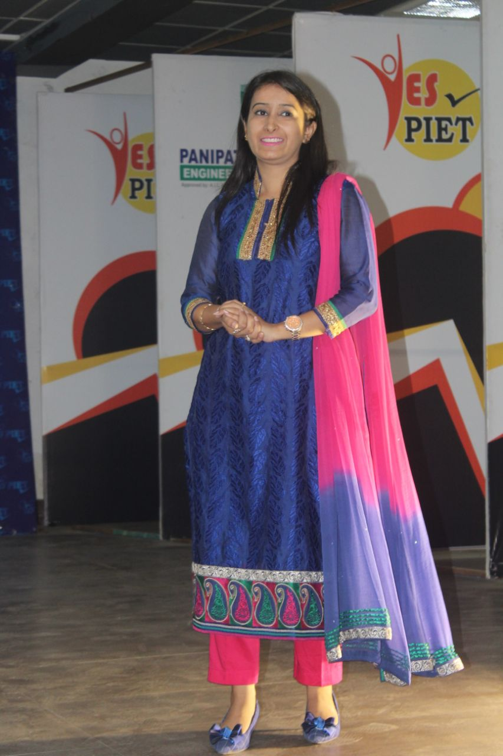
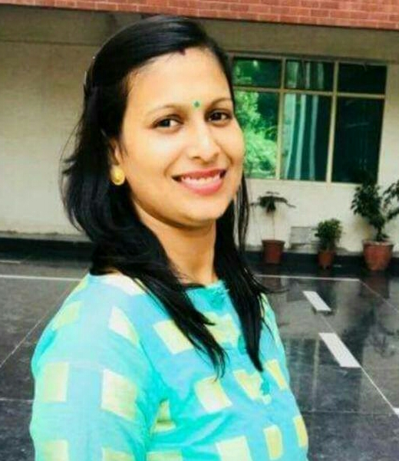
Welcome Back
At the outset it is time to welcome back Ms. Shilpa Sardana and Ms. Pooja Gupta who had gone for their Ph. D. course work from GJU Hissar.

Slide 21


NSS SWWACH SUMMER INTERNSHIP 2018
VILLAGE :- GHADI KHAJJU, SAMALKHA
DIKADHLA, SAMALKHA
KHALILA, SAMALKHA
DEHRA, SAMALKHA

Slide 22
NSS Volunteers conducted a ‘Cleanliness Campaign’. It was practiced in Govt. School of the concerning village.
A Self Awareness Lecture was given to the school students regarding their cleanliness and some basic knowledge about tree plantation, some regular diseases etc.
Our NSS Volunteers did a ‘Door To Door Awareness’ Campaign. They covered nearly 50 to 60 homes of the village. They collected information and prepare a report regarding the condition of cleanliness of the village.

Slide 23
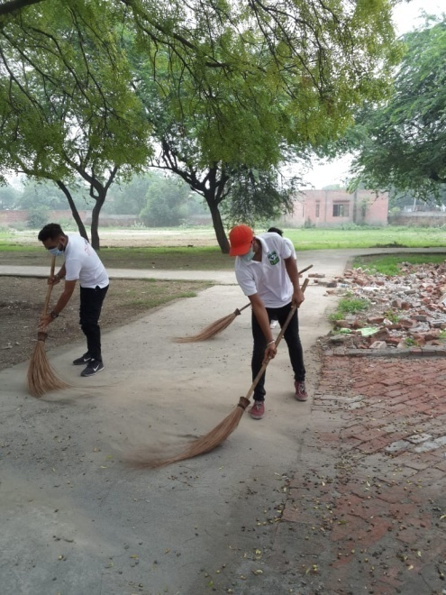
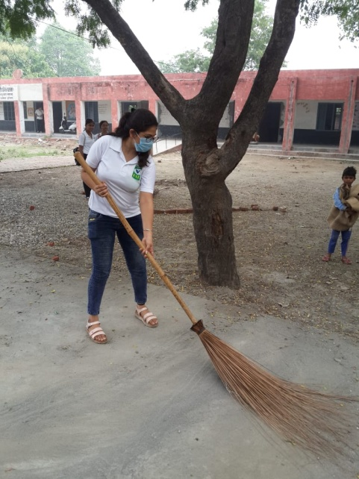
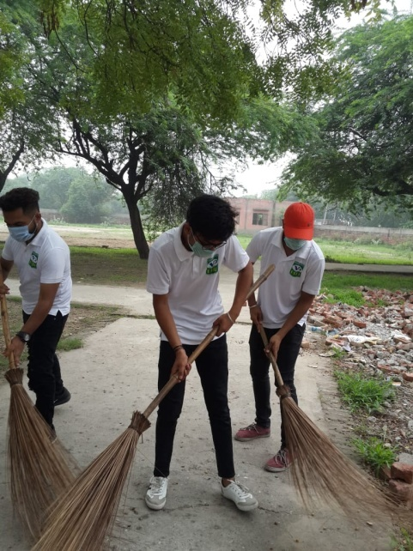
CLEANLINESS CAMPAIGN
NSS Volunteers conducted a ‘Cleanliness Campaign’. It was practiced in Govt. School of the concerning village.

Slide 24
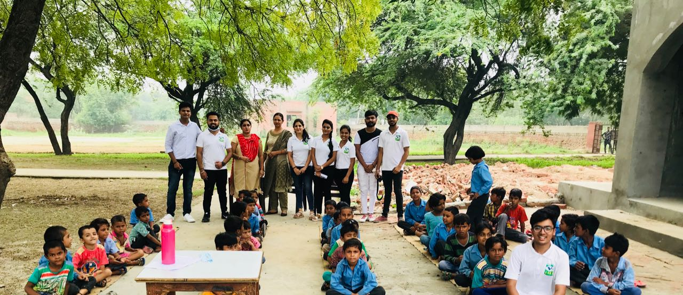
AWARENESS OF STUDENTS
A Self Awareness Lecture was given to the school students regarding their cleanliness and some basic knowledge about tree plantation, some regular diseases etc.. They also showed videos related to Sawwach Bharat Abhiyan.

Slide 25
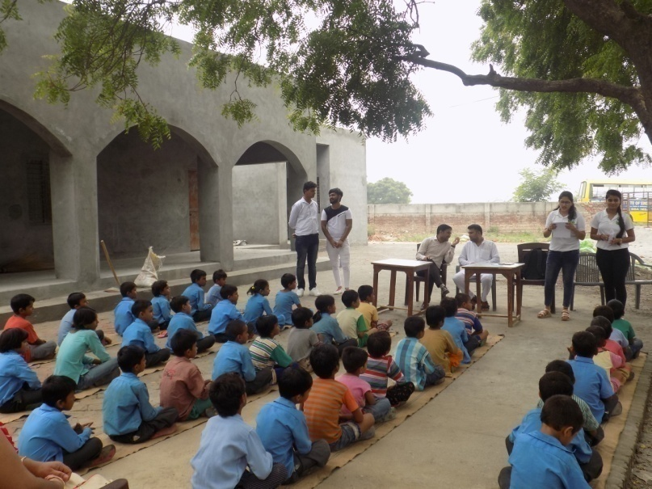
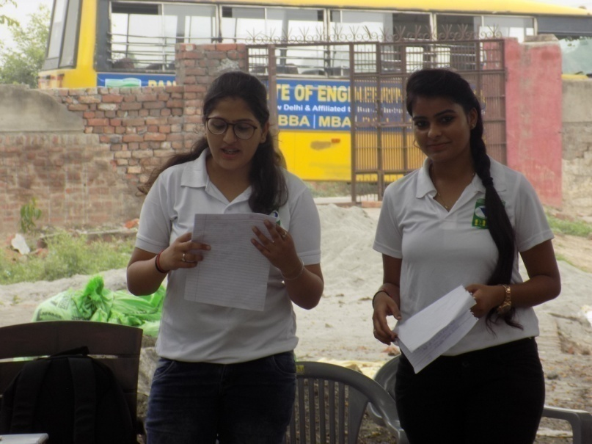
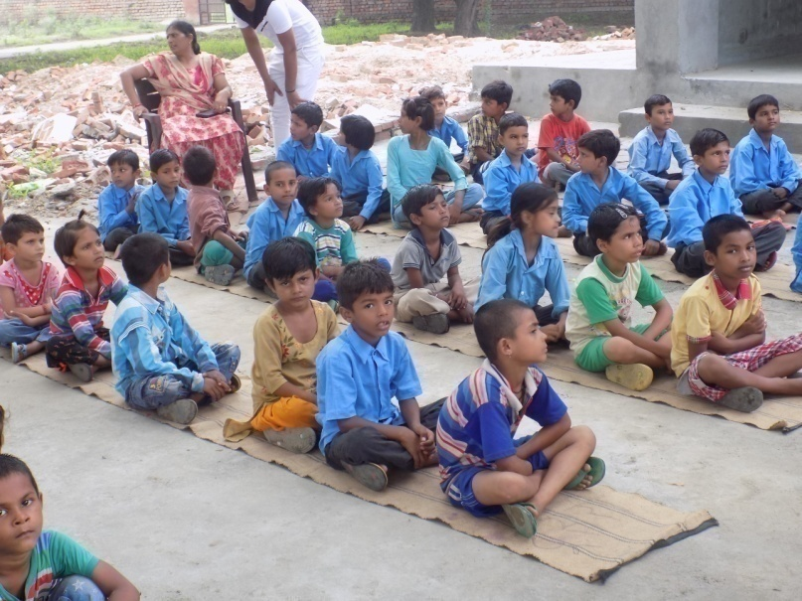
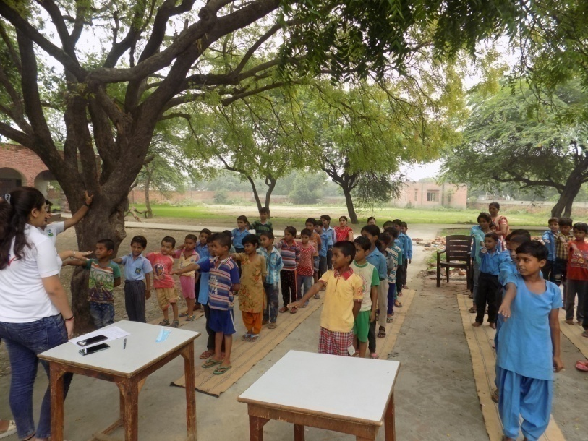

Slide 26
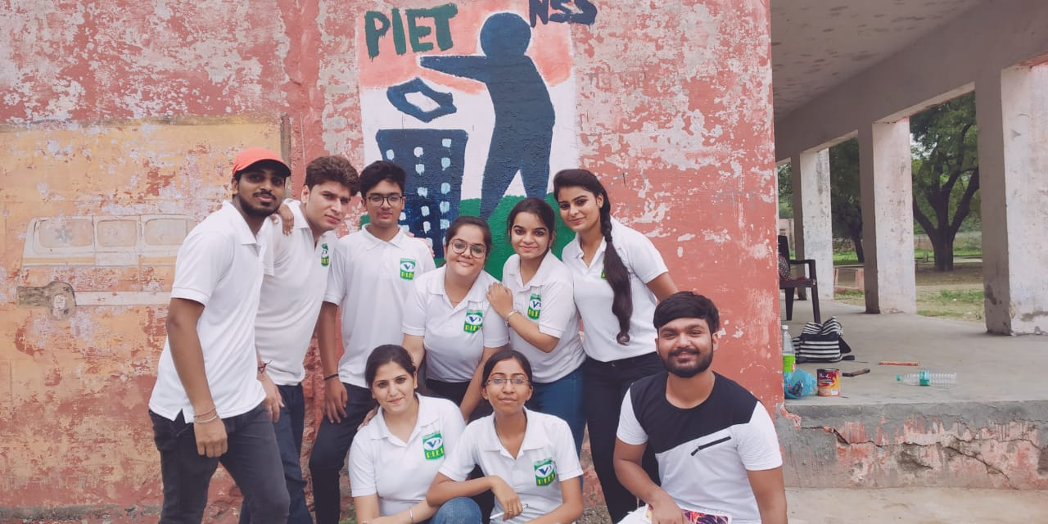
WALL PAINTING

Slide 27
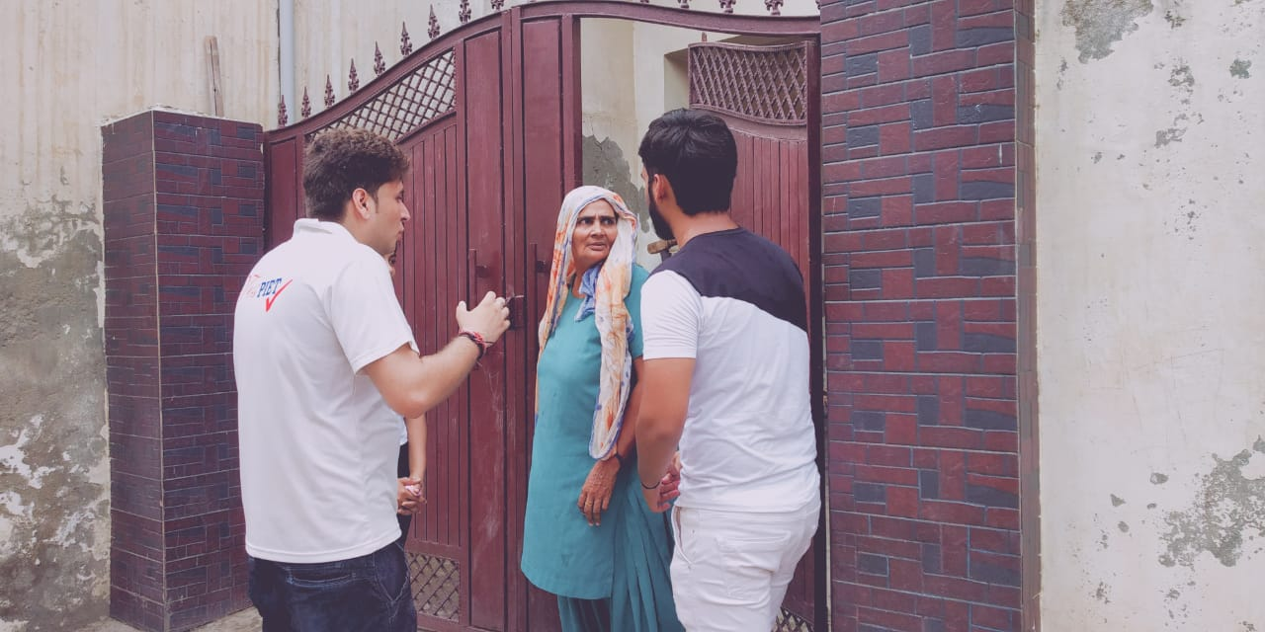
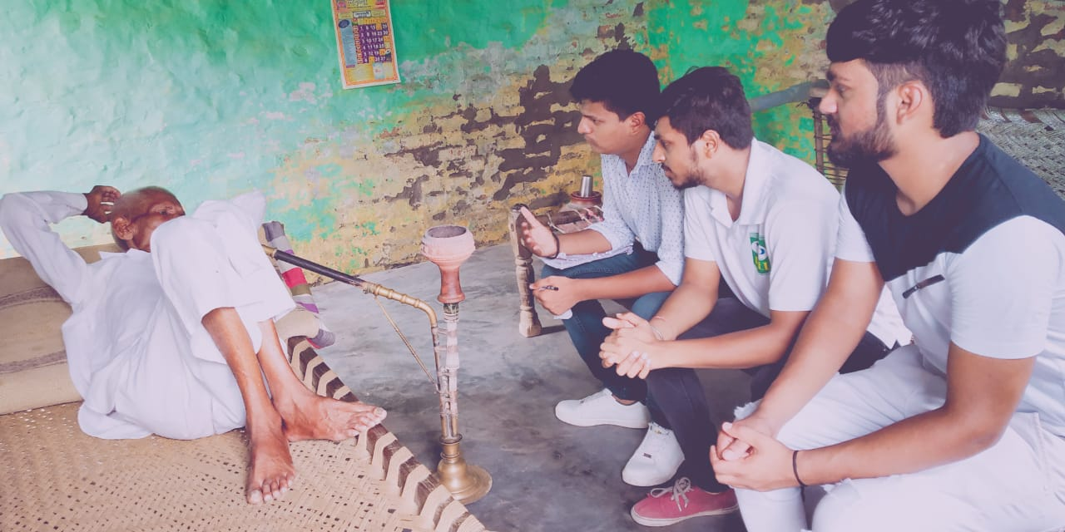
DOOR TO DOOR AWARENESS
Our NSS Volunteers did a ‘Door To Door Awareness’ Campaign. They covered nearly 50 to 60 homes of the village. They collected information and prepare a report regarding the condition of cleanliness of the village.

Slide 28
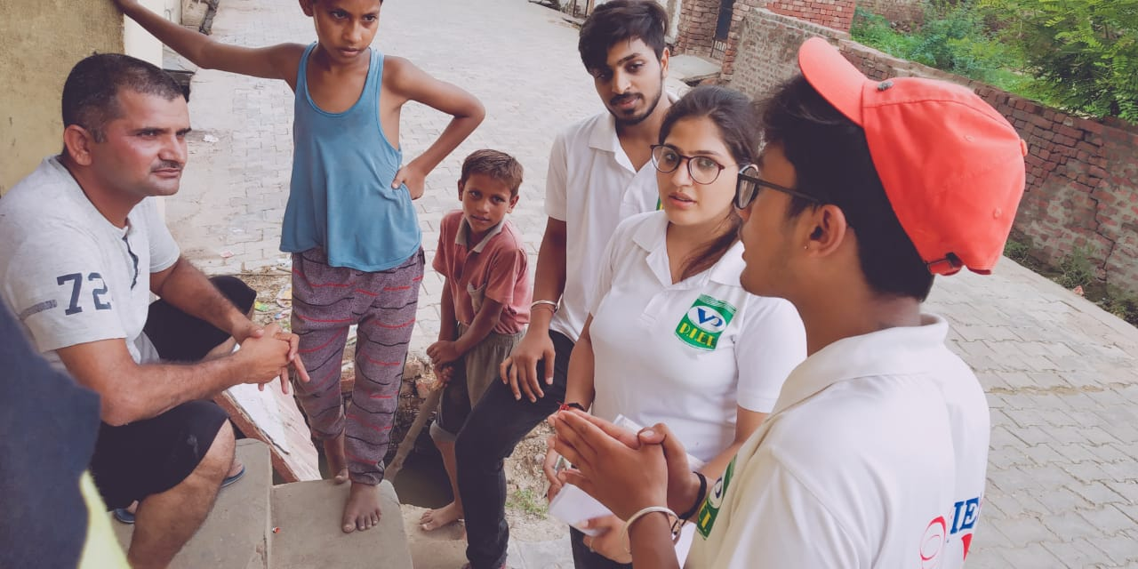
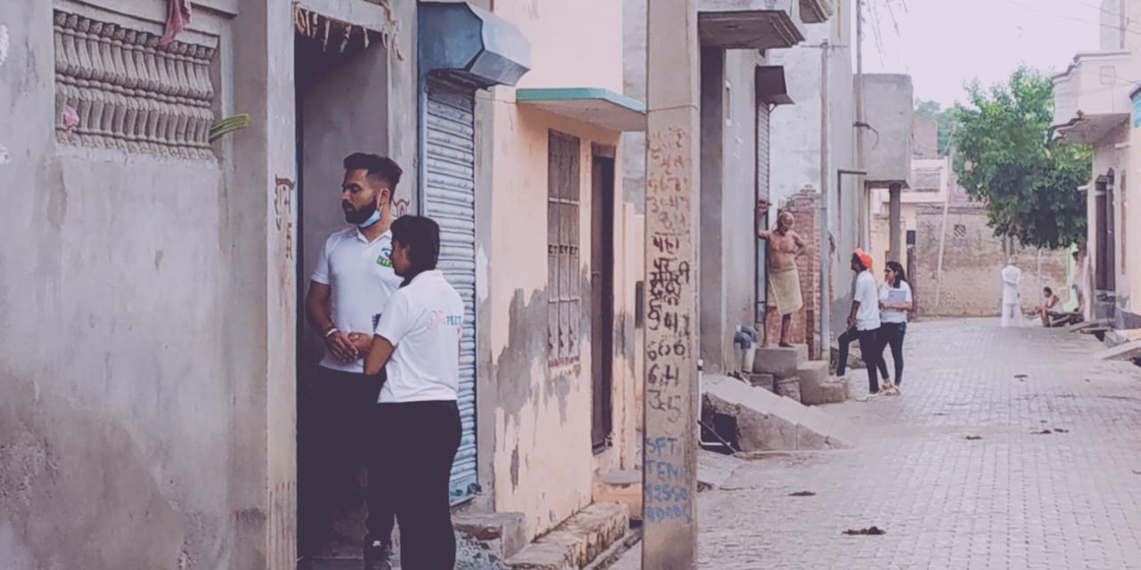

Slide 29
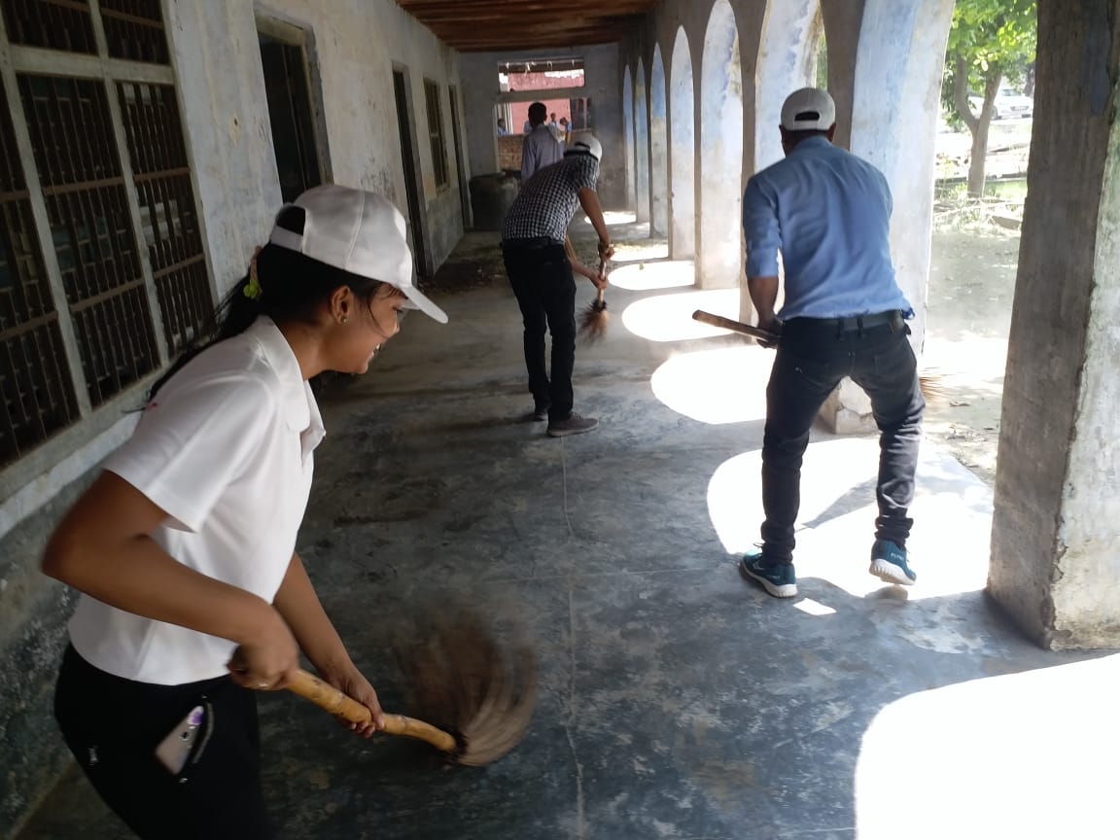
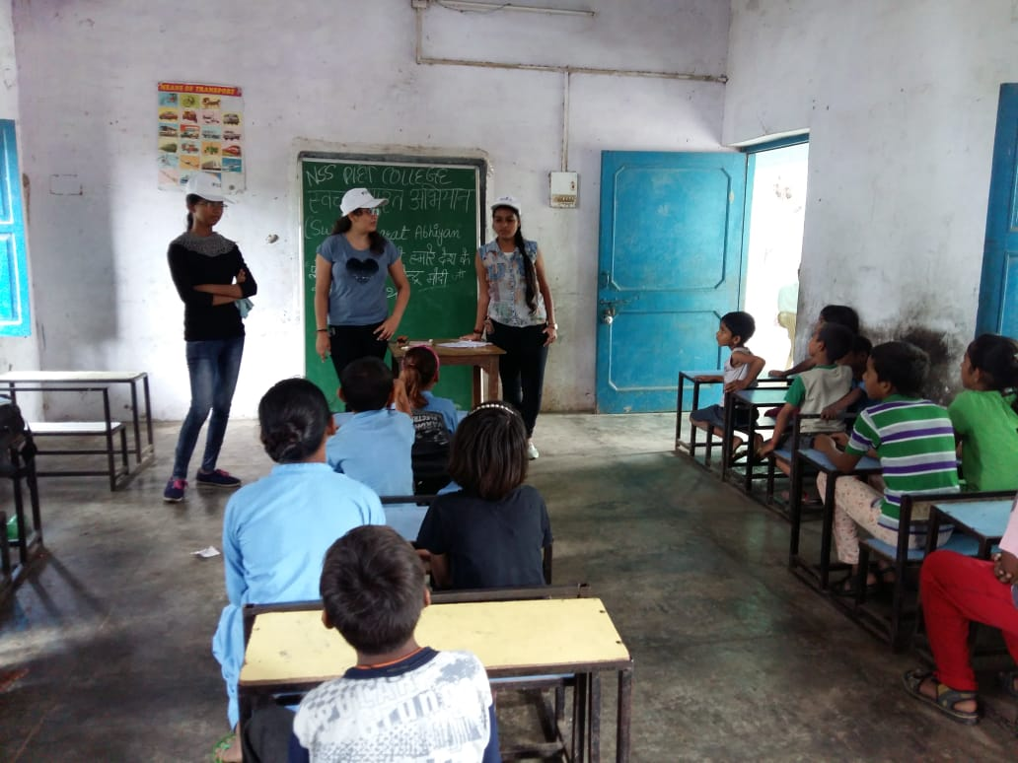
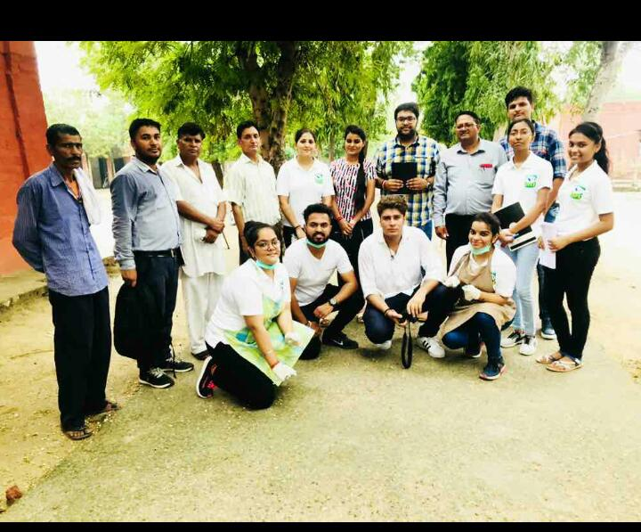

Slide 30
Raahgiri (22/7/18)
‘RAHGIRI’ is an excellent mission of the Deputy Commissioner of Panipat. It is a common platform for the people at large, students, adults, schools, colleges and business men. It is a ‘go back’ passage to pre-technology phase whereby communities mix, play and enjoy physical games.
As PIET also plays a very vital role the above three students impressed the spectators with their mind blowing performances. Not only this, but on one or two occasions two more first year students Kritika and Nishant handled the stage successfully.

Slide 31
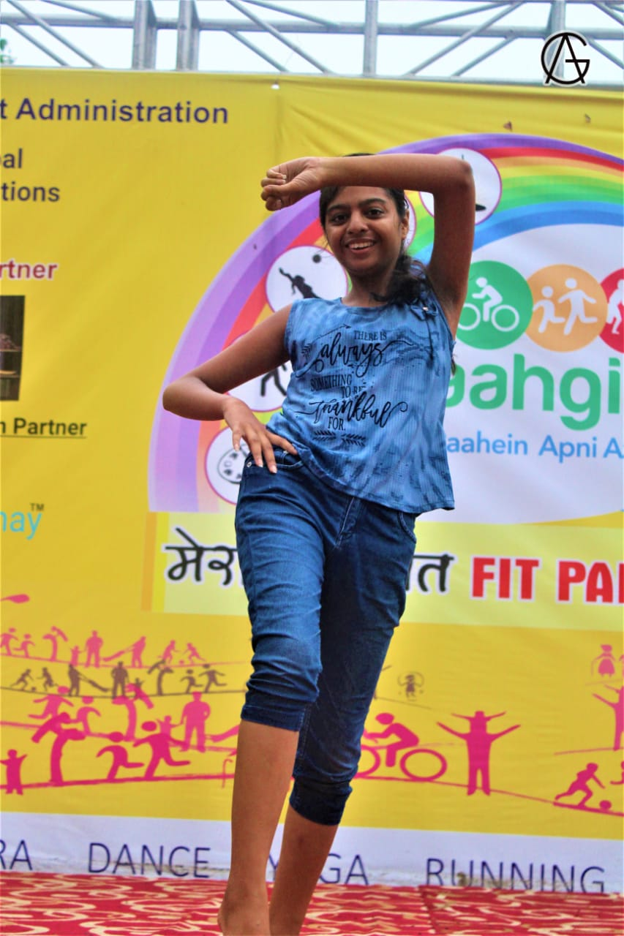
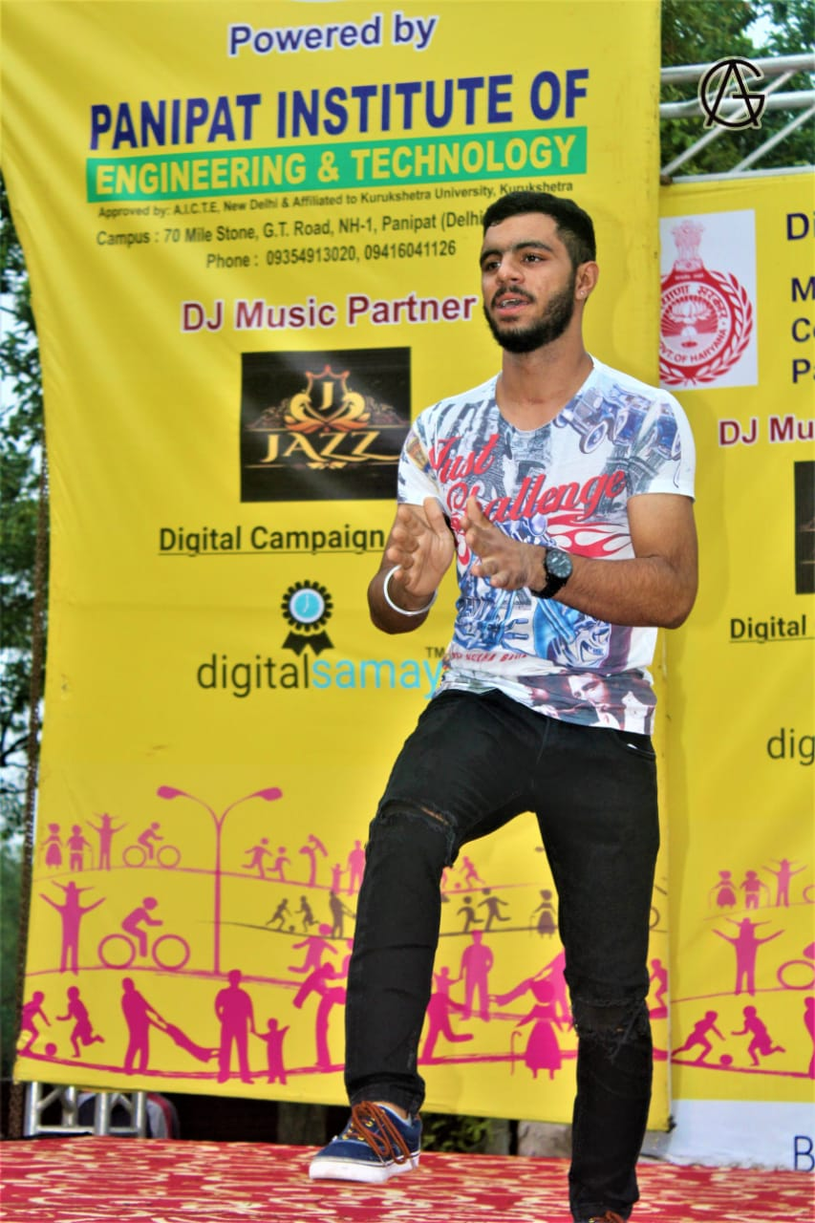
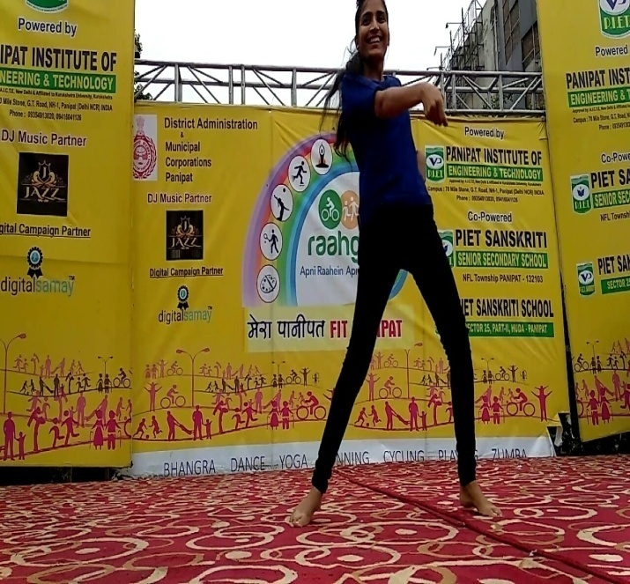
Students of BBA department performing at Raahgiri-PANIPAT
Vanshika (2nd year sec D)
Sakshi Bhutra (2nd year sec C)
Dishant (2nd year sec A)

Slide 32
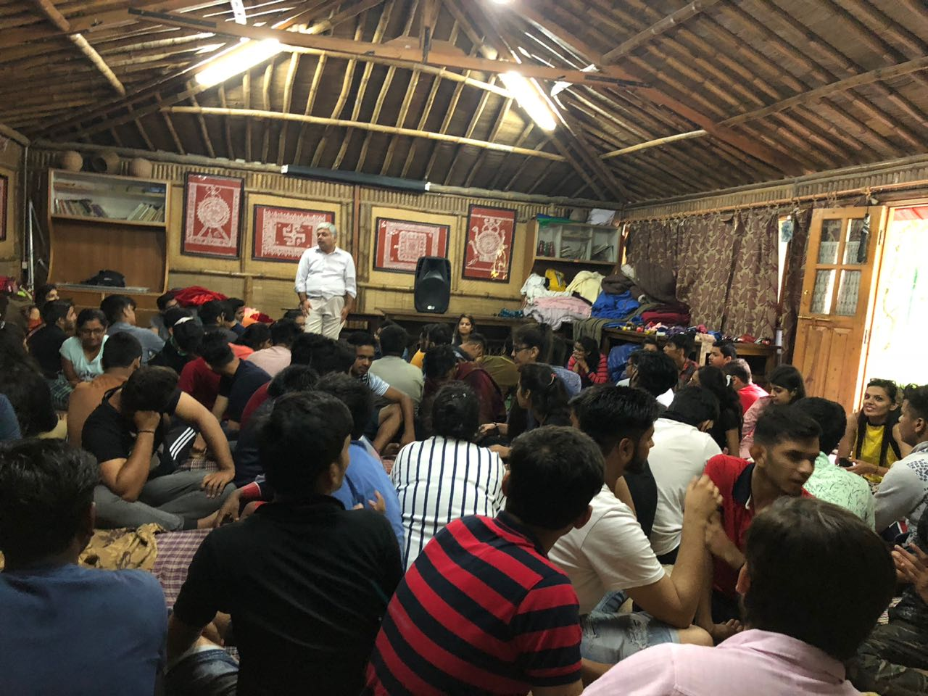
Excursion Tour 1- 21/7/18-24/7/18
As a part of education it is a tradition to take the students on trips which are a blend of enjoyment, learning and getting tuned to their teachers and class mates.
It was a good time for all.
Venue: Nainital
Students Accompanied: BBA–Ist Year
Teacher Co-ordinators: Dr. Preeti Dahiya, Ms. Namita ,Ms. Shachie
Mr. Rajesh, Mr. Ashish.
Strength: 81
Activities: Rapling, Trekking, Flying Fox, Visit to City
all of them

Slide 33
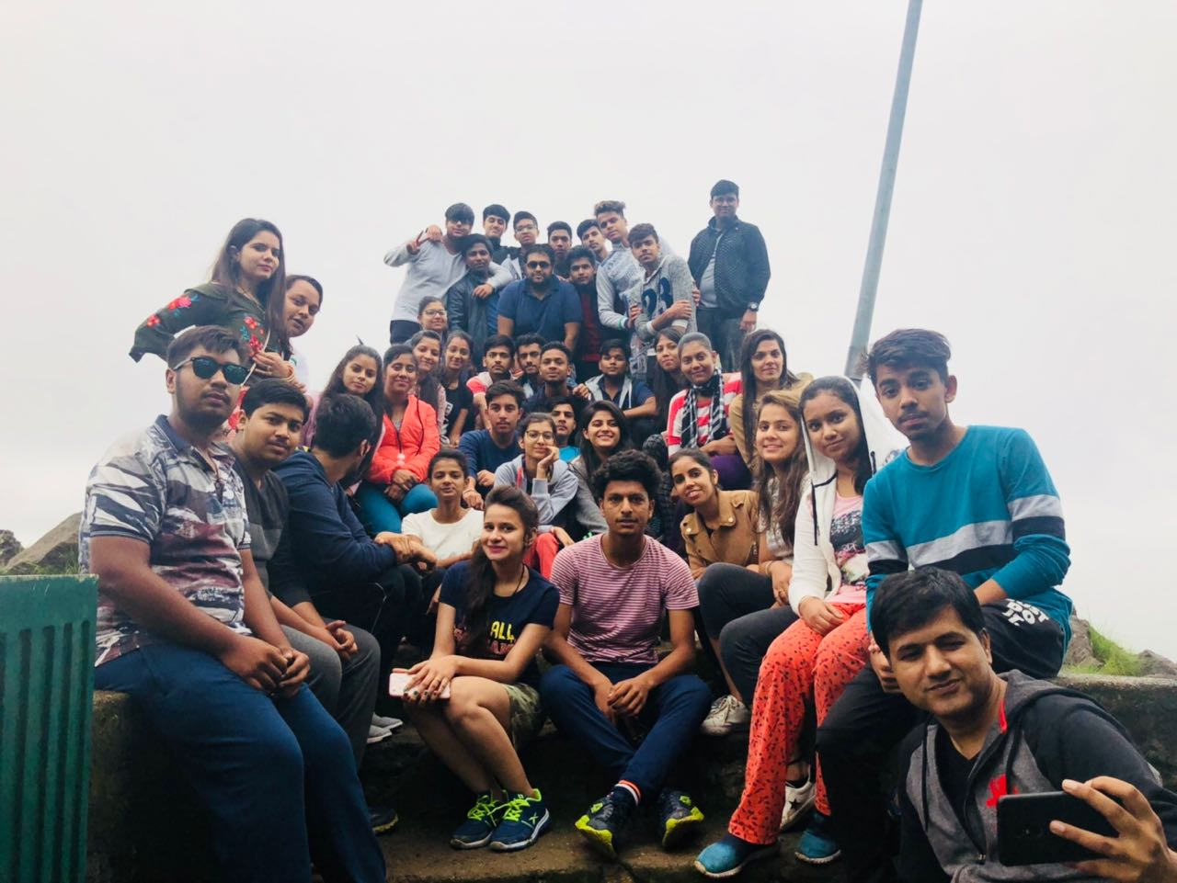
As is the PIET culture, an induction tour was planned for the fresh lot of BBA students to Nainital under the guardianship of the above faculty members. As many as 85 students had joined in the first phase between 21st and 25th July.
It is a way to let the students mix and mingle to know one another more closely and establish stronger communication.

Slide 34
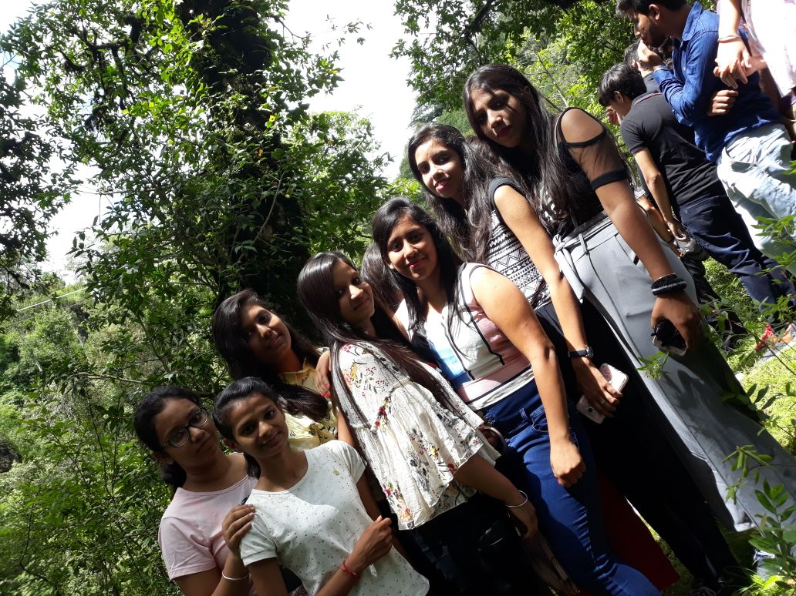
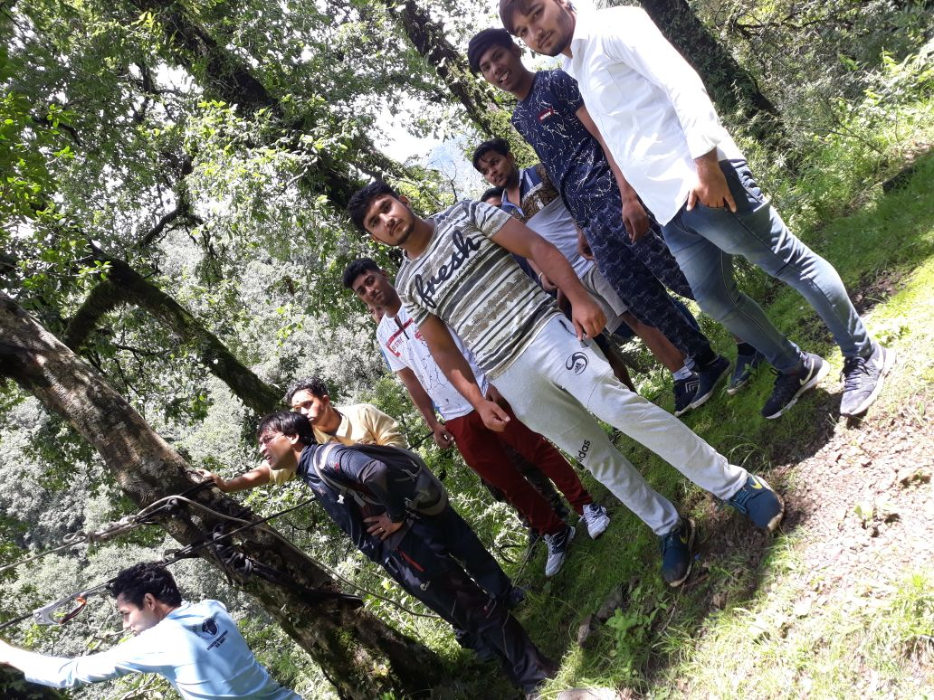
Nainital tour, activities in progress.

Slide 35
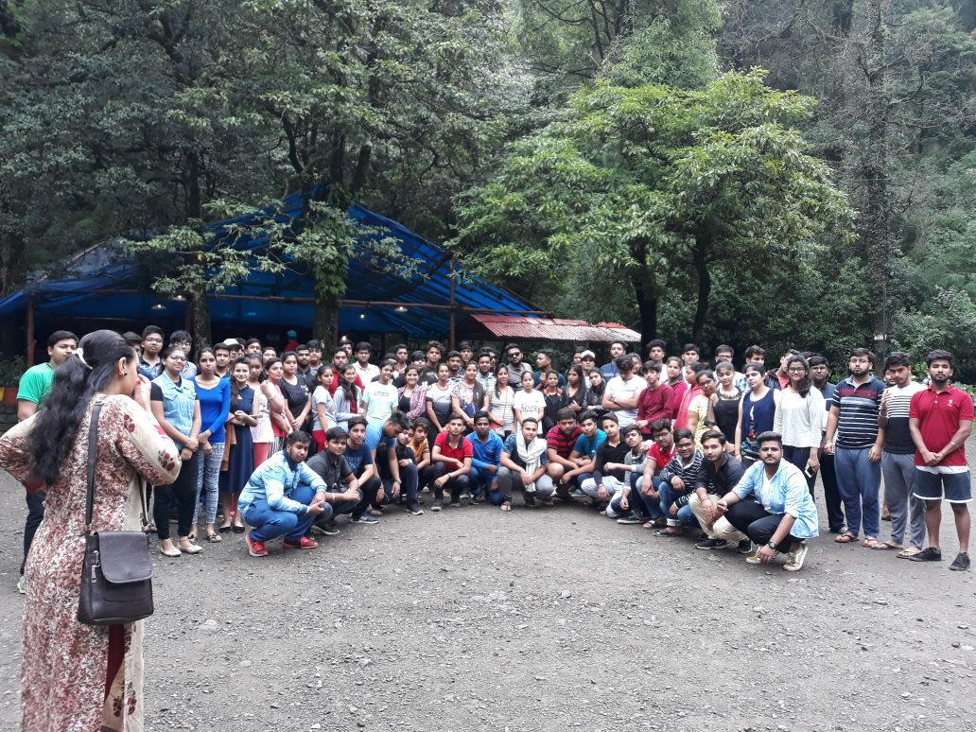
Group photograph

Slide 36
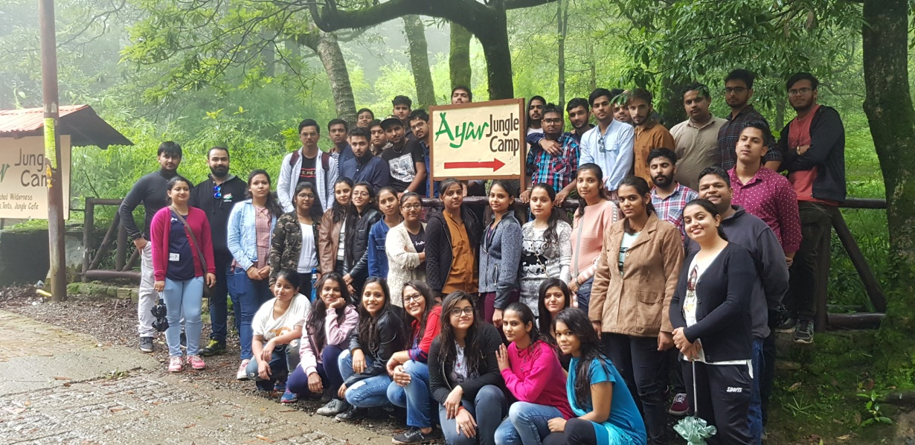
Excursion Tour 2- 24/7/18-29-7/18
In continuation of phase one, 2nd trip to Nainital comprising of 70 students was between 24th and 28th July.
The students shared their emotions and experience of having gone through an excellent period of induction, which they feel is very thrilling, especially being in the close company of teachers which helps them to understand the systems also better.
Students Accompanied: BBA–Ist Year
Teacher Co-ordinators: Dr. Saurabh,
Mr. Charan, Ms. Samriti, Dr. Annu.
Activities: Rapling, Trekking, Flying Fox, Visit to City all of them

Slide 37



Slide 38

Janta Mahapanchayat Zirakpur- 24/7/18
Faculty Coordinator: Ms. Monika and Dr. Ankur
‘The Janta Mahapanchayat’, a unique venture of the states of Punjab, Haryana, Himachal and Delhi to discuss publicly the common burning issues of all the states.
It is a matter of pride that 97 students of PIET also formed a part of this ‘Panchayat’ which proved to be a learning platform for the young students, who got an opportunity to flash their questions across to the dignitaries.

Slide 39
Students of BBA, PIET went for an Janta Maha-Panchayat Event presented by Janta TV at Hotel Park Plaza, Zirakpur(Chandigarh) on 24th July, 2018. Janta Maha-Panchayat Event was a platform for The students to discuss Punjab-Haryana’s issues. All the people from Punjab and Haryana were present in this event in order to discuss about the problems and issues which Punjab and Haryana are facing with their political leaders.

Slide 40

Janta TV is a 24X7 National Hindi news channel and news media production House. It was inaugurated on 3rd June, 2011. It’s office and multi facility studio’s production house of Janta TV are located in New Delhi, Haryana, Punjab & Himachal Pradesh. Janta TV offers all production server in house with strong Network all over India. Janta TV has organized an event named “Janta Maha-Panchayat.”

Slide 41
It is a student participative & interactive program on burning issues of Punjab & Haryana. So, the Chief Ministers of the various states were invited in this program which includes:
Shri Manohar Lal (Chief Minister, Haryana)
Captain Amrinder Singh (Chief Minister, Punjab)
Shri Arvind Kejriwal (Chief Minister, Delhi)
Shri Jai Ram Thakur (Chief Minister, Himachal Pradesh)
All the students were told to ask questions from the political leaders through the platform of Janta Maha-Panchayat event organized by Janta TV So it was a lifetime opportunity for the students to do the interaction related to Social, Culture, & Political issues with the eminent personalities of India. After the program Refreshments was provided and certificates of participation was also provided to the students for encouraging them. Moreover the event was well organized and also helps the students in sharpening and understanding about the Social, Political, Cultural & Ecomical issues of Punjab and Haryana.

Slide 42
STUDENT VIEW
It is a great opportunity and overall a good experience with an in depth learning for the BBA. There are various sessions conducted during this event. Other guests were also invited Shri Manpreet Singh Badal (Finance Minister, Punjab) was interviewed at first session; Captain Abhimanyu (Finance Minister, Haryana) was interviewed at second session; Shri Randeep Singh Surjewala (MLA, Kaithal) was interviewed at third session; Shri Abhay Chautala (Leader of Opposition, Haryana) was interviewed at fourth session, etc. The Opposition leaders were also interviewed in next sessions. The whole event was hosted by Dr. Himanshu Dwivedi (Editor-in-Chief, Janta TV) & Shri Shashi Rajan (Consulting Editor, Janta TV).
Suman Yadav
BBA 2nd Year

Slide 43


Slide 44

Parent Teacher Meet

Slide 45


As the practice in this Institute of learning, a special PTM was organised for today for the re-appear case students to sensitize the parents about the importance of internal exams. Dr. Yoginder S Kataria, HOD, BBA, addressed a group of parents who had come with their wards that college has in place very strong tools to take the students to the paths of success, but it is felt that due to misleading information that flows out to them, the results are affected.
Emphasis was laid on the importance of internal exams, which are held twice as a drill to the forthcoming university exams. This drill is not only for academics but also for discipline in the exam centers.

Slide 46


The first PTM of the new sesion. Shri S K Khanna sir and Dr. B B Sharma sir addressing the parents and teachers.

Slide 47


PTM in progress
The message has been well taken and they appreciated the gesture of this college to establish direct contact with parents for the betterment of their wards.

Slide 48


Slide 49
Pooja Gupta

Slide 50

INDIA'S MODERN EDUCATION SYSTEM

Slide 51
Education is the imparting and acquiring of knowledge through teaching and learning, especially at a school or similar institution. Education developed from the human struggle for survival and enlightenment. It may be formal or informal. Informal education refers to the general social process by which human beings acquire the knowledge and skills needed to function in their culture. Formal education refers to the process by which teachers instruct students in courses of study within institutions. Education is the equipping with knowledge. The overall development of mind, body and soul is the real education.

Slide 52
THE PRO’S
Modern day education is aided with a variety of technology, computers, projectors, internet, and many more. Diverse knowledge is being spread among the people. Everything that can be simplified has been made simpler. Science has explored every aspect of life. There is much to learn and more to assimilate. Internet provides abysmal knowledge. There is no end to it. One can learn everything he wishes to. Every topic has developed into a subject.
New inventions and discoveries have revealed the unknown world to us more variedly. Once a new aspect is discovered, hundreds of heads start babbling over it, and you get a dogma from hearsay. Not only our planet but the whole universe has become accessible.

Slide 53
THE CON’S
Firstly our education is confined to schools and colleges. It has become a process of spoon feeding. “Spoon feeding in the long run teaches us nothing but the shape of the spoon” were the words of E.M.Forster. We are being fed with facts and knowledge. Not art, not books, but life itself is the true basis of teaching and learning. Cramming of facts and dates, hi-fi mathematical formulas, theories and doctrines should be at college levels when one has chosen his area of interest. What will the history pay a doctor or a mathematician, or medical terms to a historian?
Secondly, an art can only be learned from a workshop of those who are earning their bread from it. Modern education has spread more ignorance than knowledge. Most of the women even don’t know, where, the fabric they are wearing, came from. The word “How” is missing in our world which causes ignorance.

Slide 54


Slide 55

Mahima
Chauhan

Slide 56
My experience at PIET has taught me one fundamental thing – life is unpredictable. It might be good, it might be bad, it might be weird, and it might not interest you, but expect anything to happen. PIET prepares you for all of this. It is a perfect blend of joy and hardships. This College is the Santa Claus that keeps on giving all these wonderful opportunities while you’re in it. There are also campus festivals, which draw a lot of fun crowd from other colleges and let you show off your skills. You could also enjoy with the celebrities who are invited to perform.

Slide 57

Niharika
Guglani

Slide 58
Life at College is the most glorious phase of one's life. This golden period better equips you for all the challenges you’ll face in life and creates a strong foundation of knowledge. The past three years of my life at PIET have given me greater visions of my future. The college offers me more than the great reputation of this fine school, but a large student body with diverse likes and dislikes, and many activities, both academic and non-academic, to participate in. With the help of the college and faculty, I will be successful after college and be able to make a name and place for myself in our society.

Slide 59

NAINA
GUGLANI

Slide 60
It was an amazing experience to be a part of such a reputed and disciplined institution. It was always a second home. Teachers are very kind, friendly and gave a parental advice when required. Discipline was given highest priority. I am proud to be a PIETIANS. Thanks to all for making 3 years of my life a memorable and sweet one.

Slide 61


Slide 62



Slide 63

Thank you
BBA,HOD
(Mr. Yoginder Kataria)
BBA, E- Committee
(Mr. Jagmohan Malhotra)
(Dr. Sangeeta)
(Ms. Pooja Gupta)

