Slide 1
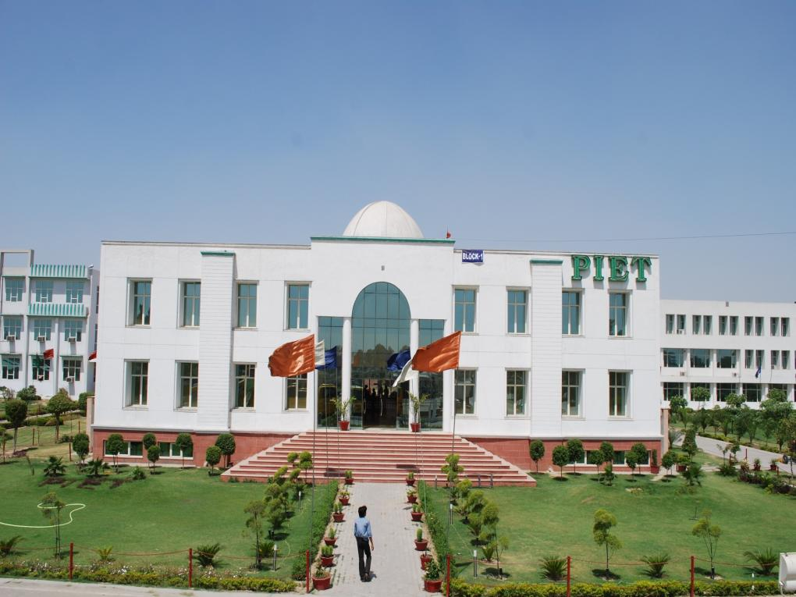

-+*

Slide 2





Slide 3




Slide 4

March is a commanding Word Which sound like an army order. Practically also it is true because the students march towards their final Exam and end of other semester.
It is also the month in which weather changes and we start getting sweat of the season along with sweat for the exam.
So we must say wish You All the best.

Slide 5

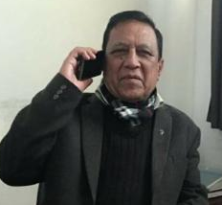
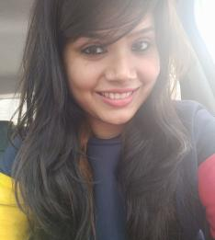
From Editor’s Desk
‘A weak link is better than a strong memory’
Is a saying which belongs to yester years and the youth of today can’t even imagine about it. Think of the feeling and emotions you would get when leafing through the dusty old pages of a college magazine which could flash across eyes endless memories with kaleidoscopic colors and designs.
You, being the ‘Kindle’ users, have been deprived of this opportunity. Anyway, this virtual magazine is still a link between the two ends of past and future and it too is an interesting and exciting experience. This news letter was one such cherished work that had its roots in the persuasion.
It is a snapshot of the various activities and advancements for all associated with PIET and BBA. Proper communication plays a vital role in institution’s development. This news letter will serve to reinforce and allow increased awareness, improved interaction and integration among all of us.
Mr. Jagmohan
Ms. Sakshi

Slide 6
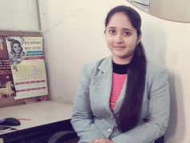
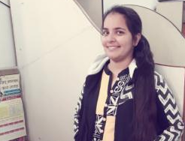
Usually we fail to appreciate the good deeds of many people and activities that happen around us as we are engaged in irrelevant talks and assumptions. It could all change if we just pause to think of what is our contribution to the society from which we have been gifted with this blessed life. The progress of the society is mainly dependent on many people who are working behind the scenes, overtime round the clock planning things to the smallest and we must acknowledge and respect all of these efforts and its results.
This is only a small step towards a long journey. To achieve progress and to meet objectives we have to cross numerous milestones. Let us all be awakened, inspired and enlightened with hope, confidence and faith while we move along the road ahead having in store endless surprises for us.
Jagmohan Malhotra
Chief Editor
Ms. Simranjeet
Ms. Simran

Slide 7
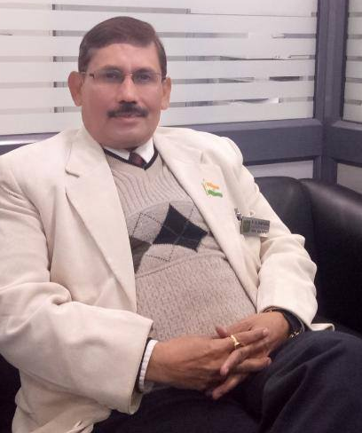

Dr. Yoginder Singh Kataria, HOD, BBA, PIET

Slide 8
HOD’s Message
Education is a shared commitment between dedicated teachers, motivated students and enthusiastic parents with high expectations and PIET is an institute which strongly believes in this principal.
We not only play the role of imparting academic excellence but also to motivate and empower our students to be lifelong learners, critical thinkers, and productive members of an ever-changing global society. This business school is being run under the aegis of well established PIET Management.
This is an institute where aspirants are encouraged to channelize their potential in the pursuit of excellence. This can only be possible in a holistic, student-centric environment. The talents, skills, and abilities of each student need to be identified, nurtured, and encouraged so that he / she is able to reach greater heights. Students need to be provided with a platform to think, express, and exhibit their skills. It is necessary to empower them to negotiate several issues that confront them, with the teacher being a facilitator.

Slide 9
PIET is striving hard to make the best possible efforts to inculcate strong values combining with academics and extra-curricular activities in the young minds. Converting every individual into a self-reliant and independent citizen, you just need to set goals within your reach and gain confidence and determination to enhance your reach to unthinkable levels and make specific plans to achieve what your desire.
Wishing you all the best
Dr. Yoginder Kataria
HOD, BBA

Slide 10



A notice board is like a face of college which displays multiple skills of the students. They not only display their creative skills but also through these notice board they depict some of the best Management lesson which help all the students to refresh these topics as and when they stand near these.
Obviously the teachers motivate students to participate their wards in these activities and provide them a platform to prove themselves. Finally these creations are examined by a team of judges and awards are given.

Slide 11
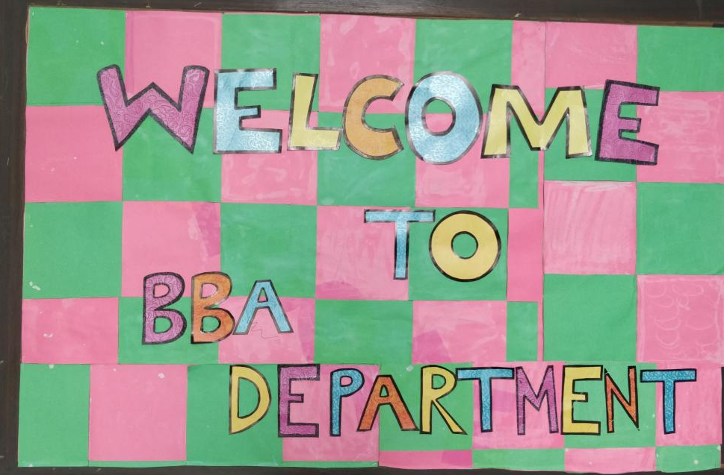
Notice Board-1 , 1st Floor
Prepared by Ms. Priya, Ms. Kirti Jain, Ms. Sakshi Rana, & Ms. Himani
(BBA 2nd Year)

Slide 12
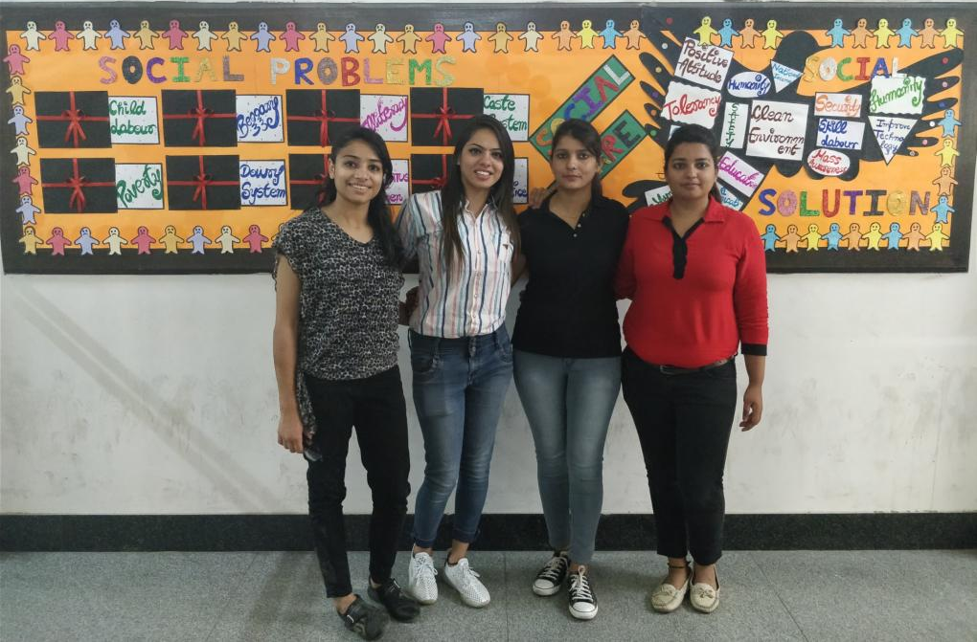
Notice Board-2 , 1st Floor
Prepared by Ms. Priya, Ms. Kirti Jain, Ms. Sakshi Rana, & Ms. Himani
(BBA 2nd Year)

Slide 13
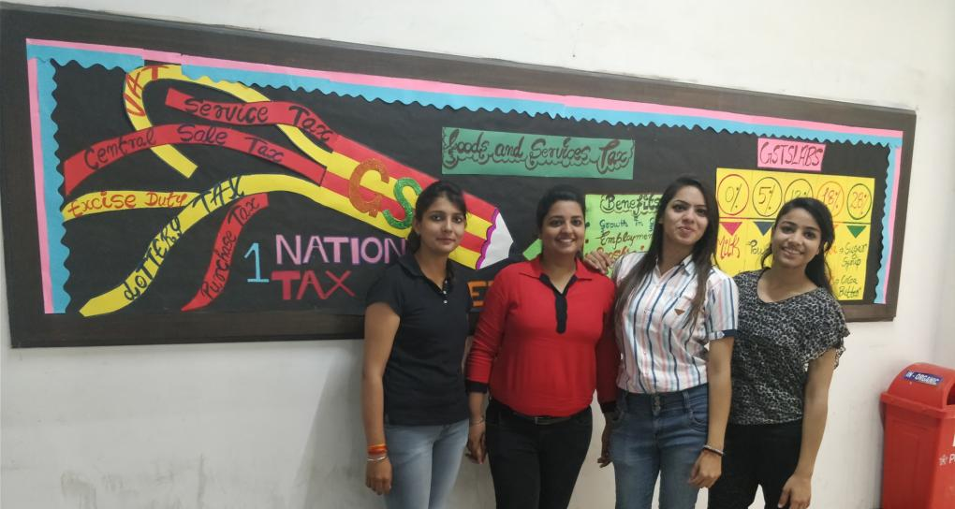
Notice Board-3 , 1st Floor
Prepared by Ms. Priya, Ms. Kirti Jain, Ms. Sakshi Rana, & Ms. Himani
(BBA 2nd Year)

Slide 14
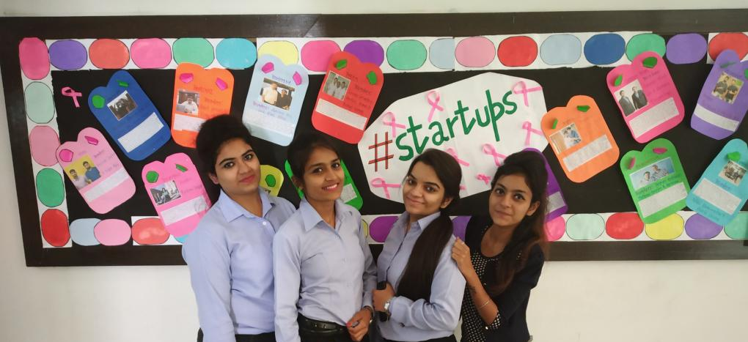
Notice Board-1, 3rd Floor
Prepared by Ms. Niharika, Ms. Shefali, Ms. Sakshi Bhutra, & Ms. Varnika
(BBA 1st Year)

Slide 15
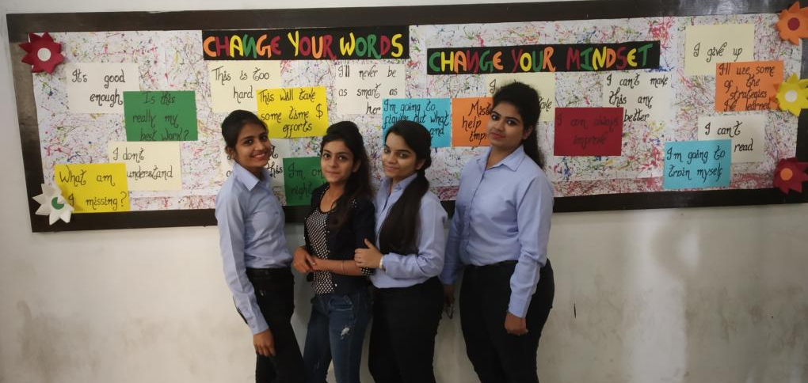
Notice Board-2, 3rd Floor
Prepared by Ms. Niharika, Ms. Shefali, Ms. Sakshi Bhutra, & Ms. Varnika
(BBA 1st Year)

Slide 16
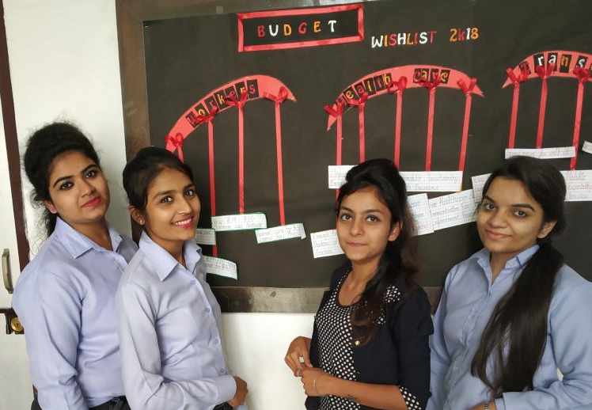
Notice Board-3, 3rd Floor
Prepared by Ms. Niharika, Ms. Shefali, Ms. Sakshi Bhutra, & Ms. Varnika
(BBA 1st Year)

Slide 17
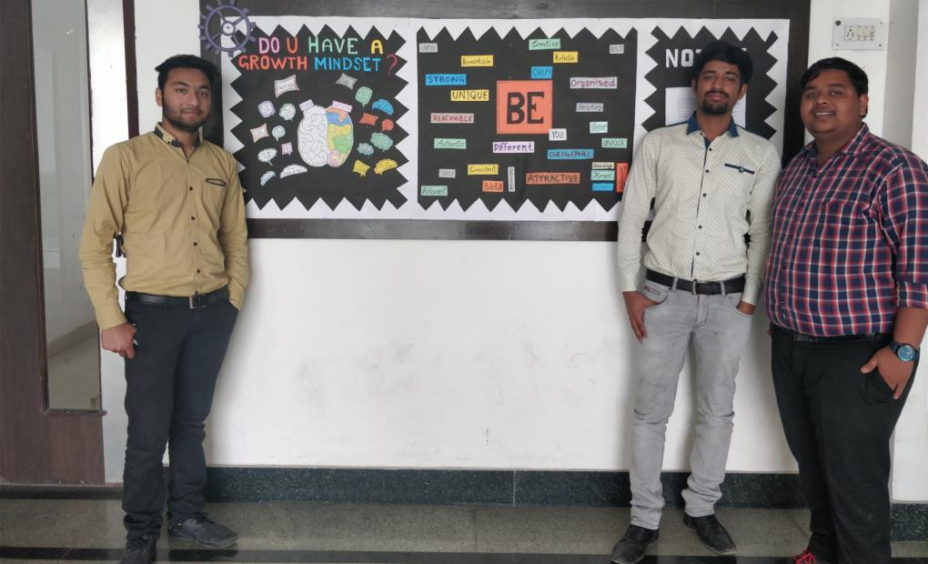
Notice Board-1 , 4th Floor
Prepared by Mr. Harsh Jain, Mr. Rishabh, Mr. Saurabh & Ms. Komal
(BBA 3rd Year)

Slide 18
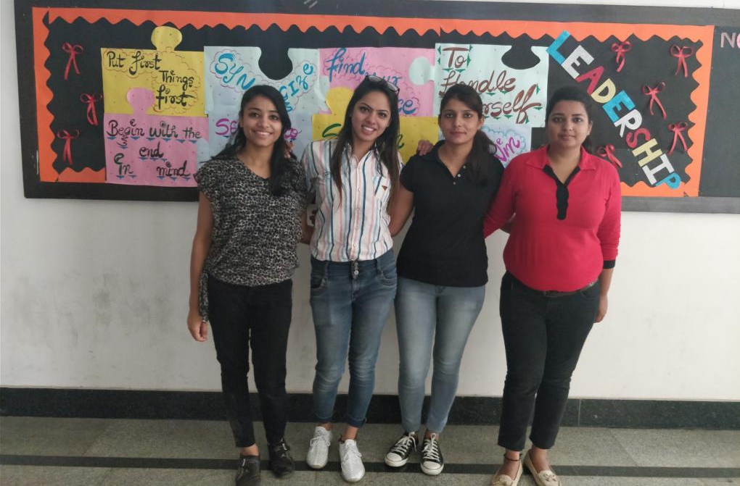
Notice Board-2 , 4th Floor
Prepared by Ms. Priya, Ms. Kirti Jain, Ms. Sakshi Rana, & Ms. Himani
(BBA 2nd Year)

Slide 19
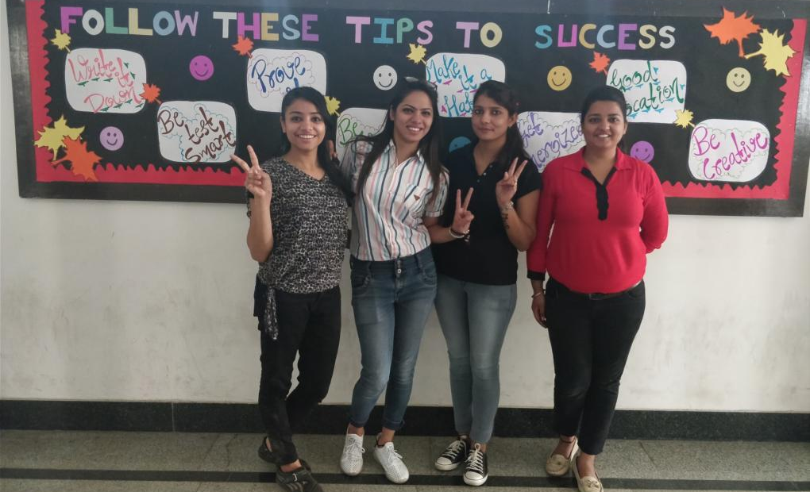
Notice Board-3 , 4th Floor
Prepared by Ms. Priya, Ms. Kirti Jain, Ms. Sakshi Rana, & Ms. Himani
(BBA 2nd Year)

Slide 20


Slide 21
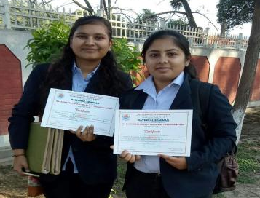
Success is a Journey not a Destination
Students of BBA 2nd year again achieved a new milestone in the journey of research. Domita and Deepam has presented their paper in National Seminar on ‘Managing Business in the Era of Transformation’ .
The title of the paper was ‘Assessing Consumer Perception regarding Environment Friendly Packaging Products.’ The paper was framed under the guidance of Dr. Sandeep and Dr. Sangeeta.
The seminar was held on 8th March, 2018 under UGC SAP- DRS phase III in Department of Commerce, Kurukshetra University, Kurukshetra.

Slide 22
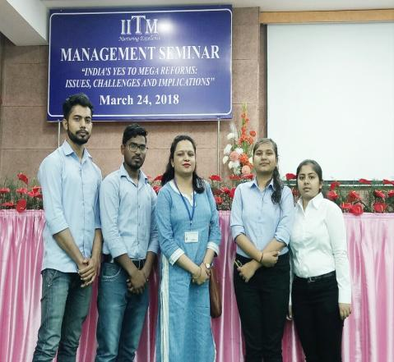
Example is better than Percept
Aiming to provide a supportive environment to the research team of BBA department and to develop their presentation and writing skills, students were encouraged for the national symposium that was held in IITM, Janakpuri on 24th March, 2018. The symposium was based on the theme ‘ India’s Yes to Mega Reforms: Issues, Challenges and Implications’.
Two teams of BBA department was presented their paper in symposium.
1. Domita Talwar and Deepam Kapoor presented paper titled “ Consumer Preception for Environment Friendly Products: an Empirical Investigation”
2. Abhinav and Nasir has presented paper titled “An Empirical Study to assess Online shopping Behaviour”.
This achievement of students were the outcome of continuous support of their mentors Dr. Sangeeta, Mr. Rajesh and Dr. Sandeep.

Slide 23



Slide 24
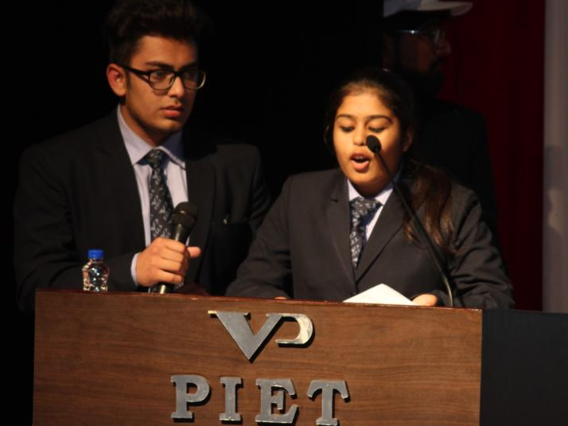
Nishant Bareja & Kritika Arora (BBA 1st Year)
Anchors of the day.

Slide 25
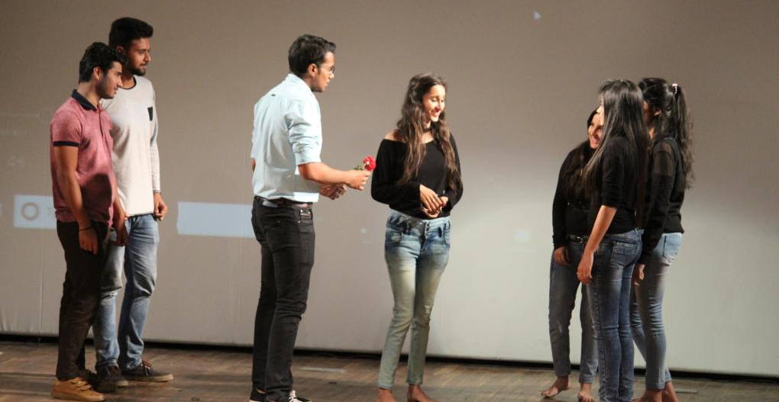
Students of BBA 3rd Year & 2nd Year performed an act on “ACID ATTACK”, It was really touching and one can relate it to reality of today’s world.

Slide 26
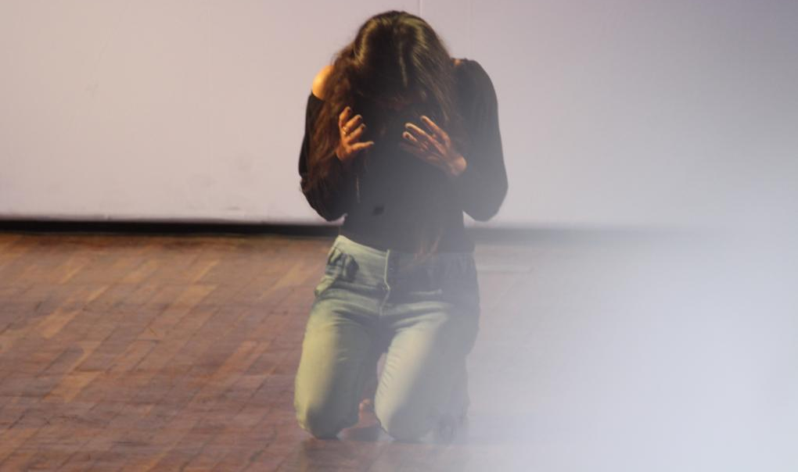
Palak Gupta, BBA-3rd Year
Performed as “VICTIM OF ACID ATTACK”

Slide 27
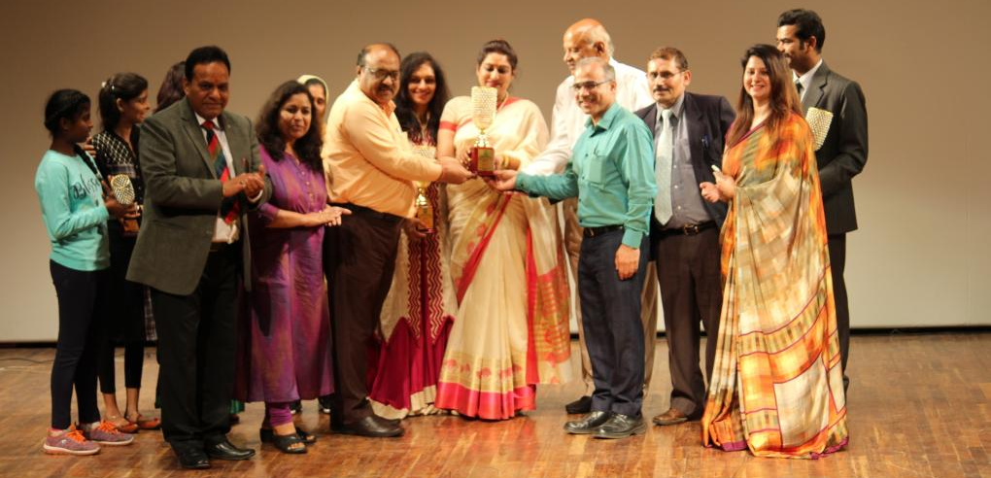
Momento presentation to Chief guest by Dignitaries of PIET.

Slide 28
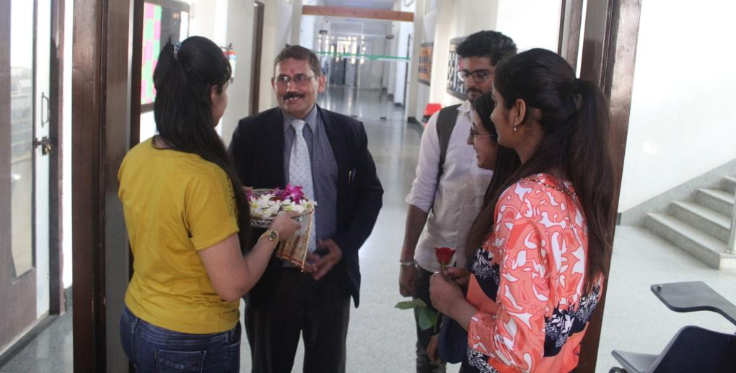
Welcoming of HOD Sir on Women’s day celebration. It was organized by BBA Students at Department level.

Slide 29
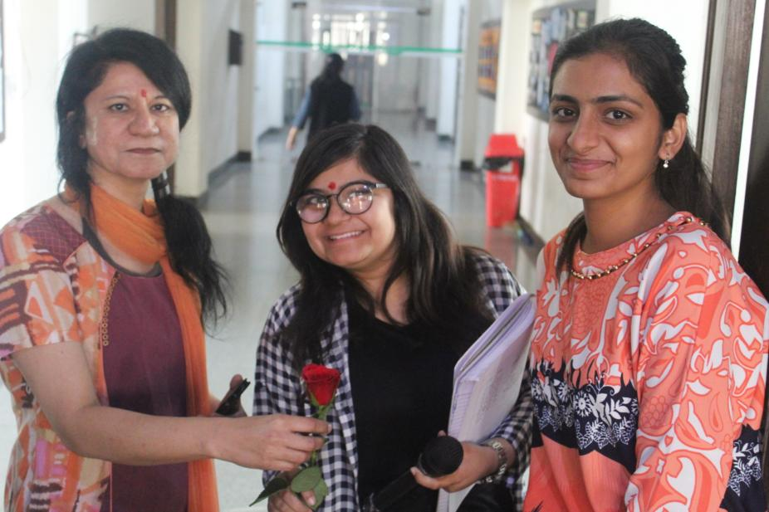
Welcome of Ms. Monika Sawhney by Ms. Vidhi & Ms. Manya (BBA 2nd Year)

Slide 30
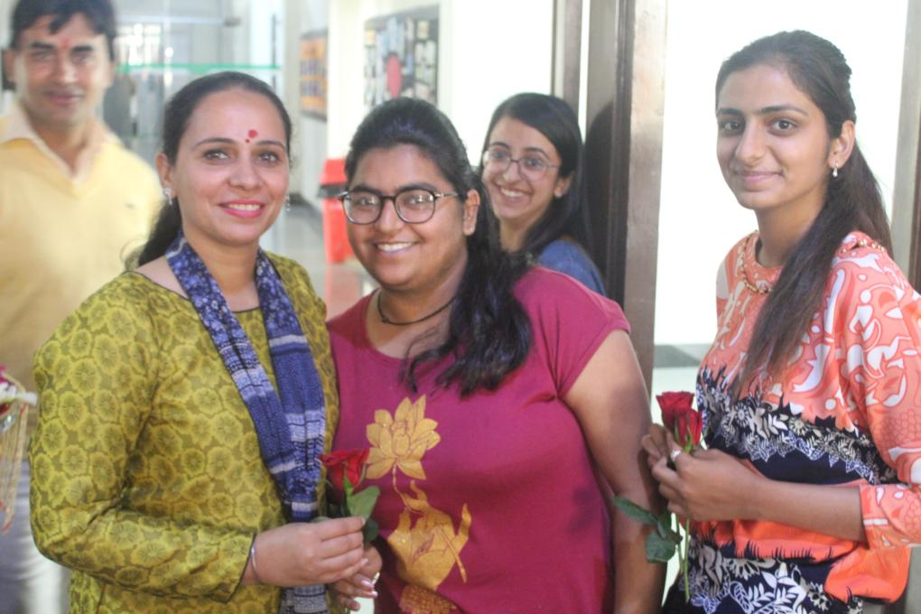
Welcome of Ms. Shachie Sandhu by Ms. Megha (BBA 1st Year) & Ms. Manya (BBA 2nd Year)

Slide 31
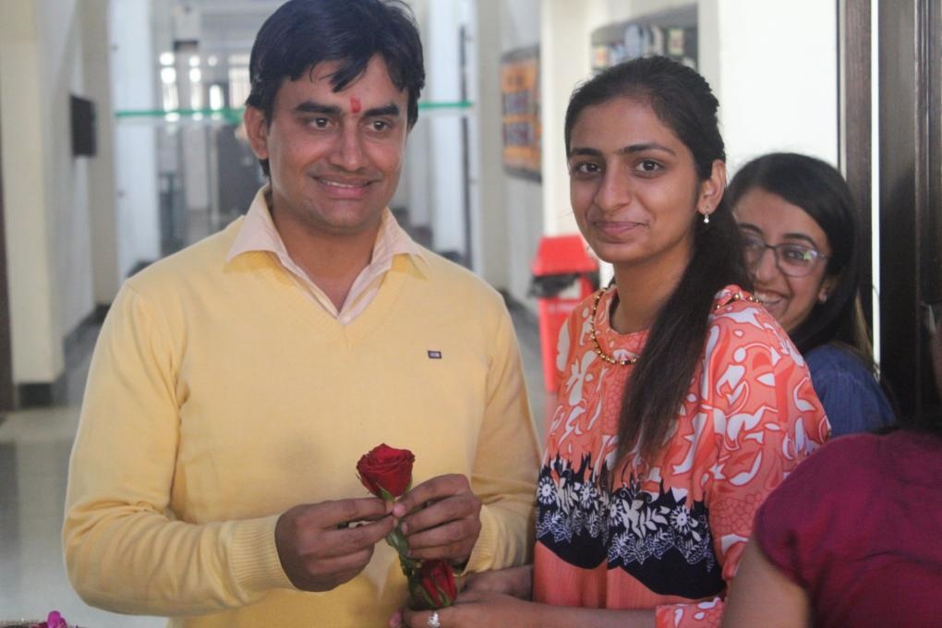
Welcome of Mr. Charan Malik by Ms. Manya (BBA 2nd Year)

Slide 32
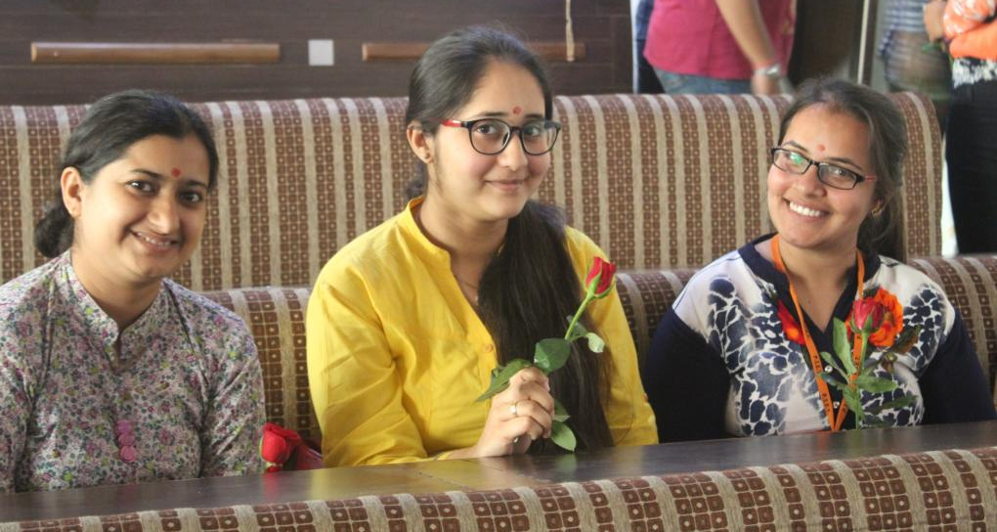
Ms. Annu Dahiya, Ms. Simranjeet & Ms. Simran during women’s day celebration.

Slide 33
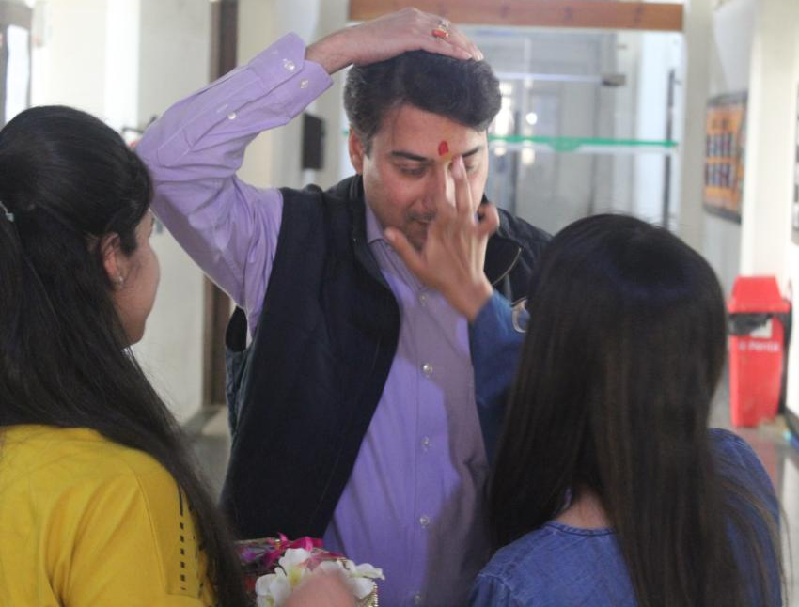
Welcome of Mr. Atul Gautam by Students of BBA

Slide 34
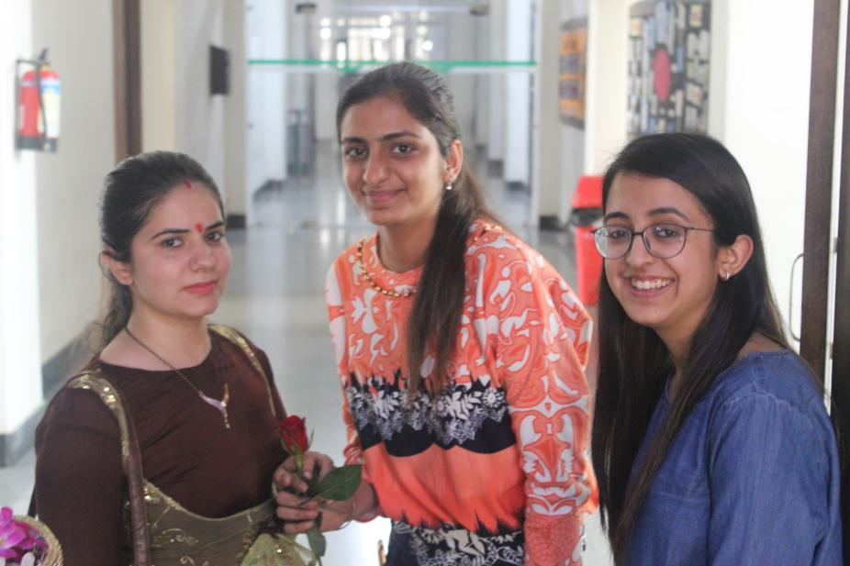
Welcome of Ms. Namita Arora by Ms. Manya (BBA 2nd Year)

Slide 35
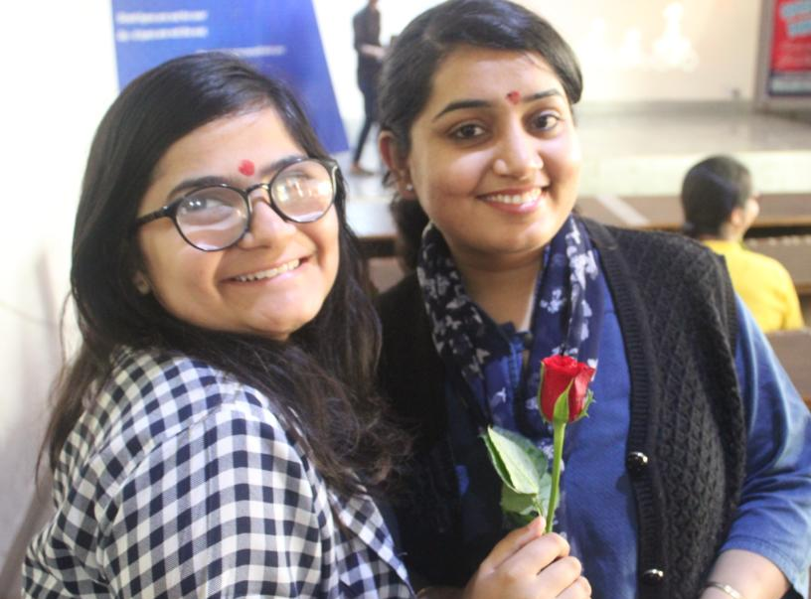
Welcome of Ms. Samriti Pasricha by Ms. Vidhi (BBA 2nd Year)

Slide 36
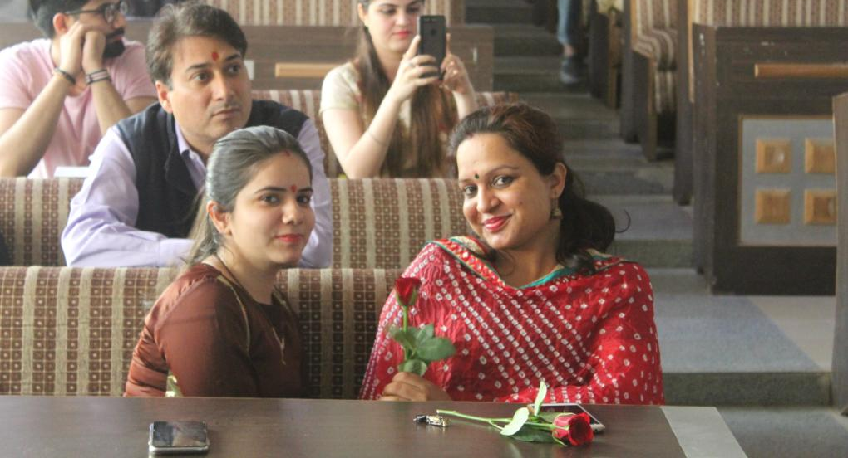
Ms. Namita, Ms. Sangeeta & Mr. Atul Gautam during the Programme .

Slide 37
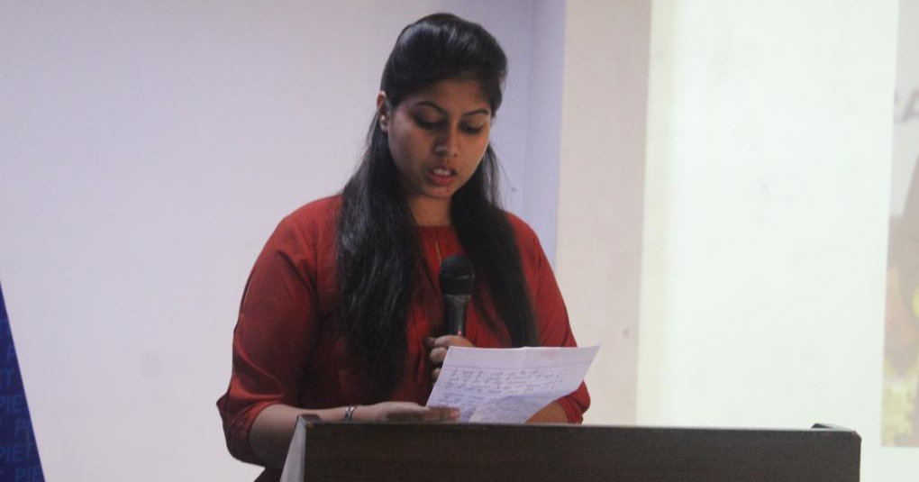
Ms. Komal Goel (BBA 3rd Year)
She receited a poem on Women Empowerment

Slide 38
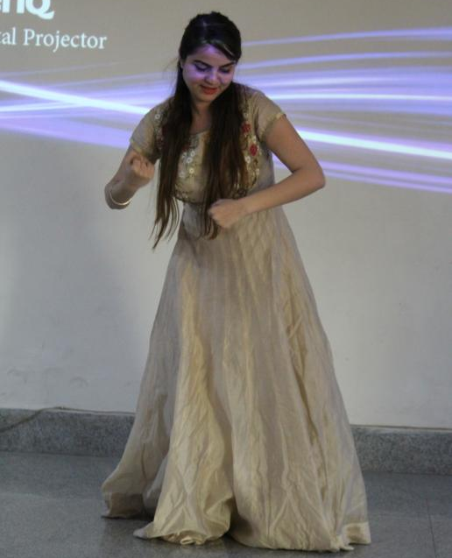
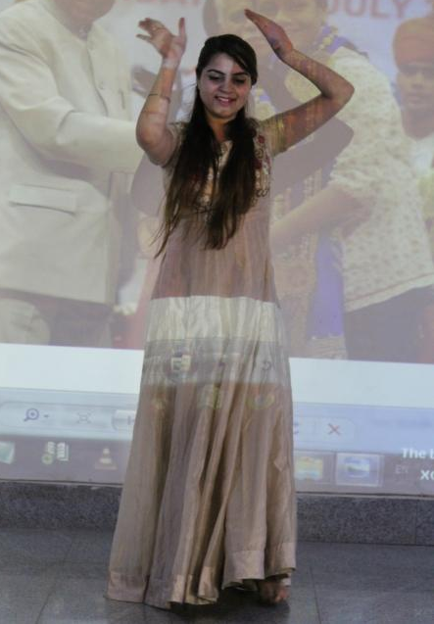
Ms. Vandana Bajaj (BBA 3rd Year)
She gave a dance performance on “TU HI TU” song.

Slide 39
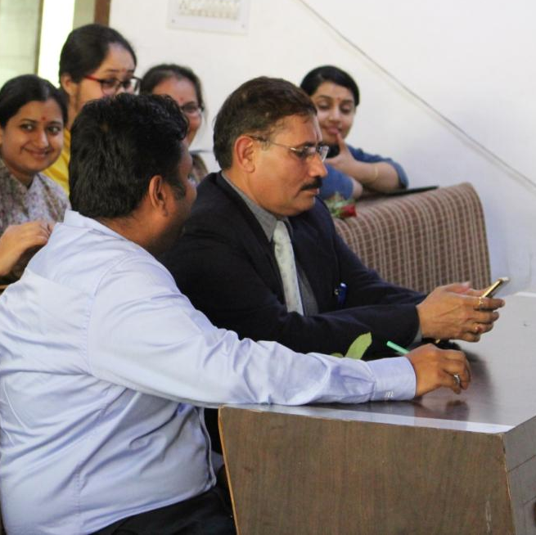
HOD Sir during the programme of women’s day in BBA Department.

Slide 40
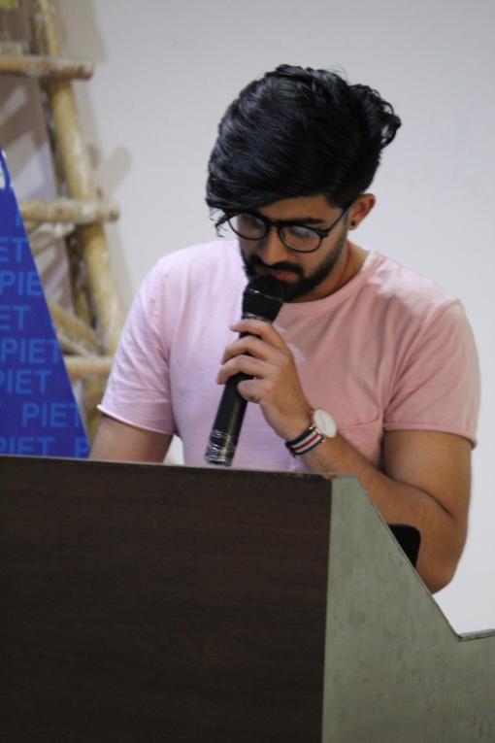
Sanyam Lakhina (BBA 3rd Year)
He recited a very sweet poem for women’s day, every word from his poem was describing the importance of women in this world.

Slide 41
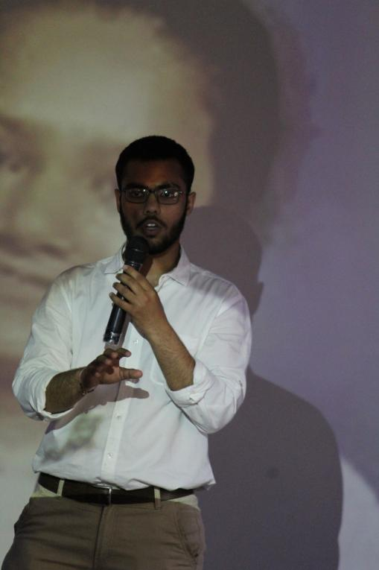
Vishav Garg (BBA 3rd Year)
He shared the story of Arunima Sinha (She is first Indian amputee to climb Mount Everest. She was a national level volleyball player who was pushed from a running train by some robbers in 2011 while she was resisting them)

Slide 42
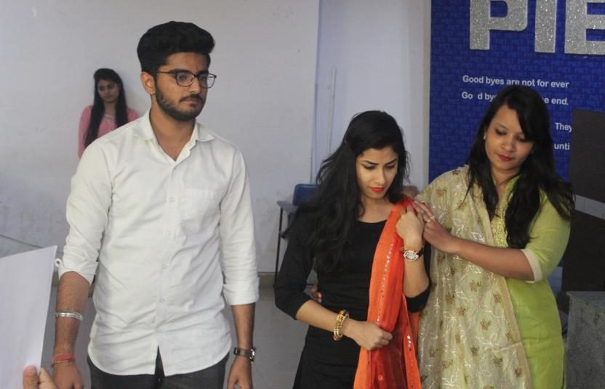
A very emotional yet harsh truth of our society is “FEMALE FOETICIDE”
BBA 1st year and 2nd year students presented a play on this topic which made eyes of every person present there to cry.

Slide 43
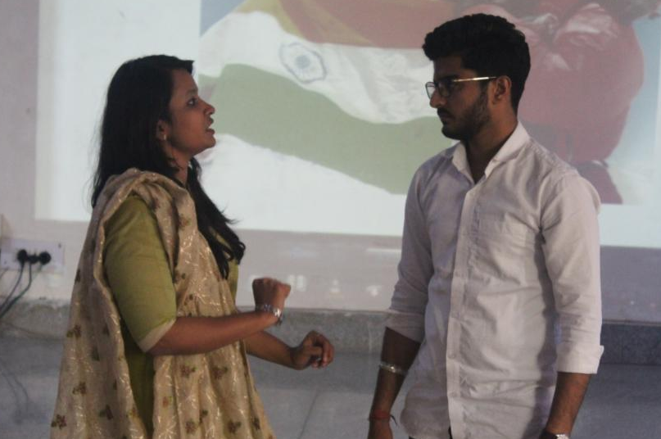
“A Baby Girl…One Of The Most Beautiful Miracles In Life.”
This play presented importance of a girl child even more beautifully.

Slide 44
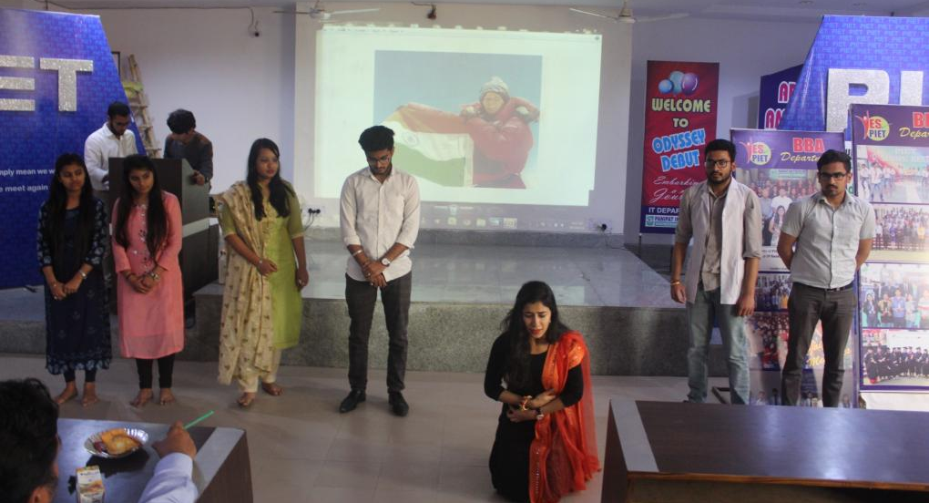
It is a murder, Mom, Don’t you realize it?
I am you and Dad’s love , I know it’s difficult to have me in your womb.
But it is all worth , I’ll make you proud, Mom.
Please don’t kill me , Please don’t let me die, Mom.

Slide 45
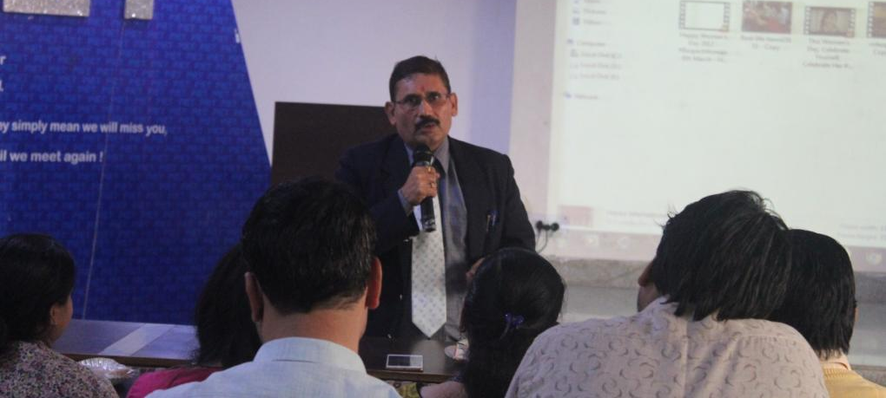
“Whenever you think about disrespecting a woman, think about how you were born into this world.
Call me old fashioned but I believe that respecting a woman is one of the most important things to uphold in life.”
-Dr Yoginder Singh Kataria

Slide 46
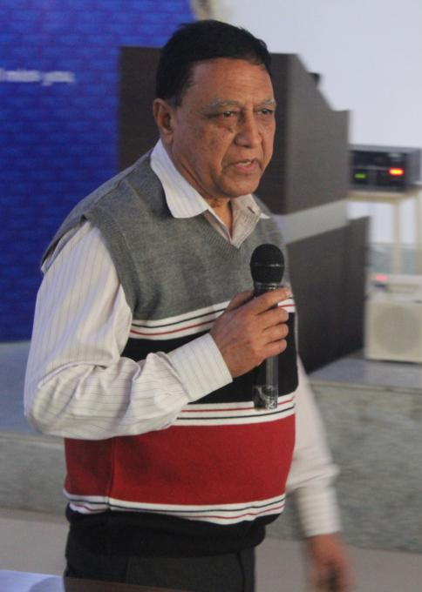
I am the one who gave you birth...
I am the one who make everyone in girth...
I am the one who spread the love...
I am the one who live like a dove…
I am the one who give you care…
I am the one who pray for you in prayer...
Just tell me…
Were my wings not meant for flying…?
Were my dreams only for dying…?
Was my care nothing meant to you as mother…?
Was my love nothing meant to you as lover…?
Why your hands don't tremble while taking the knife…?
Why your heart doesn't melt while depriving the life…?
Oh my father oh my friend…
Please don't kill me I am just a girl child..
Take an oath and Stop Female Foeticide.
-Jagmohan Malhotra

Slide 47
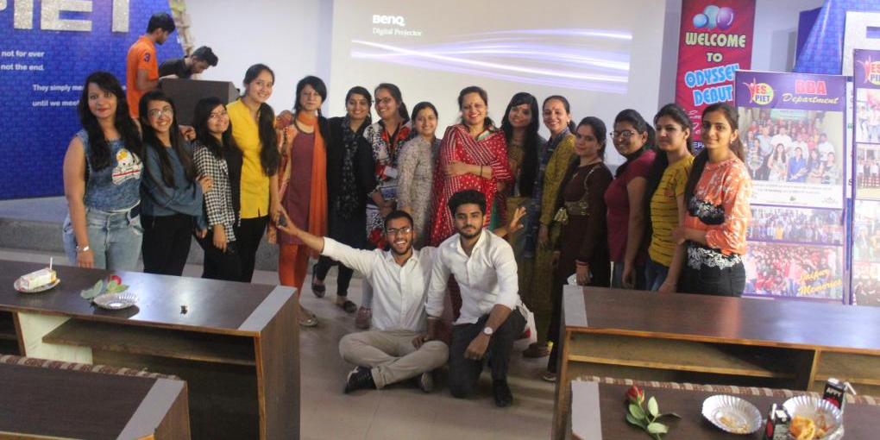
Team BBA (Students and Faculties) after the celebration of Women’s day.

Slide 48

13-March-2018

Slide 49
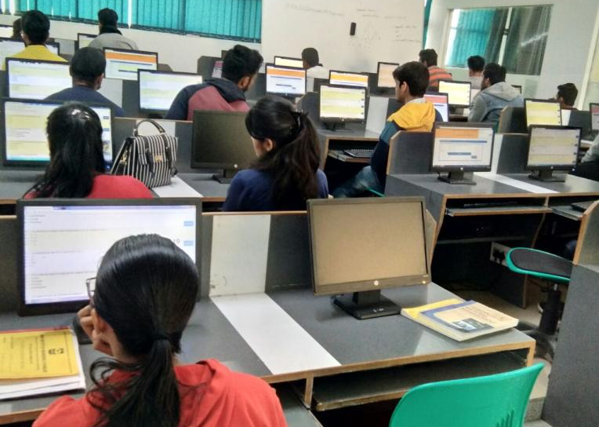
SOT-2 Going on in computer labs for all the 3 years of BBA.

Slide 50
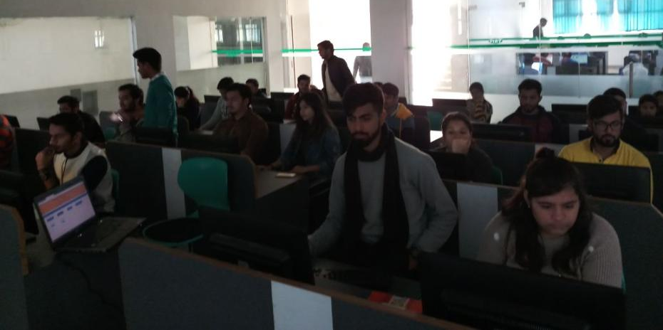
Students giving SOT-2 in computer labs.

Slide 51
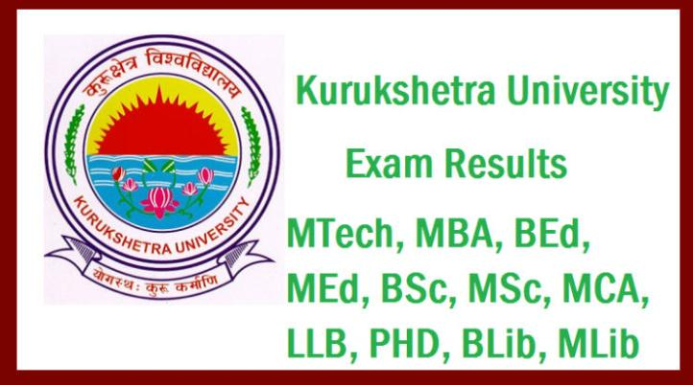

BBA
5th semester Result has proved that PIET is the best college which helps in an overall growth of the youth.
We achieved 8 Position in the top 20 Merit list of the university.
13-March-2018

Slide 52
BBA 5th Semester University Rankers (BATCH 2015-18)
S. No | Roll No | Name | Total Marks | Percentage | University Position
1 | 5874205 | GOURAV | 544 | 77.71 | 3rd
2 | 5874237 | PURVA BATRA | 538 | 76.86 | 7th
3 | 5874189 | ADITI BAJAJ | 537 | 76.71 | 8th
4 | 5874207 | AKANT BHOLA | 535 | 76.43 | 9th
5 | 5874250 | ANSHU GARG | 531 | 75.86 | 13th
6 | 5874239 | BHARTI | 530 | 75.71 | 14th
7 | 5874231 | STUTI GUPTA | 529 | 75.57 | 15th
8 | 5874272 | PRINCE GARG | 529 | 75.57 | 15th

Slide 53



17th March 2018 was stated for PTM of all BBA students. Around 40 Parents Registered their Presence which is Considered very encouraging and indicatee of a much better footfall in coming time.
17-March-2018

Slide 54
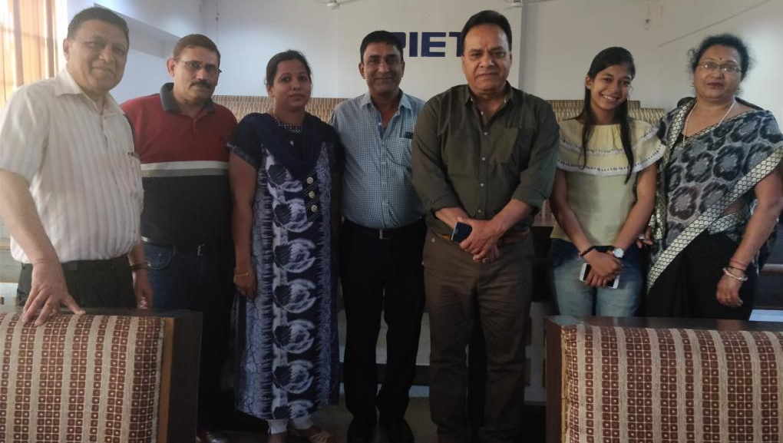
Dr. BB Sharma, Dean, Student welfare along with Dr. Yoginder Singh Kataria, HOD, BBA, Mr. Jagmohan & Parents of BBA Student.

Slide 55
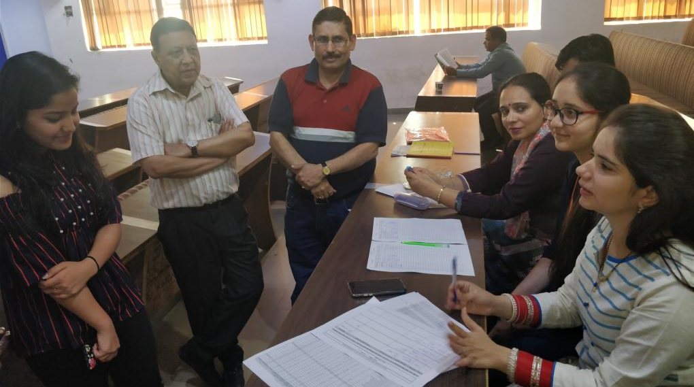
Two way communication going on with parents of BBA-1st Year Student.
Dr. Kataria, Mr. Jagmohan, Ms. Shachie, Ms. Namita & Ms. Simranjeet were all part of the same.

Slide 56
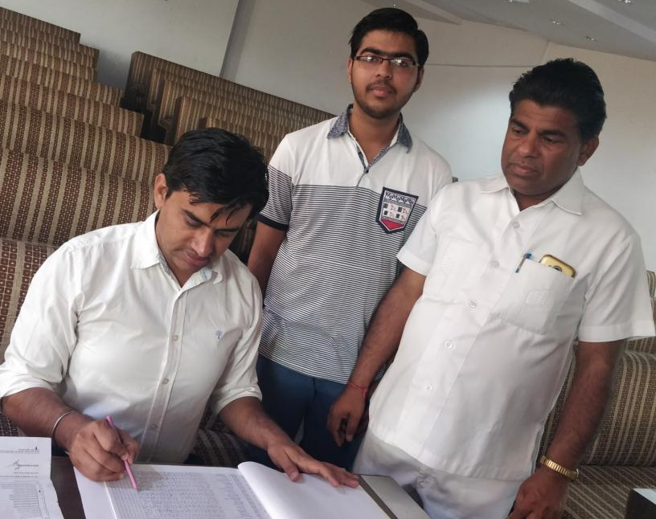
Mr. Charan Malik sharing student (BBA 2nd Year-Deepak Gupta) report to his father.

Slide 57
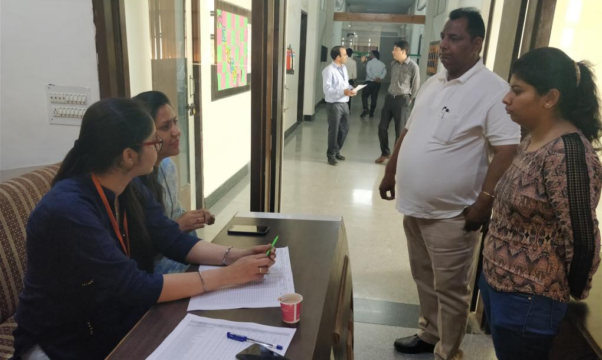
Ms. Preeti Dahiya & Ms. Simranjeet interacting with parents of BBA 1st Year.

Slide 58
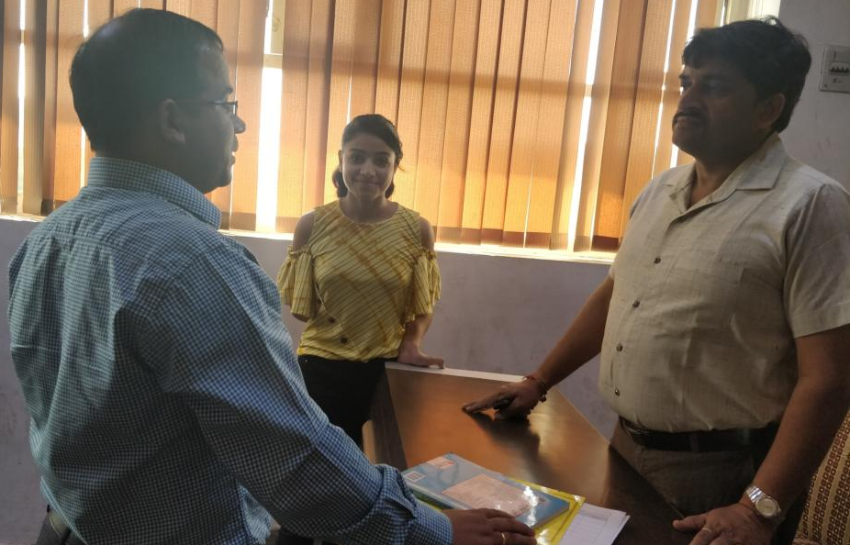
Mr. Vikas Deswal sharing overall report of the student (BBA 2nd Year-Kirti Jain) to her Father.

Slide 59

Dr. Sandeep Kumar sharing student (BBA 2nd Year-Harikrishan) report to his father.

Slide 60

Ms. Namita Arora listening queries of the parents.

Slide 61

Mr. Ashish guiding parents.

Slide 62

Mr. Rajesh attending parents of BBA 3rd Year.

Slide 63

2nd

Slide 64

BBA Students giving Sessional exam. In 2nd Sessional exams remaining 50 percent syllabus is given for each subject. This is how full syllabus is covered as 50 percent comes in 1st Sessional.

Slide 65

Students giving Sessional exams. With this they are going towards end of semester.

Slide 66

SMART INDIA HACKATHON-2018
Panipat Institute of Engineering and Technology (PIET) was chosen as the Nodal Centre for Ministry of Communication for the Grand finale of ‘Smart India Hackathon-2018’ on 30th and 31st March, 2018 with an objective to seek solutions to many problems related to communications through exceptional coding skills.

Slide 67

MAMTA PANDEY
BBA-1st Year
It will provide an opportunity to the various computer connoisseurs to brain storm and bring about disruptive solutions to many communications related problems through their exceptional coding skills. PIET is now gearing up for organizing “Smart India Hackathon” for 2018 on a usual grander format, to be held on 30th and 31st March, 2018.

Slide 68


MAMTA PANDEY
BBA-1st Year
Welcome Dance-Ganesh Aarti
Vidhi Arora
BBA-2nd Year
Formal Anchor of the event

Slide 69

Panipat Institute of Engineering and Technologies (PIET) have been chosen as the Nodal centre for Ministry of Communication for the Grand finale of Smart India Hackathon 2018 which is scheduled to be held on 30th and 31st March, 2018.
Dr. Yoginder Singh Kataria,HOD,BBA headed valedictory for the event.

Slide 70

Prime Minister – Sh. Narendra Modi live at PIET to interact with students.

Slide 71

PIET hosted around 42 teams having around 336 participants from all across the country. Smart India Hackathon was organized in collaboration with Ministry of Communications, Department of Telecommunications, Ministry of Communications, AICTE, MHRD with an objective to promote innovative thinking in the students, with a special focus on solving problems of public importance and seeking out- of- the- box solutions with objective oriented approach. The mission in hand is to solve the issues and challenges related to communications faced by India.

Slide 72

BBA, HOD
(Dr. Yoginder Singh Kataria)
BBA, E-Committee
(Mr. Jagmohan Malhotra)
(Ms. Sakshi Garg)
(Ms. Simranjeet Kaur)
(Ms. Simran Verma)

