Slide 1
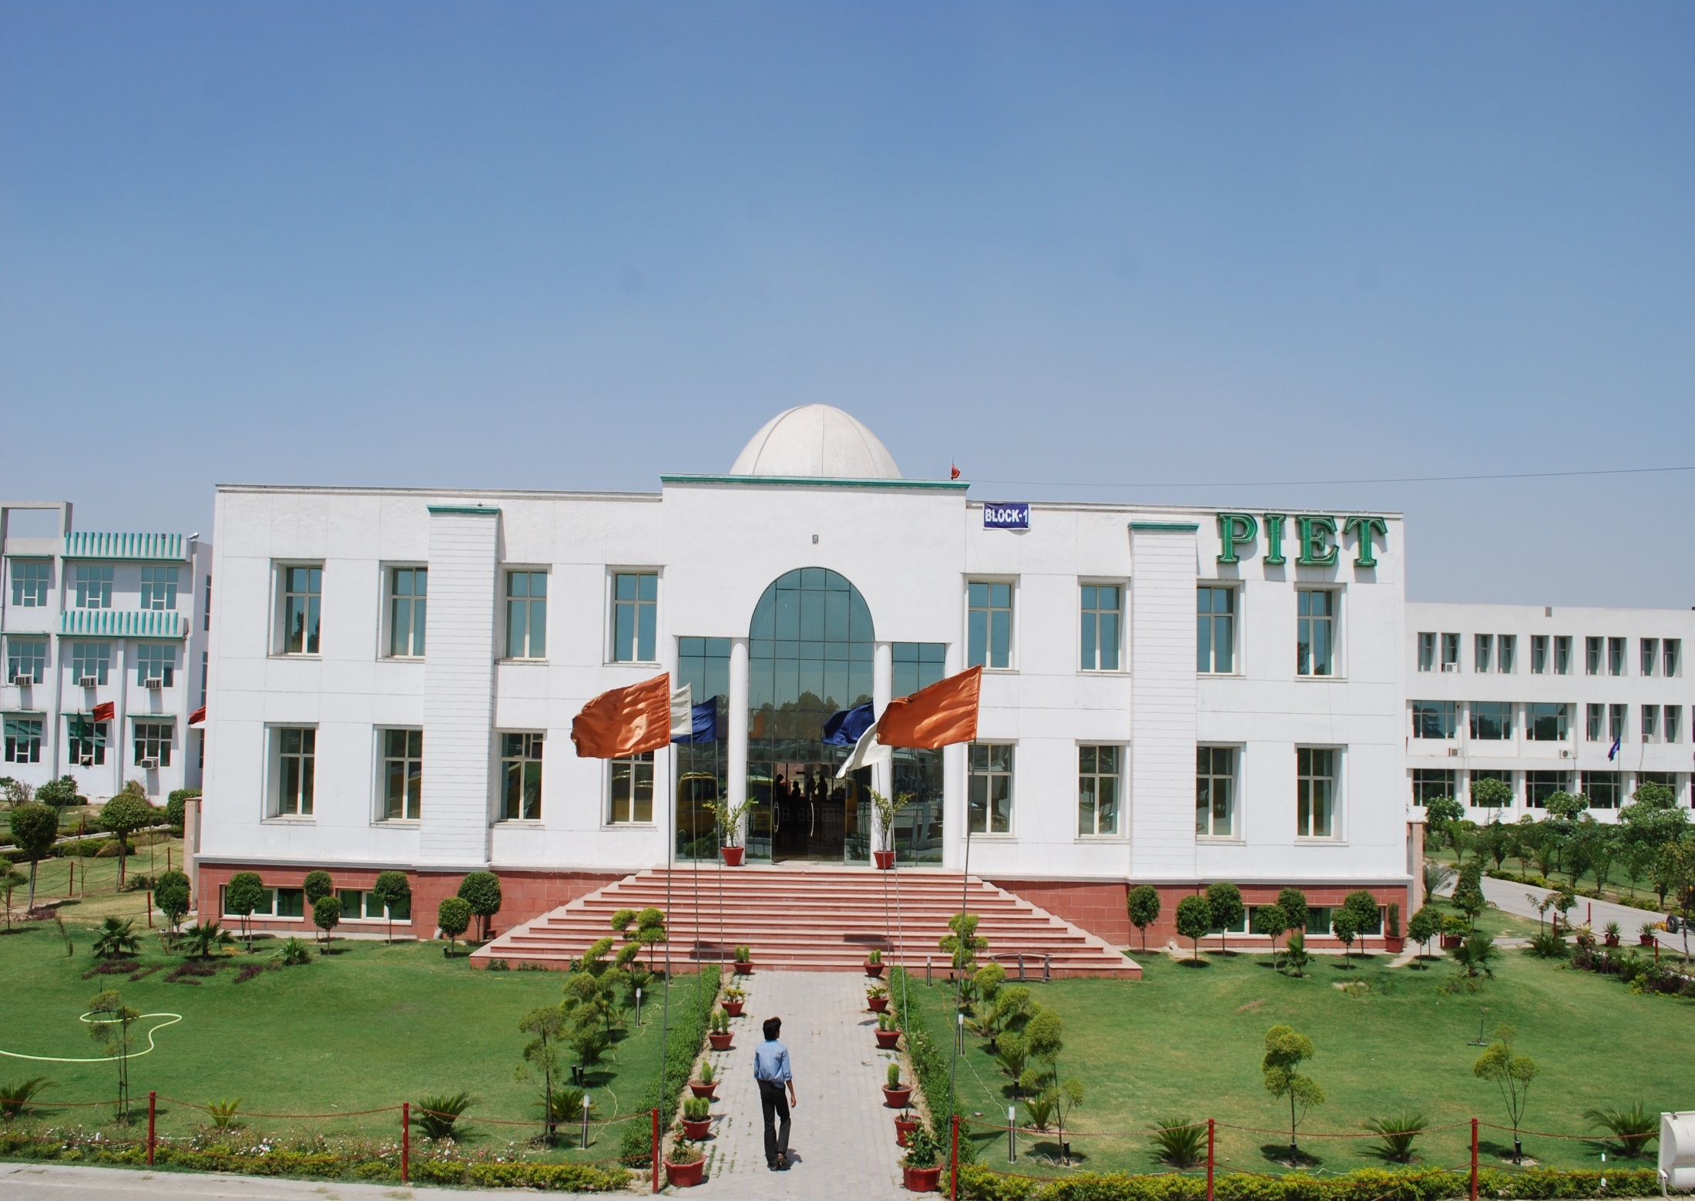


Slide 2





Slide 3


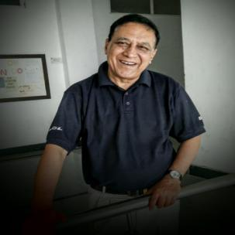
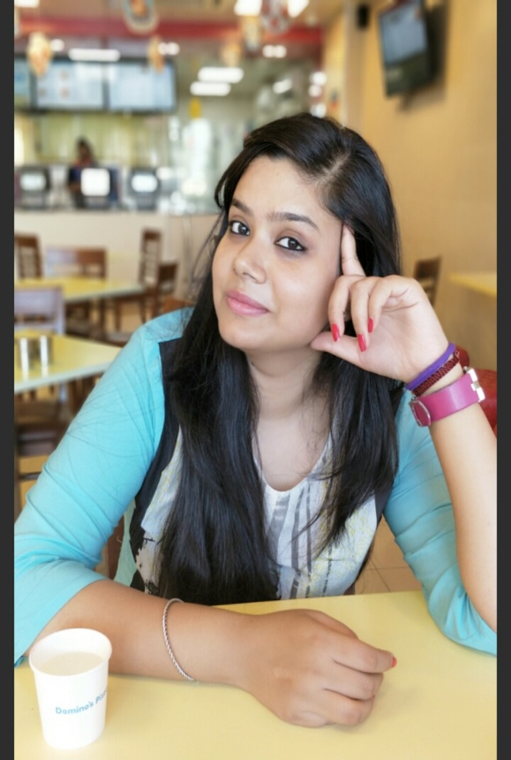
This is the first magazine release of the new semester and it brings you NEWS about happenings at PIET so as to update your information about the institute and BBA department.
We at PIET prepare students to live lives of leadership and good for the common and to meet challenges of professional world. These days people question the value of a college degree. I can’t say about all colleges in the vicinity, but at PIET you get value for money which comes in the form of personality transformation and campus placement. We teach you to think critically and communicate cogently.
Wishing you the best of times academically and forthcoming annual events, a blend of education and entertainment for a balanced personality.

Slide 4



Slide 5
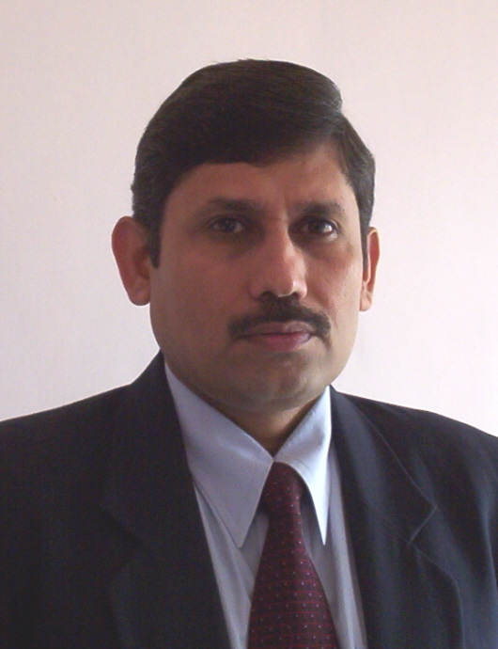

Dr. Yoginder Singh Kataria, HOD, BBA

Slide 6
HOD’S MESSAGE
From HOD’s Desk
Welcome to the Department of Business Studies which is known as the most vibrant department in the PIET campus in terms of student population, faculty, facility, placements & other activities. The department is continuously making efforts to impart cutting edge knowledge in the direction of transforming our youth into professional managers and entrepreneurs.
Our department has very cordial atmosphere between faculty & students and has always been known for its conducive ambience where students flourish & cherish. Faculty members of our department are always involved in passionate teaching and other related activities which focus on the over all development of the youth. We constantly look for bright enthusiastic students who have passion to participate in all our activities & promote them to the level of leaders. We strive for excellence in whatever we do and I hope we will be able to maintain this in future too.

Slide 7
HOD’S MESSAGE
The institute is striving to foster a strong partnership with the industry and some of the European universities to ensure relevancy in curricula and prepare our graduates for the market challenges of today and beyond who are found valid anywhere in the world. Collaboration focuses on the development of course syllabus by obtaining feedback from experts on our existing learning outcomes. It also involves sharing of experiences by hosting experts on campus to lecture on managerial advances and innovative practices in the various fields of management.
There is continuous internal evaluation of students through unit tests, internal assessment tests and quiz programmes. The problems of students are solved to the extent possible as and when they arise. The attendance and progress reports are sent to the parents after every internal assessment tests. The parents of weak students are informed about their status by telegram and also by telephone calls. The attendance of students are monitored on hourly basis and is updated online daily in the students’ progress report.

Slide 8
HOD’S MESSAGE
The students are encouraged to participate in seminars conducted from time to time. They are made to compulsorily participate in the departmental activities such as debate, extempore, group discussion, Quiz and brain storming sessions. Some expert lectures are arranged every semester on important topics to the benefits of both staff and the students. The staff members are encouraged to attend national and state level workshop to enhance their knowledge.
Every effort is made to constantly improve the results of the students. I am very happy to inform that due to the concerted efforts of both staff and students; the results are very encouraging this time again and are constantly improving.
Dr. Yoginder Singh Kataria
HOD, BBA

Slide 9


Slide 10
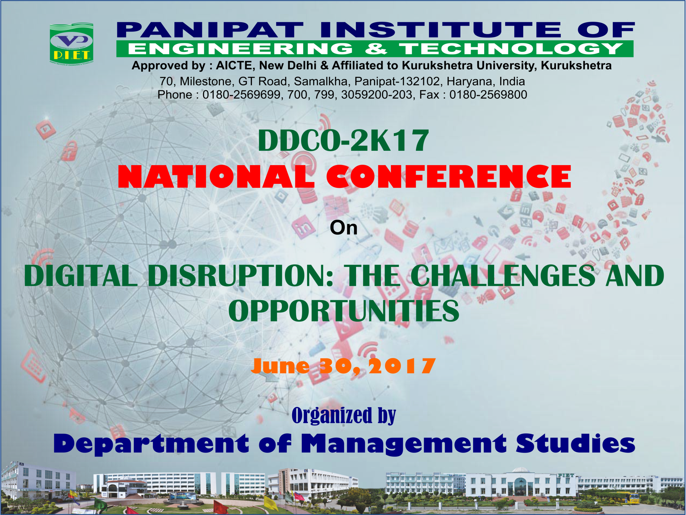

Slide 11
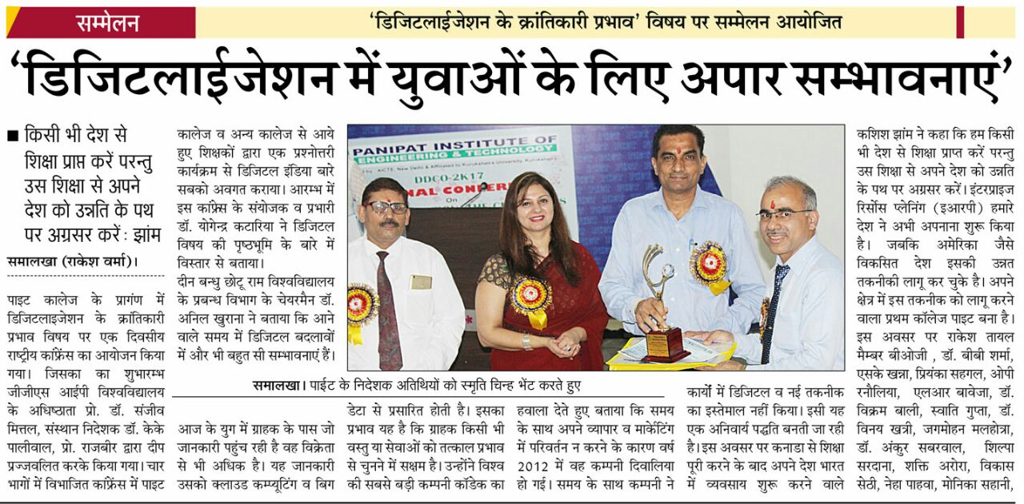

Slide 12
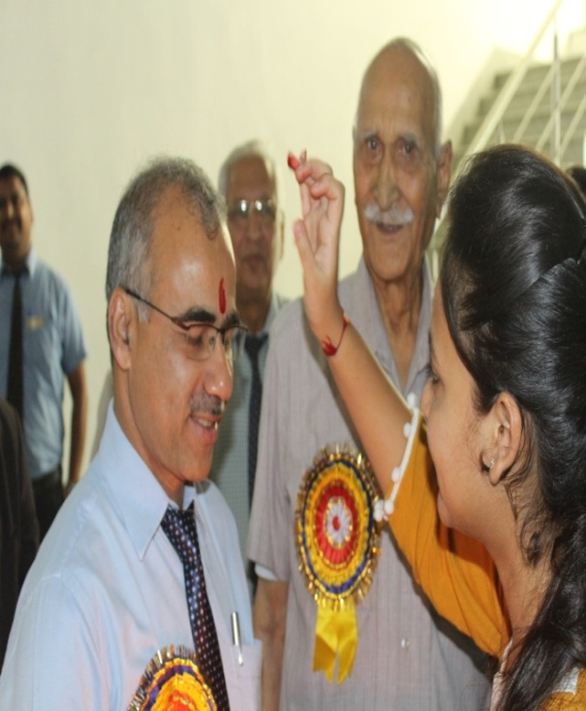
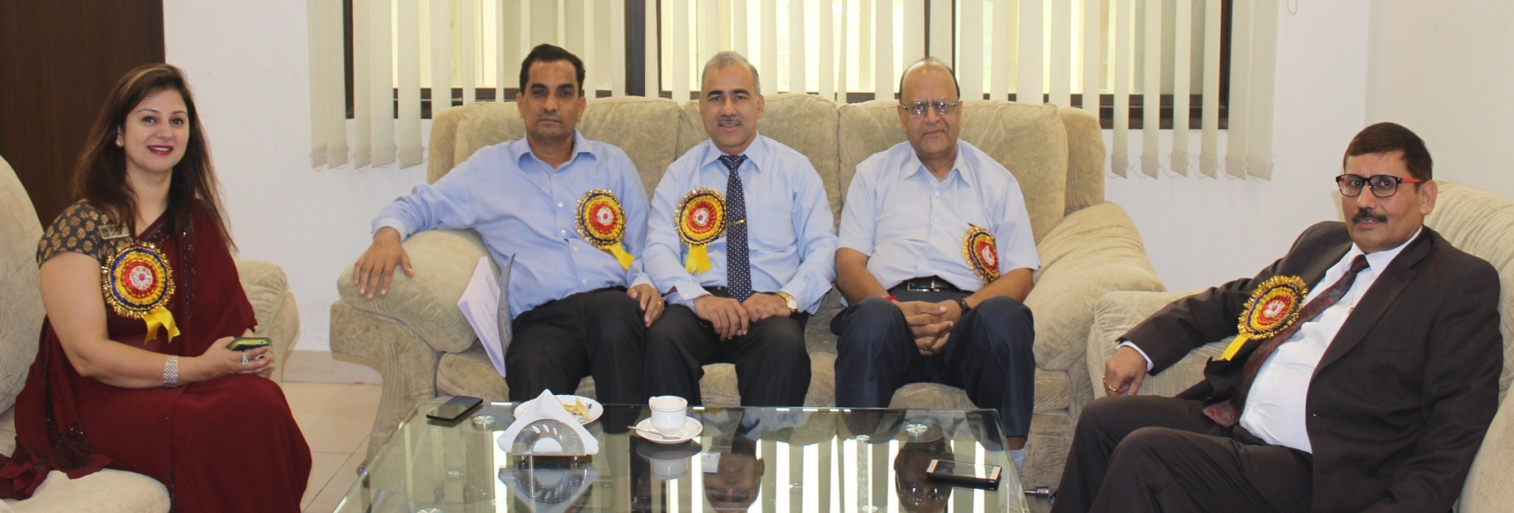
30 June 2017
A national conference on the topic “Digital Disruption- Challenges and Opportunities” was held on 30th June. The theme of this one day conference was that evolution is the simmering process for a big bang shift of paradigm which is neither stable nor permanent. Every such revolution again turns into a simmering process to give rise to another big change. This is what we are facing today, much discussion about ‘Digital Disruption’ as it relates to an innovative business model, which is destined in upending the industry incumbents.

Slide 13
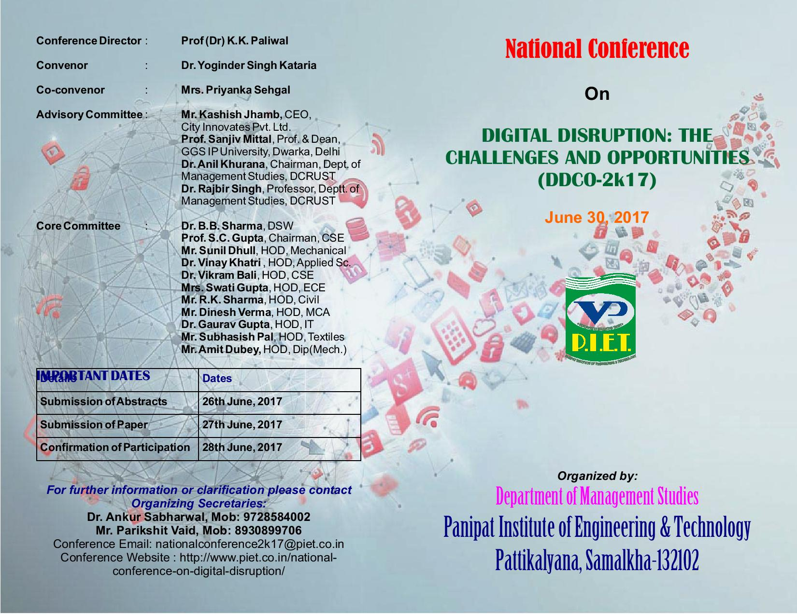

Slide 14
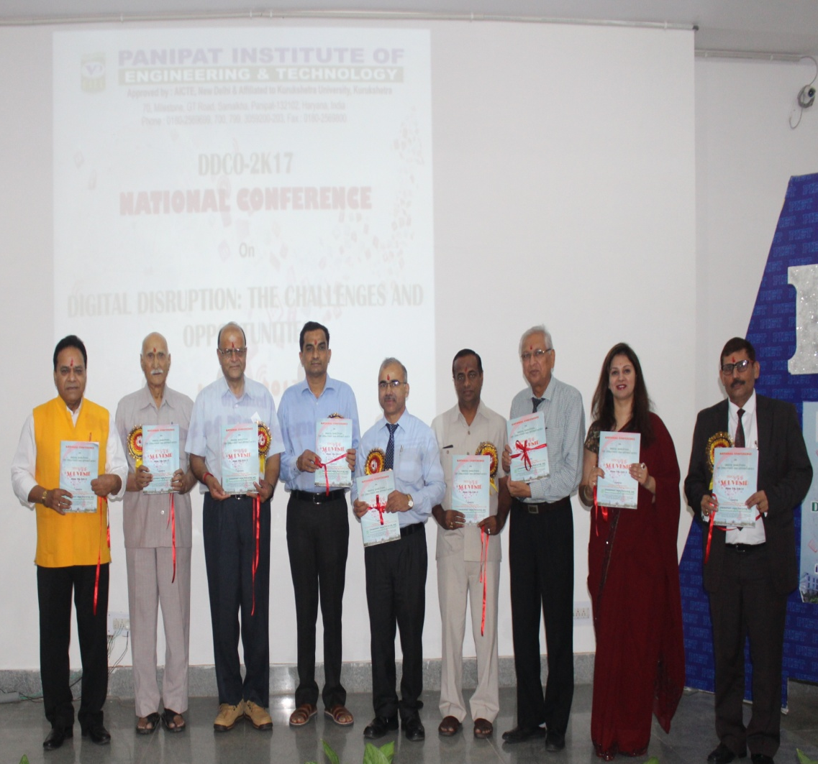
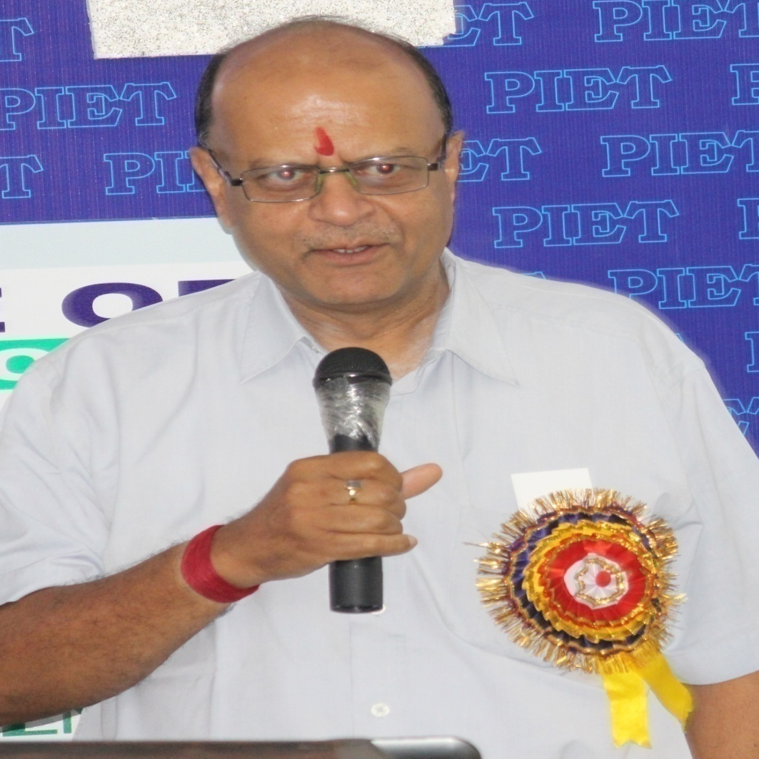
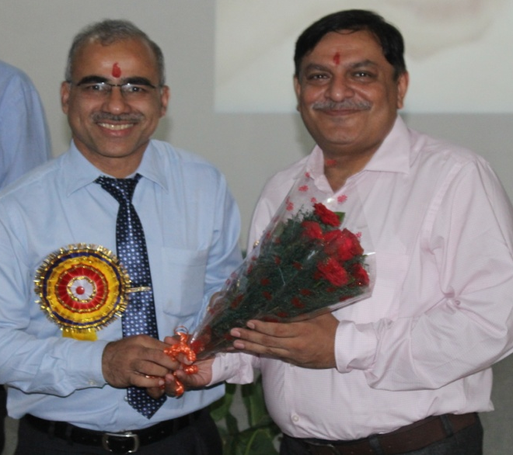
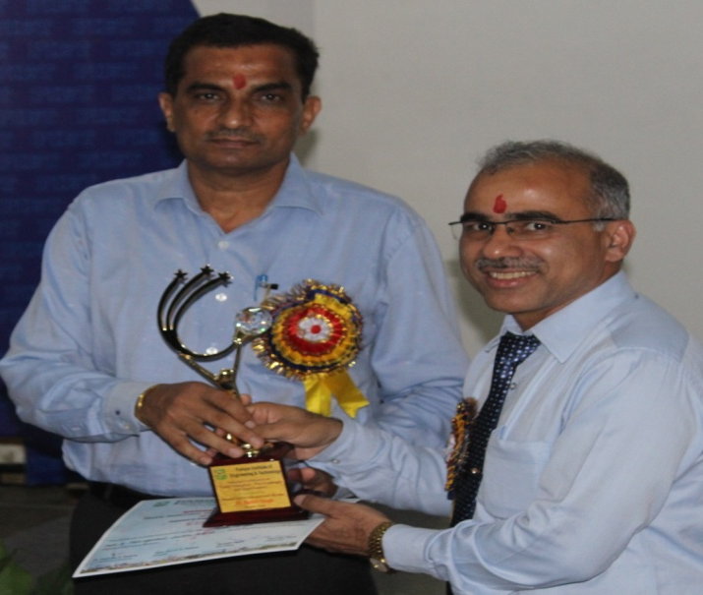
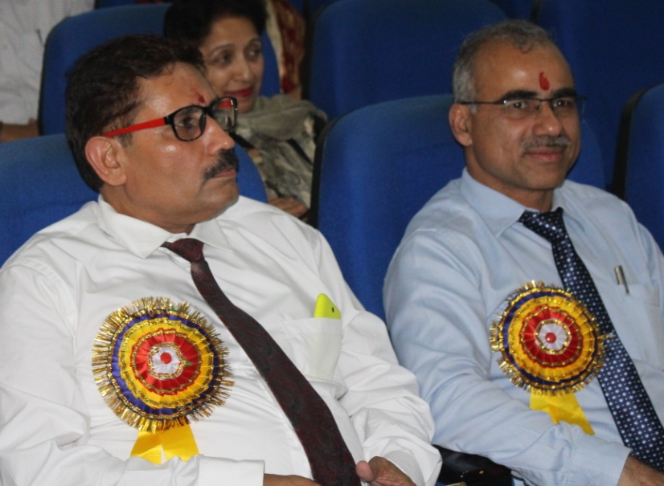
30 June 2017

Slide 15




Slide 16
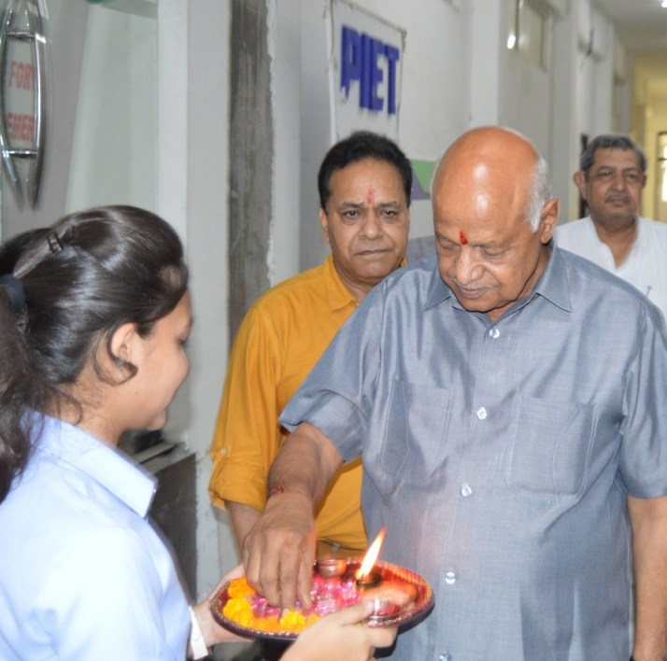
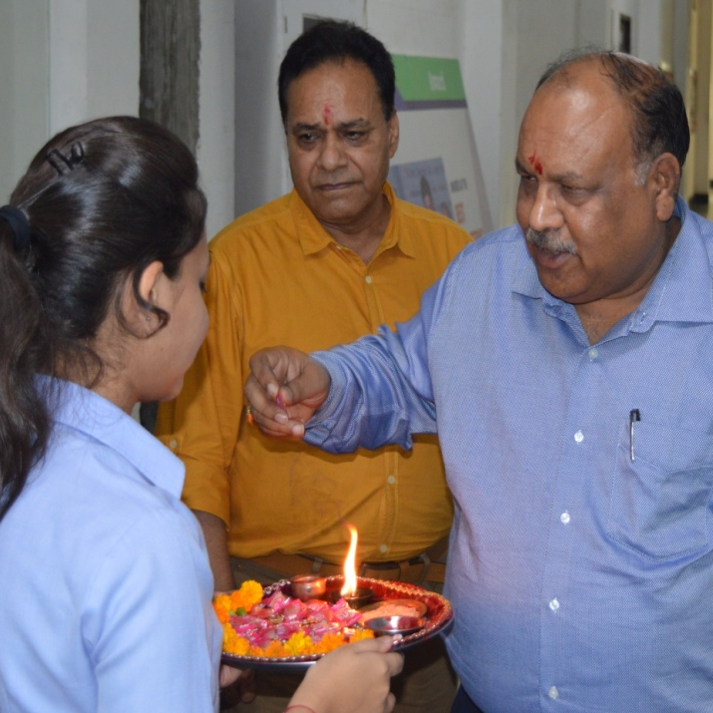
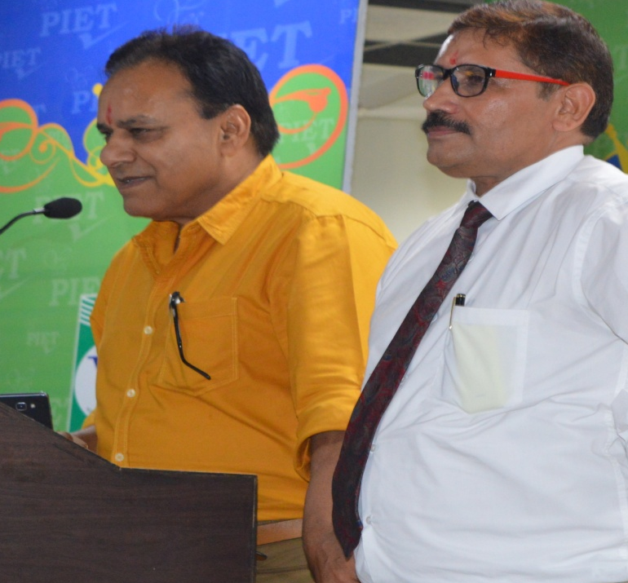
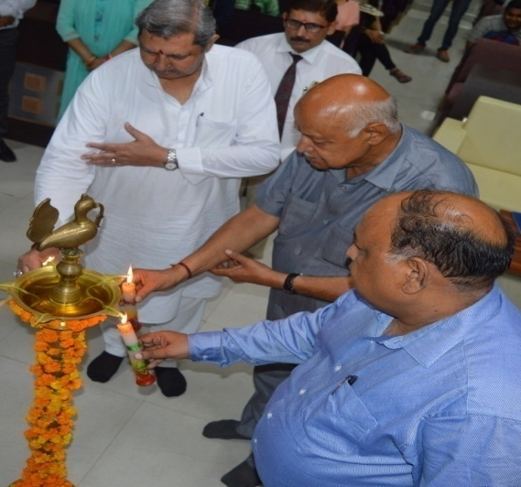
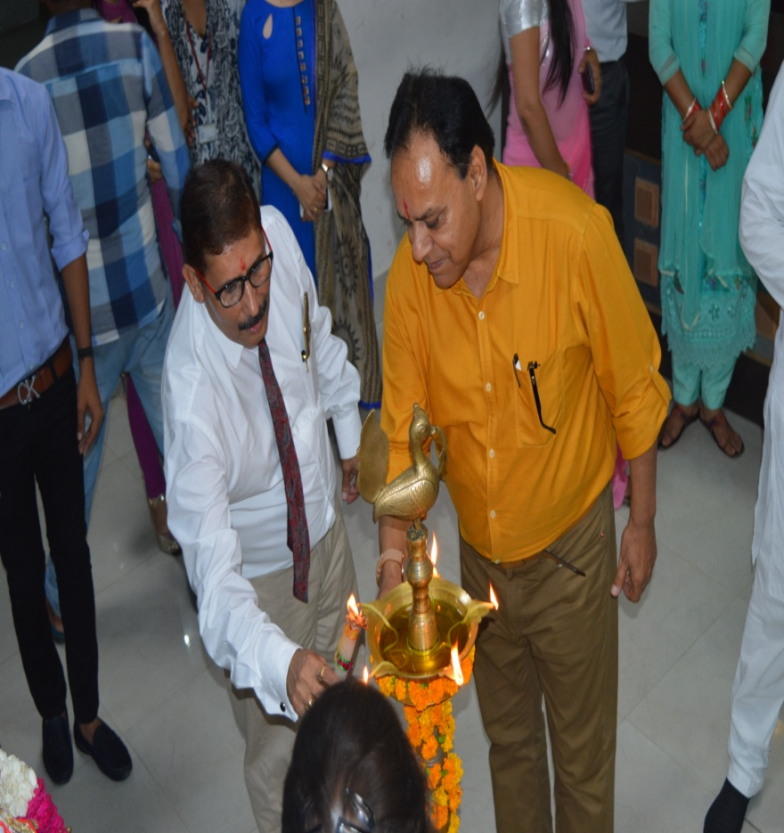
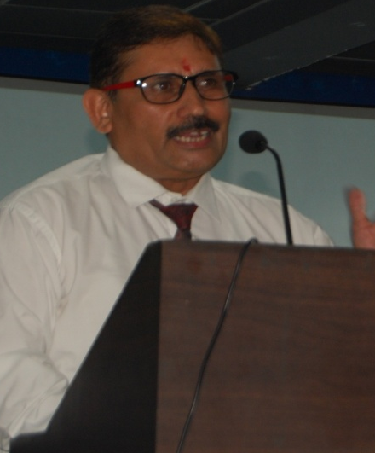
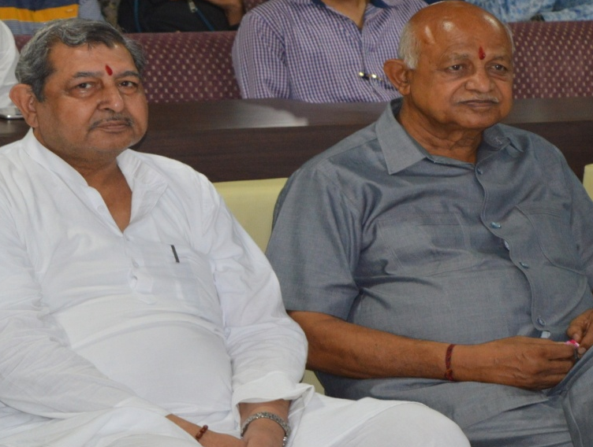
12 July 2017
It was a day of welcome to the fresher who were greeted with Indian traditional ‘Tilak Ceremony’ which assured them of being in a place of our culture. On the occasion Capt (Dr.) K K Paliwal, Director PIET addressed the young aspirants and motivated them to partake in all college activities happening from time to time.

Slide 17
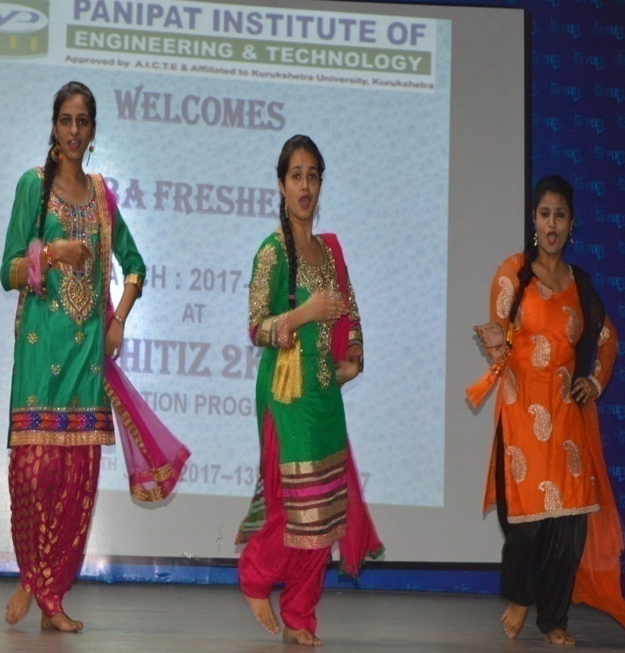
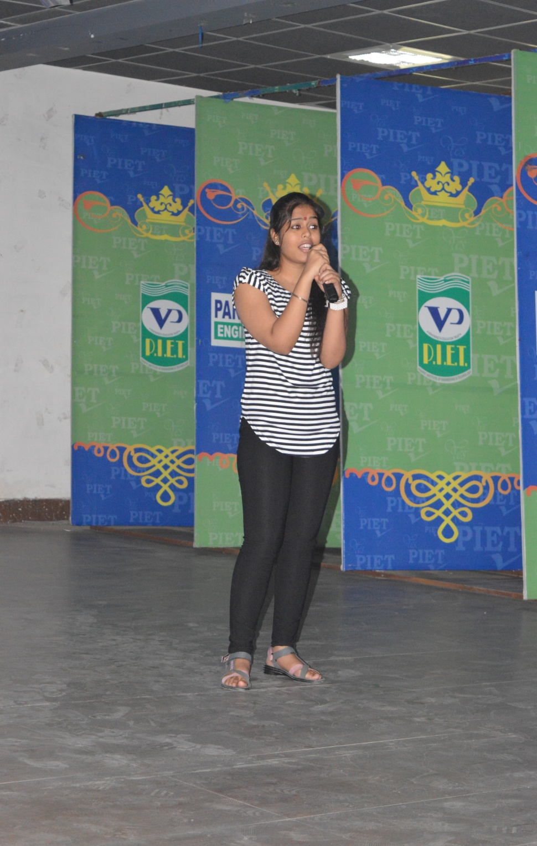
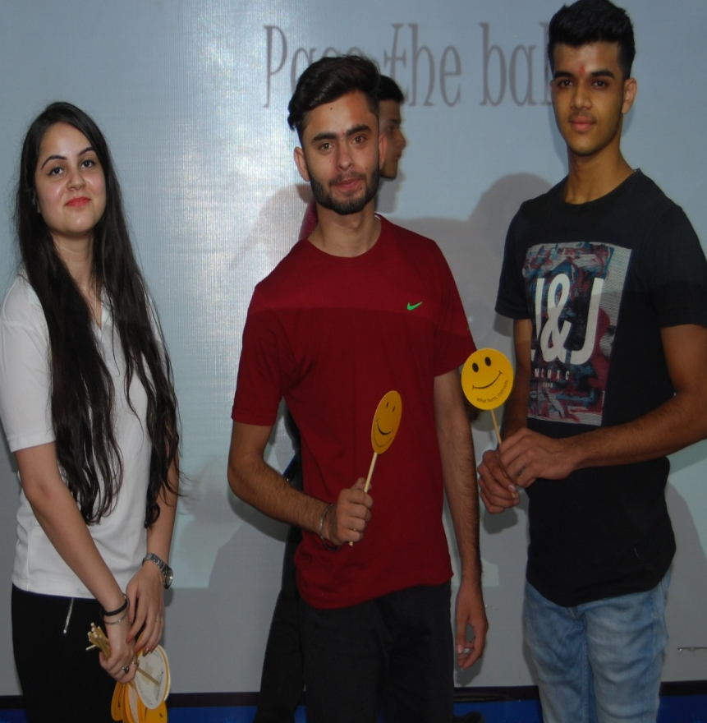
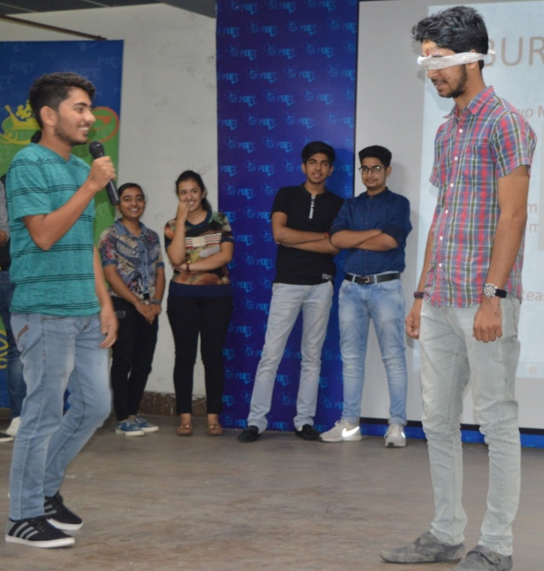
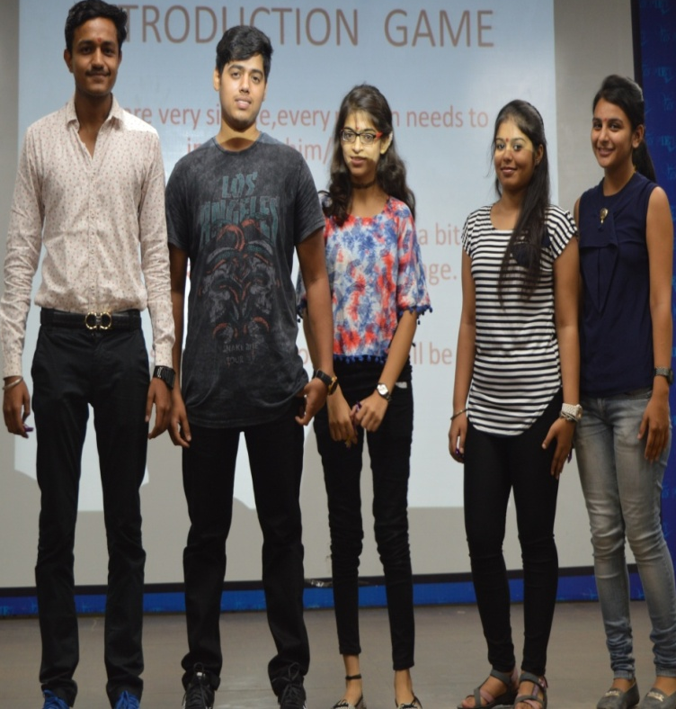
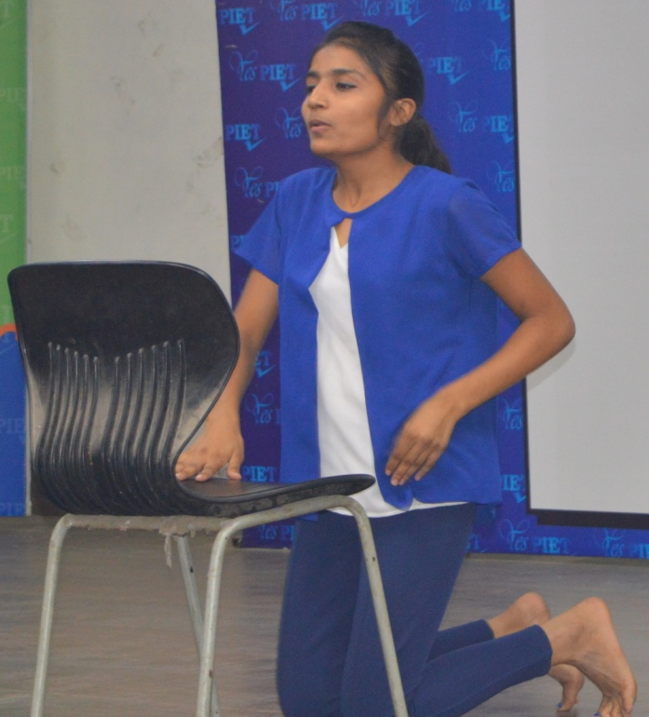
12 July 2017

Slide 18


Slide 19
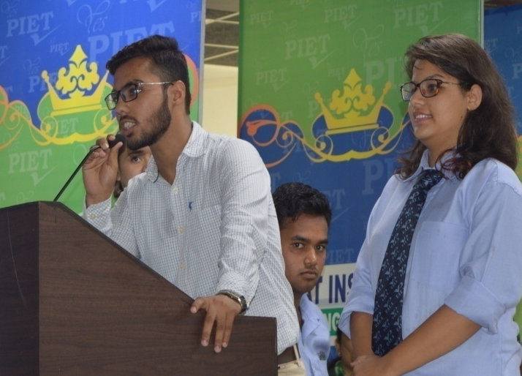
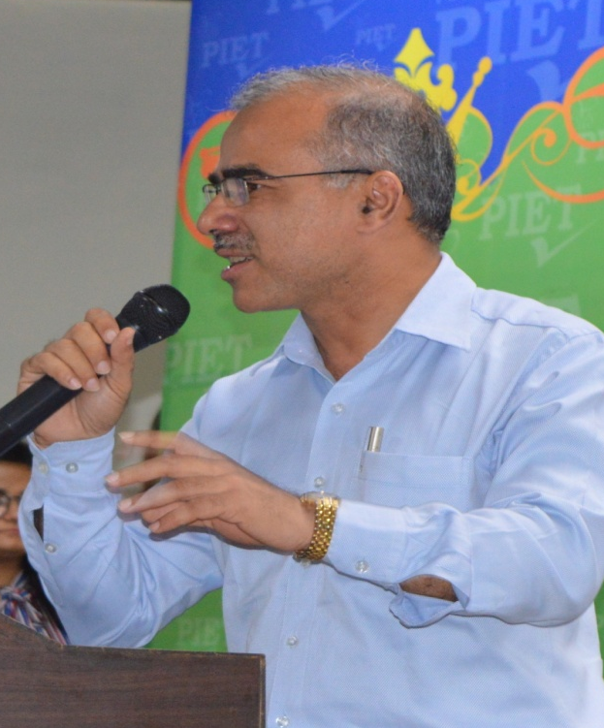
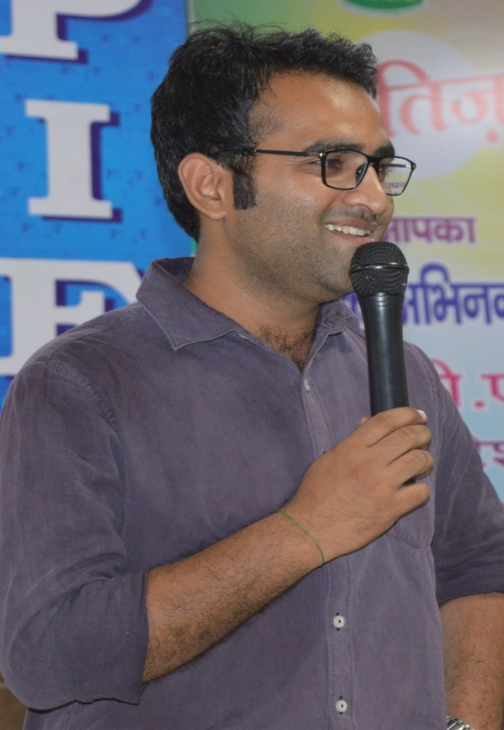
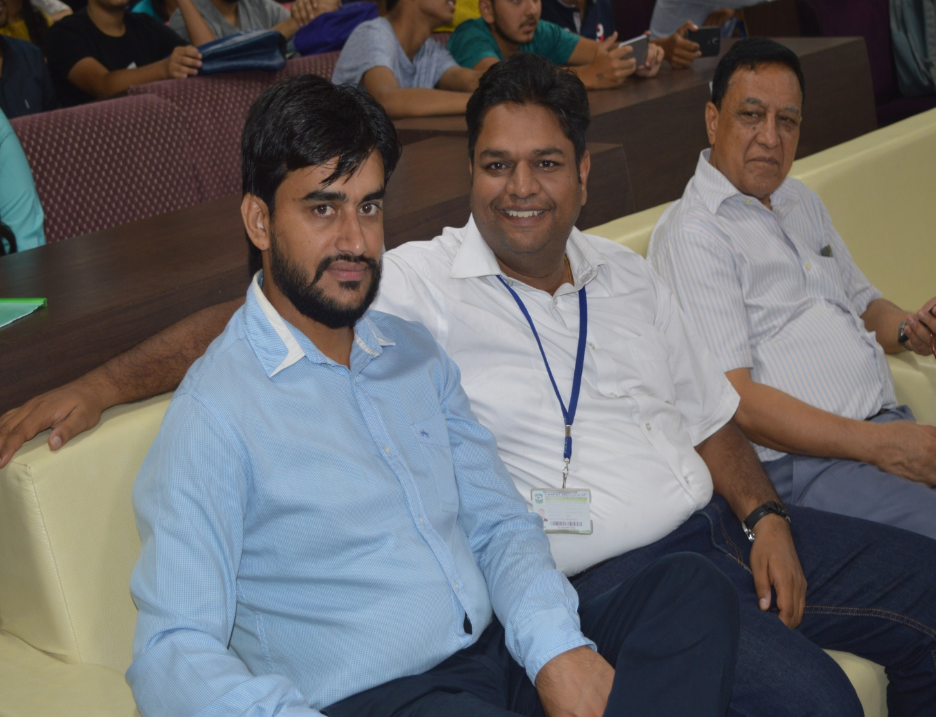
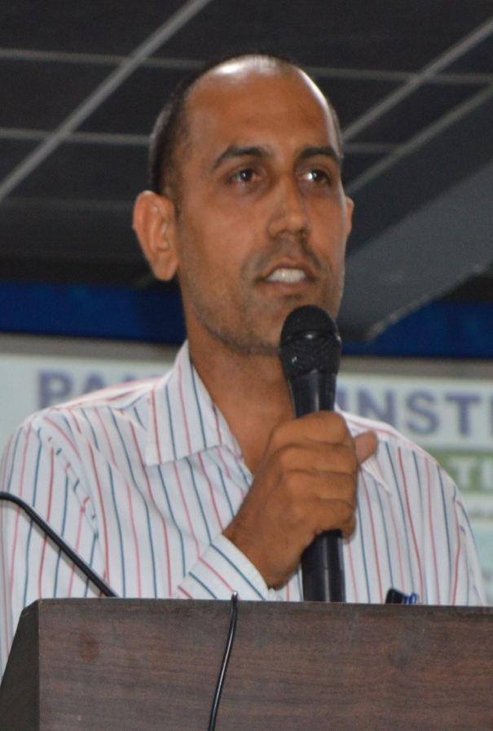
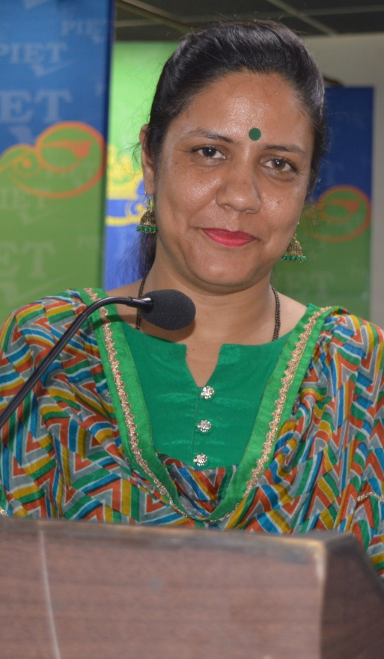
This day all belonged to the new comers. It was time for them to exhibit their skills on stage and it was discovered that today’s youth is full of enthusiasm and creative minded too.
13 July 2017

Slide 20
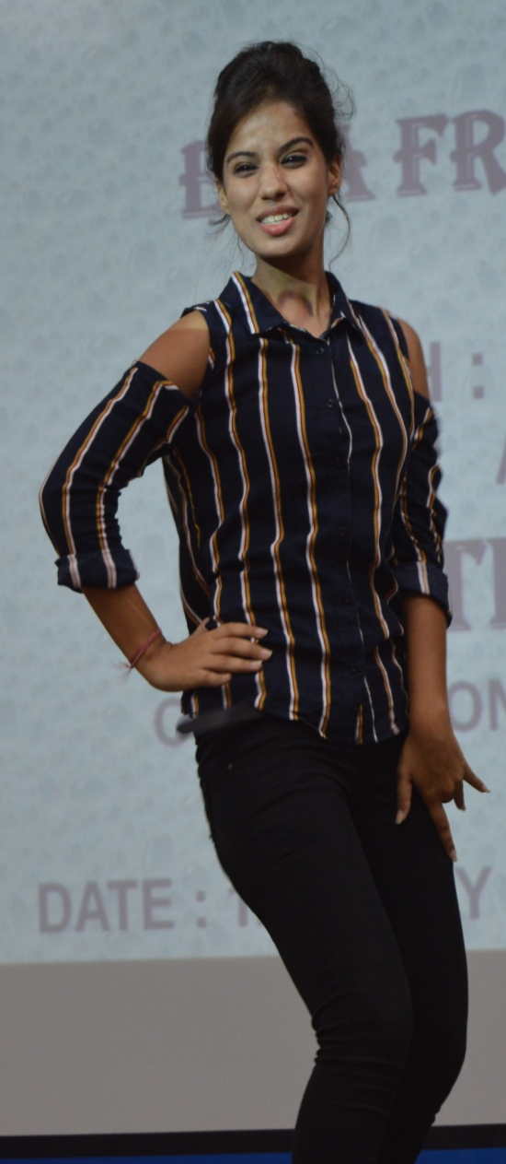
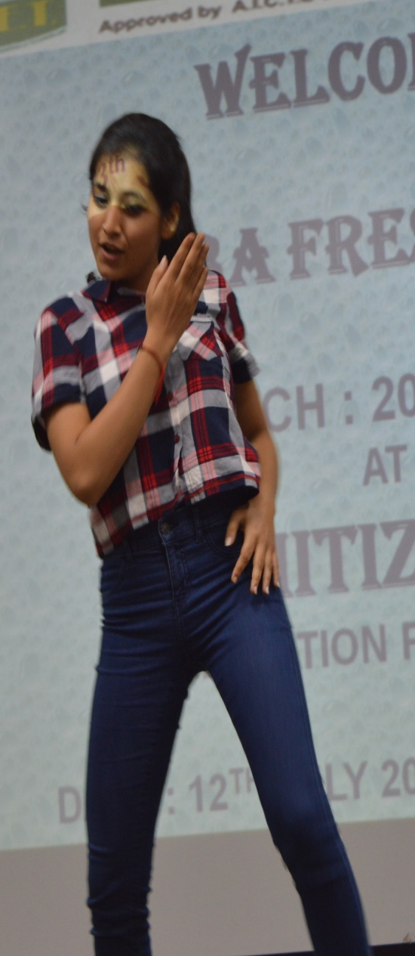
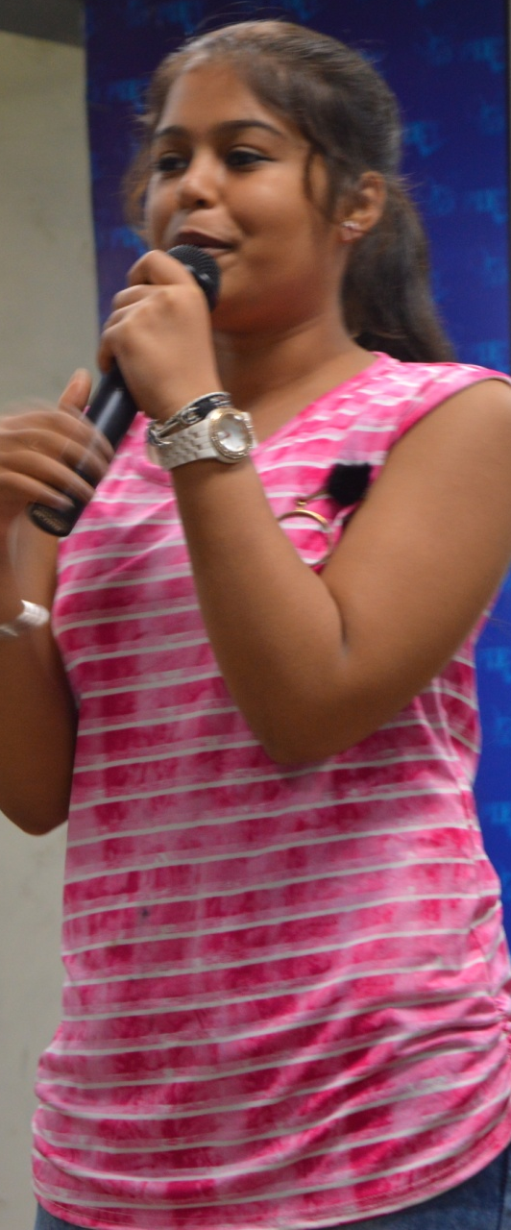
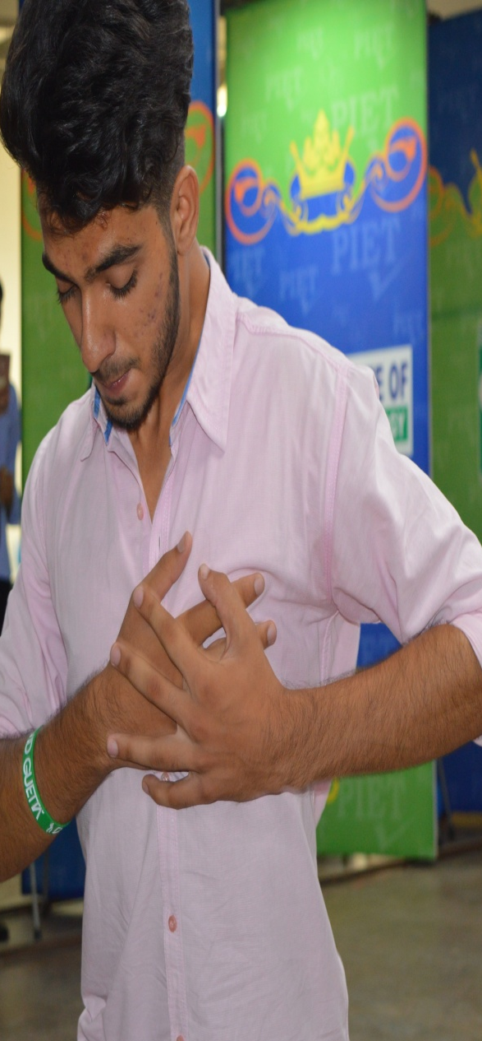
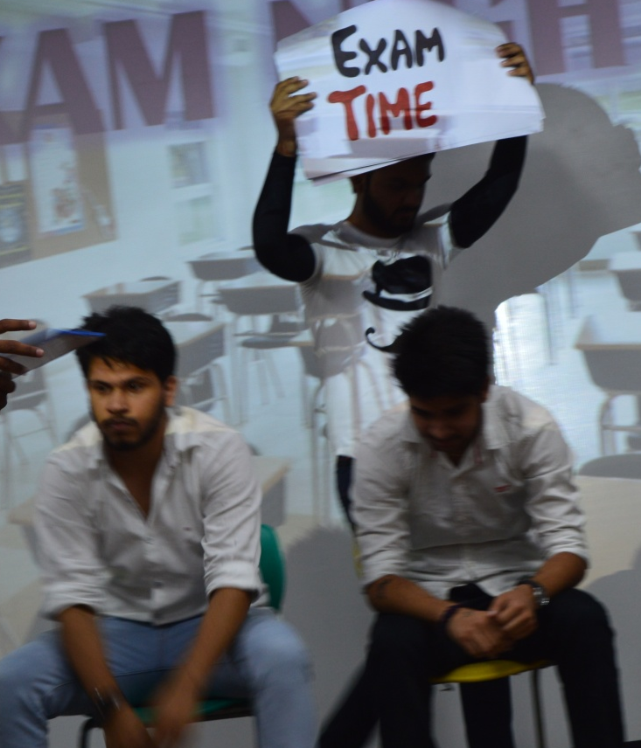
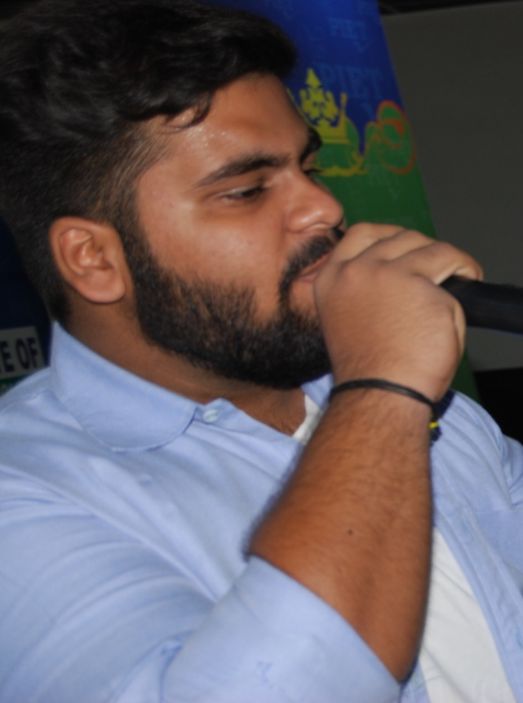
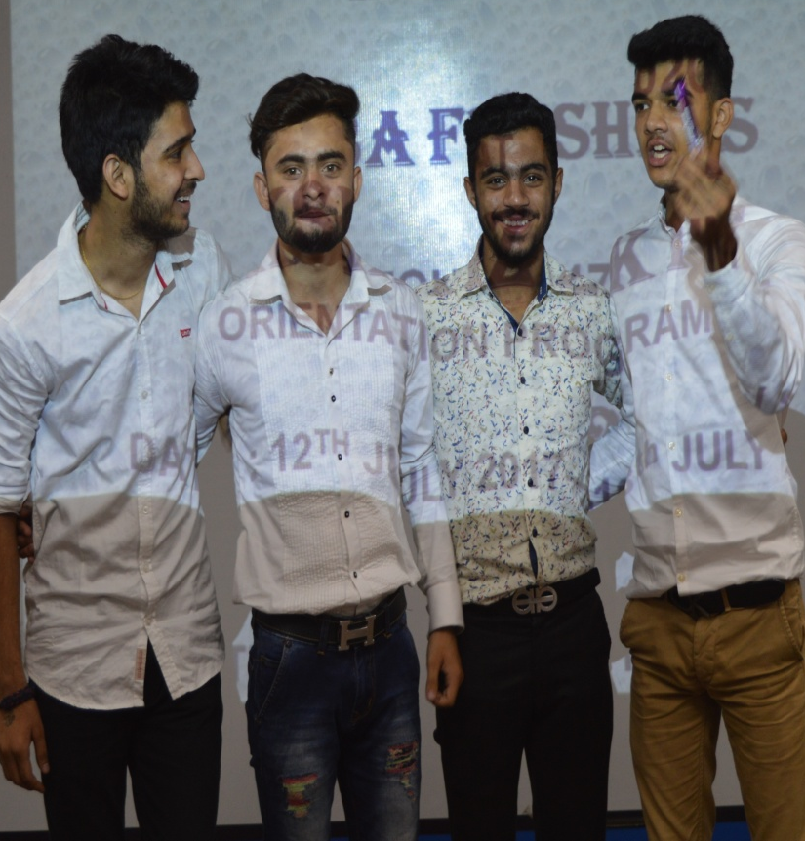
13 July 2017

Slide 21


Slide 22
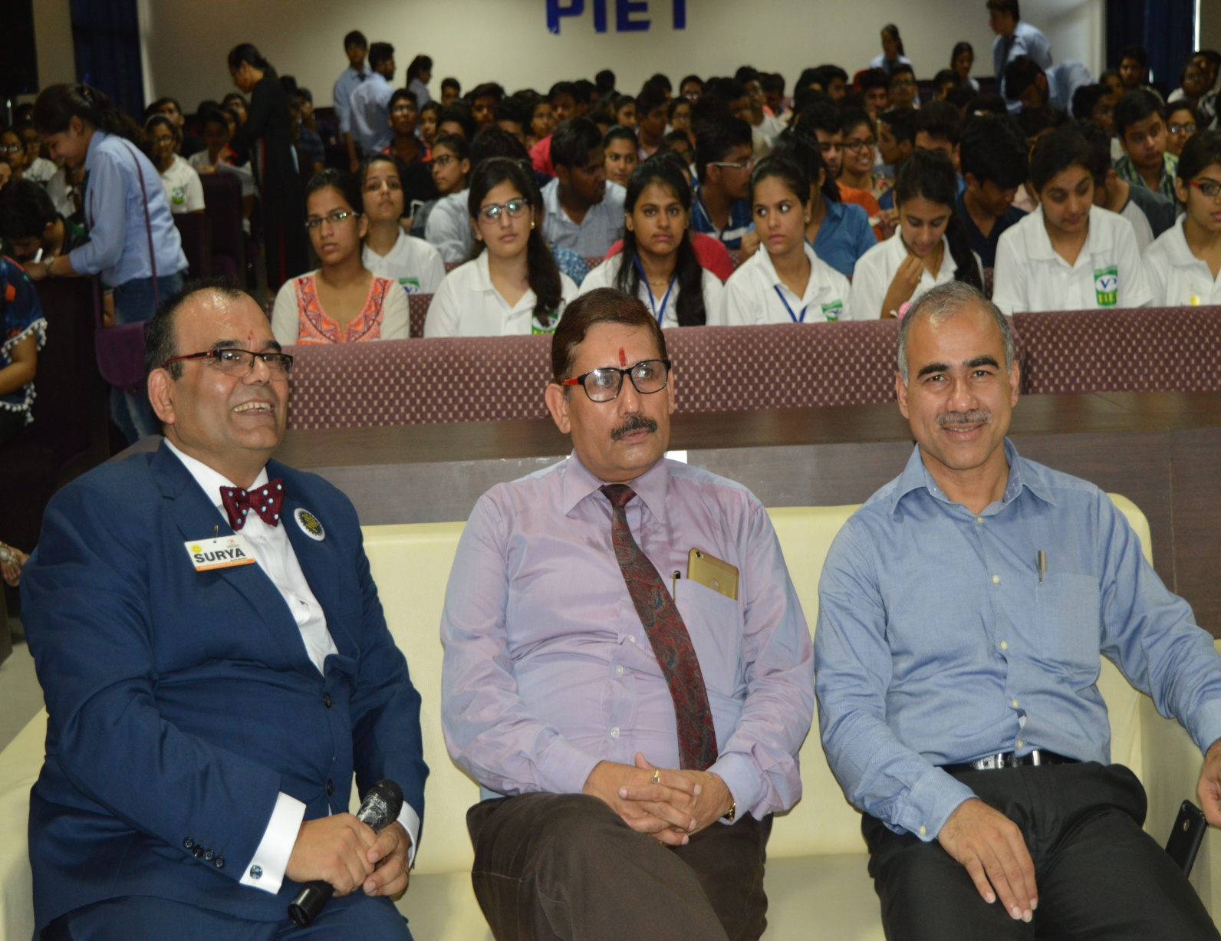
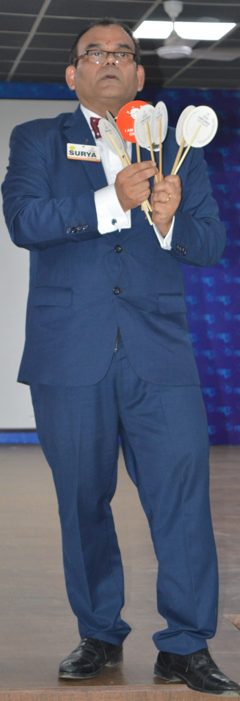
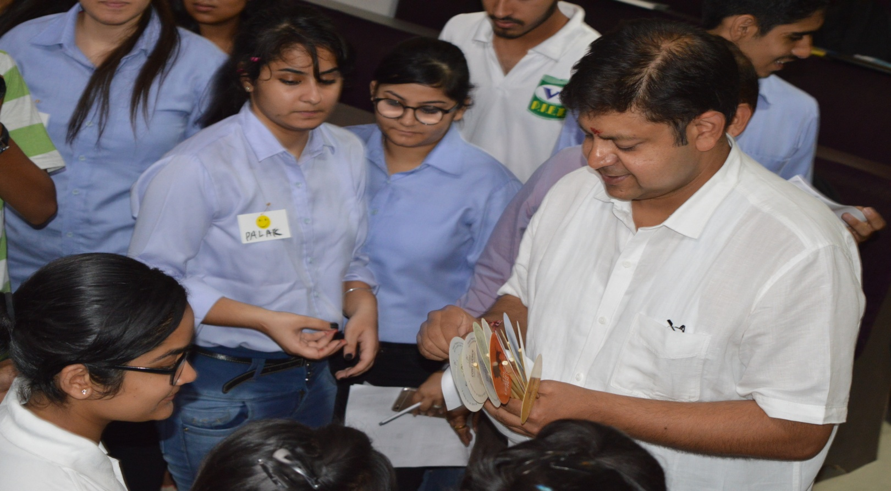
This day is always special which is handled by Mr. Surya, Managing Director of Confluence Organization. Mr. Surya is a a renowned motivator and trainer who make students learn with the help of game plays and other quiz activities. The smile on the their faces was a clear indicator of their understanding of being in the right college which would focus on the it over all development
19 July 2017

Slide 23
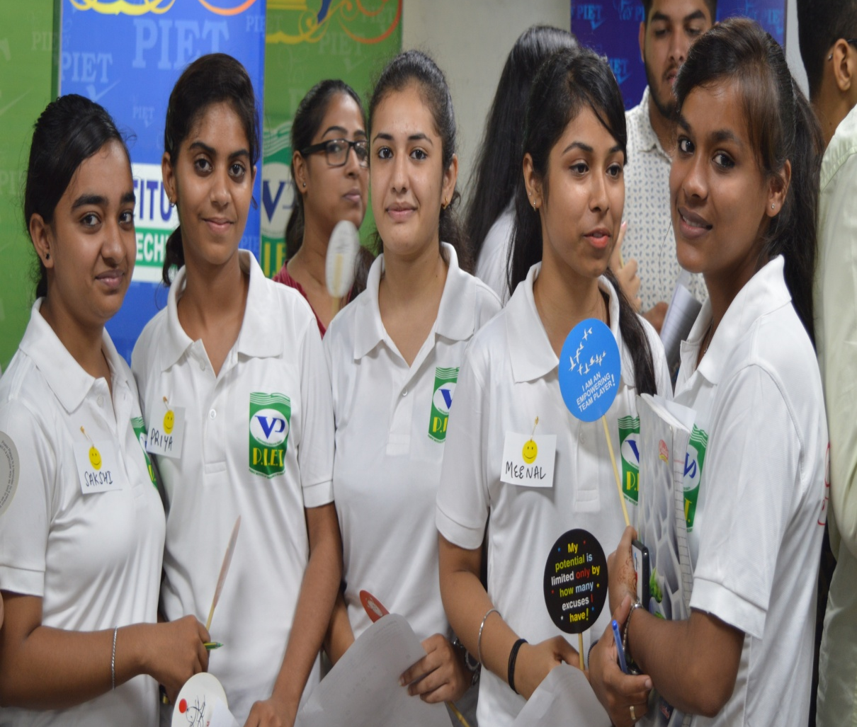
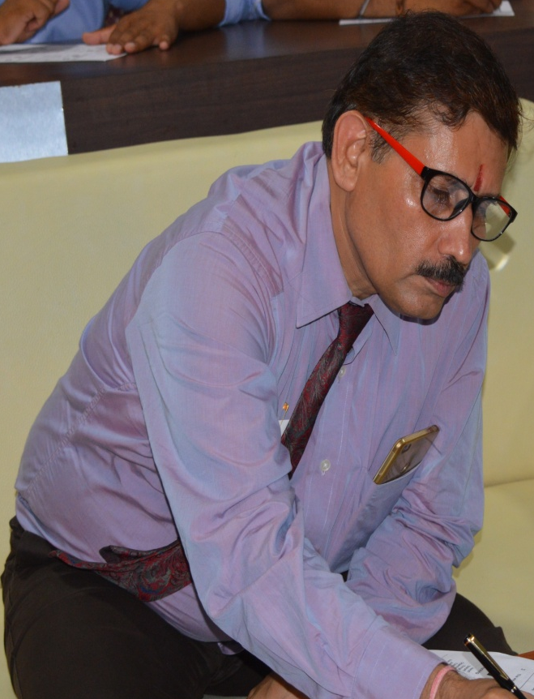
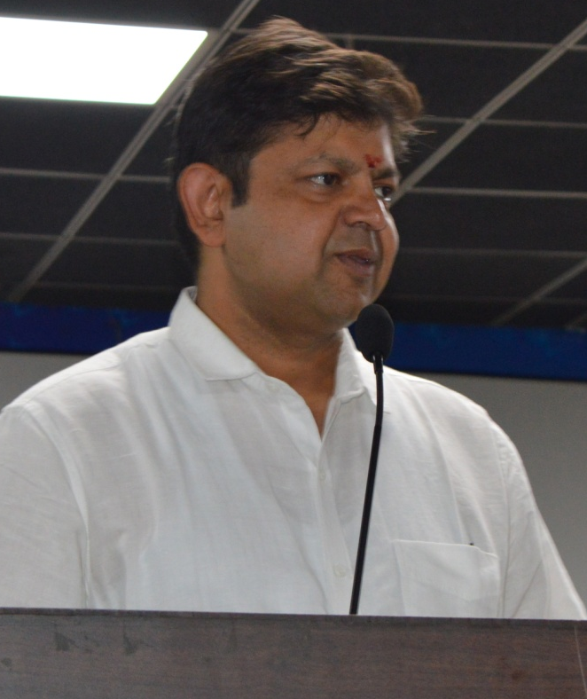
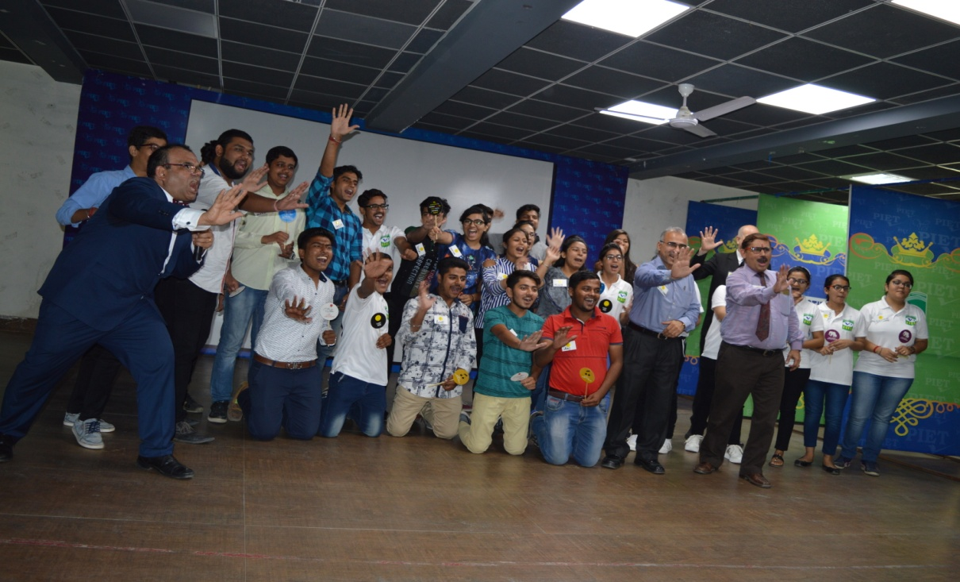
19 July 2017

Slide 24




Slide 25
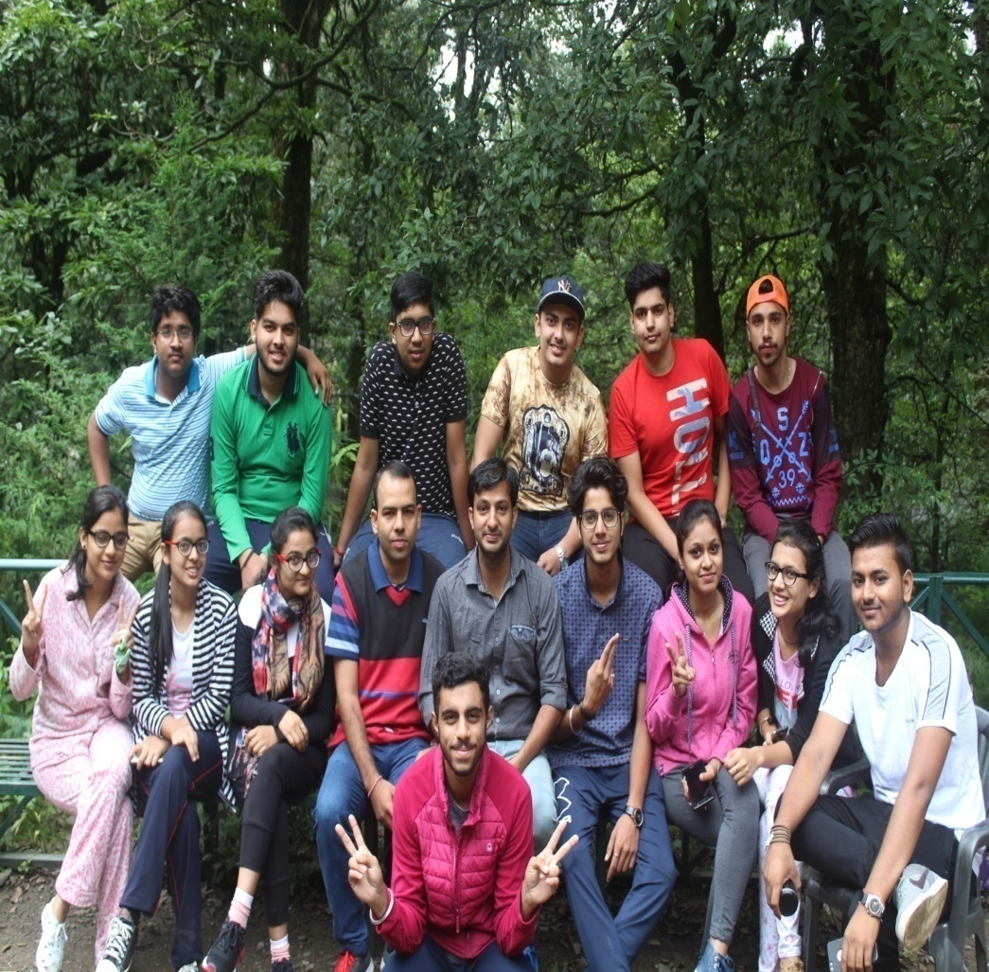
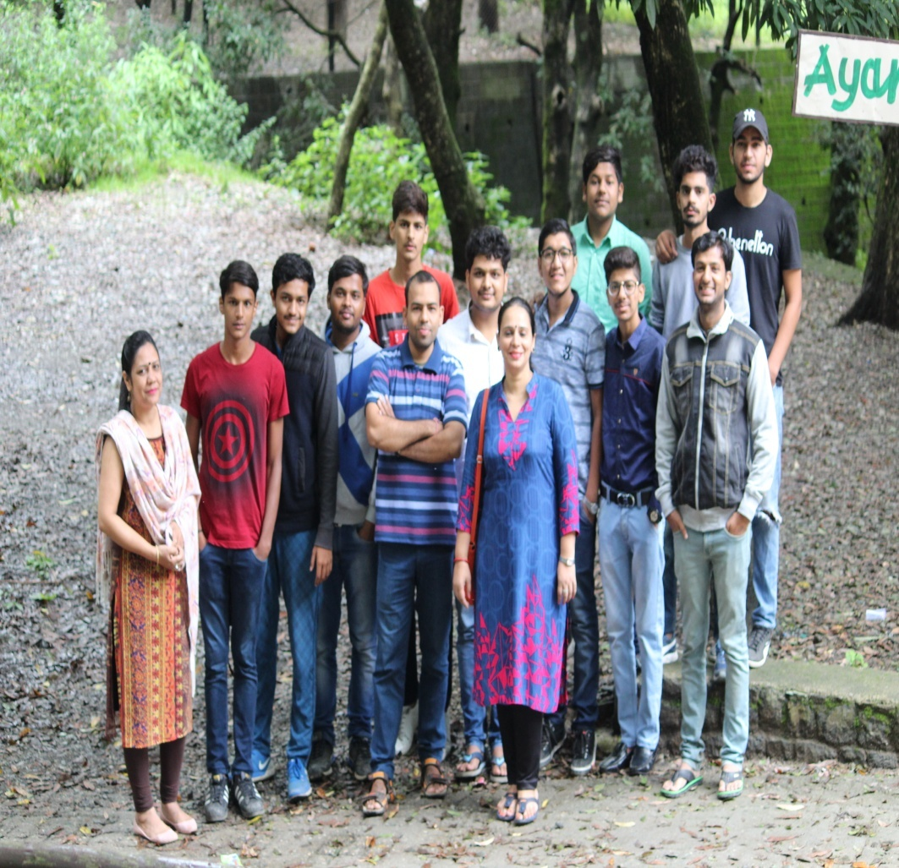
EDUCATIONAL CUM EXCURSION TOUR
22nd and 25th July were the days slated for two different groups of the new comer for a trip to Nainital, which is aimed at enjoyment, learning to adapt to new places and with new people and seeing new places which adds to their knowledge.

Slide 26
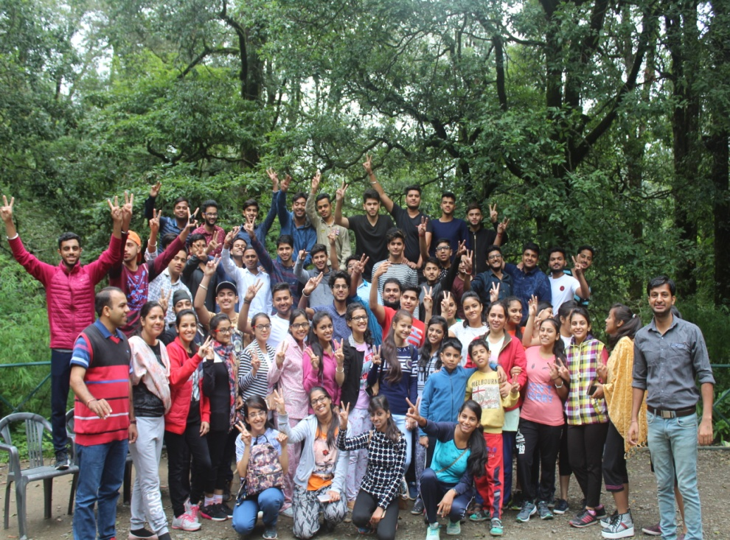




Slide 27



Slide 28



28 July 2017

Slide 29


BBA students attending Guest lecture on “Industrial Motivational campaign.” by Sh. Major Singh (Director MSME)
28 July 2017

Slide 30




Slide 31





A NSS camp was organized at Panipat Institute of Engineering and Technology, Samalkha from 24th July to 31st July 2017 in which about 100 volunteers participated actively to execute various events. These were ‘Youth for Development’, The Glory of India’, ‘Medical Camp’, woman empowerment, Tree plantation and Drug abuse.

Slide 32





24 to 31 July 2017

Slide 33



Slide 34

28th July was a day of industrial visit of 2nd year students to M/s Hindware, a sanitary ware manufacturing company. These visits are needed by students for a practical learning of the shop floor situations which adds to their managerial skills. A total 48 students availed this opportunity.
28 July 2017

Slide 35




28 July 2017

Slide 36



Slide 37

BBA HOD Dr. Yoginder S. Kataria sir Delivering expert lecture in One Week Short Term Course (STC) on “Design of Experiments and Advanced Optimization Techniques” (DEAOT-2017) from 10th to 14th July, 2017 organized by ME Dept. |He took session for faculty on “Emerging Trends in Technology and A Case Study on Fuzzy Logic” with practical on MATLAB.

Slide 38

BBA Faculties (Ms. Shilpa, Ms. Namita) receiving Certificates for attending in One Week Short Term Course (STC) on “Design of Experiments and Advanced Optimization Techniques” (DEAOT-2017) from 10th to 14th July, 2017 organized by ME Dept. |

Slide 39

Seven Habits of Highly Effective People
Expert Lecture – 31st July 2017
“Excellence is an art won by training and habituation. We are what we repeatedly do. Excellence, then, is not an act, but a habit” Aristotle

Slide 40

HOD sir Delivering expert lecture on “Seven Habits of effective People" to applied sciences students first year during bridge classes.
Attended by 120 students. Invited by HOD Applied sciences Dr. Vinay Khatri supported by Dr. Sudhir Mahajan and Prof. Arun Rana

Slide 41

Conoscenza – 2k17 – A student research program
HOD sir holding interactive and motivation session with students of BBA students to discuss various aspects of research. Active members of initiative include Dr. Ankur, Dr. Rajesh, Mr. Atul, Dr. Sangeeta, Ms. Shilpa, Dr. Sandeep, Ms. Namita. Among active students Ms. Shrishti Jain, Ms. Shivan Jain, Ms Kritika, Mr. Anshuman, Ms. Ananya, Mr. Gavish, Ms. Naina and Ms. Meenakshi.

Slide 42

He discussed various tools and techniques of research and provided detailed guide map to students covering issues like research paper writing, importance of research in industry, how research can help to build better career in data analytics and consultancy firms etc

Slide 43




Slide 44
BBA 4th Sem (Batch 2015-18)
S. No | Roll No | Name | Total Marks | Percentage | University Position
1 | 0005874382 | SHRISHTI JAIN | 0534 | 82.15% | 1st
2 | 0005874426 | VAISHALI | 0531 | 81.69% | 3rd
3 | 0005874207 | AKANT BHOLA | 0528 | 81.23% | 5th
4 | 0005874254 | DIMPLE RAHEJA | 0526 | 80.92% | 6th
5 | 0005874253 | GUNJAN | 0525 | 80.76% | 7th
6 | 0005874399 | SHIVANI | 0520 | 80% | 9th
7 | 0005874204 | TANUGUPTA | 0513 | 78.92% | 13th
8 | 0005874205 | GOURAV | 0511 | 78.68% | 14th
9 | 0005870279 | ANJALI GUPTA | 0511 | 78.68% | 14th
10 | 0005874171 | VANDANA BAJAJ | 0511 | 78.68% | 14th
11 | 0005874358 | JAYACHOPRA | 0509 | 78.30% | 15th
12 | 0005874367 | SUSHMITA DEWAN | 0506 | 77.84% | 16th
13 | 0005874328 | NISHA JAIN | 0505 | 77.69% | 17th
14 | 0005874189 | ADITI BAJAJ | 0505 | 77.69% | 17th
15 | 0005874319 | MEENAKSHI SEHGAL | 0501 | 77.07% | 19th
16 | 0005874312 | SHRISTHI MITTAL | 0501 | 77.07% | 19th

Slide 45



Slide 46

BBA, HOD
(Dr. Yoginder Singh Kataria)
BBA, E-Committee
(Mr. Jagmohan Malhotra)
(Ms. Sakshi Garg)

