Slide 1
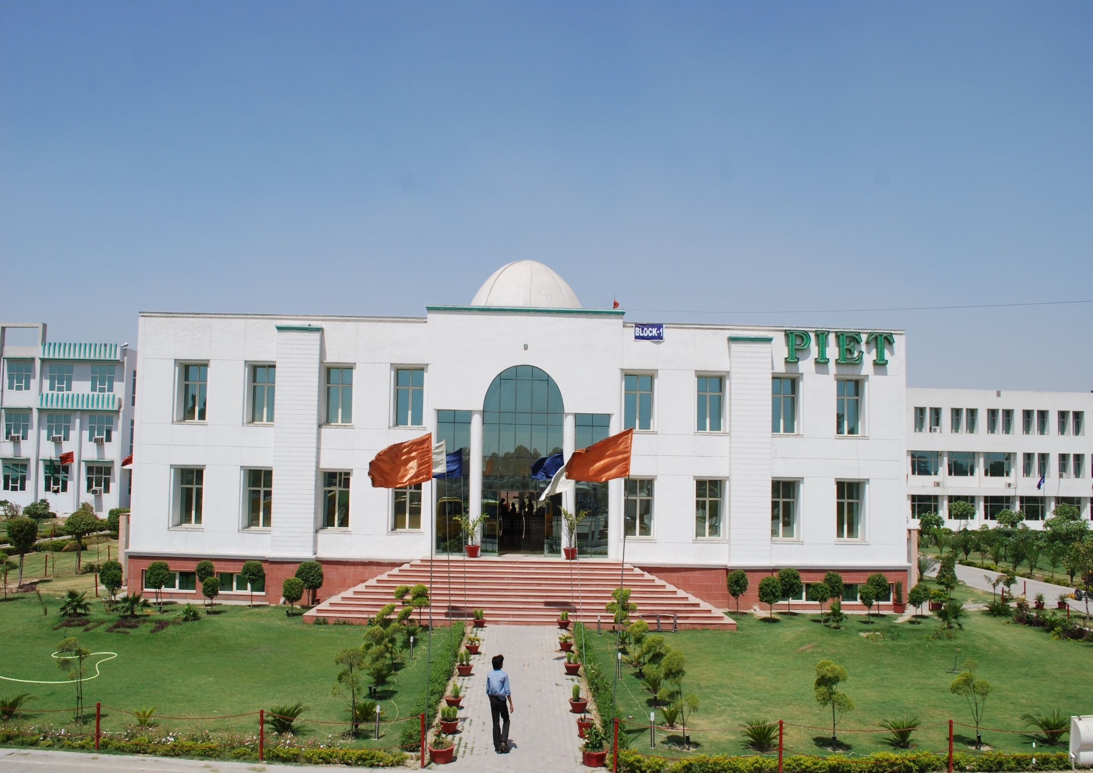


Slide 2





Slide 3


Slide 4


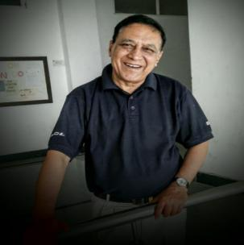
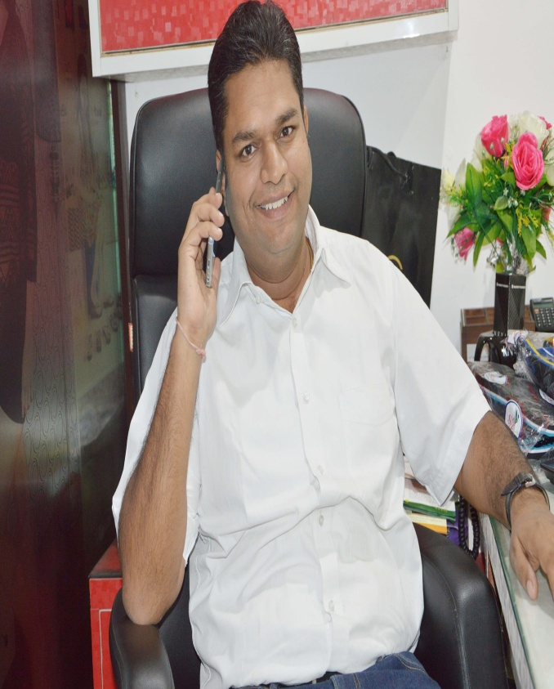
This Magazine is a team work to bring to surface the happenings around the calendar month it relates to. This in turn serves as a motivating factor for the whole lot of students who get encouraged to participate all the more.
Each month, our team of editors, designers and photographers innovate presentation in addition to generating creative content for the student population, work extensively to report on events in and around college. The final publication reflects and encompasses the diversity inherent to the academic and extra curricular spaces in BBA department.
The magazine continues to expand its reach to achieve its vision of being a truly representative student projection publication. We have recently expanded from reporting about college events to reporting about student participation and achievements. The team hopes to build on this ethos just as much in the upcoming issues.
Wishing you brilliant times ahead with an energy level to burn mid night lamps,

Slide 5
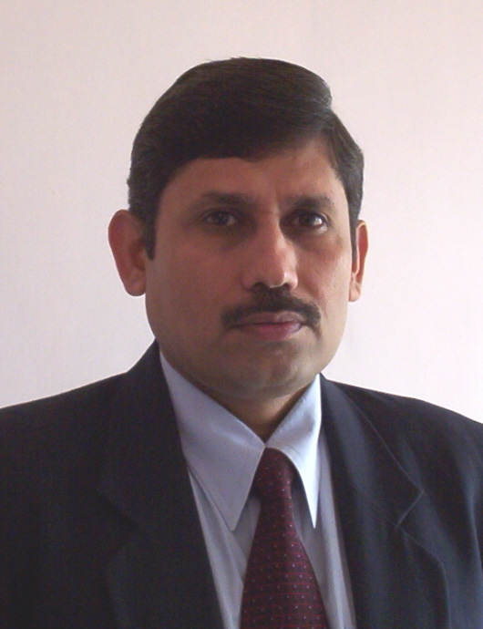

Dr. Yoginder Singh Kataria, HOD, BBA

Slide 6
FROM THE HOD’s DESK
Of late the benefits of BBA have been exceptionally expressed in terms of increased earnings and improved financial performance of the organizations employing them. These days a BBA degree is viewed as an elitist qualification, available to an exclusive group of selected students who underwent a rigorous academic programme with a strong emphasis on quantitative and analytical skills clubbed with on job project work for a deeper insight into the business world scenario and the situations he would face when in job. This in fact has made the qualification more attractive to employers. Over and above enhanced earnings for graduates, and improved financial performance for the organizations employing them, the relevance of the BBA has widened to embrace the needs of individuals and organizations in the private and public sectors.
The hard and consistent work on the part of the student has its accompanying rewards. Employers, no longer perceive the BBA as simply representing theoretical knowledge, inadequate understanding of the real world and high salary demands. Rather, they see the BBA, associated with experience and organizational achievements, as enhancing graduates’ flexibility, the ability to embrace change, innovation and a range of other attributes required for success in a fluid organizational and business environment.

Slide 7
May I reiterate that all big and small events like BBA Star, staging skits, talent hunt, encouraged participation in stage anchoring, owning coordinating and managing roles in Carbuncle, Maestros and the most prestigious of all PIET Quest are nothing but a way to push you all from behind to be strong enough to face the reality. The on job Project Work is another tool, the last one at college level, to make you stand strongly at your own feet. I would expect the coming year seniors to understand the importance of the same and determine to make more serious efforts in this direction.
While you are already off to a new start of the semester once you get free from the forthcoming exams slated in December, I wish you all success for a glorious finish for the effort put in by you during these months.
Dr. Yoginder Singh Kataria
HOD,BBA

Slide 8

Student Development Workshop on
“How to excel in University Exams”
03/November/2017

Slide 9
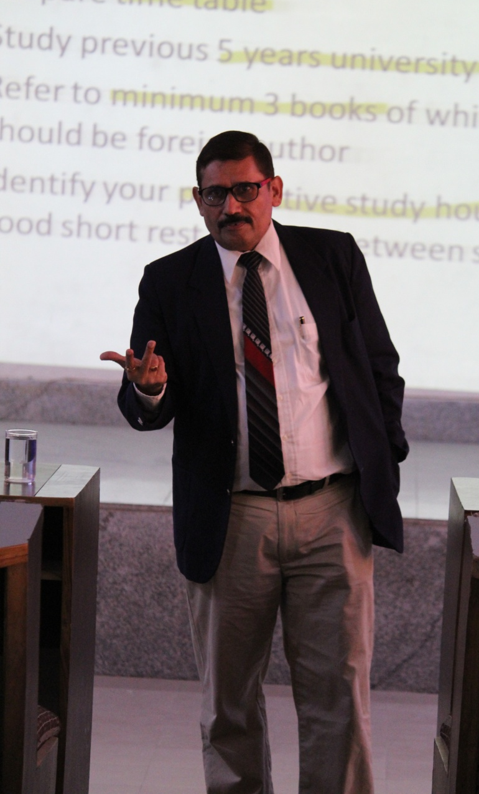
Student Development Workshop on
“How to excel in University Exams”
While the exams are declared a seminar was held for the brilliant students on the subject ‘How to Excel in Exams’.
The seminar was conceived by Dr. Yoginder Kataria and presented by him with Shachi Mam and Kataria sir.
Adding value to the topic Pof. K K Paliwal, Director PIET said, “As a student you should not limit yourself to the four corners of the class room. To expand your potential create the 5th corner, which is nothing but your own self.”
Worthy Director sir were very appreciative about such programs being planned in BBA.

Slide 10
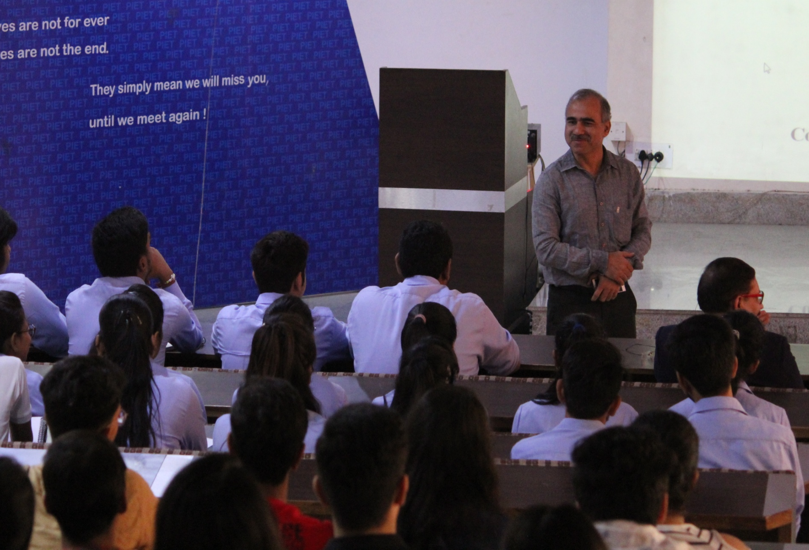
Prof. K K Paliwal, Director PIET speaking to the students on the occasion. He advised them to follow the ‘no stress’ principal which says Don’t look back, stay focused on upcoming papers.

Slide 11
Dr. Yoginder Kataria, HOD, BBA advised them about nurturing good habits, do’s and dont’s and how to have good time management during exam.
He further added that “opportunity meets the prepared mind”. He advised students not to have the habit of comparing your preparedness with that of your friends to stay motivated. He suggested techniques of answering different types of questions and various strategies that will help them differentiate and score better.

Slide 12
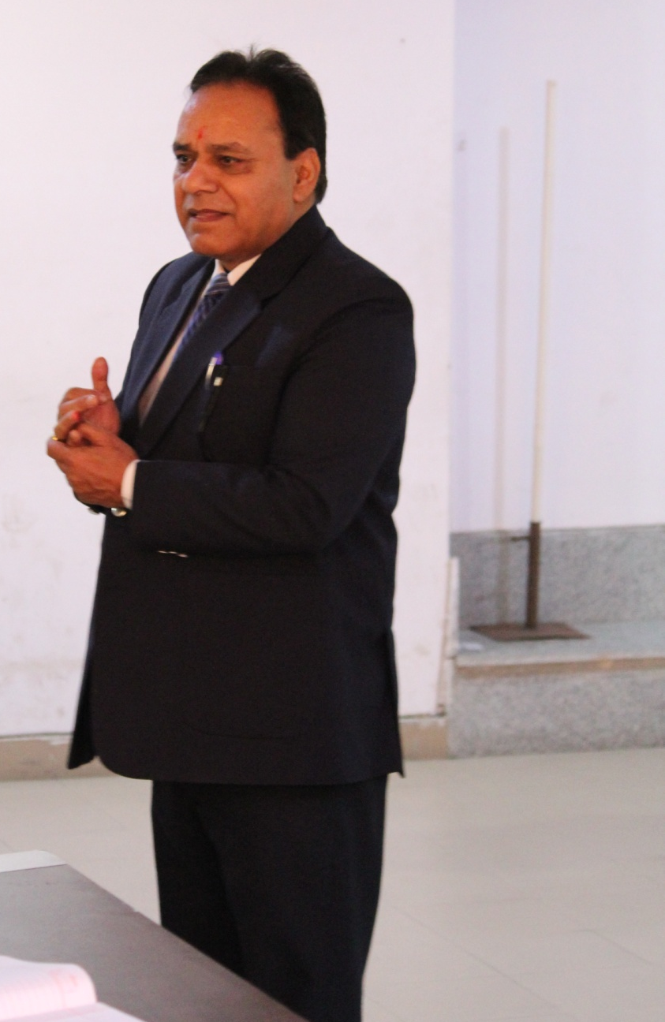
Speaking to the students Dr. B B Sharma, Dean Student Welfare said that you are going to appear in a written examination so marks will be given only on the basis of what has been written in the paper and not on the basis of how much you know. Preparing for the exams by doing writing practice helps you in improving your speed and handwriting. This will help you finish the paper in time and revise it before submission, thus reducing the possibility of silly mistakes.

Slide 13
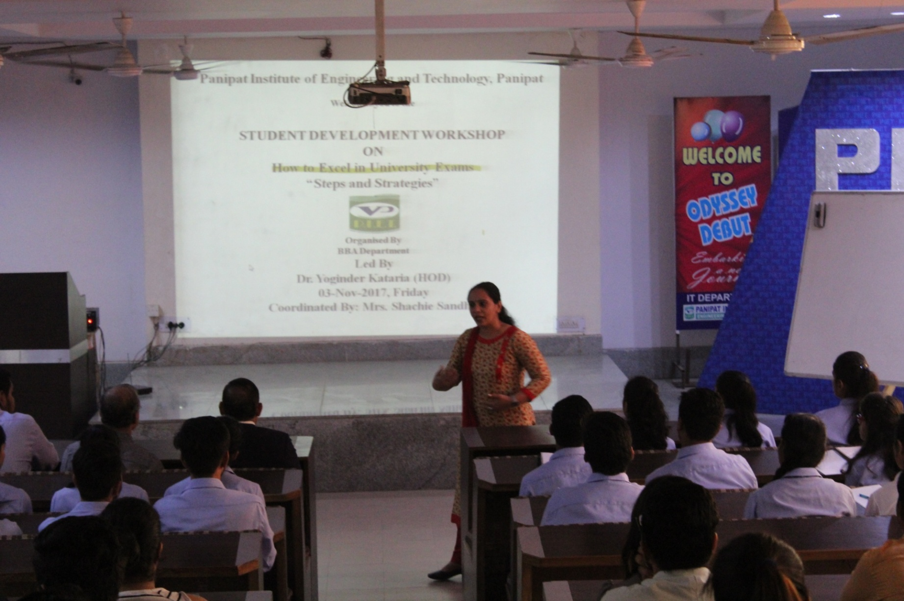
On the same subject Shachie Mam said that staying motivated is one of the most important requirements for students appearing in university exams. Your performance in the exams depends in a big way on how motivated you are and how you maintain it throughout the exam period

Slide 14


Achievers, Benefactors & Regulars

Slide 15




Slide 16
Panipat Institute of Engg.& Tech BBA 1st YR -A
Sr.No | Class | Roll No. | Name | Remarks
1 | BBA 1st | 17005 | Suman | Regular
2 | BBA 1st | 17171 | Nidhi | Achiever
3 | BBA 1st | 17143 | Dishant | Benefactor
BBA 1st YR -B
Sr.No | Class | Roll No | Name | Remarks
1 | BBA 1st | 17008 | Ankush | Regular
2 | BBA 1st | 17244 | Nimi | Achiever
3 | BBA 1st | 17015 | Sahil | Benefactor
BBA 1st YR -C
Sr.No | Class | Roll No | Name | Remarks
1 | BBA 1st | 17078 | Mehak | Regular
2 | BBA 1st | 17182 | Charu | Achiever
3 | BBA 1st | 17139 | Sakshi Bhutra | Benefactor
BBA 1st YR -D
Sr.No | Class | Roll No. | Name | Remarks
1 | BBA 1st | 17251 | JAHNVI | Regular
2 | BBA 1st | 17031 | JASIKA ARORA | Achiever
3 | BBA 1st | 17229 | DHRITI BHUTRA | Benefactor
BBA 1st YR -E
Sr.No | Class | Roll No | Name | Remarks
1 | BBA 1st | 17191 | Aireen Khan | Regular
2 | BBA 1st | 17039 | Tapsi Katyal | Achiever
3 | BBA 1st | 17225 | Aman Goel | Benefactor

Slide 17
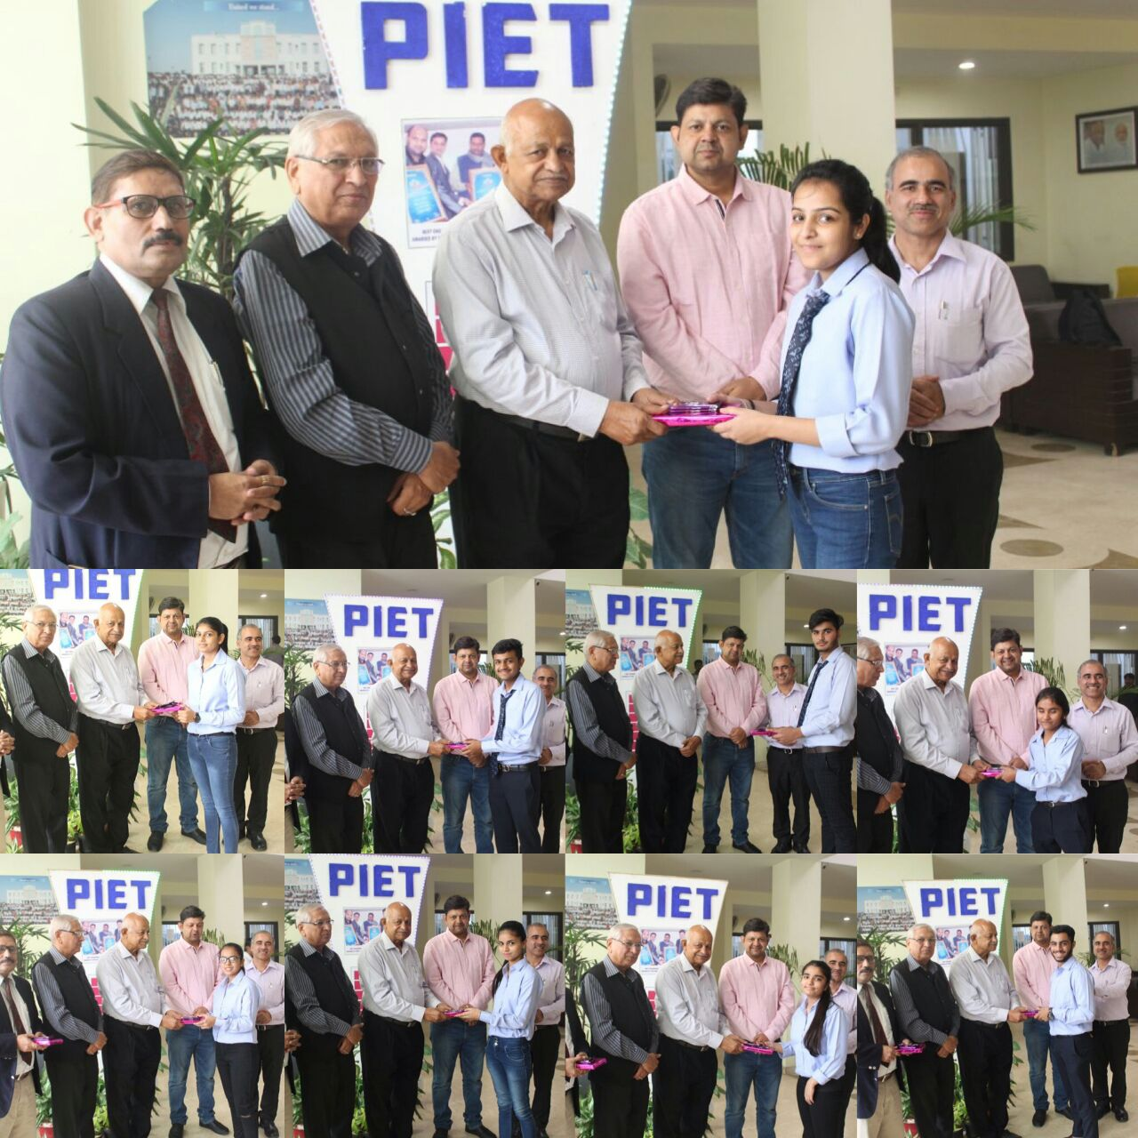
BBA 1st Year

Slide 18
Panipat Institute of Engg.& Tech BBA 2nd YR -A
Sr.No | Class | Roll No. | Name | Remarks
1 | 2nd YR | 16006 | TWINKLE | Achiever
2 | 2nd YR | 16311 | PAVNI | Regular
3 | 2nd YR | 16159 | RISHABH JAIN | Benefactor
BBA 2nd YR -B
Sr.No | Class | Roll No | Name | Remarks
1 | 2nd YR | 16287 | Rishabh | Achiever
2 | 2nd YR | 16144 | Neeraj | Regular
3 | 2nd YR | 16188 | Gavish | Benefactor
BBA 2nd YR -C
Sr.No |  | Roll No | Name | Remarks
1 | 2nd YR | 16156 | Tanya | Regular
2 | 2nd YR | 16096 | Nancy | Achiever
3 | 2nd YR | 16066 | Hari | Benefactor
BBA 2nd YR -D
Sr.No | Class | Roll No. | Name | Remarks
1 | 2nd YR | 16058 | Aarzoo | Regular
2 | 2nd YR | 16001 | Ashima | Achiever
3 | 2nd YR | 16148 | Shubham Gupta | Benefactor
BBA 2nd YR -E
Sr.No | Class | Roll No | Name | Remarks
1 | 2nd YR | 16134 | Shivam Kapoor | Regular
2 | 2nd YR | 16284 | Lashit | Achiever
3 | 2nd YR | 16268 | Tanya | Benefactor

Slide 19
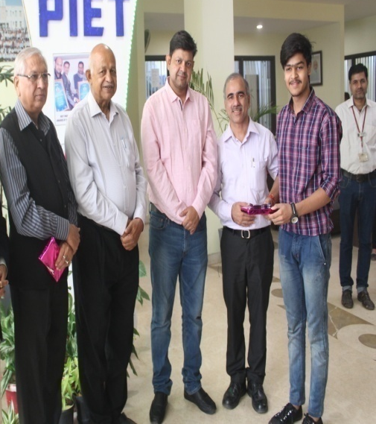
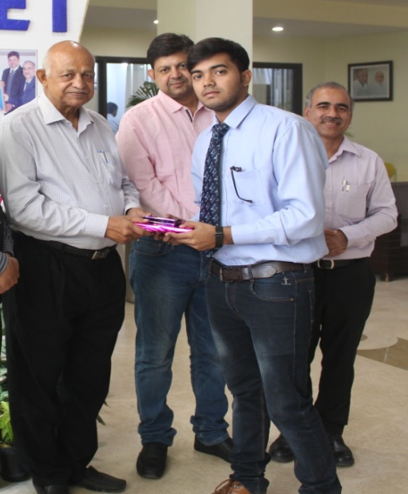
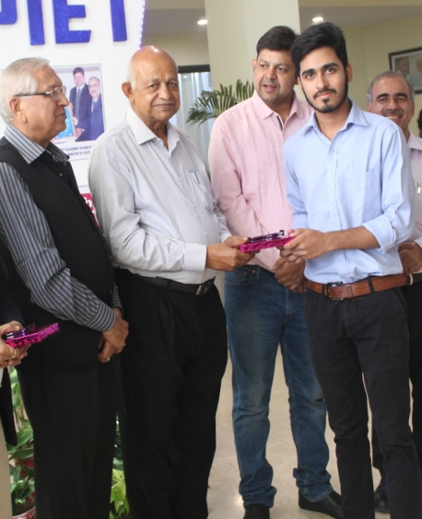
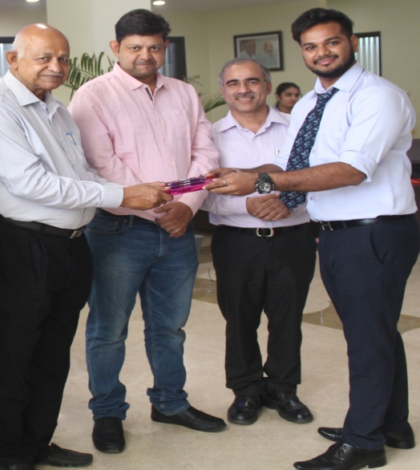
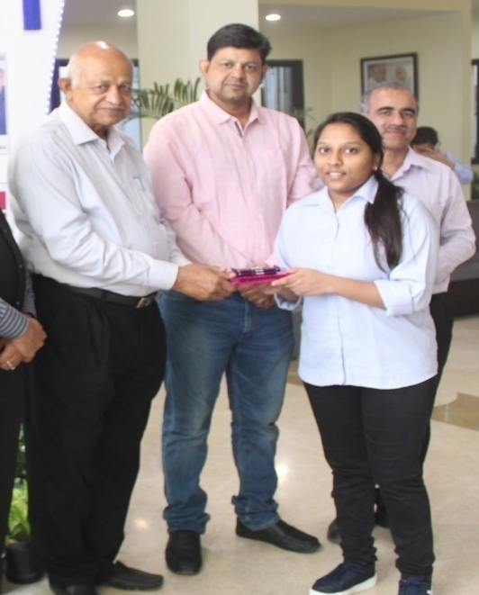
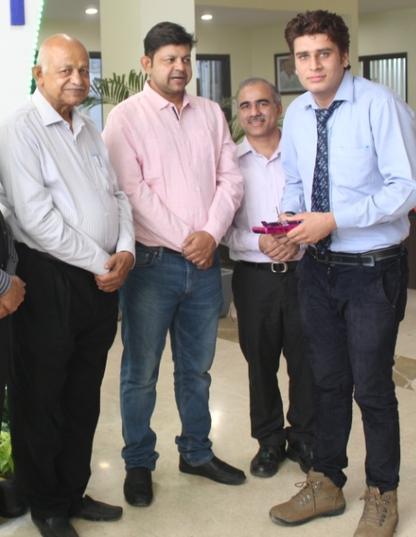
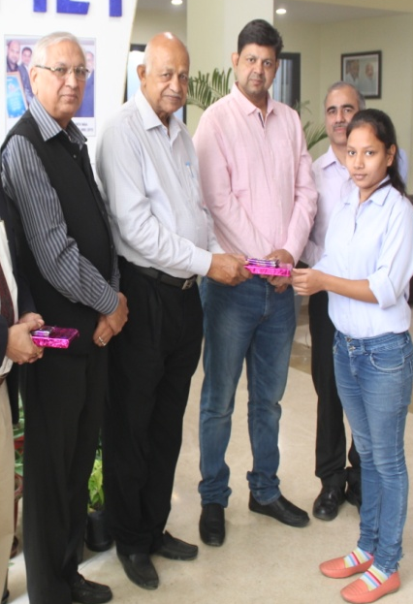
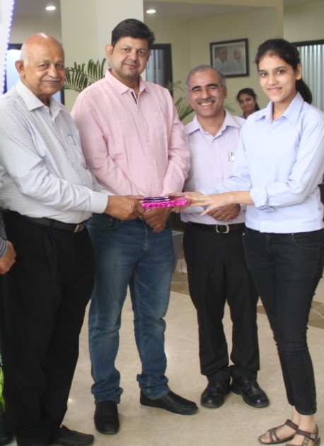
BBA 2nd Year

Slide 20
Panipat Institute of Engg.& Tech BBA 3rd YR -A
Sr.No | Class | Roll No. | Name | Remarks
1 | 3rd Yr | 15005 | Naina Guglani | Regular
2 | 3rd Yr | 15264 | Gunjan | Achiever
3 | 3rd Yr | 15041 | Meenakshi | Benefactor
BBA 3rd YR -B
Sr.No | Class | Roll No | Name | Remarks
1 | 3rd Yr | 15043 | Gazal | Regular
2 | 3rd Yr | 15172 | Vandana | Achiever
3 | 3rd Yr | 15122 | Nikhil | Benefactor
BBA 3rd YR -C
Sr.No | Class | Roll No | Name | Remarks
1 | 3rd Yr | 15106 | Vishav Garg | Regular
2 | 3rd Yr | 15105 | Shrishti Jain | Achiever
3 | 3rd Yr | 15294 | Rishabh Batra | Benefactor
BBA 3rd YR -D
Sr.No | Class | Roll No. | Name | Remarks
1 | 3rd Yr | 15310 | Anjali | Achiever
2 | 3rd Yr | 15222 | Sagar | Regular
3 | 3rd Yr | 15215 | Akant | Benefactor

Slide 21
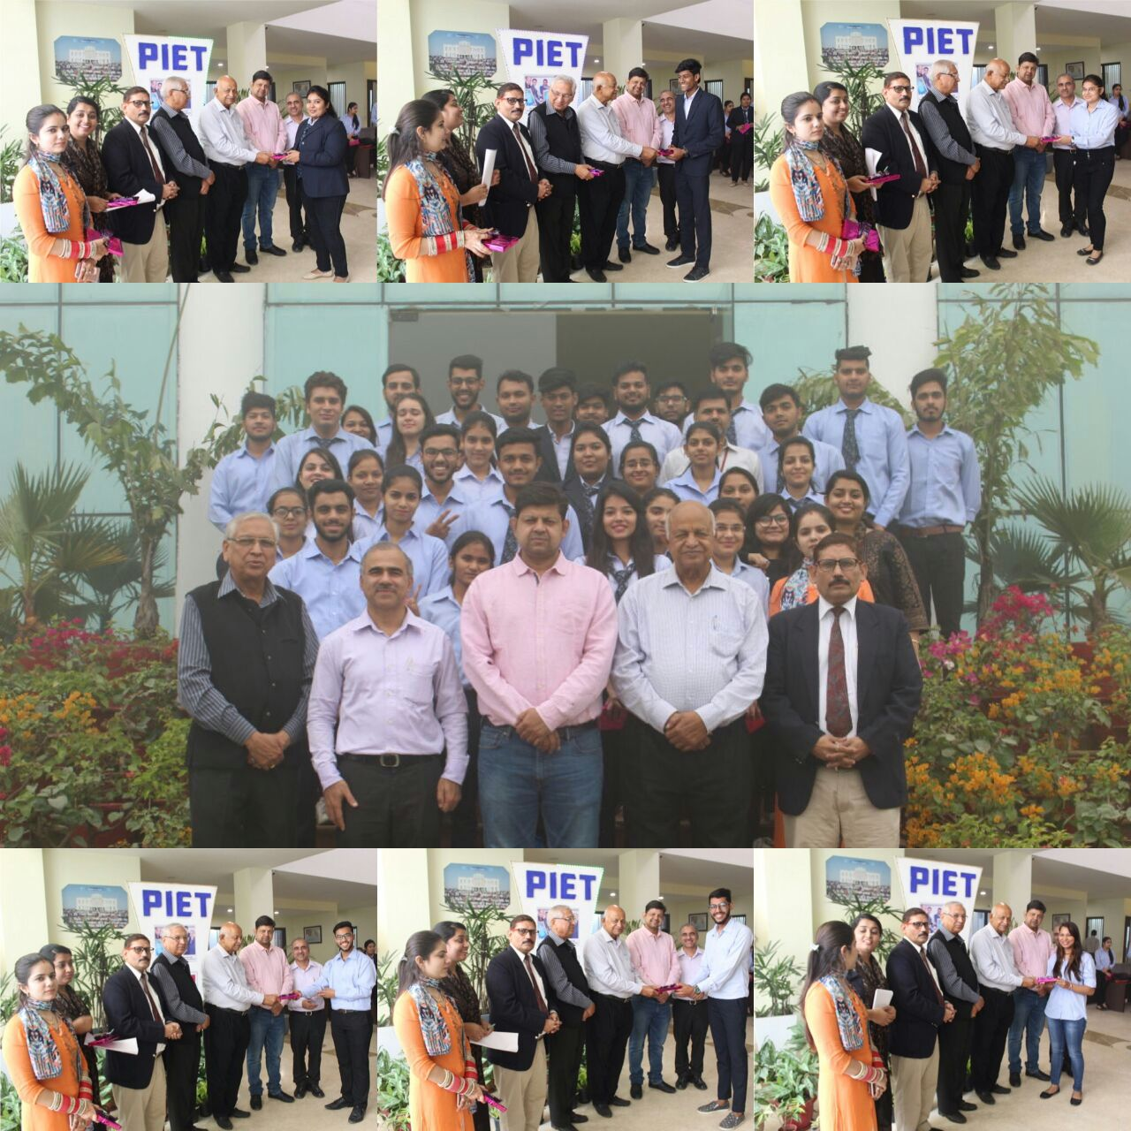
BBA 3rd Year

Slide 22


Slide 23
PIET
Dept. Of Management Studies
Welcomes
Sh. Surinder Kumar Babbar, Asstt. Commissioner
Sh. Satvender Gaur, Superintendent, GST Seva Kendra

Slide 24


GST AWARENESS CAMPAIGN
Office of Assistant Commissioner , Panipat
7th November,2017

Slide 25
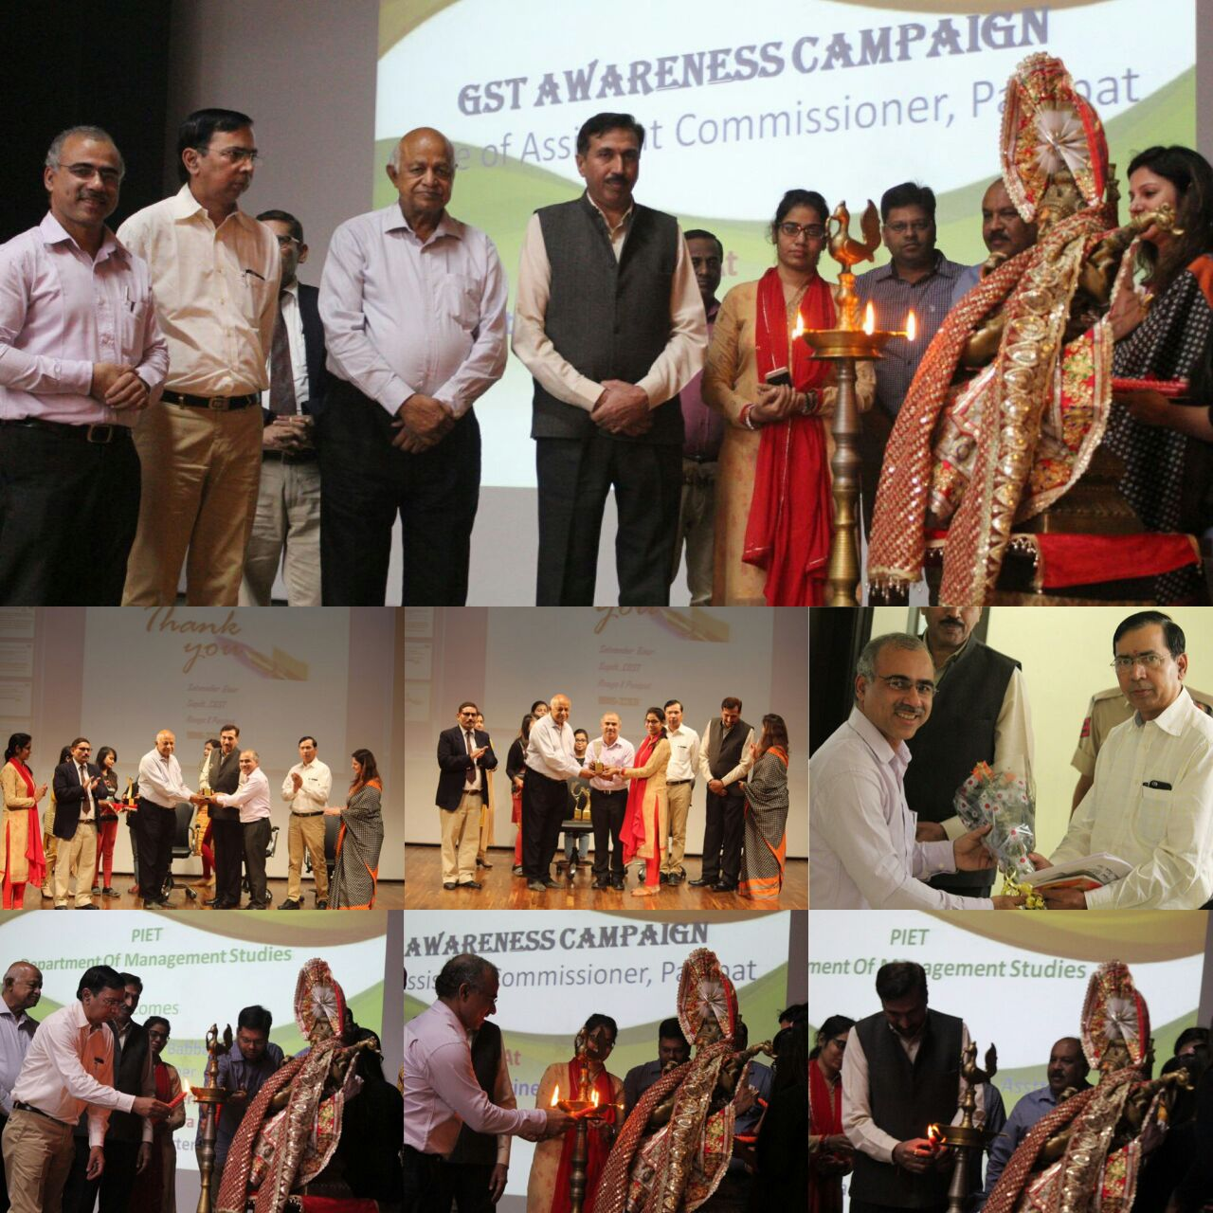
Shri Surinder Kumar Babbar, Asstt. Commissioner GST Seva Kendra, Panipat initiated an awareness session at PIET with an aim to prepare India for the migration from the old tax regime to the new reformed GST (Goods & Services Tax) regime. Now that almost the entire nation is GST-registered, the facilitation center or the GST Help Desk is all ears to their GST-related queries such as GST registration, GST migration and GST return filing. The seminar was attended by the leading industrialists of Panipat and there was an expert ‘question-answer’ sprint which helped the attendees to understand the in depth aspects of GST.

Slide 27
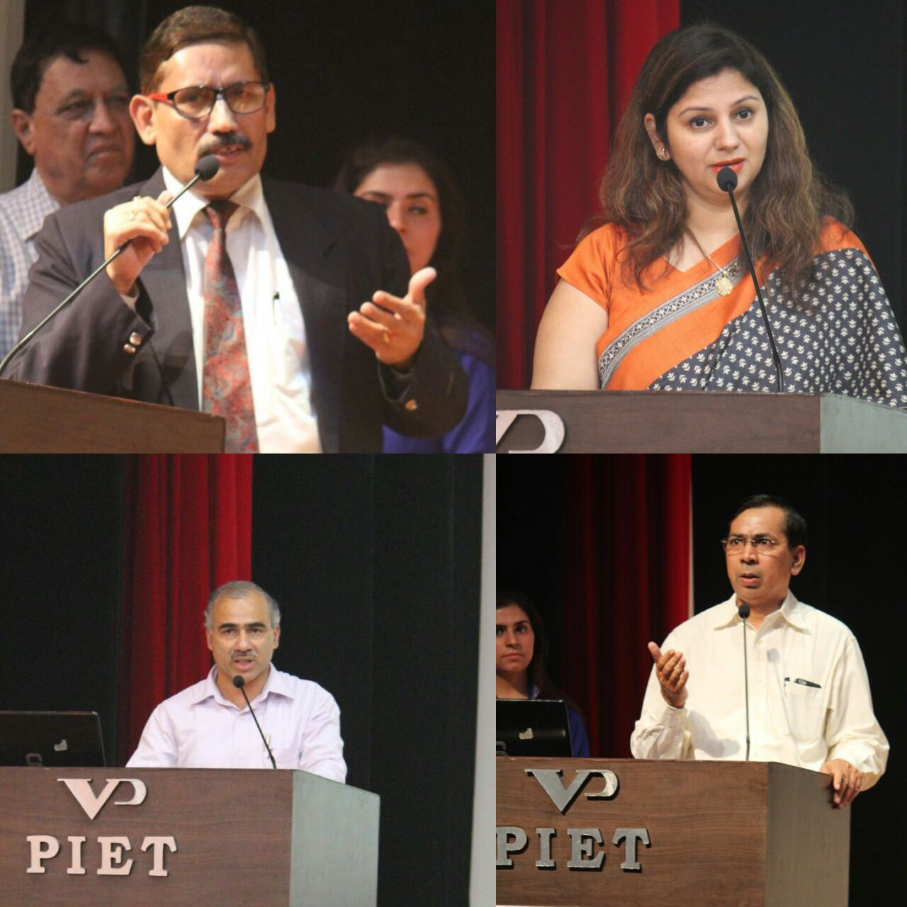
Interestingly the question-answer part was well participated by Prof. K K Paliwal, Director PIET and Dr. Yoginder Kataria, HOD, BBA.

Slide 28
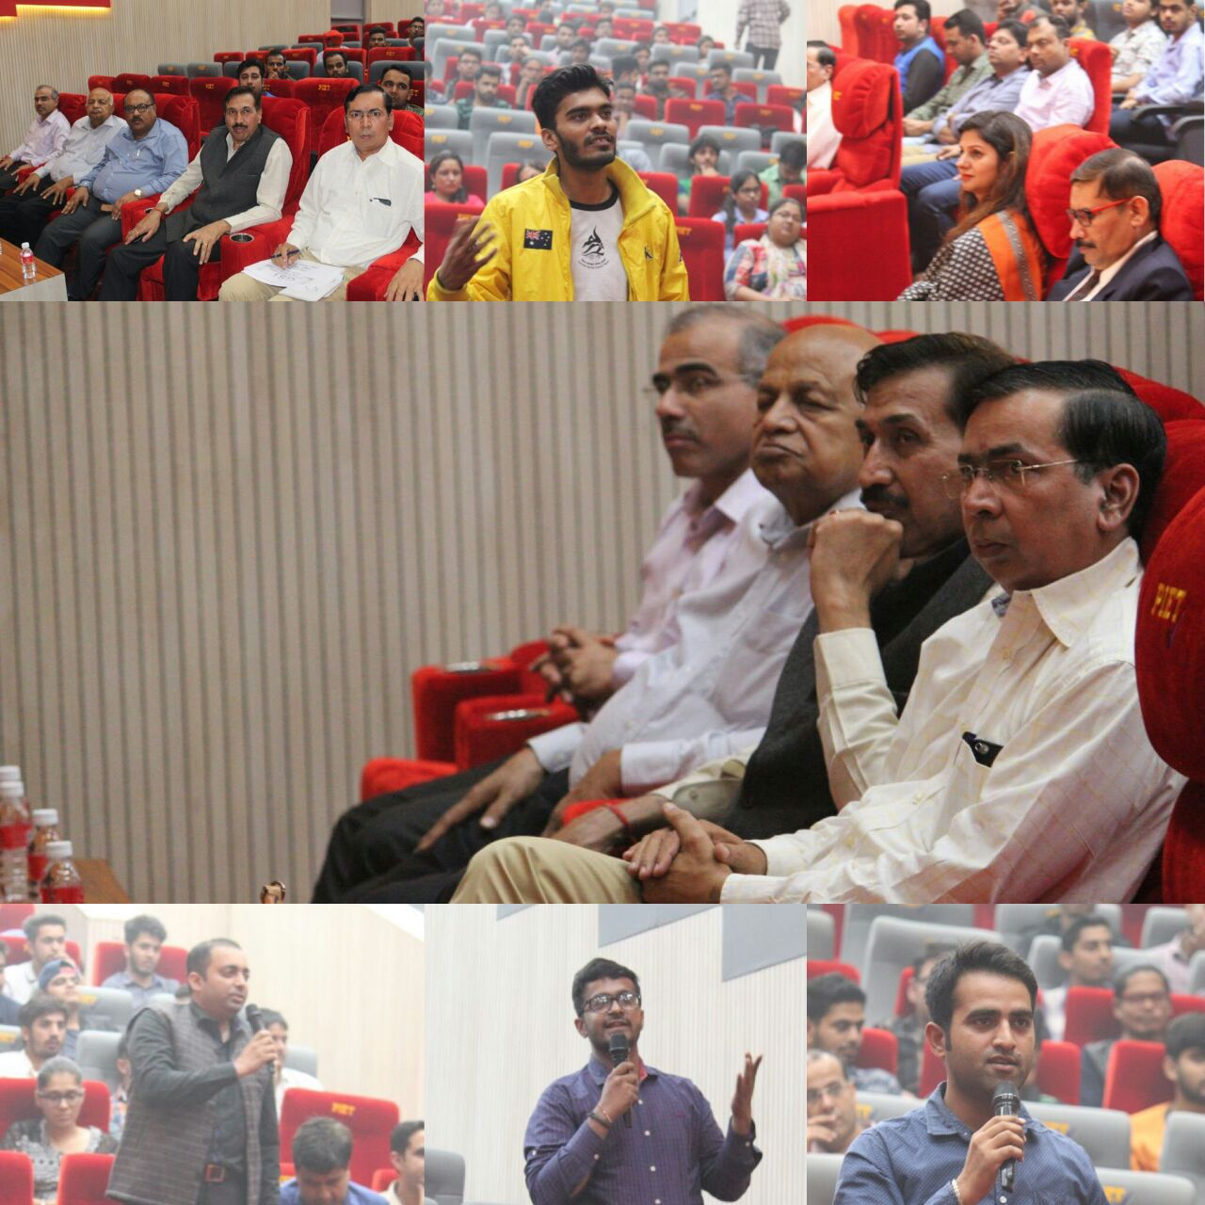

Slide 29



Slide 30
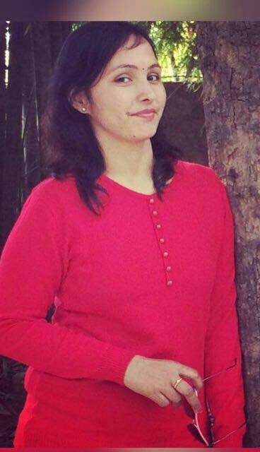
“अस्तित्व”, “क्या कहूँ क्या न कहूँ”, “अहसास”
These poems have been contributed by Dr. Nisha, who is an English teacher in Applied Sciences and also contributes in BBA, where she is taking regular classes.
About Dr. Nisha, she is not just a teacher but also a wonderful anchor and above all a very good poetess. She is a spontaneous poetess and have the capability to express her heart felt feelings in beautiful poetic words which drench the hearts of the readers.
Dr. Nisha , Applied Sciences

Slide 31
“अस्तित्व”
दुनिया तुझ से क्या कहूँ और किस लिए
जो बनती है हमी से हमी को बताने के लिए
दिल जलाने के लिए और रुलाने के लिए ।
दुःख में दुखी करने के लिए
रिश्तों की दुहाई देकर झकझोरने के लिए
दुःख आते ही दुनिया के सारे नियम
हम पर हावी हो जाते है
पर न जाने क्यूँ अमीरों के लिए
वो सब कहाँ उड़ जाते है ।
आज मन उद्लित है कि दुनिया को दिखाऊँ
जो भी रिश्ते-नाते हैं सब को बताऊँ
तुम्हारा कोई वजूद नही हैं मेरी जिन्दगी में
मैं तो जीना चाहती हूँ बस अपने अस्तित्व के लिए
क्यों बाँधना चाहते हो नियमों की जंजीरों में
उस नेक दिल को जो है अपनी मस्ती में
अगर तुम हो खुदा तो क्यूँ नही बदल देते सबके दिल
तुम्हारे कायदे, नियम और क़ानून जो हैं सबके लिए अलग-अलग
जब नही कर सकते ये सब तो क्यों दिखाते हो अपनी मर्दानगी उन पर
जो जीना चाहता है अपने अस्तित्व को संभाल कर ।

Slide 32
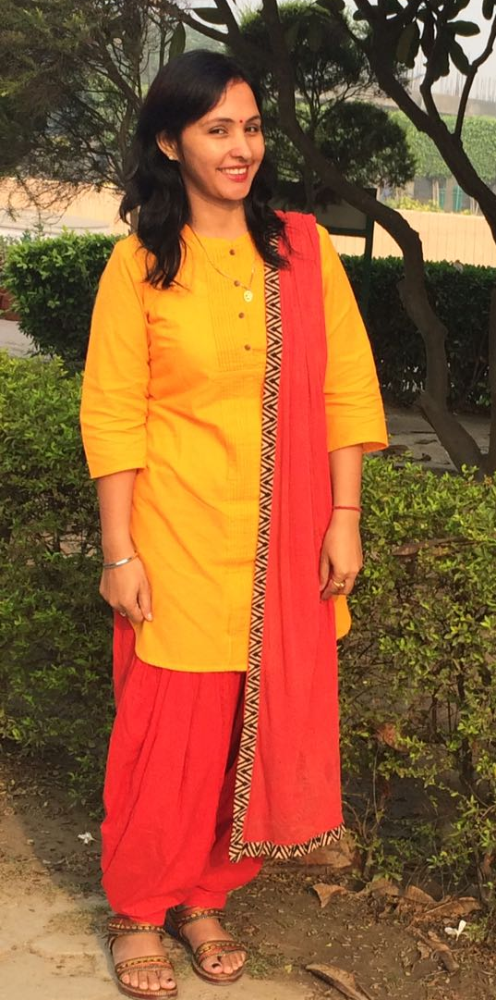
“क्या कहूँ क्या न कहूँ”
अहसास तो तुम्हारी भावनाओं का पयार्य हैं
क्या ये हर किसी का खुद का अध्याय है
किसी से जुड़ना,मिलना और बिछड़ना
सब अहसास ही तो लाता है ।
कभी हँसाता, चौकाता,डराता
तो कभी रुलाता है
कोई अनछुआ न रह पाया आज तक
कितने अजीब है ये अहसासों के मामले
कुछ अनकहे, कुछ अनसमझे और कुछ अनसंभले
क्या कहूँ क्या न कहूँ
इस भंवर से कैसे बाहर निकलूँ
पर क्या इनके बिना जीना संभव हो पाएगा
या इन्ही के द्वारा एक को दुसरे से जोड़ा जाएगा
कभी कोई टूटे तो हमारे अहसासों का अहसास
ही तो है जो उसके जीने का पयार्य बन जाता है
जिन्दगी को आखरी सांस तक जीते है हम
अगर अहसास हमारे अहसासों को जिन्दा रख पाता है ।
पर अगर अहसास ही अहसास होना बंद होने लगे
और जिन्दगी भी एक अजूबा लगने लगे
तो ये क्या इशारा है .............
मैंने जिन्दगी जीना छोड़ दिया है या
जिन्दगी ने मुझे मजबूत कर दिया है
शायद आने वाला समय इन सवालों का जवाब दे पाए ......

Slide 33
“अहसास”
अहसासों की एक लम्बी लडी है
क्या याद रखूं क्या भूल जाऊं मुश्किल बड़ी है
आ रहे याद वो लम्हें हर घड़ी हैं
और मची दिल में कशमकश बड़ी है
अहसासों का भी अपना एक घरौंदा है ।
आते है जाते है मुश्किल खड़ी कर जाते है
कभी अपनेपन का अहसास कराते हैं
तो कभी दिलों को करौन्ध जाते है ।
डर लगता है अहसासों के जुड़ने से
कभी आने वाले खतरों का सबब तो नही
हर अहसास ने इतना खकझोर दिया है
हर नए अहसास को महसूस करने के लिए ।
जानता है कि कुछ नही है ये
बस है एक छोटे से पल के लिए
समझना चाहती हूँ इस बदलाव का कारण
और बताना चाहती हूँ इस अहसास कराने वालो को
कि मै हूँ नही ऐसी पर ये अहसास हैं कि
कुछ क्षण बाद बदल जाते हैं, मुझसे अलग हो जाते हैं
और फिर से अकेले रहना चाहते हैं आजाद परिंदे
की तरह बिना किसी जुडाव के ।

Slide 34



Slide 35
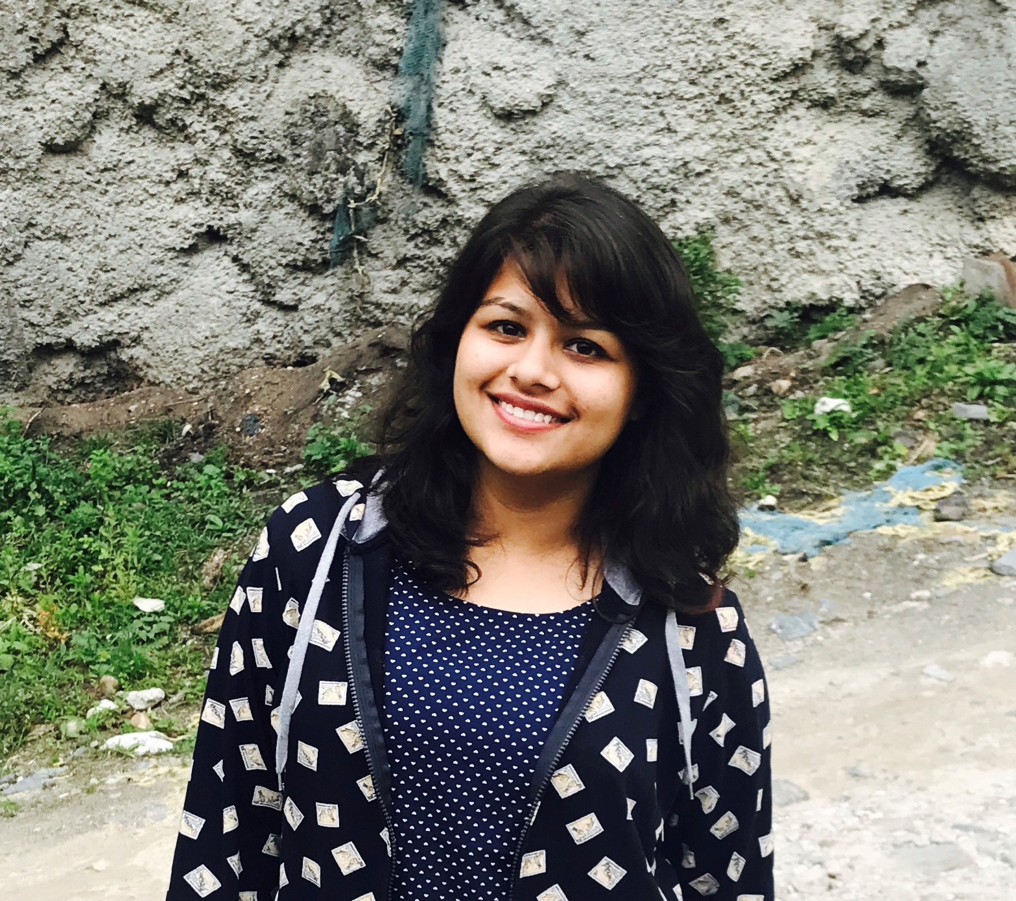
Jigyasa Arora, BBA-2nd Year, Section-B
Rotaract to me has shaped my identity and personality through out these years. From being a socially awkward girl at the time of joining the college to now, the change is drastic. Rotaract and my college has a big role in this and I am enjoying each and every moment of it. The best part of it is the people in it, you get to meet like minded people like you and you learn a lot. The one soul satisfying thing which I get is through Rotaract. I am giving my share in changing the society no matter how small it is. Though our lives as leaders are filled with ups and downs, these are not hindrances for us to stop from believing that we could lead people towards positive change. I hope that in future it will continue to give meaning to my identity and take me to newer paths. It is an honor to accept the presidency of Rotaract club at PIET. At last I wish to express my thanks to all my fellow members, BBA dept. and my college for contributing to the club in a beautiful way.
Thank you.

Slide 36

It has been a rewarding experience going through the successful completion of the semester. Thank you to all members of our learning community for a very vibrant and productive time all through the months. Staff and students have been focused on establishing clear goals to maximize learning and engagement. College staff have been meeting, reviewing and planning further implementation of programs to ensure the success and engagement of all our students.
Now that Exams have been slated out by the university as under:
3rd Year from 28th November
2nd Year from 1st December
1st Year from 7th December
We wish all students the best of performance and good luck

Slide 37


Slide 38

BBA, HOD
(Dr. Yoginder Singh Kataria)
BBA, E-Committee
(Mr. Jagmohan Malhotra)
(Dr Saurabh Garg)

