Slide 1
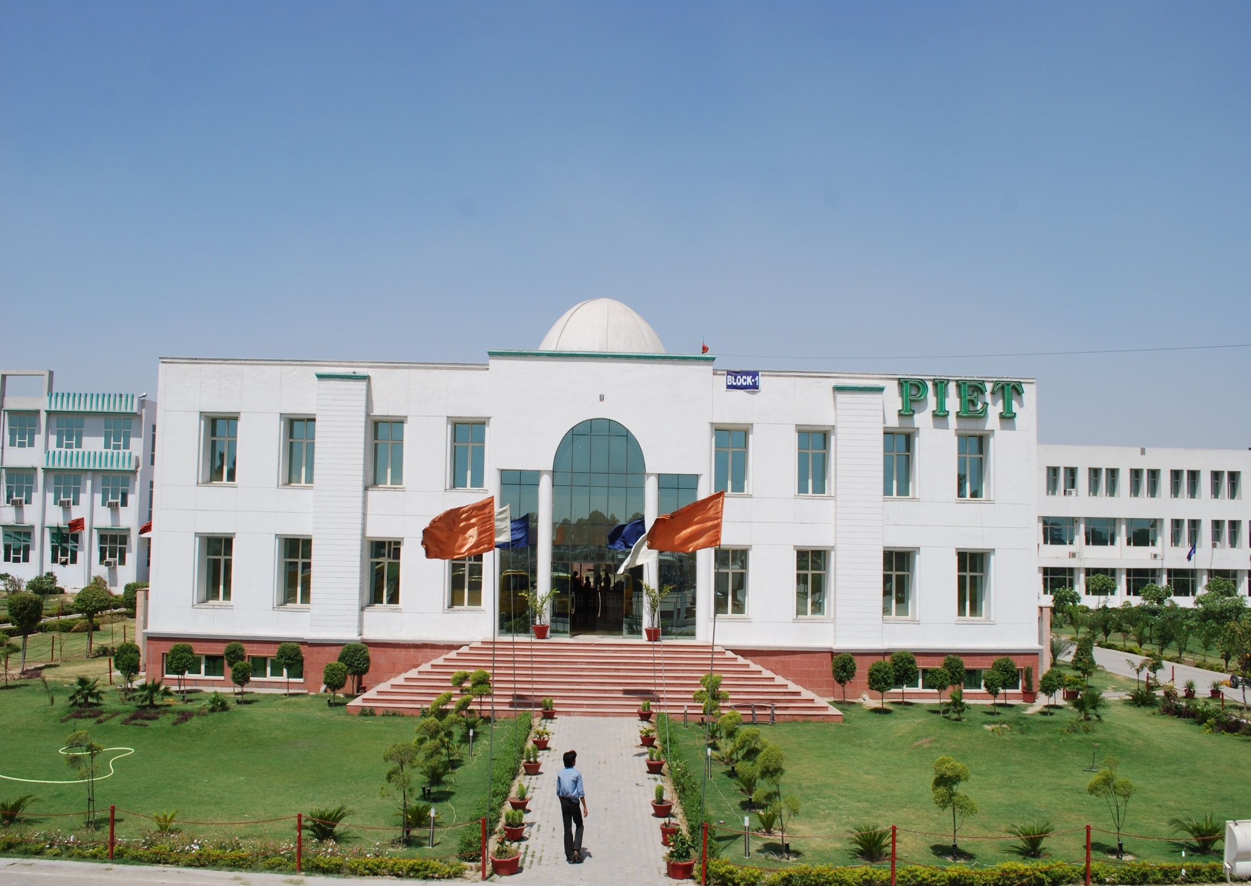


Slide 2





Slide 3


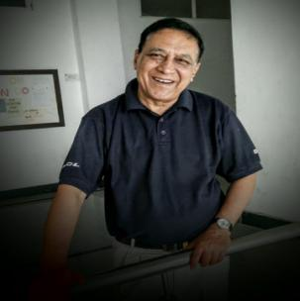
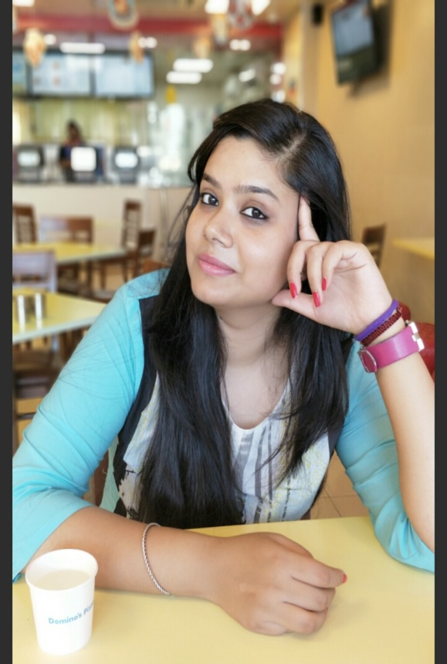
Fall of spring is one of the most exciting periods at a college because it’s the start of something new for so many students.
The PIET campus is filled with smart, inspired students ready to take advantage of everything both in the classroom and in the many extracurricular options of student life. It is heartening to find them a step ahead whenever they see the opportunities of innovation, diversity and educational excellence that BBA offers.
We know and believe that this learning institute promotes our international presence, feature the innovative dynamic opportunities provided by various grand events on campus and spotlight its presence around in the state and NCR region.
As we approach the end of semester, we are drawing curtains on extra curriculum part so that each one of you can focus on your university examination for best results.
With best wishes from the editorial team for a wonderful festive season.
Jagmohan Malhotra
Sakshi Garg

Slide 4


Slide 5
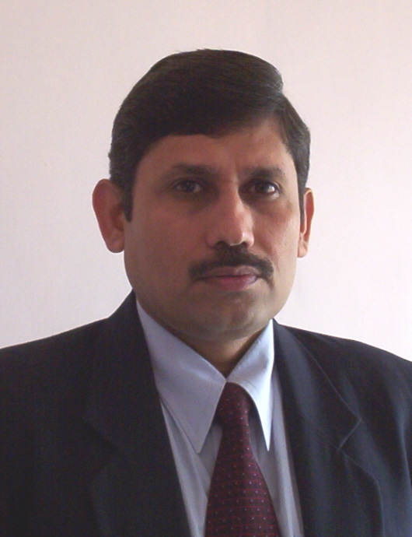

Dr. Yoginder Singh Kataria, HOD, BBA

Slide 6
FROM THE HOD’s DESK
This is the time for reflection and to look forward to the coming year while looking back over the happenings and doings as a memory. I have been delighted with the way the students and faculty team quickly coming together as a community and establishing a positive and supportive learning environment. The mutual respect that is evident needs a special mention which echoes the ethos of the founders.
Looking ahead there are new challenges to be faced and deadlines looming for the students. On top of a heavy academic workload we are now beginning to look to the future and options for life for which purpose there have been so many training programmes and research activities around.
The Enrichment Programme for the current spring term have been, therefore, packed as always with many visiting speakers, workshops and activities. We are enormously grateful to the worthy management who give us liberties, flexibilities and opportunities to perform and illustrate career pathways to our young people.
Welcome to the October newsletter of the year which brings in its fold the flavor and fragrance of the most coveted festive season which, with the advent of Diwali, marks a pause to enjoyment and plunge into the pool of annual examinations.
I wish you all the best for your efforts being put all though the semester which is now nearing an end and look forward with high hopes to the university merit list to find most names in the top twenty as has been happening hitherto.
Dr. Yoginder Kataria
HOD, BBA

Slide 7

1/10/2017
Organized By-
JCI KARNAL AGILE (JCI INDIA)

Slide 8
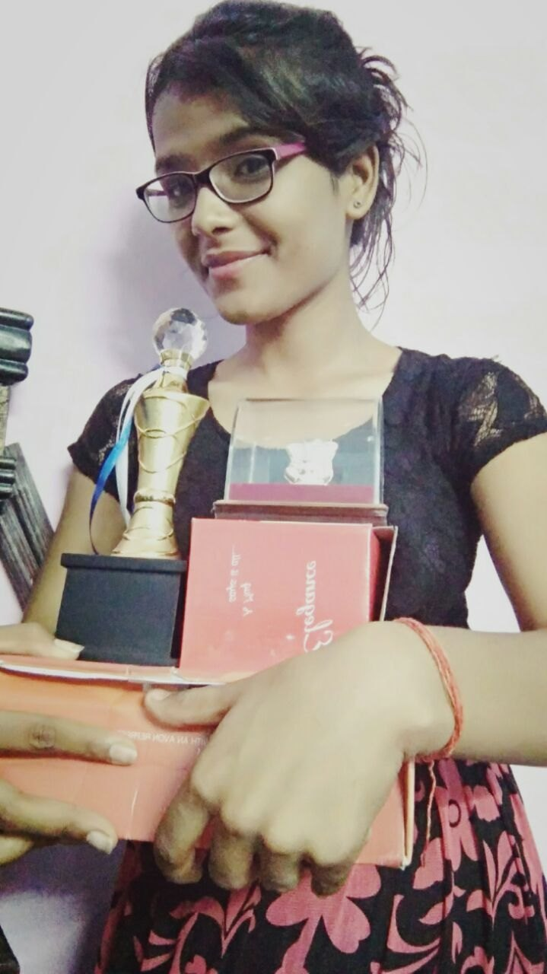
Mamta got 4th position out of
30 finalist.
It was a talent hunt which conducted auditions in many districts around Karnal. More than 500 children participated. Out of 500 only 30 were selected for the “GRAND FINALE”
Mamta BBA 1st Year Section-A

Slide 9

BBA STAR PROGRAMME

Slide 10
BBA Star Contest
In continuation of the above event the 4th Round named ‘Interview Round’ was held for finalists.
The following were the short listed candidates:
1st Year: Kritika Priya Nimmi
2nd Year: Vidhi Shivam Jigyasa
3rd Year: Vandana Akant Diksha
The interview board consisted of Prof. K K Paliwal, Director PIET, Dr. Yoginder Kataria, HOD, BBA, Dr. B.B. Sharma Dean - SW and Dr. Nidhi, Director T& P. It had been a very professional session, an acid test process of the aspirants.
The STAR performers were Priya, Vidhi and Akant. While the contest was very close it was really a tough job to strike the hammer.

Slide 11
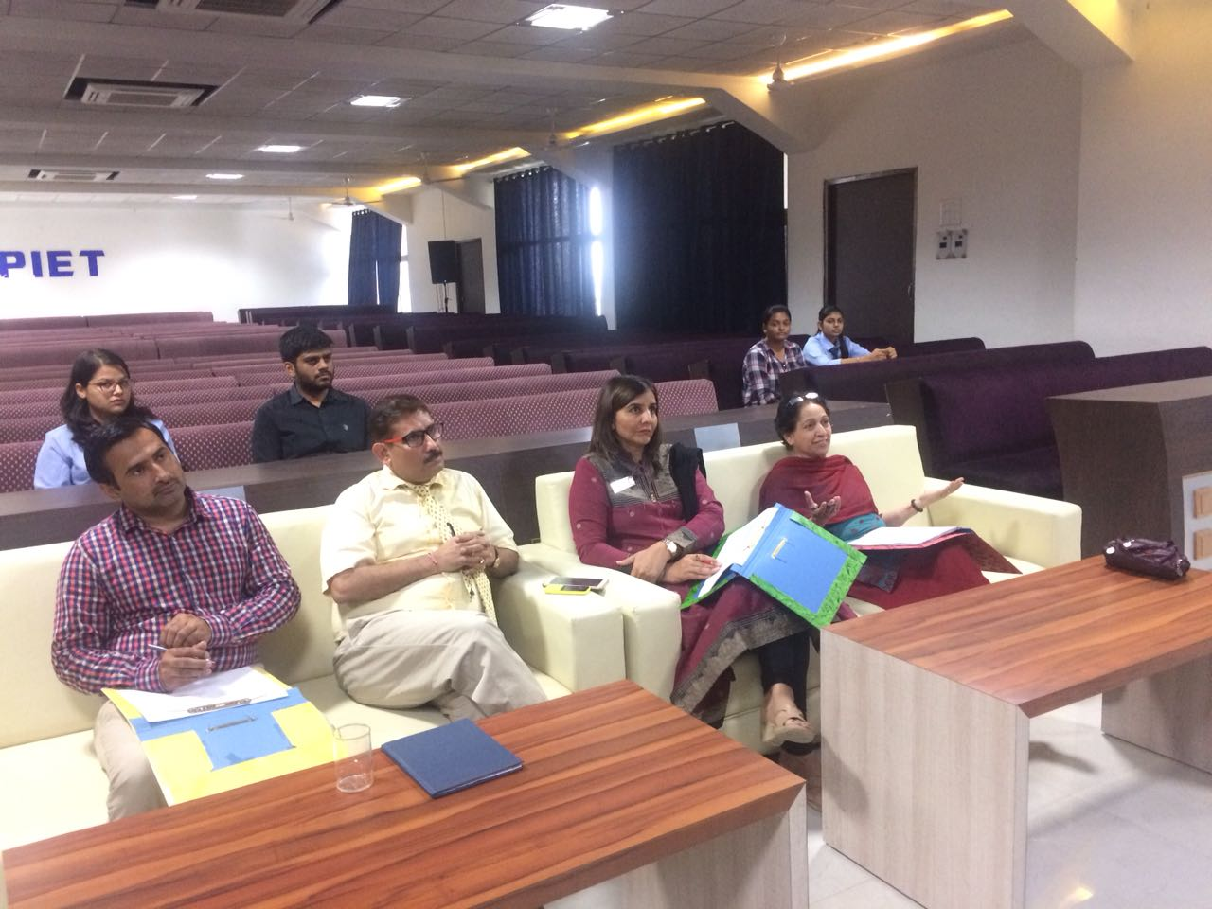
ROUND-3 Presentation
03 October 2017
Dr. Kataria, Dr. Vinay Khatri, Mr. Sunil Dhull, and Ms. Rekha doing judgement
For Presentations.

Slide 12
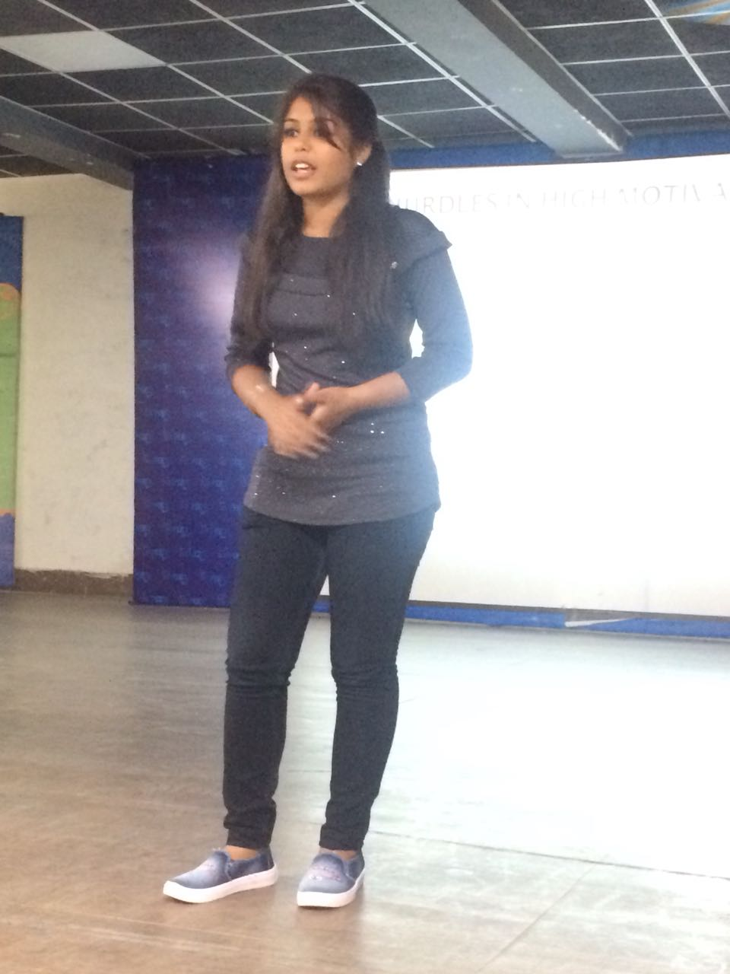
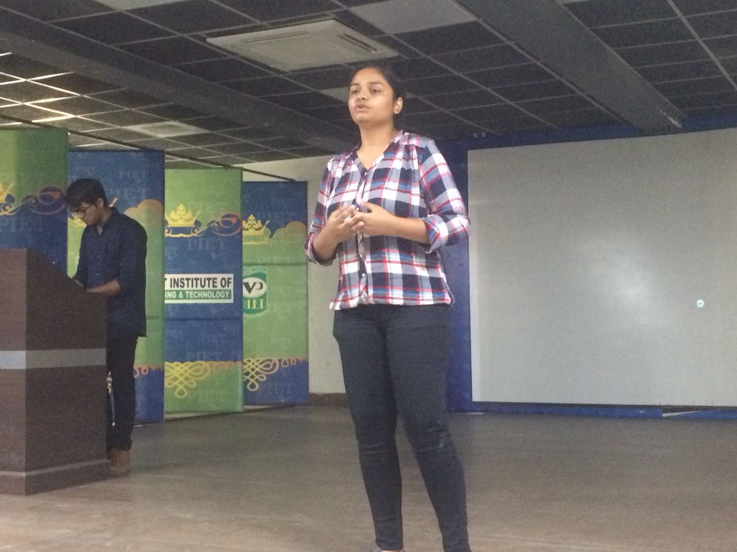
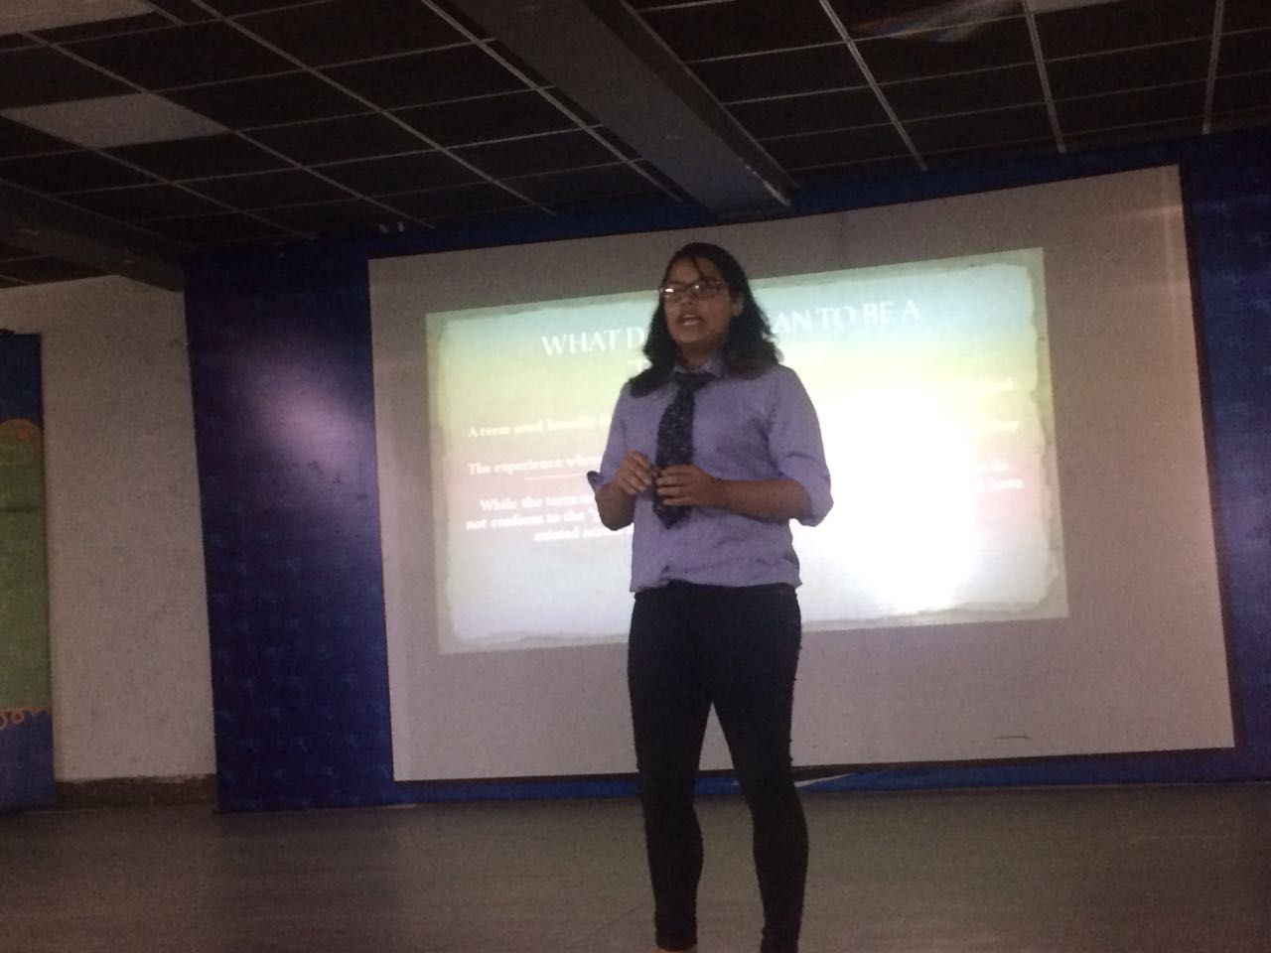
From GD the march was to presentation session, a skill that takes the aspirants closest to being the final star.
Kritika Arora, BBA 1st Year, Sec-A
Priya , BBA 1st Year, Sec-B
Jigyasa Arora , BBA 2nd Year, Sec-A

Slide 13
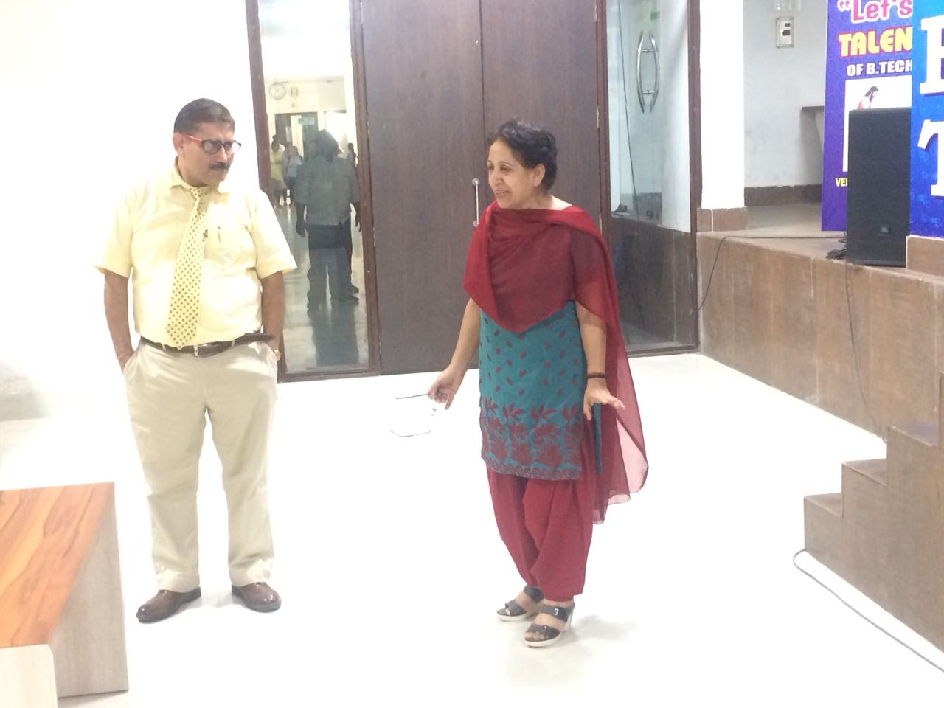
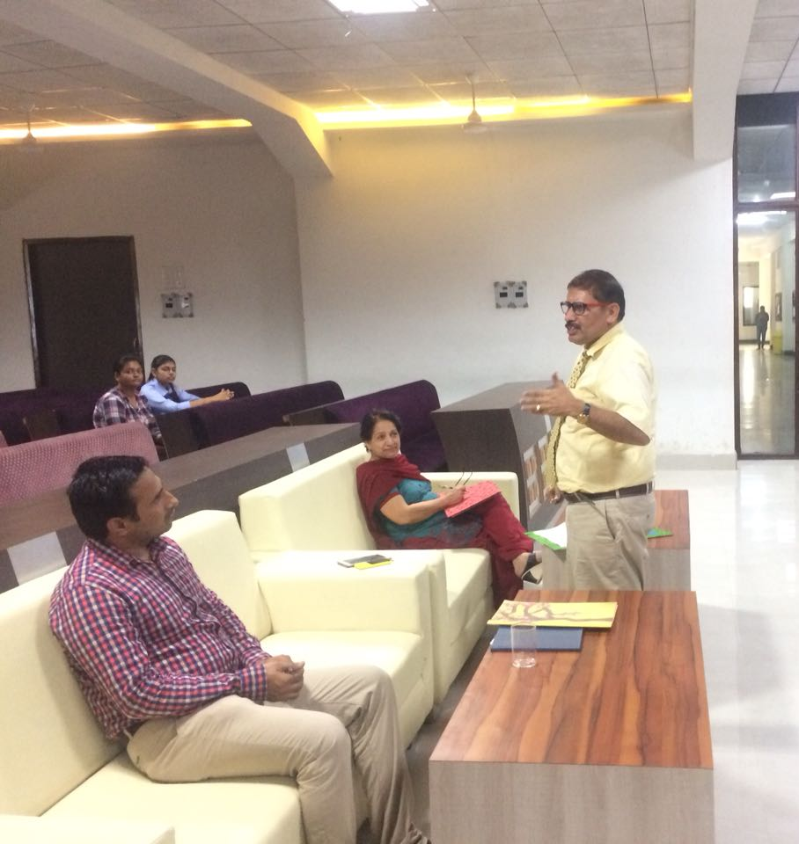
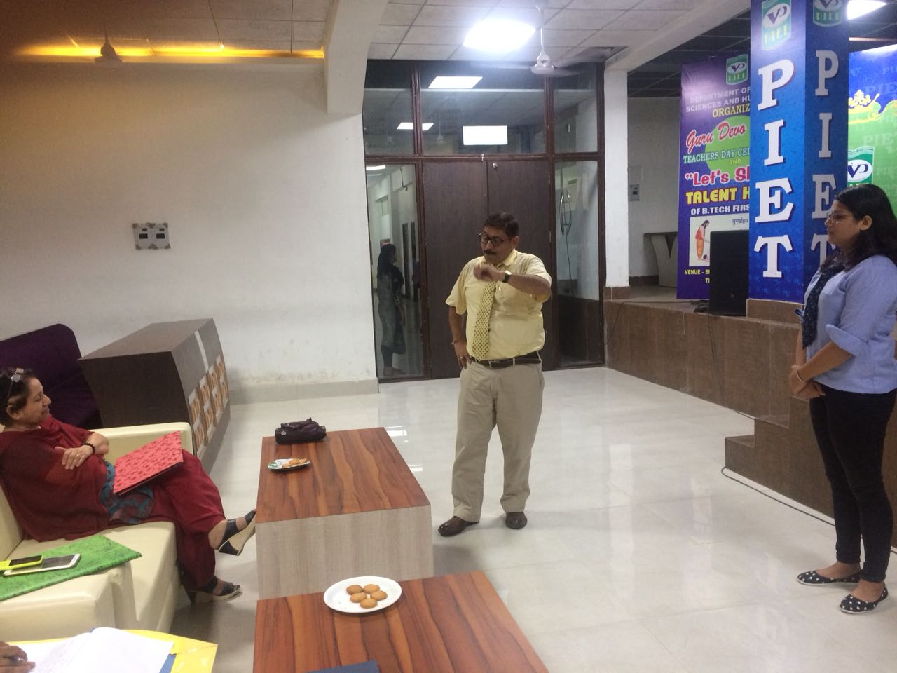
HOD sir discussing with Mr. Sunil Dhull (HOD,ME) And Ms. Rekha

Slide 14
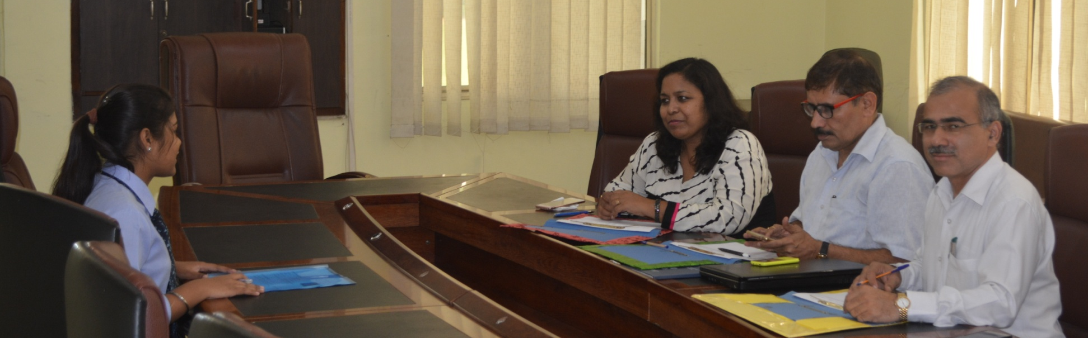
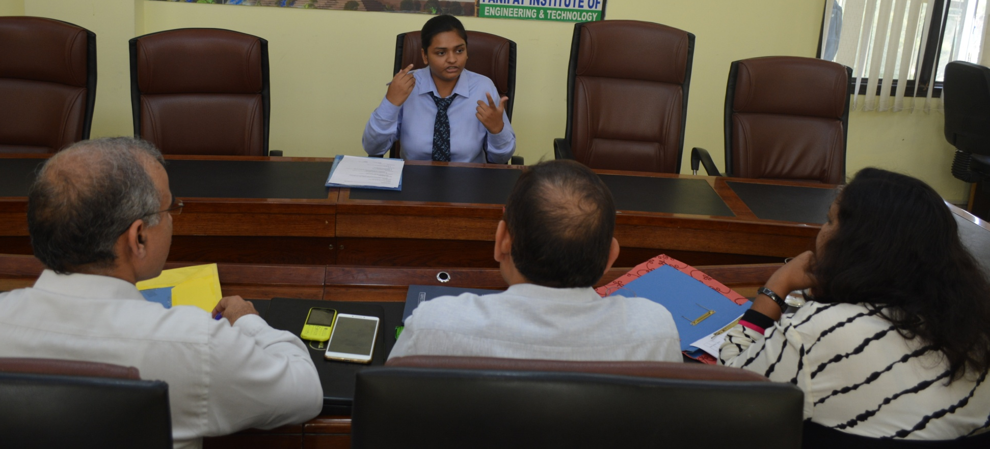
ROUND-4 Interview
10 October 2017

Slide 15
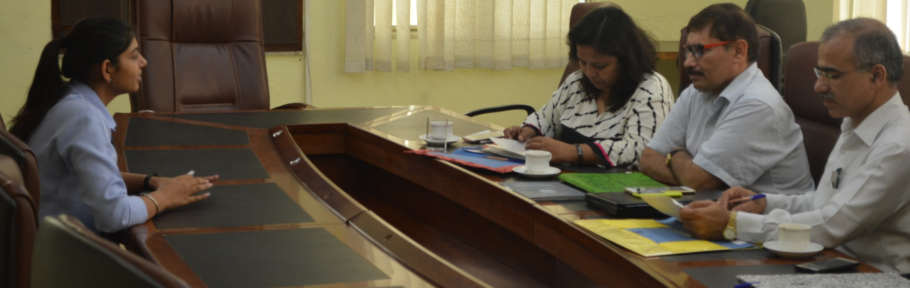
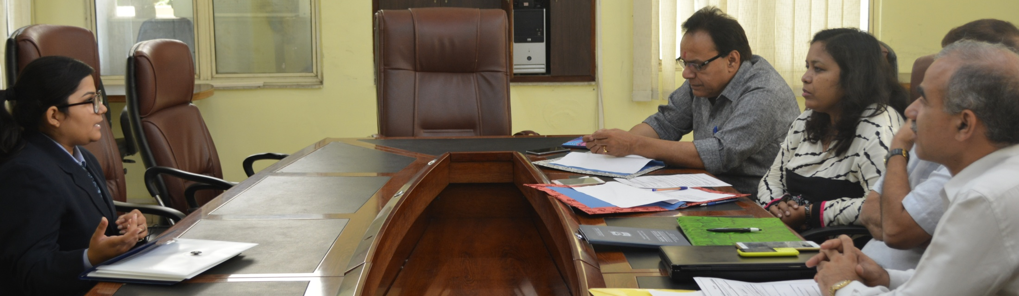
BBA 1st Year Interview Round

Slide 16
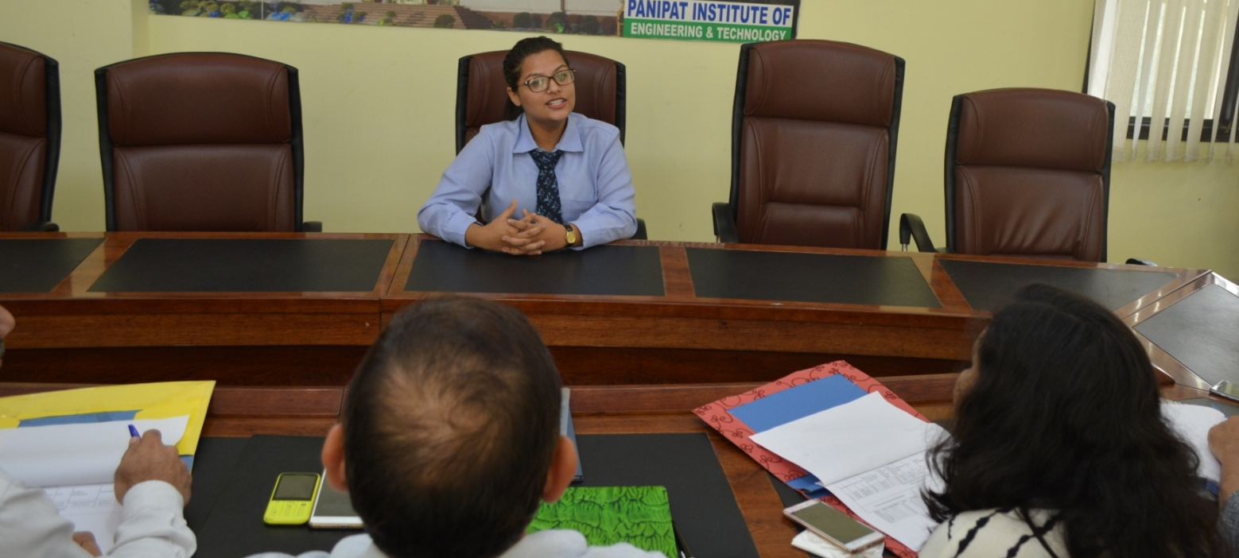
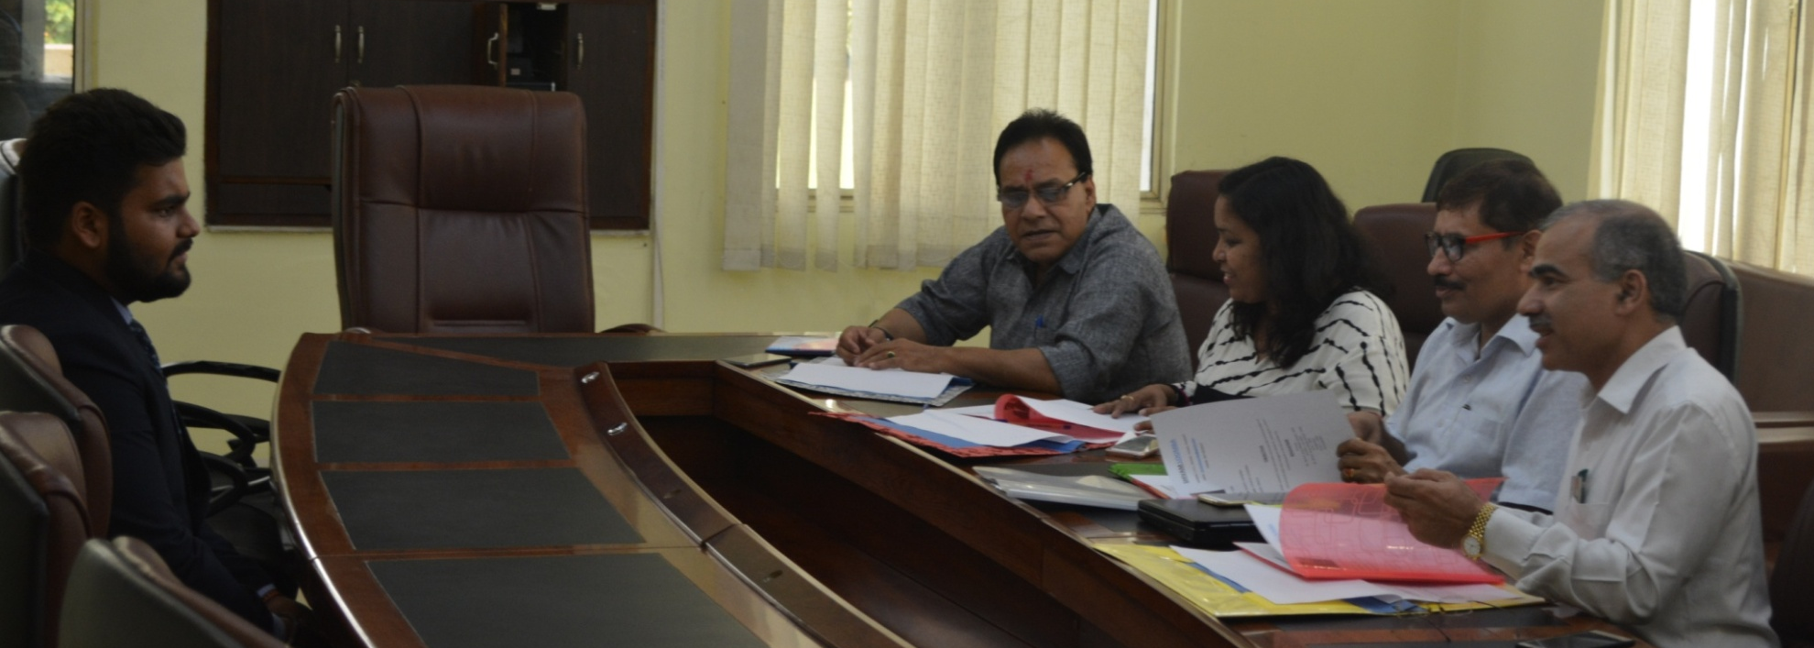
BBA 2nd Year Interview round

Slide 17
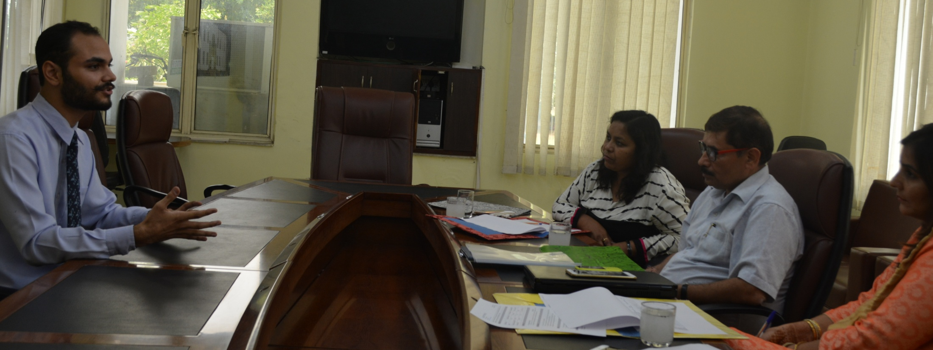
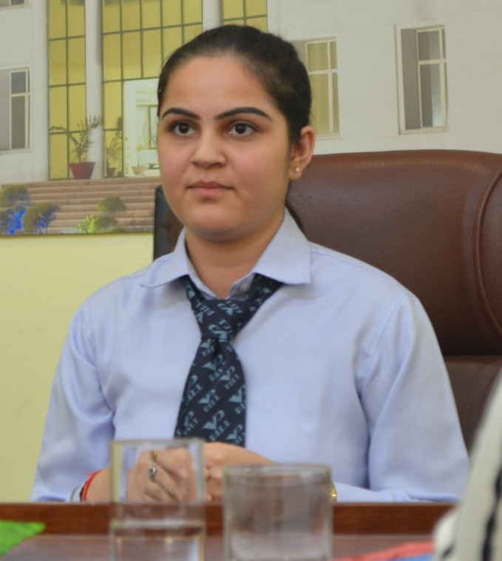
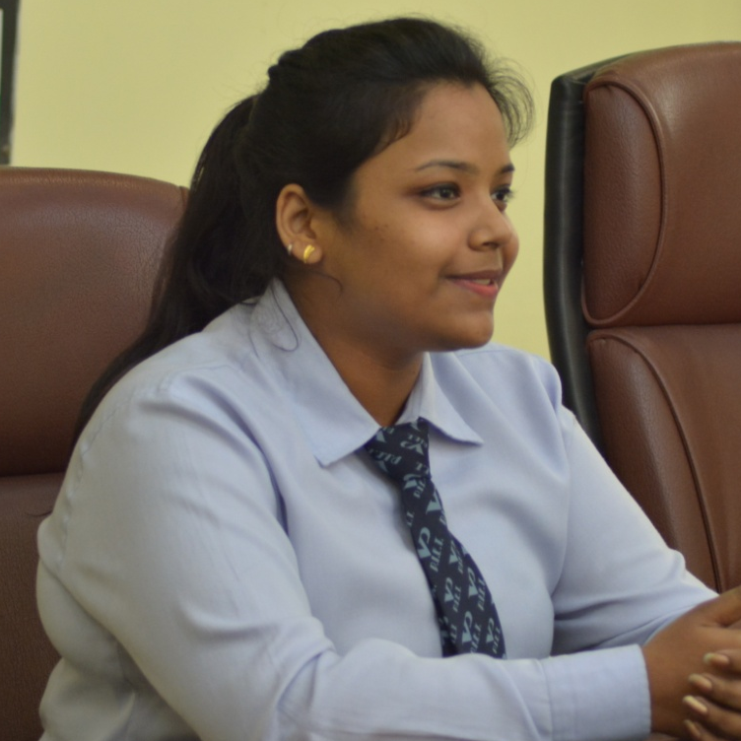
BBA 3rd Year Interview Round

Slide 18
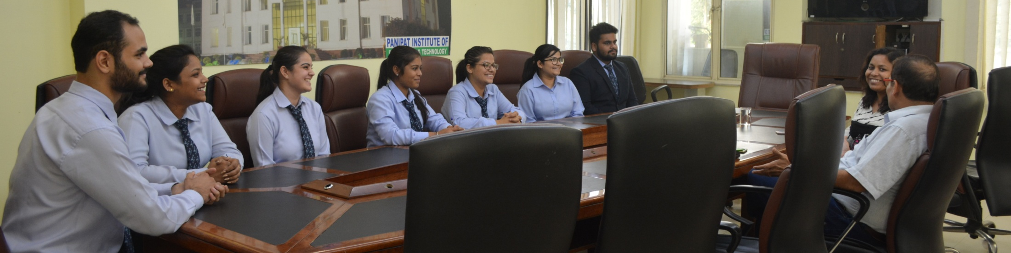
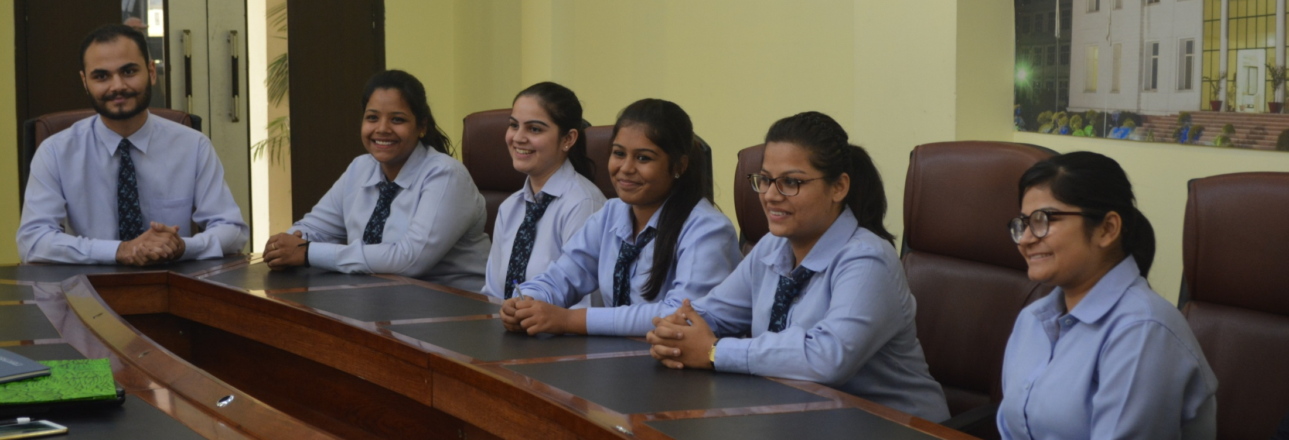
All selected students for Interview round.

Slide 19
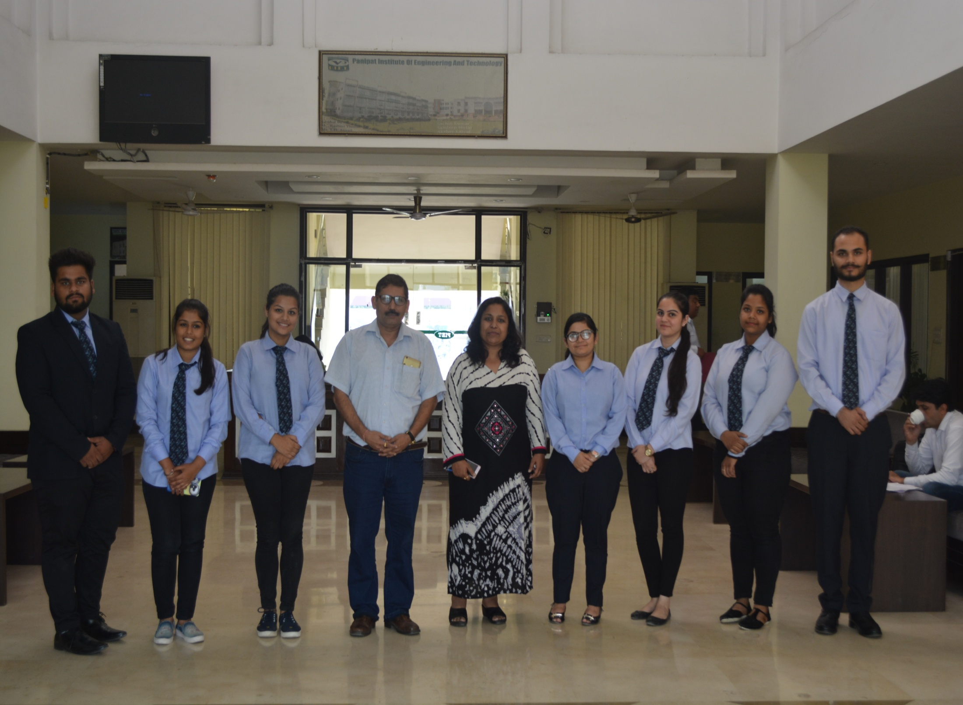
Team after completion of Interview round

Slide 20



Slide 21
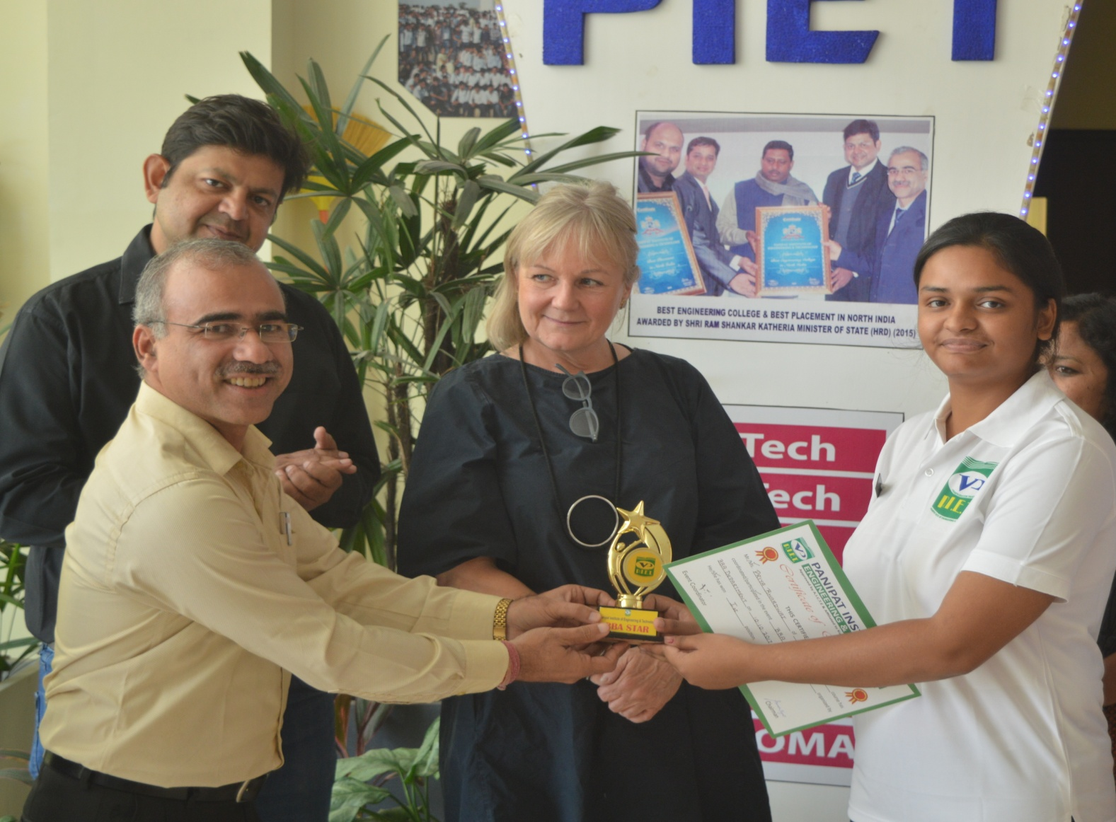
BBA Star 1st Year
Ms. Priya BBA 1st Year (Section-B)

Slide 22
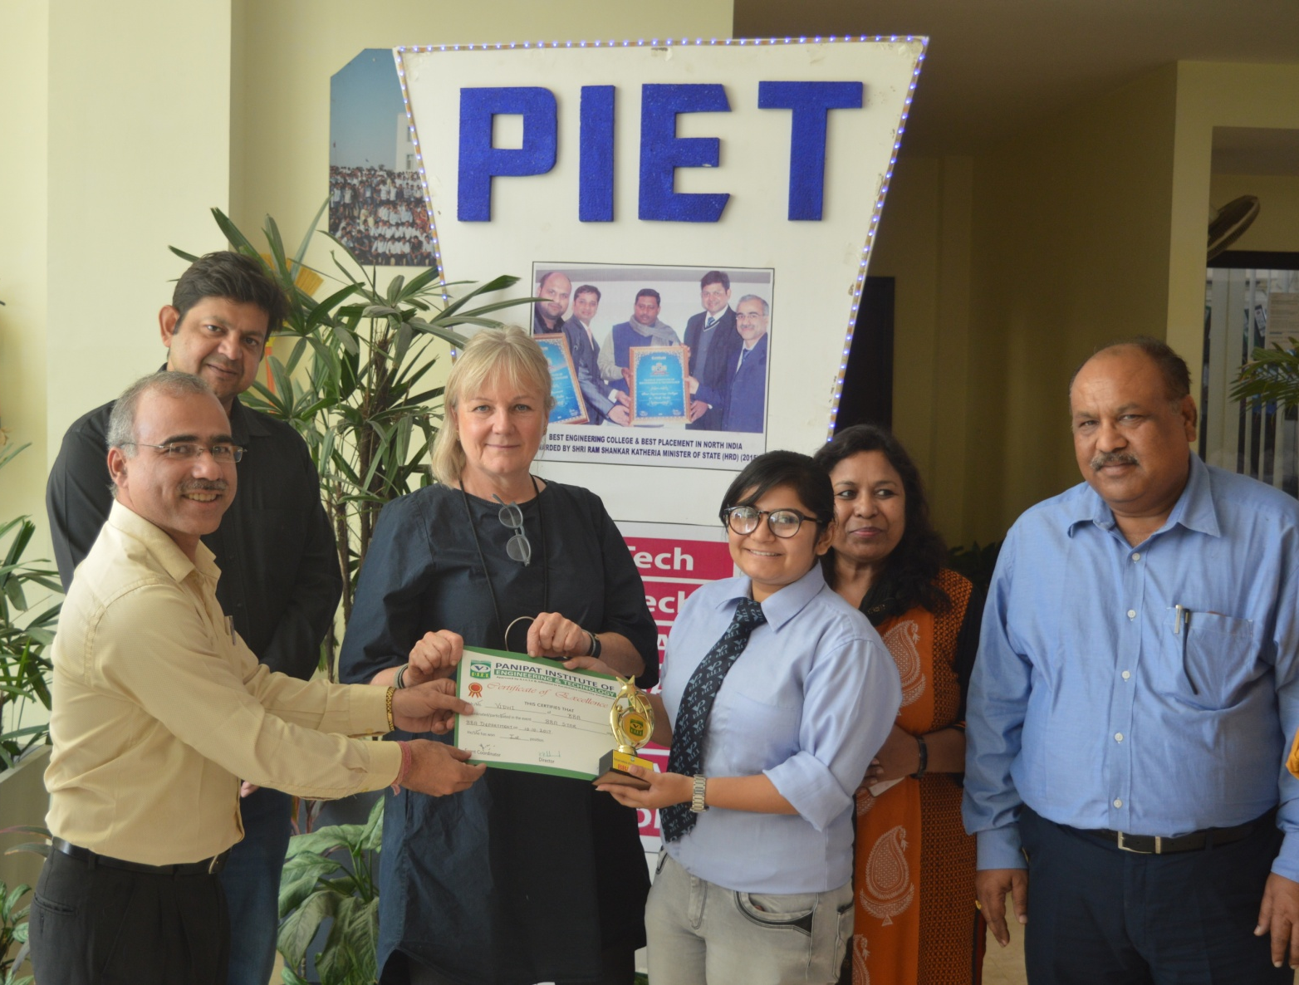
BBA Star 2nd Year
Ms. Vidhi BBA 2nd Year (Section-C)

Slide 23
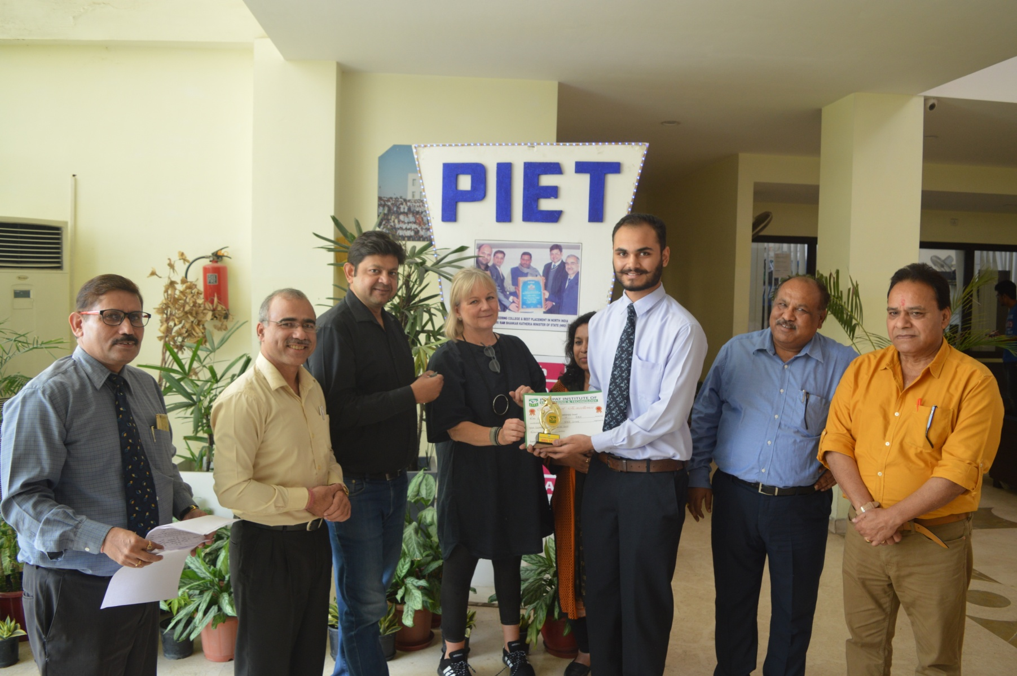
BBA Star 3rd Year
Mr. Akant Bhola BBA 3rd Year (Section-D)

Slide 24
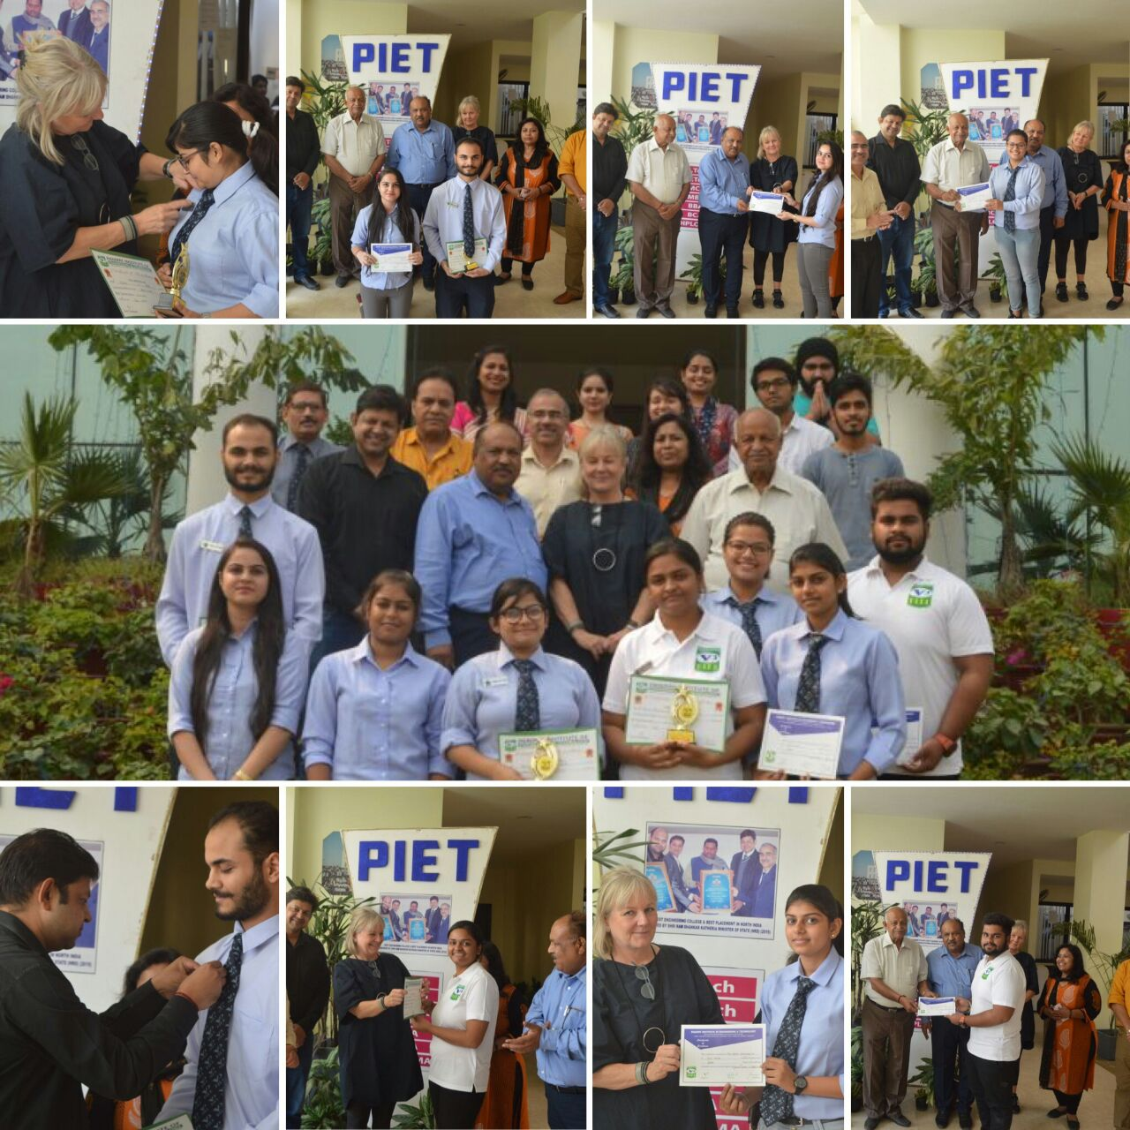
BBA Star Moments

Slide 25
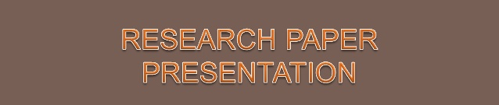

13/10/2017

Slide 26
Glimpses of the felicitations presented by the PIET Management to the Research students of BBA
On 26 September Students of BBA department presented research paper at National Conference on “Changing Dimensions of Business Management and Corporate Social Responsibility in Globalised Era” at IMSAR, MDU, Rohtak.
Speaking on the occasion Mr. Rakesh Tayal, Member BOG, PIET highly appreciated the initiative by the very innovative HOD, Dr. Yoginder Kataria and the all round efforts put in Dr. Ankur, Mr. Rajesh and Dr. Sangeeta to encourage the young minds to shift their bent of mind towards research activities at this tender age. Students are highly motivated by this appreciation and achieve a new perspective from the available opportunity in research. The supporting role of mentors like Mr. Atul Gautam, Ms. Shilpa Sardana and Dr. Sandeep deserves equal recognition.

Slide 27
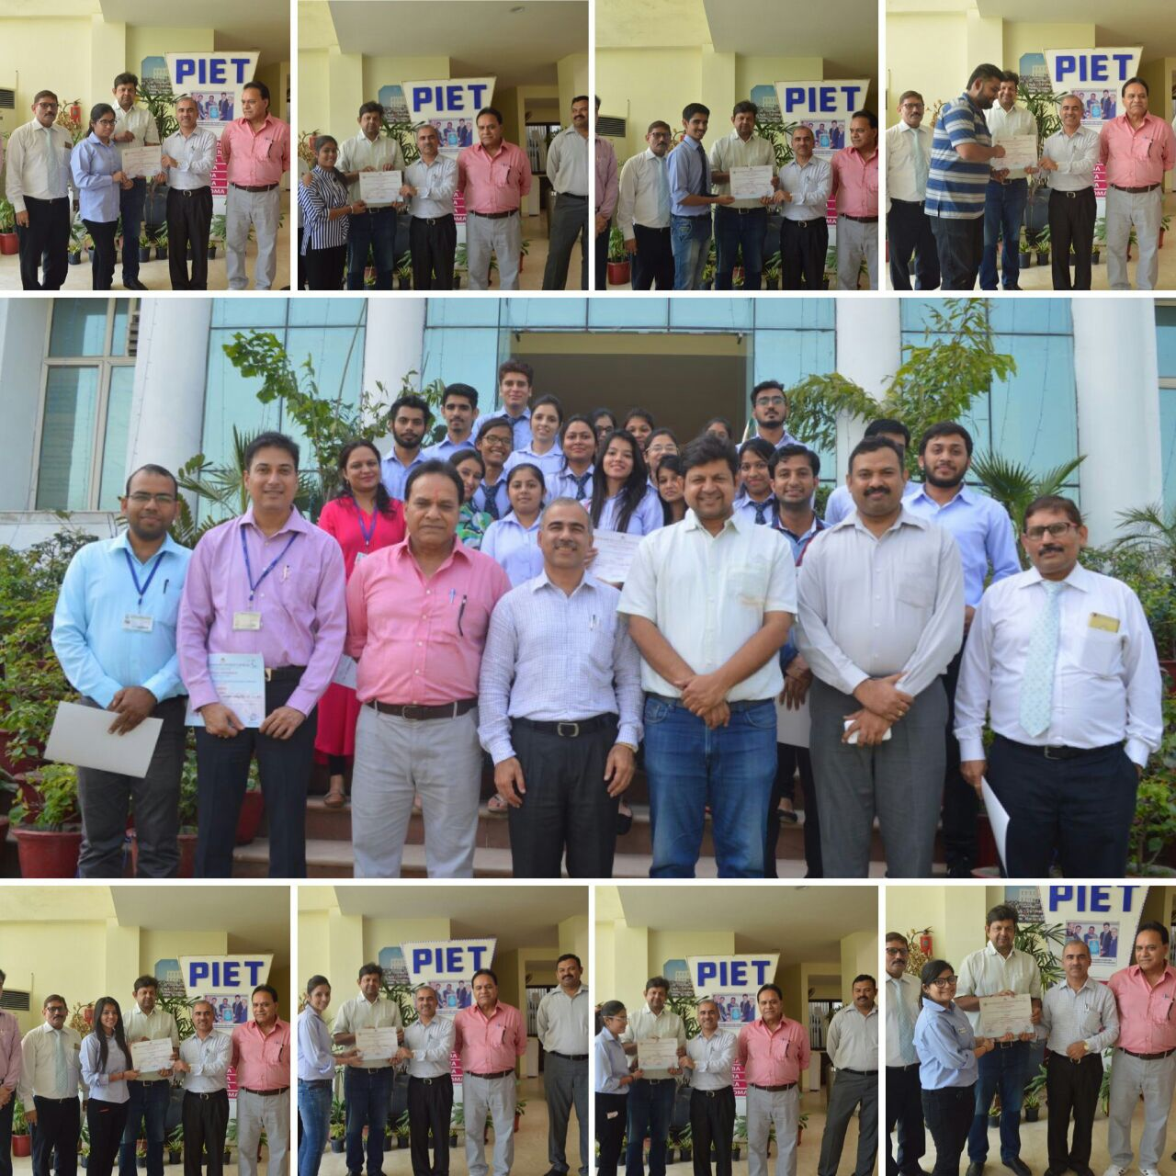
Certificate Distribution To Research Team

Slide 28
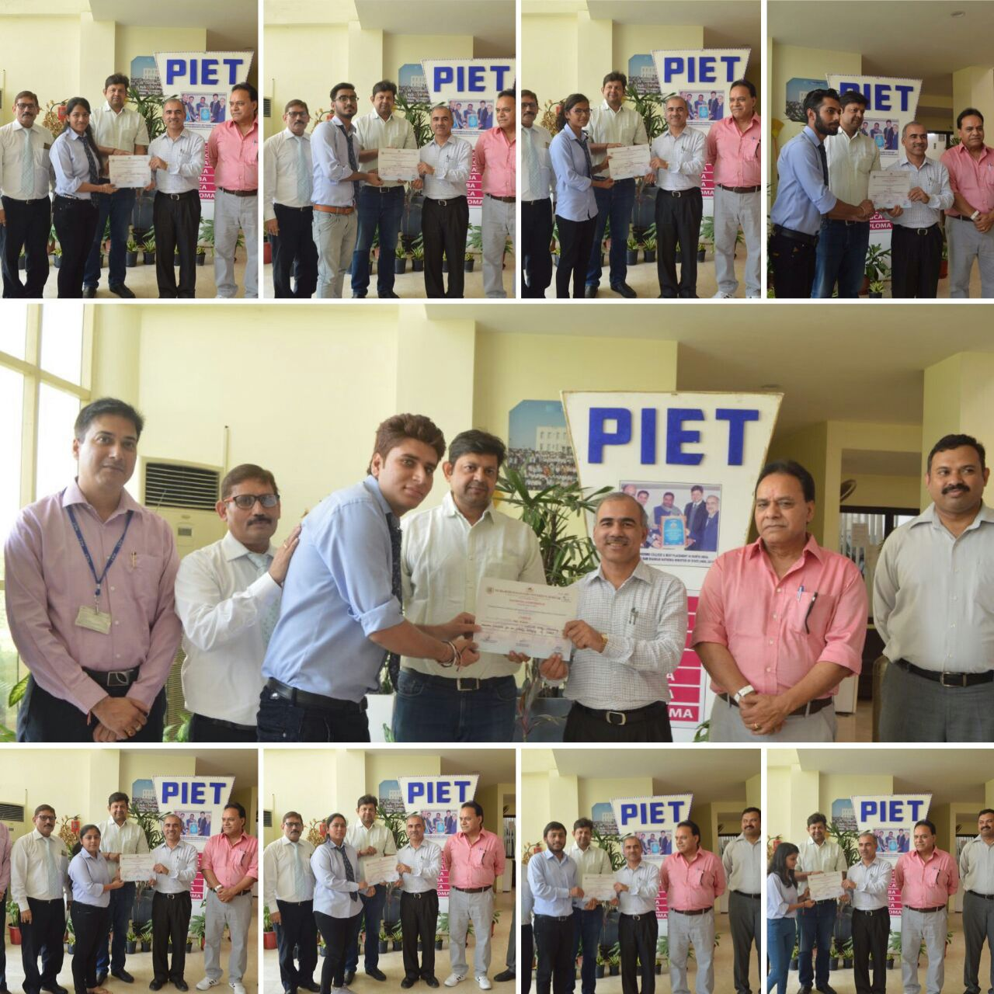
Certificate Distribution To Research Team

Slide 29


On 14th October 21 students of BBA went on a National Seminar organised by GIBS, Rohini, (Delhi).
Various post effects of GST were discussed and the whole concept of GST was explained in a very simple manner. It was a great experience for the students and helped them a lot in knowing the GST way much more better.
Dr. Preeti & Ms. Pooja accompanied students for the same.
14/10/2017

Slide 30
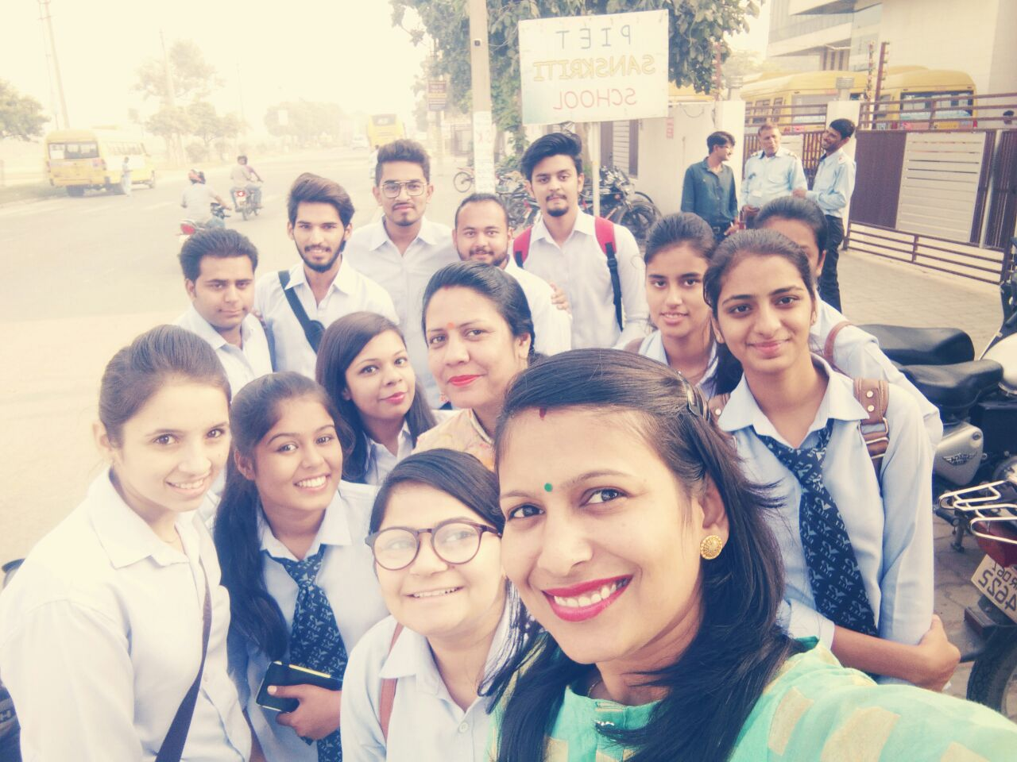
BBA Team at GIBS (Rohini) for National Seminar

Slide 31

SURPRISE OBJECTIVE TEST
06 October 2017

Slide 32
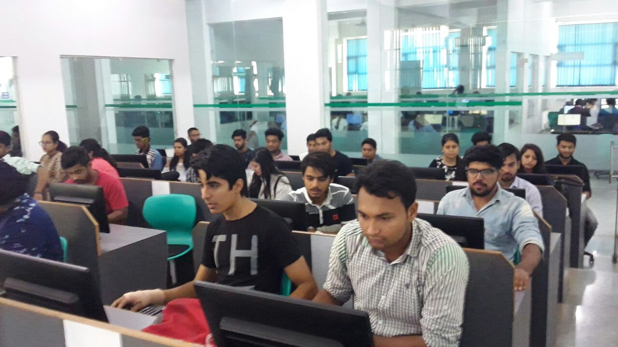
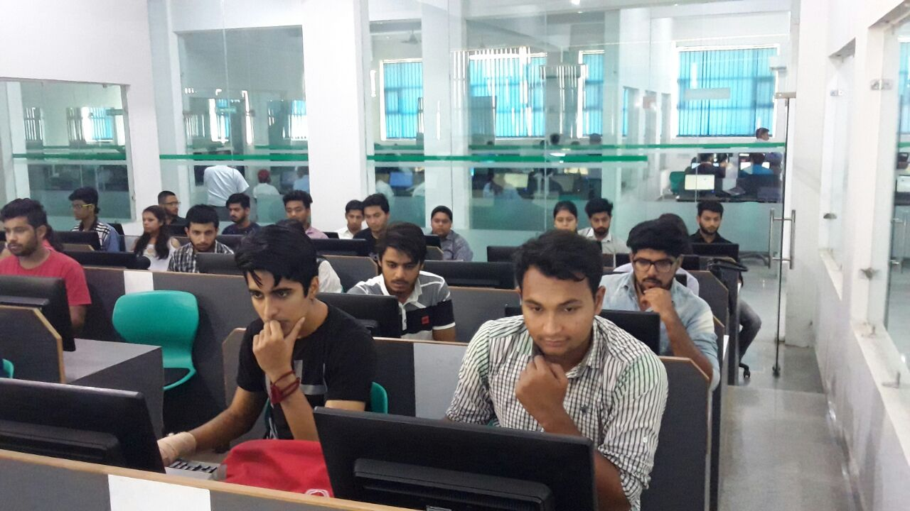
The Second SOT was held on 6th October and was successfully conducted

Slide 33


17/October/2017

Slide 34
DIWALI MILAN
The most glorious of all festivals, DIWALI was celebrated with great pomp an show. In the first place a small get together was organised at department level to felicitate the ‘helping hands’. Gifts and sweets were distributed to the attendants and sweepers, whose contribution can not be undermined in the smooth running of the department.
Subsequently an institute level programme was held at Dr. A P J Kalam auditorium with management and faculty team. It was another mega event filled with fun and frolic.
While BBA faculty team participated in Diwali Poojan by singing hymns and bhajans, a classical dance performance was presented by the BBA 1st year student Mamta. A team of BBA students enacted a play ‘Say No to Crackers’, which was widely acknowledged by the audience for underlying message to control pollution.

Slide 35
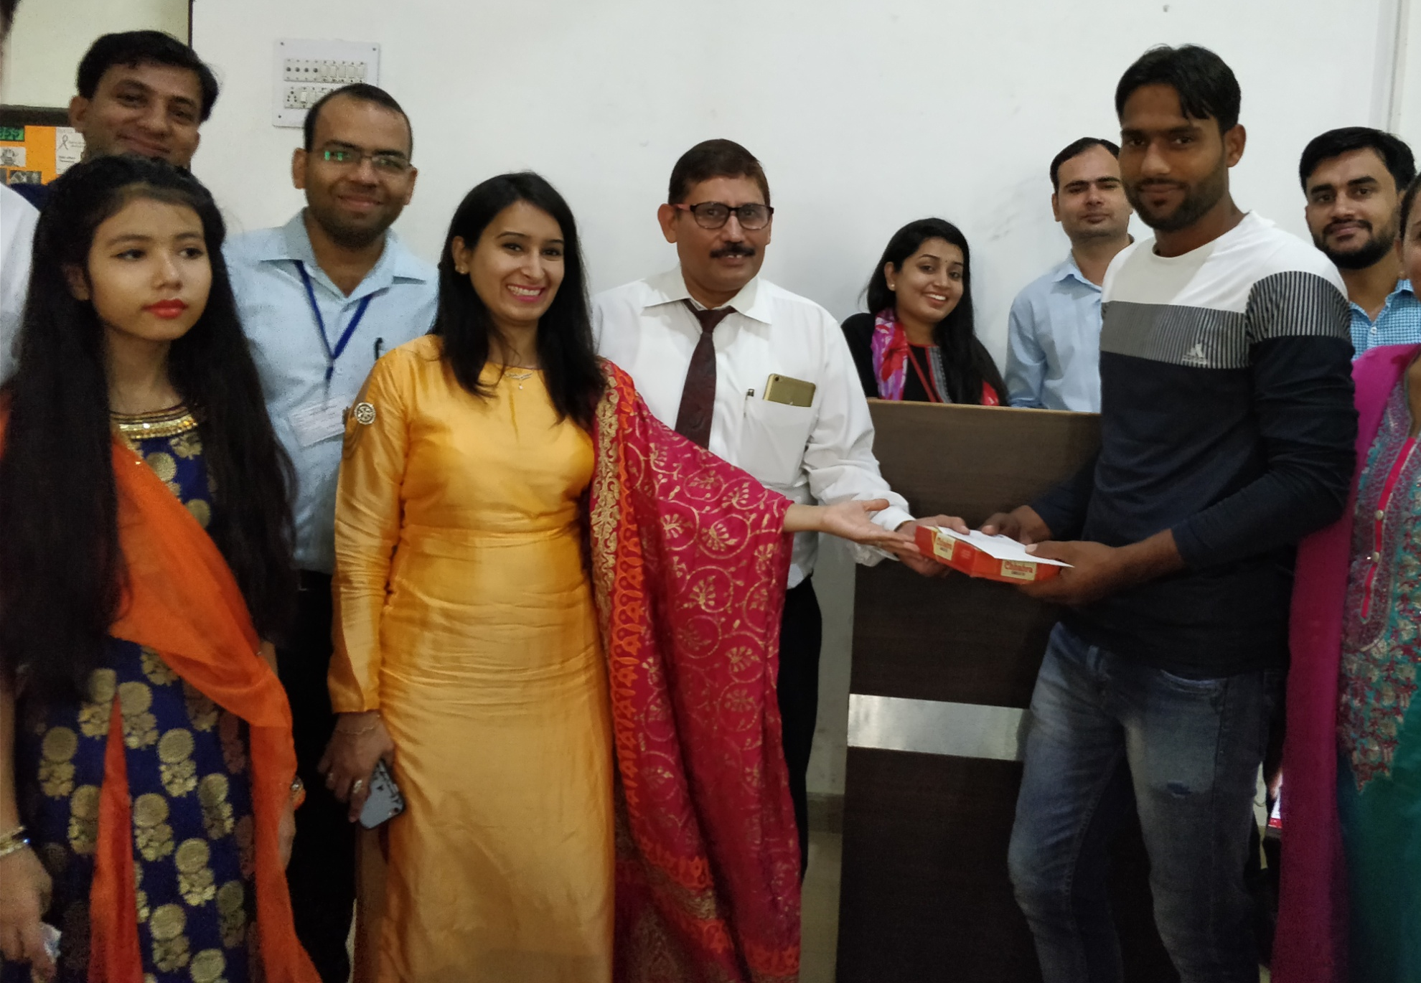
Diwali gifts Felicitations

Slide 36
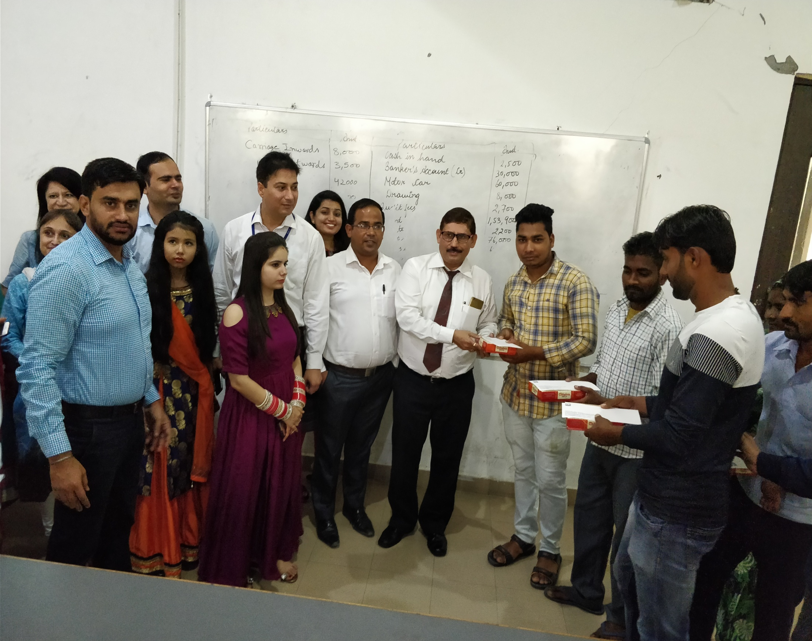
Diwali Celebrations in BBA

Slide 37
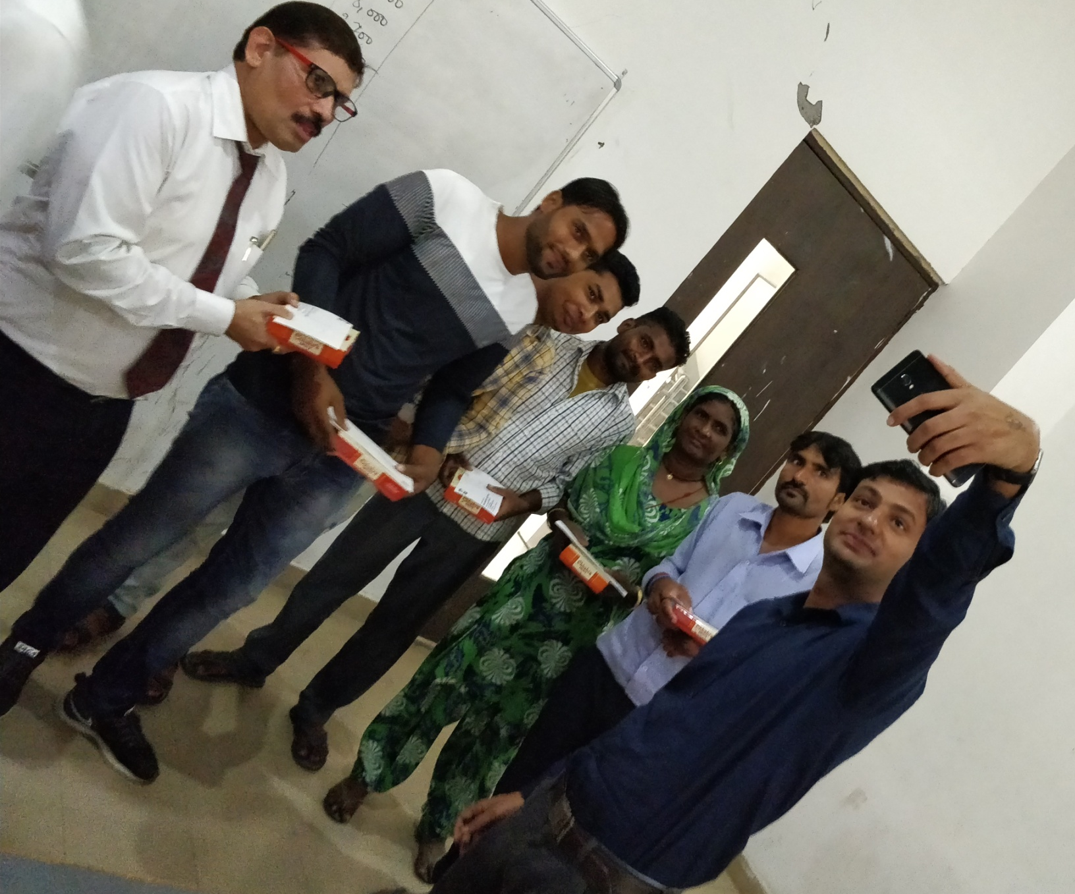
Happy moments

Slide 38
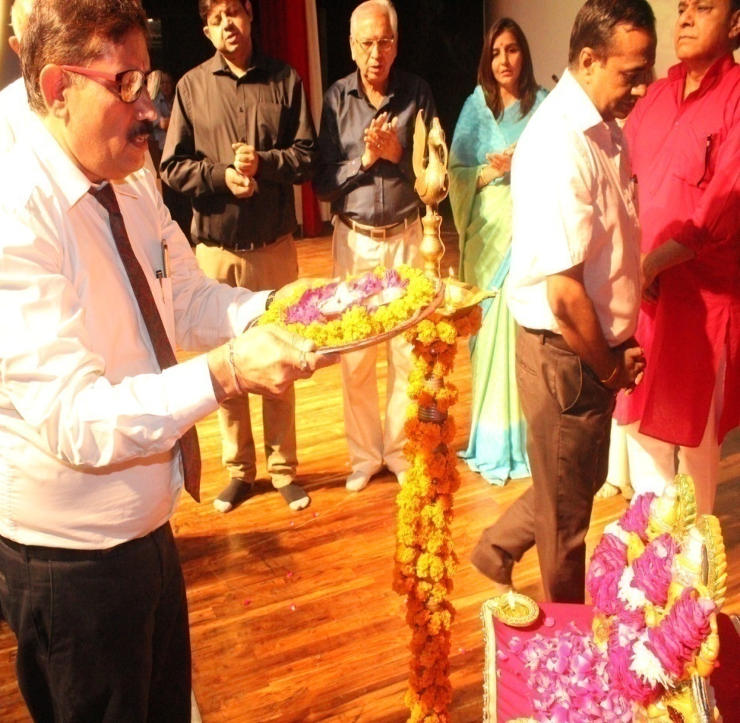
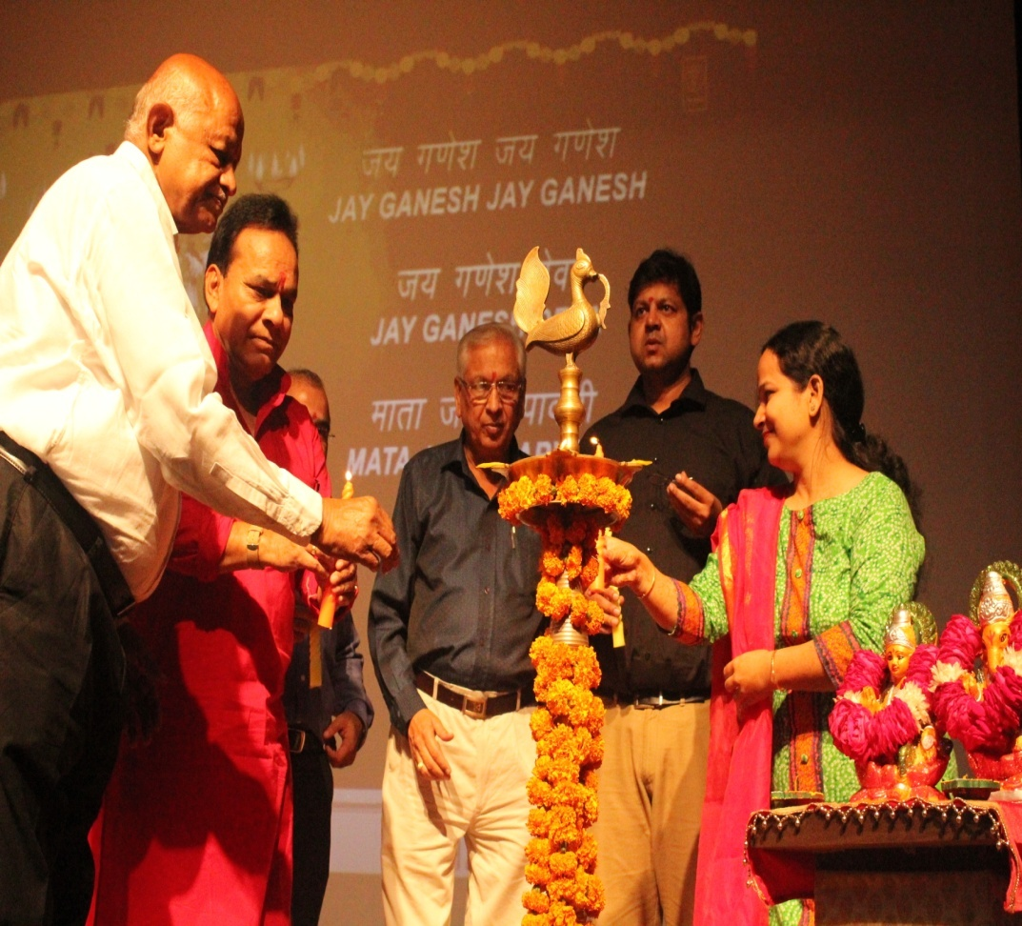
Diwali Poojan By Management and HOD sir

Slide 39
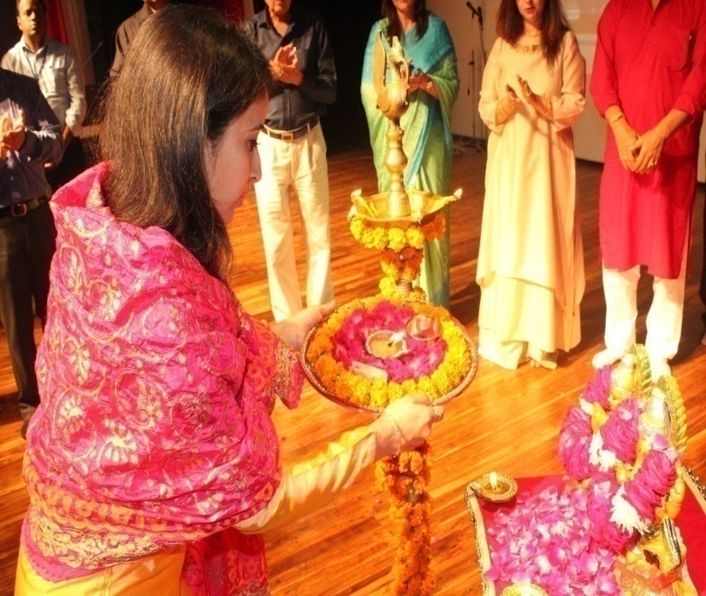
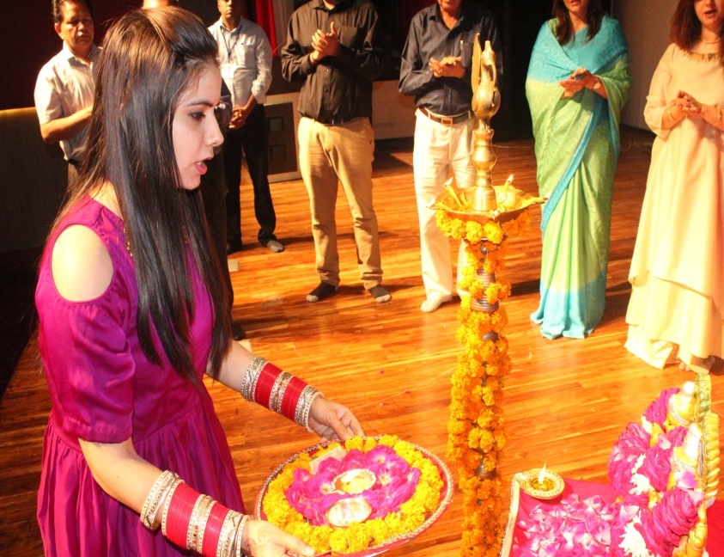
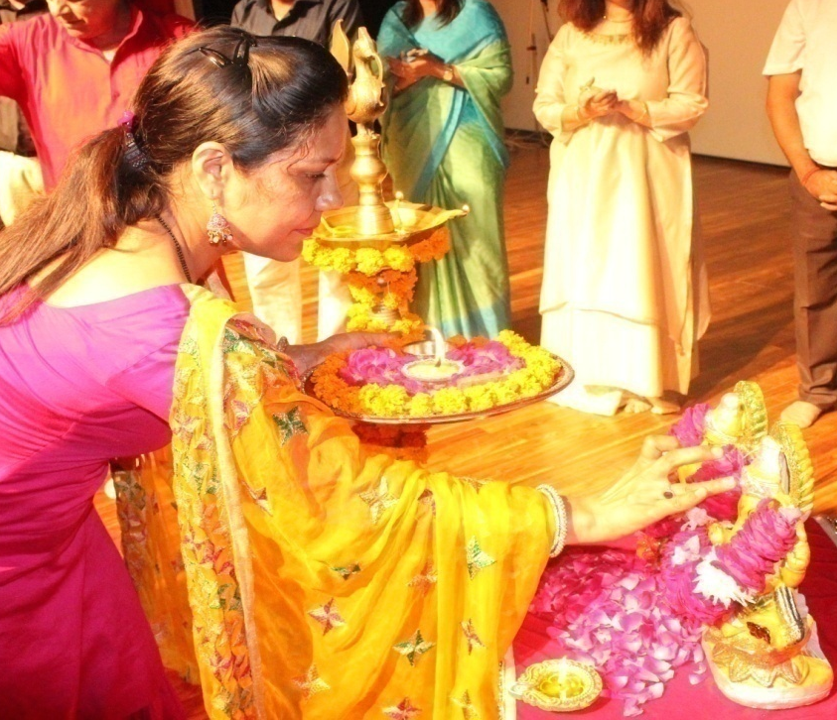
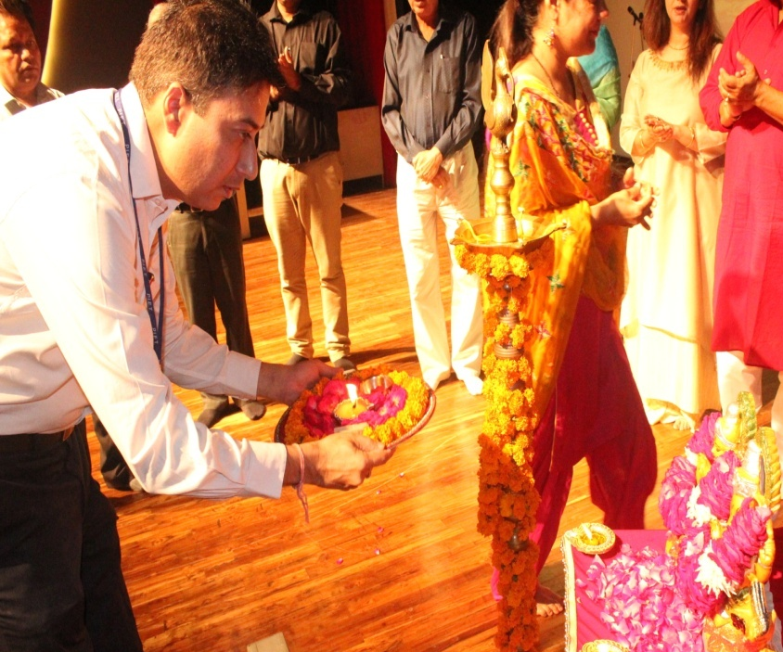
Diwali Poojan by BBA Faculties

Slide 40

Devotional Song by HOD sir and Team

Slide 41
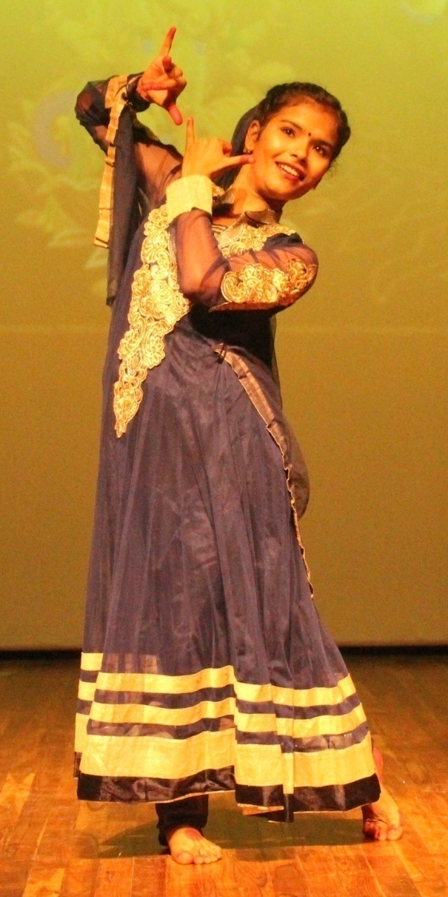
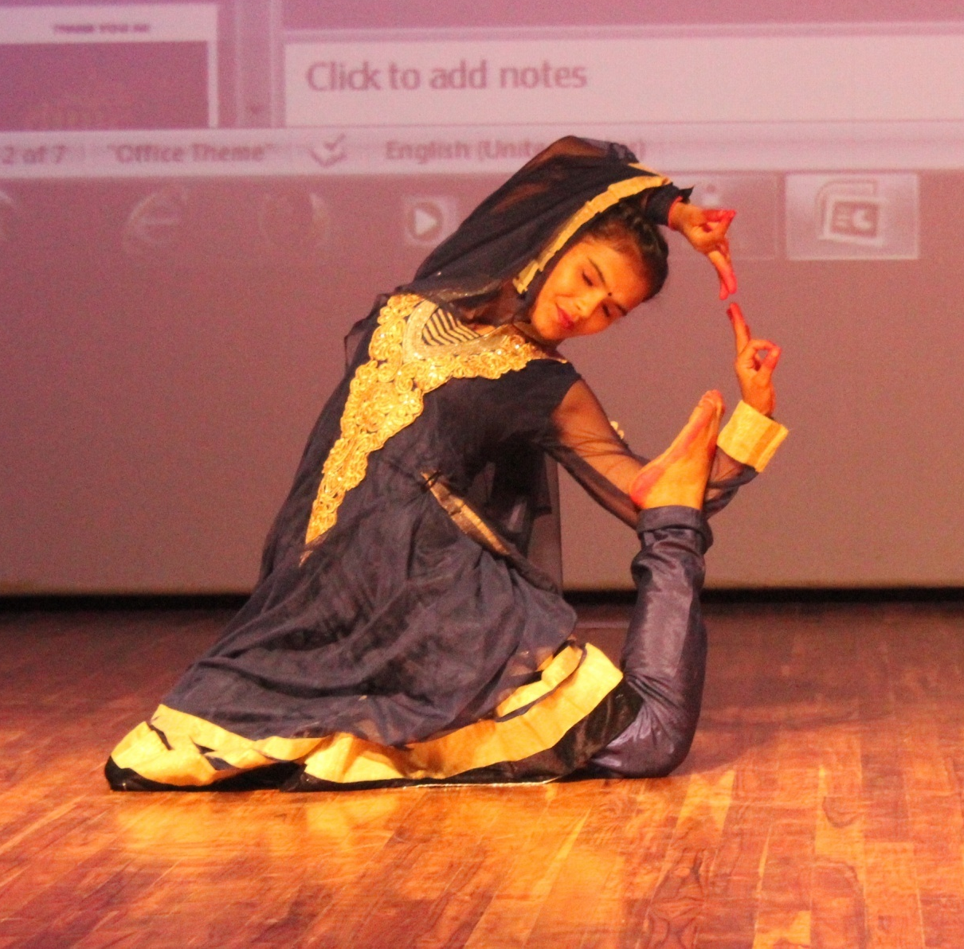
Dance performance by BBA 1st Year Student Mamta Pandey

Slide 42
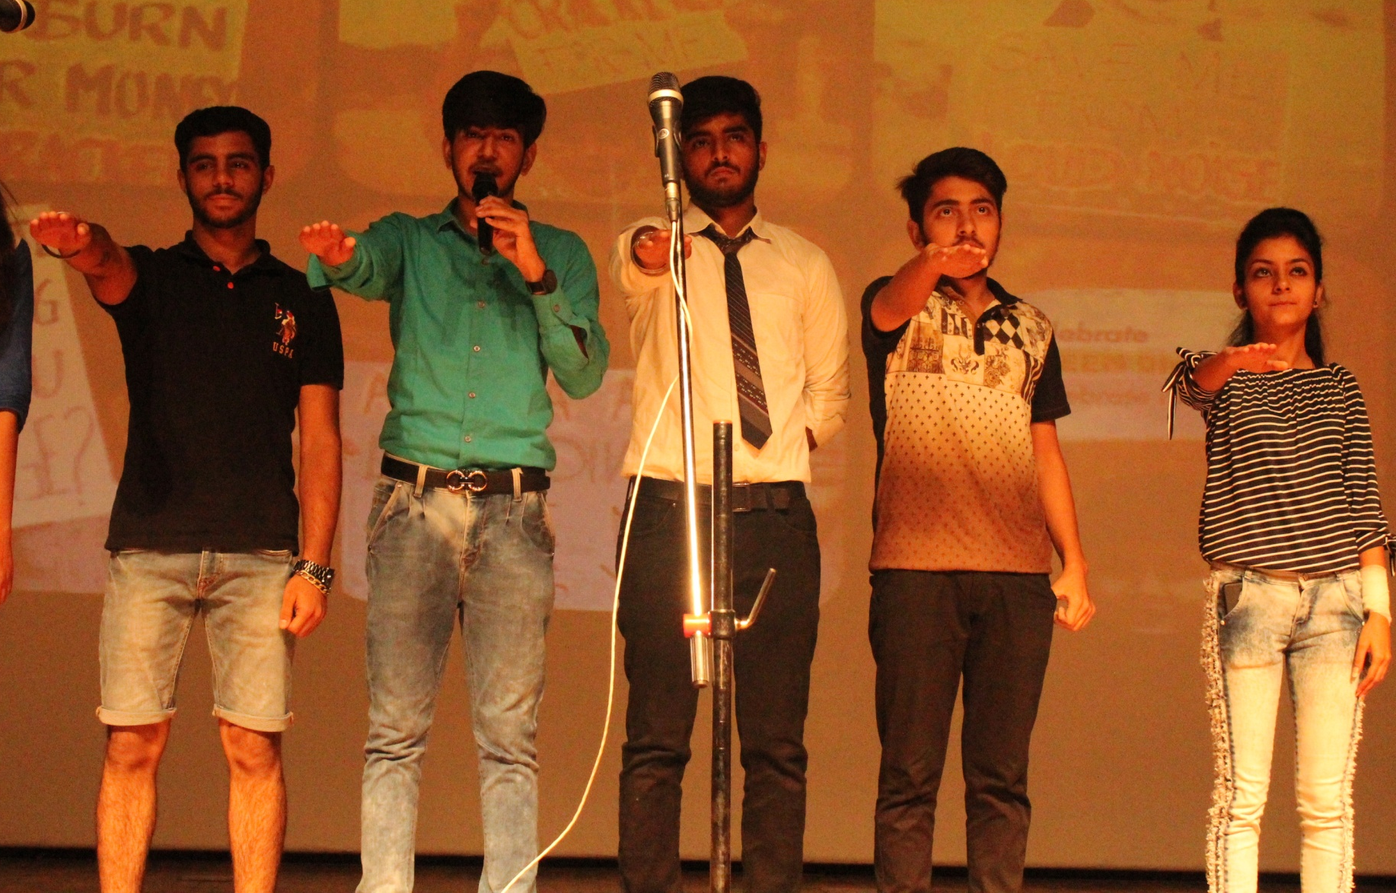
A Play on “SAY NO TO CRACKERS” by BBA Students

Slide 43
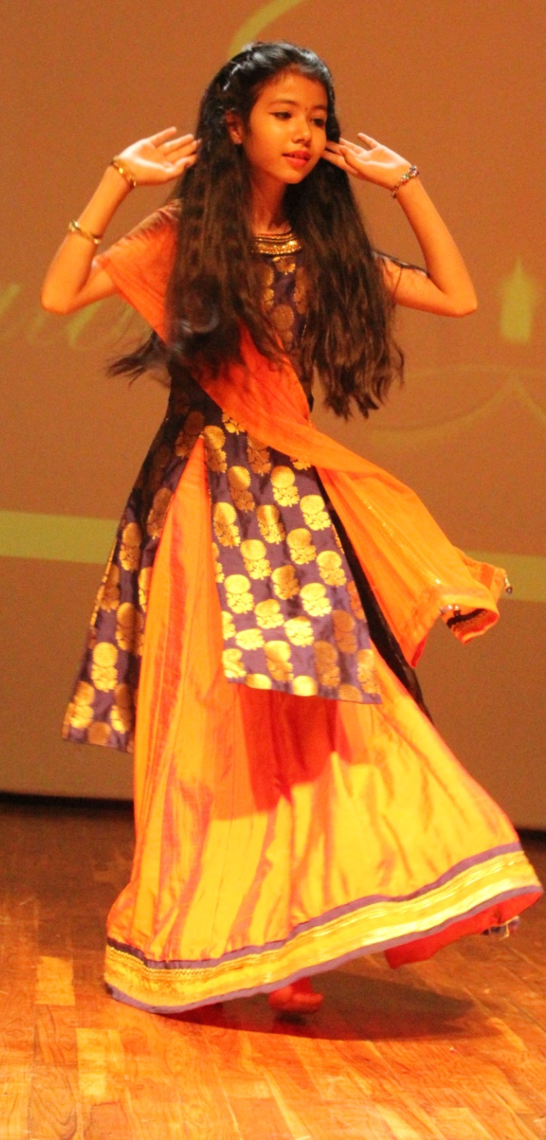

Dance Performance by Daughter of Mr. Atul Gautam (AP-BBA)

Slide 44

26/October/2017

Slide 45
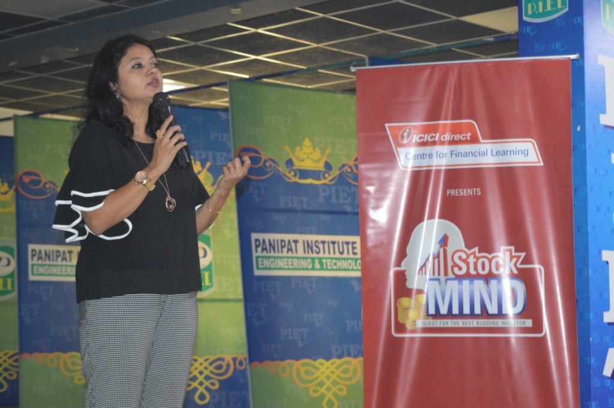
StockMIND is an annual, nationwide virtual stock market competition for college students. StockMIND is a real-world trading environment helps you sharpen your analytical, decision making and quick thinking skills. You can compete for the title of ‘Best Budding Investor’ not just within your college, but at the national level too!
StockMIND aims to provide students a platform to develop and sharpen skills that are highly valued in any industry. They might choose to make their careers in equity markets. Most importantly, the Stock Market Game will help you develop positive financial habits and prepare you for your future. And you can win attractive prizes at every level.

Slide 46
STOCK MIND
ICICI Direct Centre for Learning conducted a seminar on the above topic with an objective of enhancing financial literacy and to empower investors in taking better and informed investing decisions. The session was enthusiastically attended by BBA students who experienced it beneficial in understanding the fundamentals of trading and investment in stock market.

Slide 47
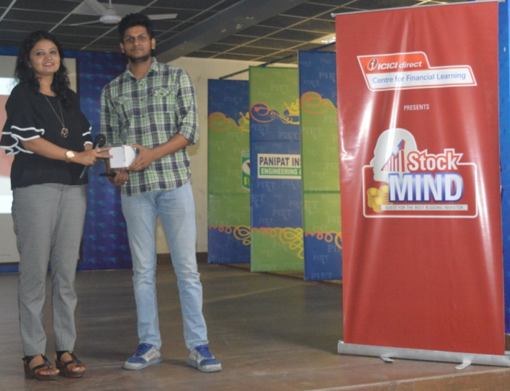
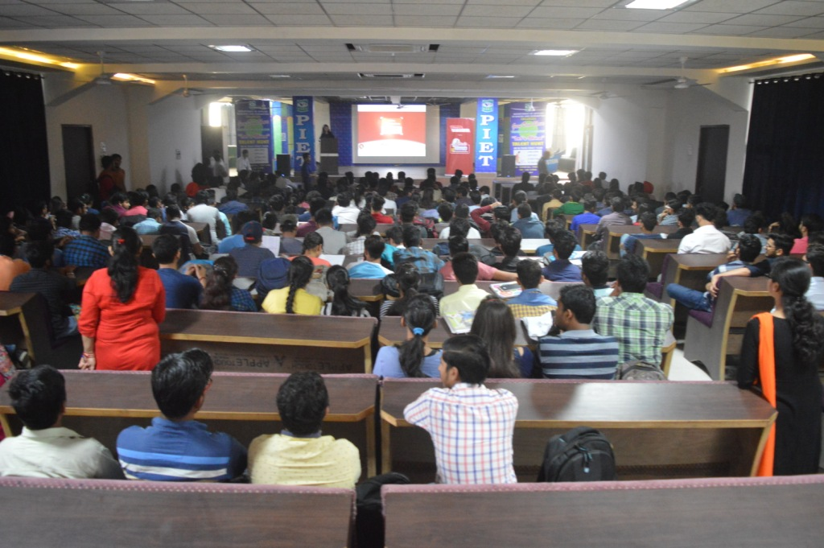



Slide 48

Here Comes 2nd Sessional exams
Having gone through full syllabus for the current semester time has come to put to test the knowledge gained by way of second sessional exam, which we strongly believe, helps students to prepare themselves for the University exams. This way testing system x-rays the strength and weaknesses that might have been and definitely goes a long way in establishing a strategy to fight off the weaknesses.
We wish you all good luck.
28/30/31 October 2017

Slide 49



Slide 50



Slide 51

HOW TO ANALYSE YOUR PERSONALITY
Ms. Monica Sawhney, Assistant Professor, BBA-PIET

Slide 52
HOW TO ANALYSE YOUR PERSONALITY
A.Reflecting on your personality
1. Identify your morals. Everyone has an inherent sense of what they know is right and wrong. Many call this their “inner voice” or conscience. When you understand your moral codes, you may feel good and pleased. When you don't listen, your "inner voice" may make you feel guilty, uncomfortable, or anxious.
2. Recognize your values. Values are the big ideas that shape your decisions. These ideas are broad goals like having financial security, being close to family, or staying healthy. When you can acknowledge your values, you can set goals that are in alignment with your personality. This will increase the likelihood that you meet your goals and lead a happy life. For example, if you value financial security, you could set the goal of having six months worth of salary in an emergency savings account. While this is hard to accomplish, if you are being true to your values, you have greater chance of succeeding.
3. Know what you are passionate about. While your values are the motivation behind your goals, your passions can provide the focus needed to reach them. You will know you are passionate about something if it holds your interest for extended periods of time. If you build a career (or even a hobby) around these passions, you will remain happier and more fulfilled than if you neglect them. For example, if your passion is art, you will be much happier in a career that focuses on art instead of a career in banking. Even if you are not an artist, you could do things like curate art, teach art, or write about art.

Slide 53
4. Understand your social needs. While all people need some general things like friends and a support structure, the degree to which one person needs them may vary. This is where the words introvert and extrovert come into play. Take notice of how you recharge yourself after a hard week. Do you go out with friends, or do you need some time alone? Understanding these needs will allow you to keep yourself balanced and happy as you march through your day to day life.
Extroverts enjoy being around people and being spontaneous.
Introverts enjoy time alone and planning their days carefully.
5. Acknowledge your strengths and weaknesses. No one is great at everything, and that’s okay. Recognize the things that other people acknowledge you for doing well, and the things they don’t. Also, pay attention to when you feel like you are succeeding in a task, and when you are struggling. This will start building your awareness of your own particular talents and abilities. When you know what these are, you can use that knowledge to improve your weaknesses or play to your strengths.
6. Get feedback. Ask your close friends and family how they see your personality. Compare what they say to how you feel about your personality. If they match, then it is likely that you display these traits consistently.
If several people close to you have very different views on your personality, you should examine your beliefs about yourself.

Slide 54
B. TAKING PERSONALITY TESTS
1. Understand what type of test is best for you. There are hundreds of different types of psychological personality tests that assess and measure your unique and individual variables. The type of tests that you choose will depend upon what it is you want to find out about yourself, how much time you are willing to commit to taking the test, what questions you are willing to answer, and how much you want to spend on taking the test. These tests may include:
Tests to measure your level of intelligence as well as your neurological and cognitive analytical functioning.
Tests to measure if you're an extrovert or introvert and how you work with others.
Tests to measure how you analyze situations and cope with varying types of stresses.
Tests to measure if you are more prone to certain types of mental health concerns.
Recognize that each test has its own strengths and weaknesses, and it will be up to you to do your research on the type of test that interests you.
2. Choose a personality test. Carl Jung is credited with starting our fascination with personality testing. In the early 1900s he developed a way to take inventory of a person’s particular traits. Since then this idea has been adapted to several different versions. Some popular ones include:
Personality and Preferences Inventory (PAPI) - This test is often used to screen candidates in a business setting.
Myers-Briggs Type indicator - This test is used to identify personal preferences in introversion, extroversion, sensation, thinking, intuition, and functioning.

Slide 55
C. Understanding Personality tests
1. Know the basis for most personality tests. Though this may not stand true for every test ever developed, most personality tests evaluate personality based on five traits (often called the Big Five). Each of these traits show up in some degree in all people, and your personality depends upon which ones are dominant. These five characteristics are abbreviated with the acronym OCEAN. The traits are as follows:
O is for openness.
C is for conscientiousness.
E is for extroversion.
A is for agreeableness.
N is for neuroticism.
2. Change parts of your personality that makes you unhappy. If you are not happy with your current personality, you can make changes. Just setting goals and focusing on the traits you want to display can effect short term changes in your personality. If you keep this going long enough, you can start to see yourself differently and alter your social and emotional self to the point that changes become long term.
If you are serious about changing major aspects of your personality, you may want to consult a mental health professional. They can offer guidance and supervision to help you attain your goals in a safe and responsible way.

Slide 56

BBA, HOD
(Dr. Yoginder Singh Kataria)
BBA, E-Committee
(Mr. Jagmohan Malhotra)
(Ms. Sakshi Garg)

