Slide 1
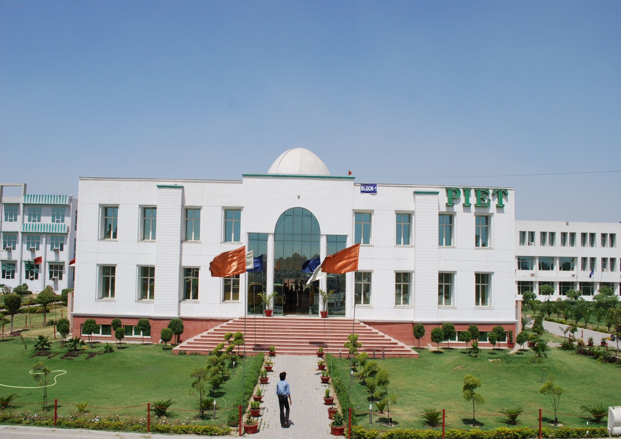


Slide 2





Slide 3


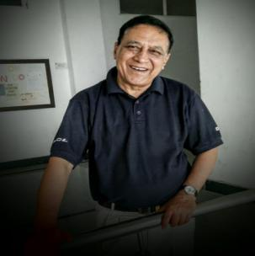
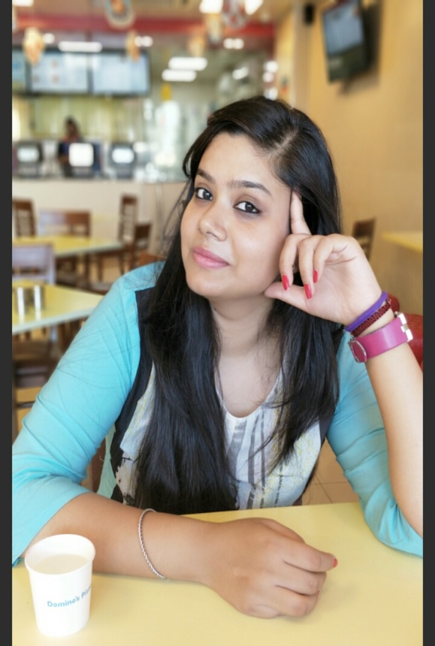
Message from the Editorial Team
It gives us immense joy and satisfaction to finally flash on your laptop screens your very own college e-magazine. Just like the gods and the asuras churned the ocean to extract the nectar, we have tried to churn out creativity from this amass of brilliance in BBA. A lot of efforts have gone into BBA Star round 1 attended by as many as 210 students across three years and 14 sections, which would still require at least two more rounds to churn the cream.
It all happened while the month was already marked by very important events like Teachers’ Day, Blood Donation Camp, Youth Conference, Hindi Diwas on the one hand and Surprise Objective Test (SOT) and preparations for CARBUNCLE on the other.
While all activities do not match an inch with one another, the quality of BBA students lies in smooth sailing with the rise and fall of waves.
We hope you enjoy reading the magazine which represents the creative side of students to a fair degree-something that we think we all need to reconnect with. Amidst the busy schedule of a 4-month semester, with 3-exams, surprise quizzes and all those assignments and problem sheets that make you want to bang your head on the wall, we tend to lose track of all the other simpler things that we are capable of, things that we could have been proud of, that can bring one satisfaction. So this time we have made an attempt to bring out the talent concealed within our student community in a newer way. This issue includes highlights of such events. We hope you enjoy reading this issue as much as we have enjoyed making it.
Prof. Jag Mohan Malhotra
Prof. Sakshi Garg

Slide 4



Slide 5
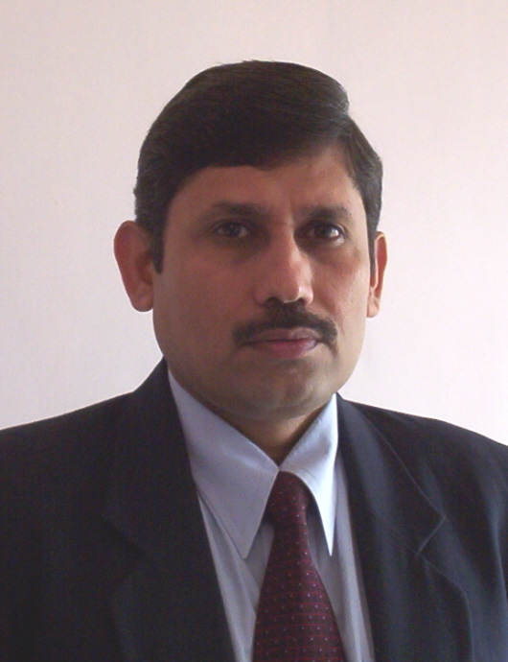

Dr. Yoginder Singh Kataria, HOD, BBA

Slide 6
From the HOD’s Desk
"We cannot always build the future for our youth, but we can build our youth for the future."
- Franklin D. Roosevelt
These words by Franklin D. Roosevelt perfectly describe our aim at Panipat Institute of Engineering and Technology. Beyond providing a sound education, we wish to provide our students a holistic learning experience for life. Our aim is to teach students to LEARN, not just STUDY. Hence, we strive to travel beyond the boundaries of mere books. We have realized that the future is abstract and unknown but the youth in our hands are real and can be molded.
Dear students, "You are the nation-builders. You are the movers of technology. You are the agents of change." It is our fervent hope that the years that you spend in PIET would enable you to equip with leadership and managerial skills. The knowledge that you will gain, the fine qualities that you will imbibe and the technical skills that you will learn to apply will be your major contribution to your parents, to society, and to the nation.
We invest our trust on you. You are our safe source and we bank all our efforts on you. We create not the future instead we craft you for the future. There are strong challenges to great efforts but, always remember, great effort bears the sweet fruit of success. We want you to taste the fruit of success once and for the rest of your life, you will never rest.
"You don't have to be great to start, but you have to start to be great.“
Dr. Yoginder Singh Kataria
HOD, BBA

Slide 7


5 September 2017

Slide 8
Teachers’ Day
5th September, the birthday of a great scholar, Dr. S Radhkrishnan, was celebrated at PIET with great zeal and vigour in three phases.
In the first phase a ‘Blood Donation’ camp was organized in collaboration with Lion’s Club and 150 units of blood were donated by PIET students.
In the second phase it was activity time for college faculty to exhibit their talents in dance, song and drama.
In the third phase Teachers not only from PIET but from other schools and colleges were also honored by Mrs. Monika Singh, IAS, Joint Commissioner Income Tax and Shri Deep Chan Nirmohi, a renowned author and social worker.
From BBA department Dr. Saurabh Garg and Prof. Rajesh Kumar were awarded as ‘Best Teachers’ and Prof. Charan Singh was awarded for ‘Best Idea’ contribution for improvement of the college.

Slide 9
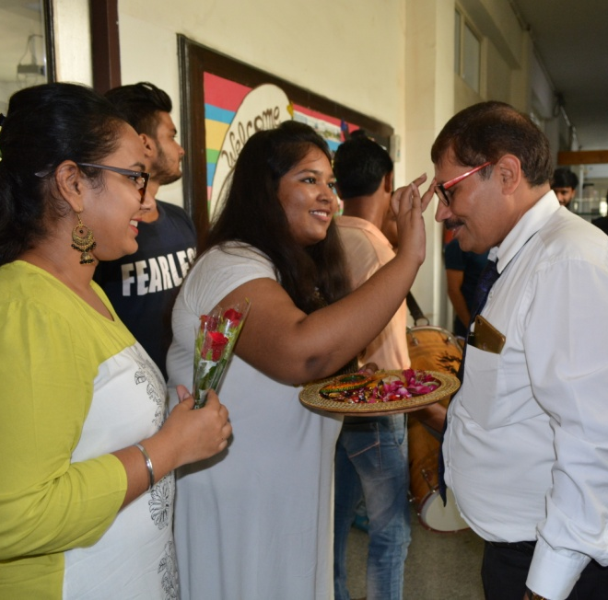
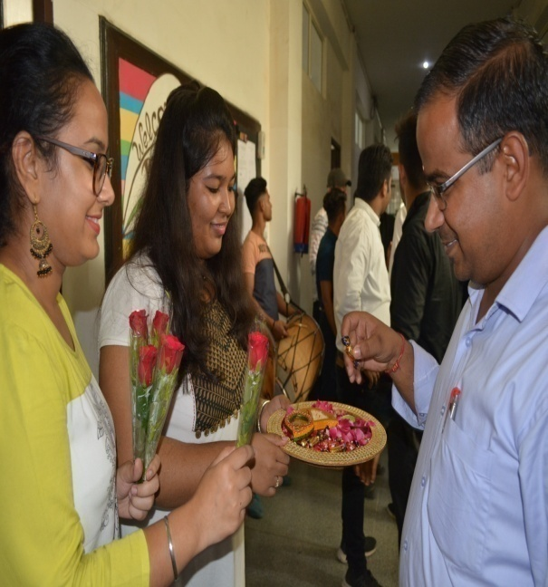
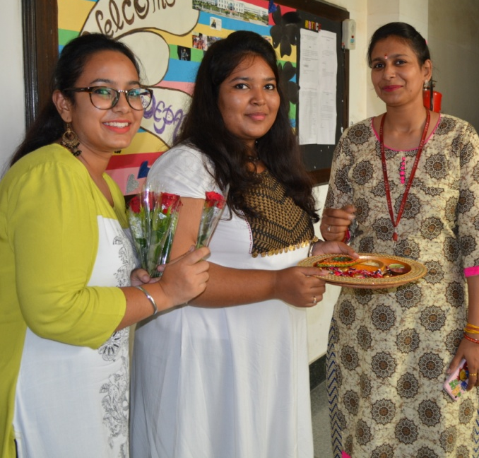
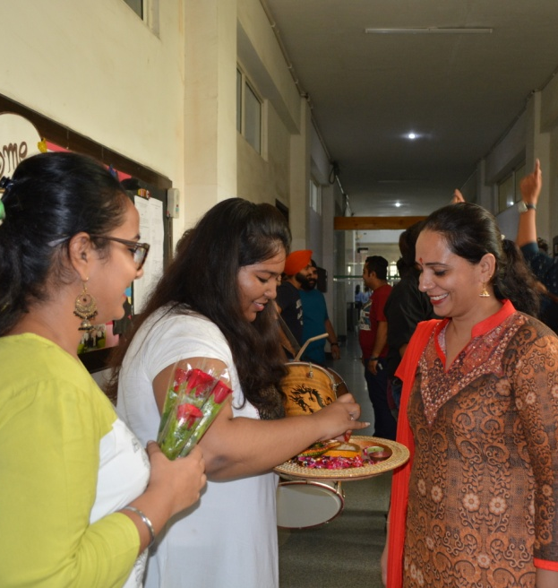
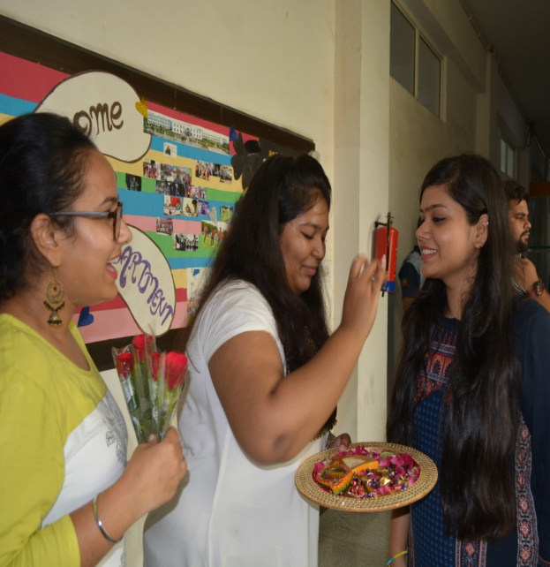
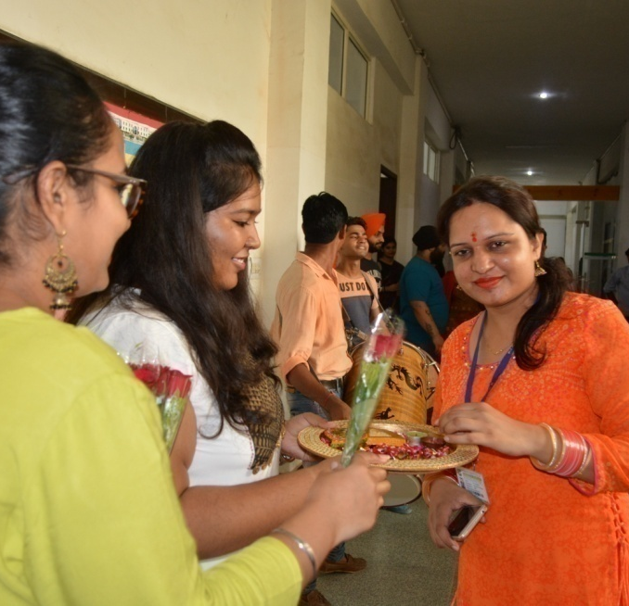
Students of BBA Welcoming Teachers.

Slide 10
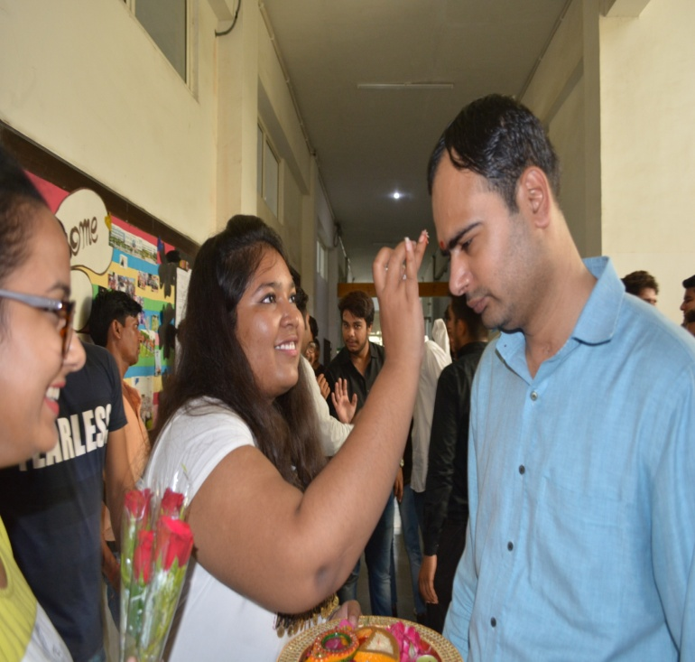
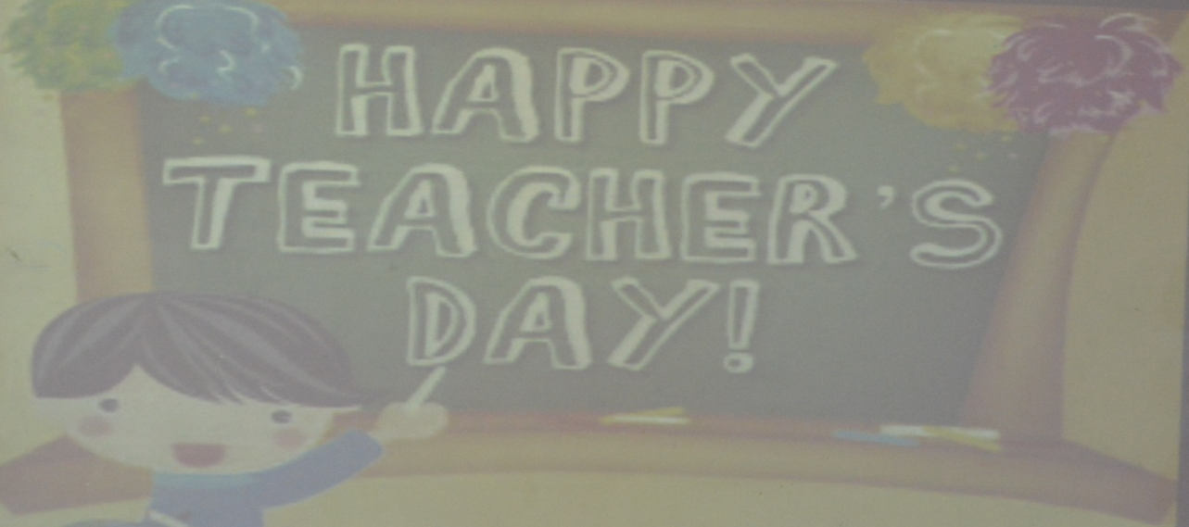
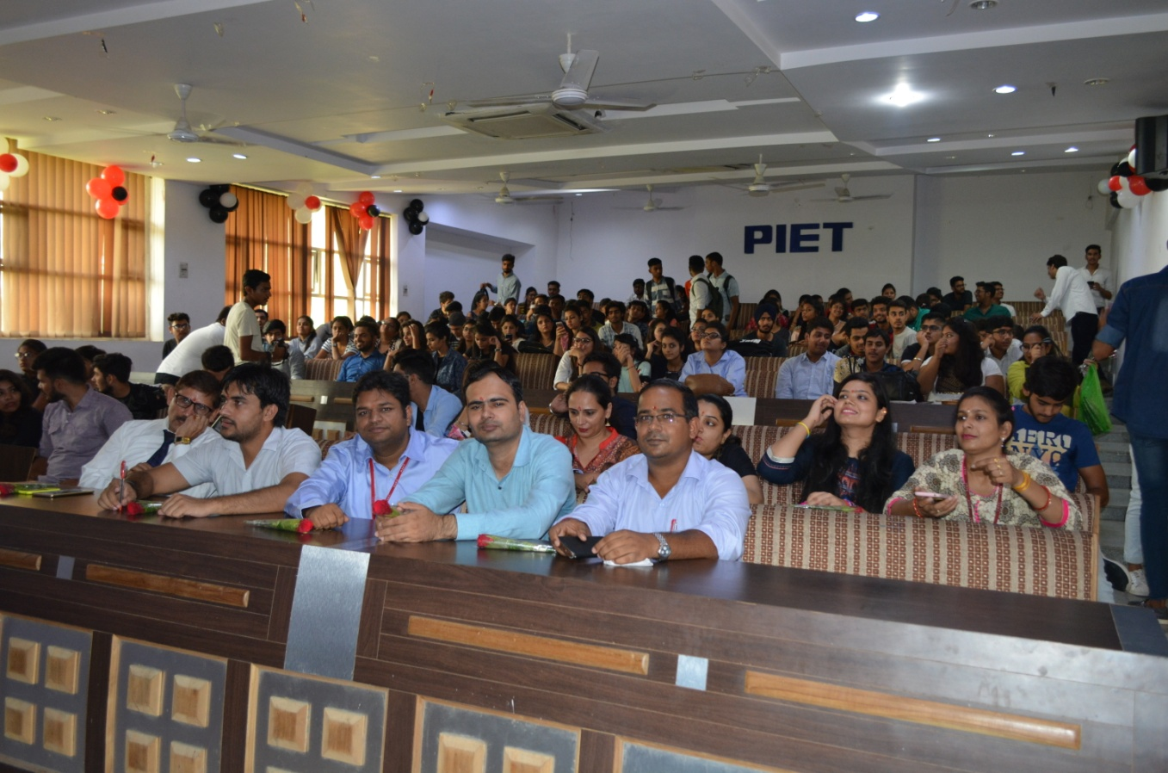
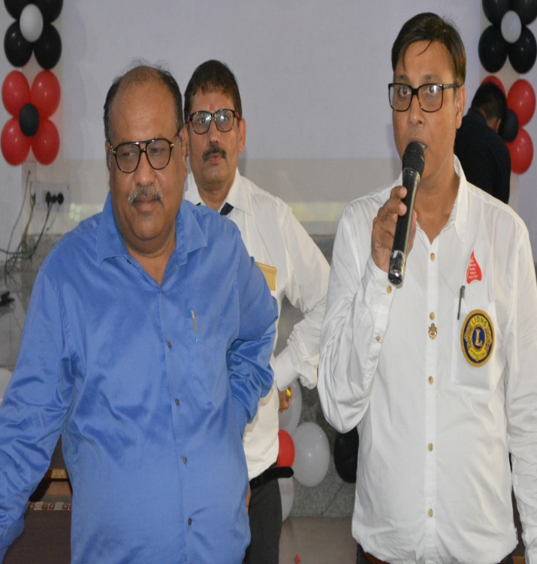

Slide 11
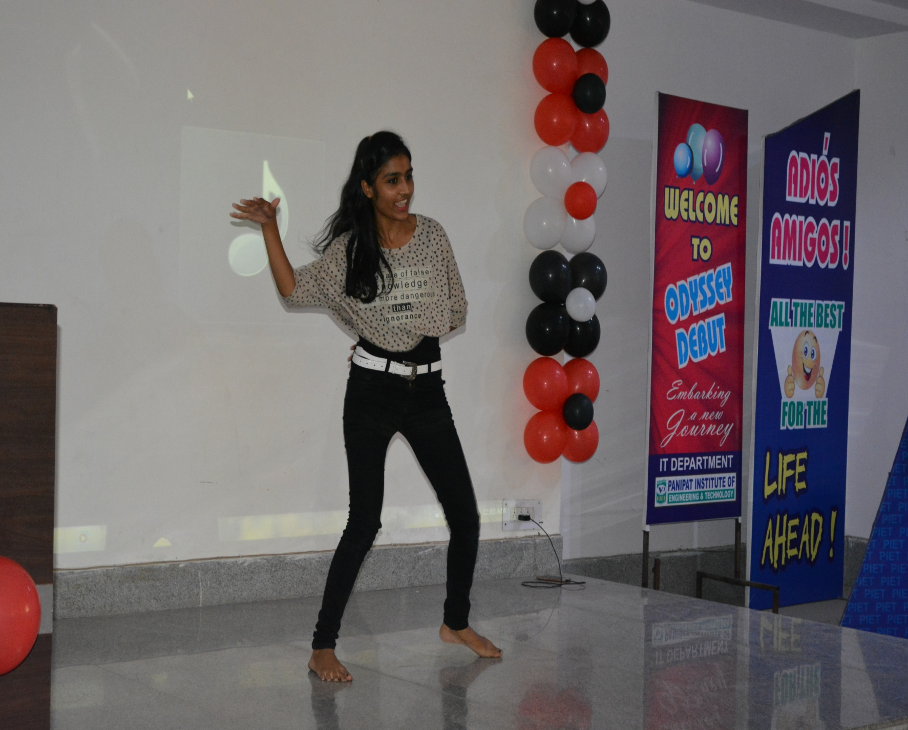
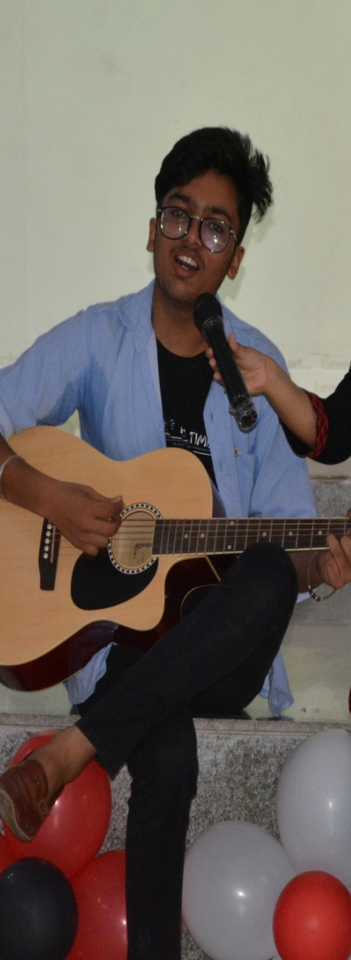
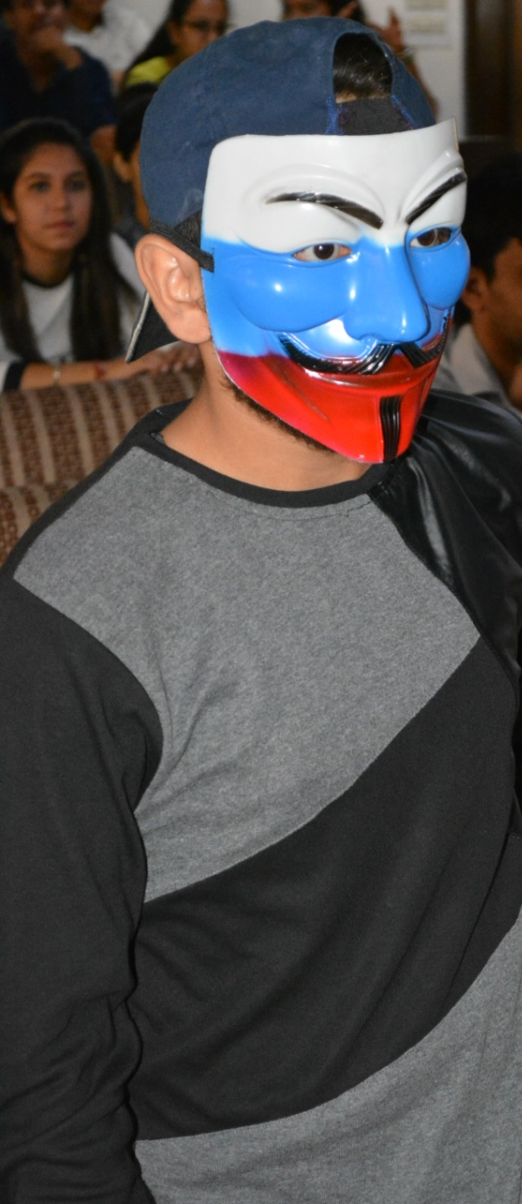
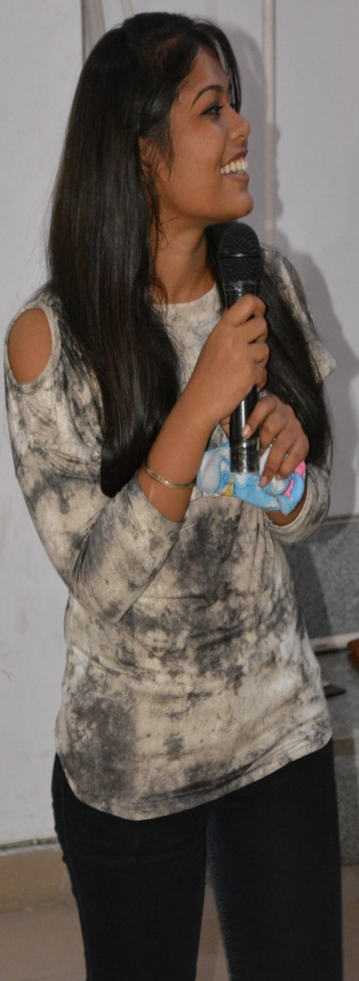
BBA 1st Year performing on Occasion of Teacher’s Day.

Slide 12
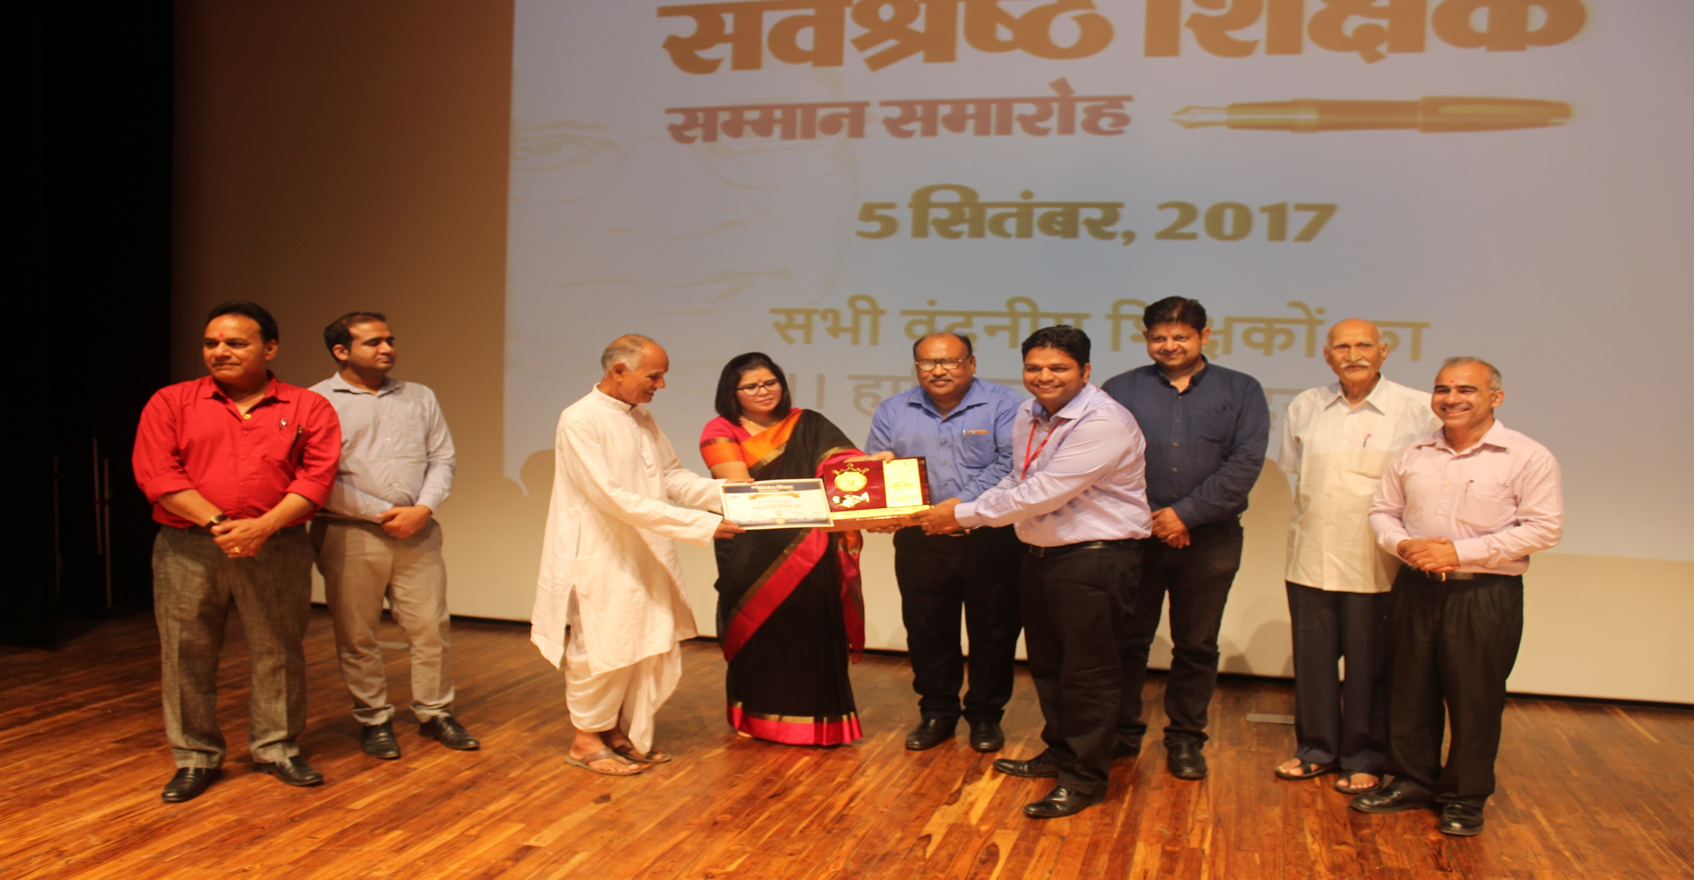
Dr. Sourabh Garg (Associate Professor-BBA) getting award for “Best Teacher”

Slide 13
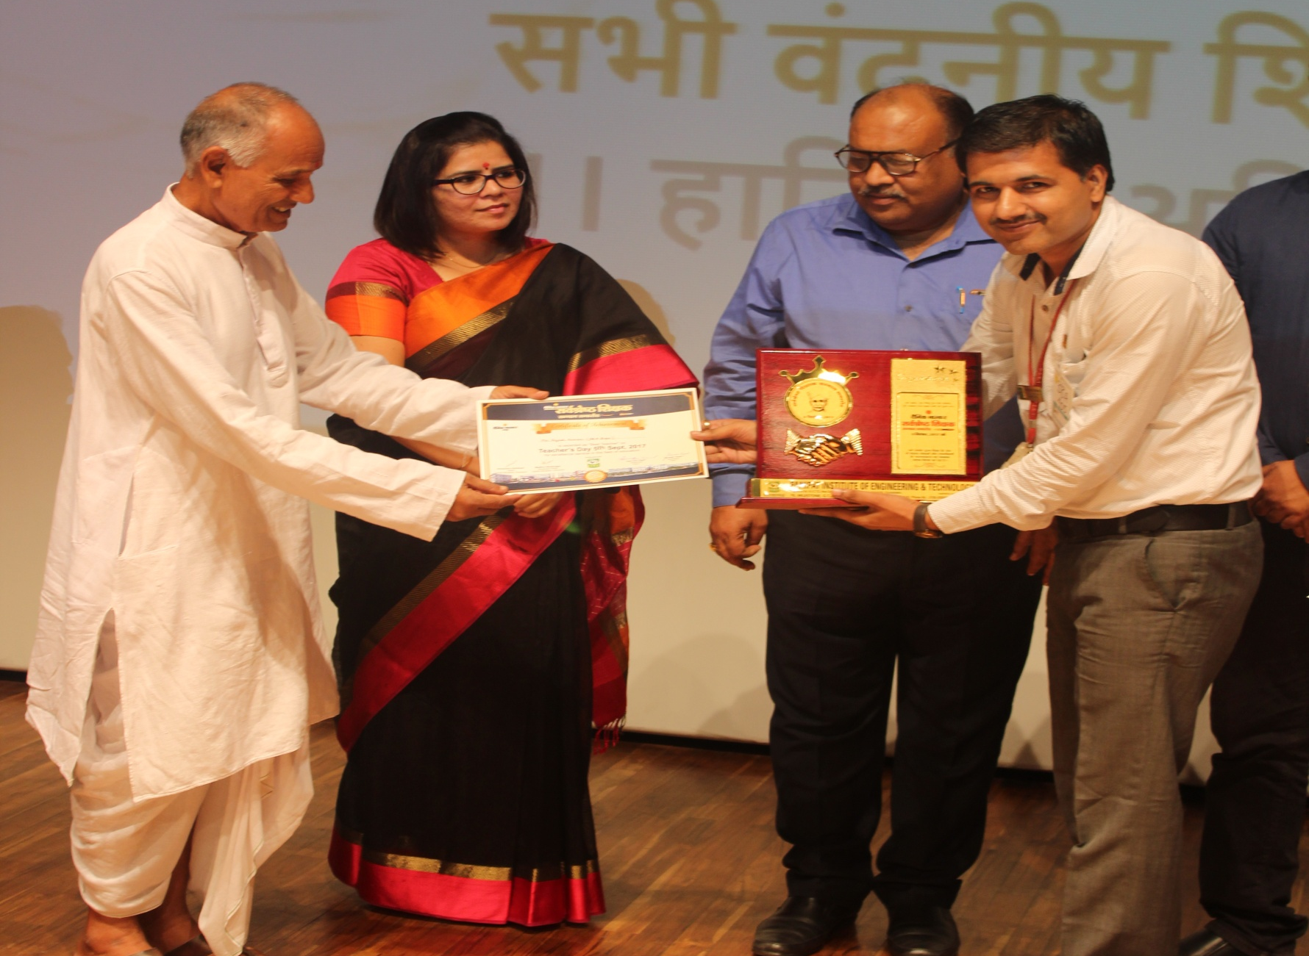
Mr. Rajesh (Assistant Professor-BBA) getting award for “Best Teacher”

Slide 14
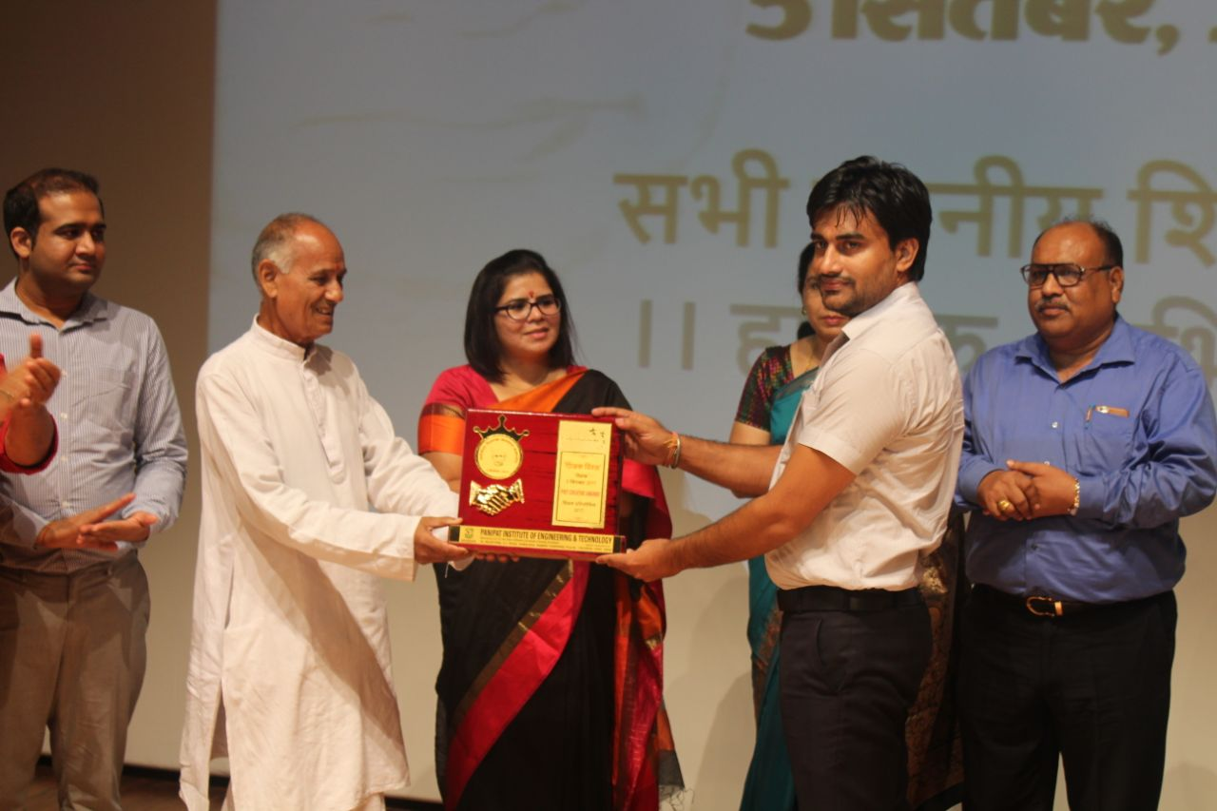
Mr. Charan Malik (Assistant Professor-BBA) getting award for “Most creative idea for PIET”.

Slide 15



5 September 2017

Slide 16
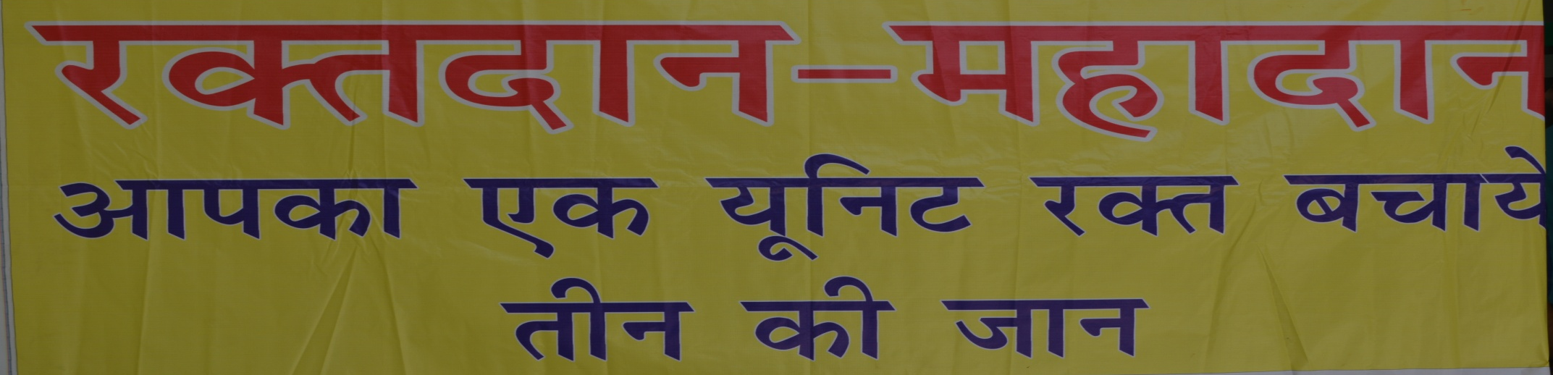
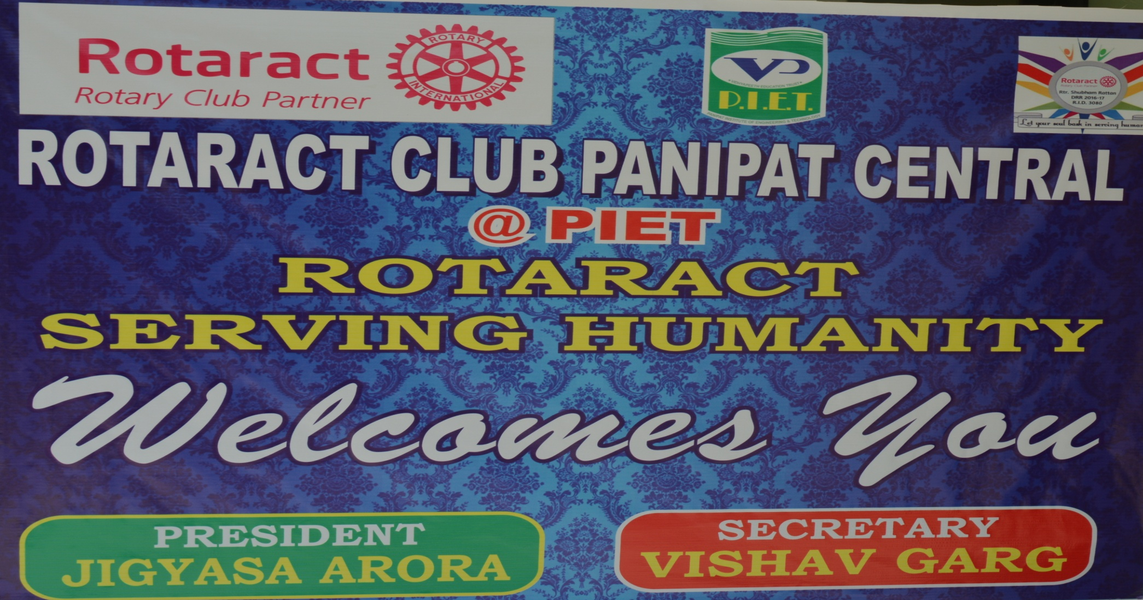

Slide 17
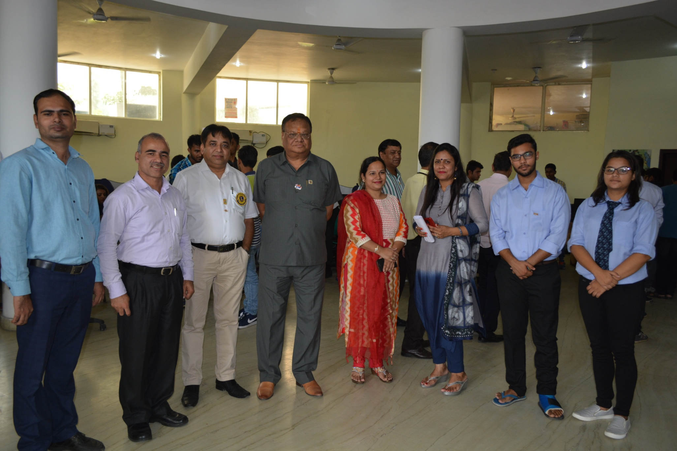
Blood Donation Camp Coordinated by Ms. Preeti Dahiya(AP-BBA) And Vishav & Jigyasa(BBA 2nd and BBA 3rd Year)

Slide 18
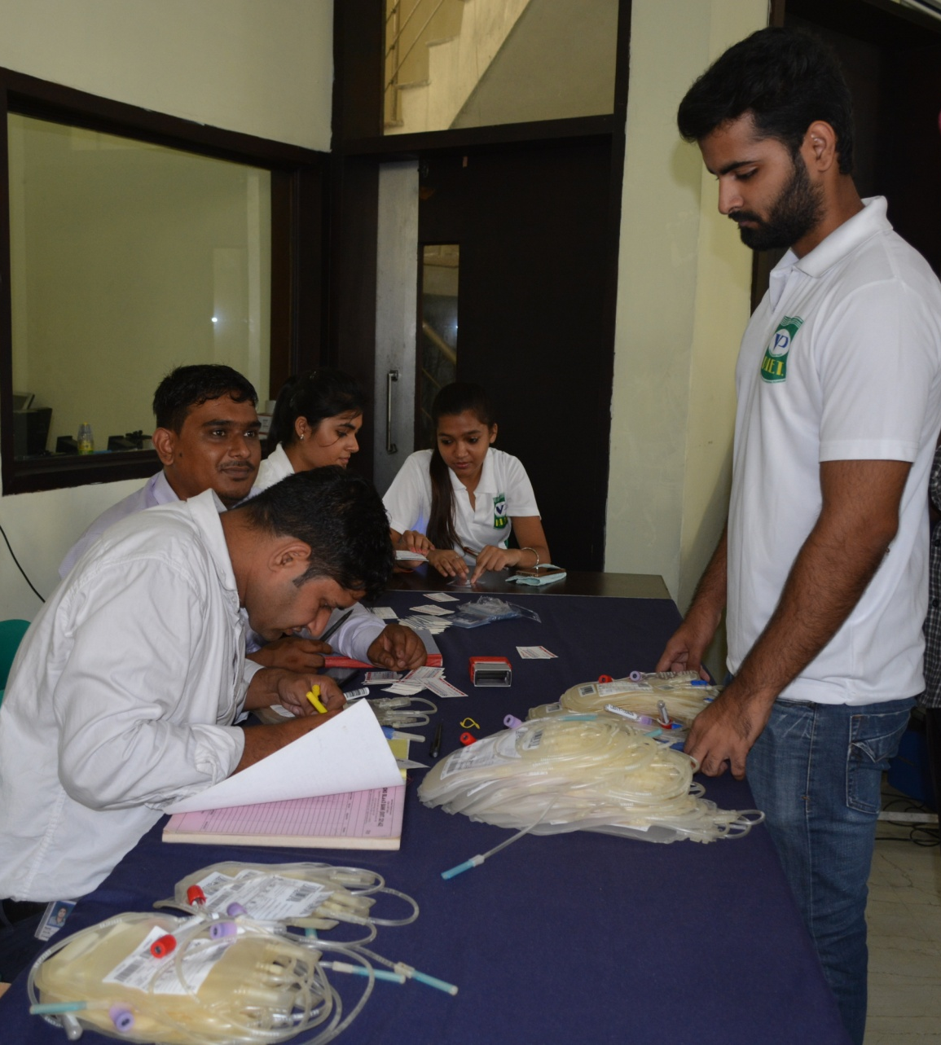
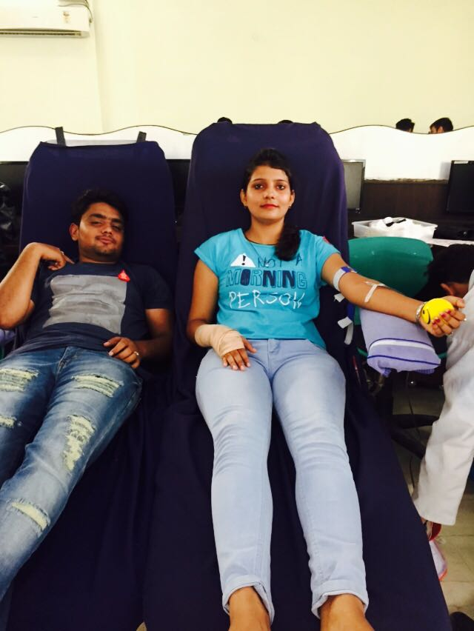
Sakshi and Bharat BBA 2nd year Donating Blood

Slide 19



4 September 2017

Slide 20
University positions BBA (2016-19) 2nd Sem
ROLL NO | SECTION | NAME | TOTAL | UNIV POSITION
0006874266 | A | TWINKLE SADANA | 0517 | 3rd
0006874086 | D | NEHA ARYA | 0514 | 6th
0006874262 | D | ASHIMA JAIN | 0508 | 8th
0006874062 | C | AARTI SHARMA | 0507 | 9th
0006874177 | E | MANSI | 0503 | 10th
0006874210 | B | RISHABH RAJBHAR | 0502 | 12th
0006874188 | B | KUNJAL GARG | 0501 | 13th
0006874130 | D | REEMA CHUGH | 0500 | 14th
0006874135 | B | MAMTA | 0500 | 14th
0006874205 | B | ANSHIKA MITTAL | 0500 | 15th
0006874348 | C | NANCY MITTAL | 0497 | 16th
0006874230 | A | SAUMYA | 0495 | 17th
0006874115 | C | TANYA | 0494 | 18th
0006874192 | A | MANPREET KAUR | 0488 | 20th

Slide 21

SURPRISE OBJECTIVE TEST
8/11 September 2017

Slide 22
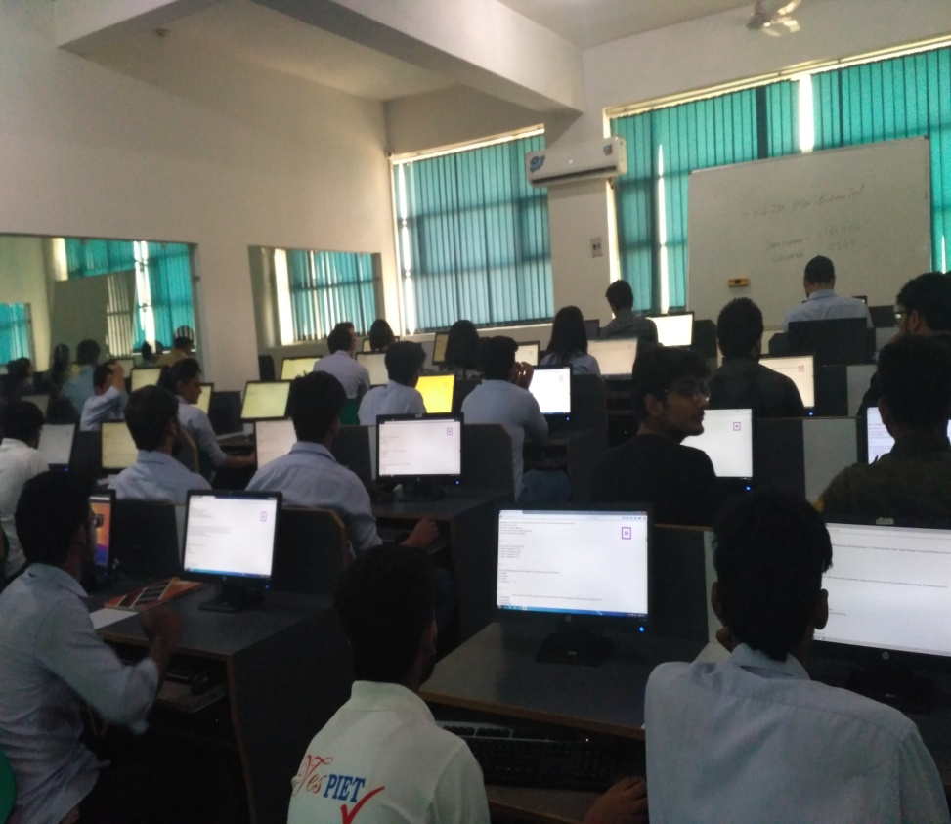
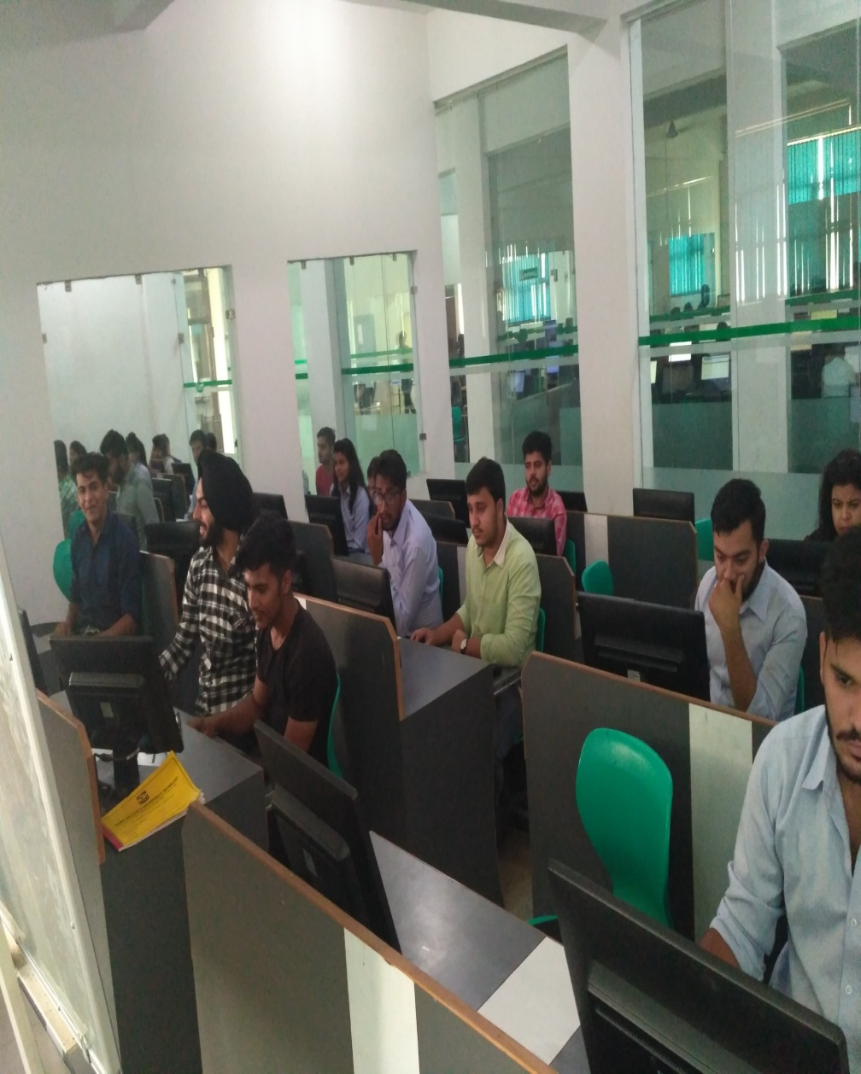
The first SOT was held on 8th sept and was successfully conducted.

Slide 23


8 September 2017

Slide 24
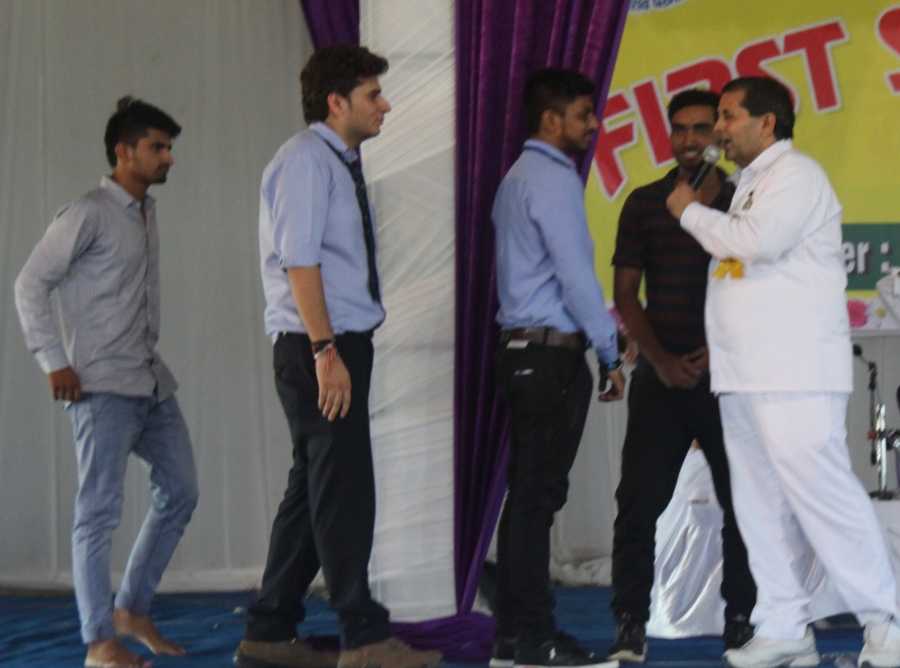
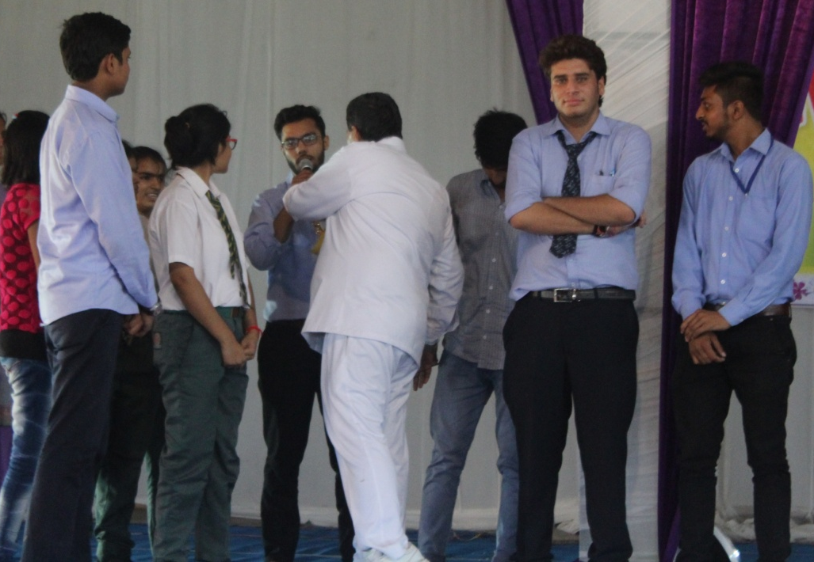
A soulful session of youth development for PIETians was organized by pure and human souls BRAHMAKUMARIS on 8/09/2017 at Madlauda.(Panipat)
Around 100 of students attended that event.
Their valuable words enlightening candle to those fortunate kids who got the privilege to attend that youth development session. The calmness of the place was so divine that it left us stunned and their valuable speeches were so good.
Under the guidance of those people we learned to cope up with the issues the face in our daily life. Over and all it was such a divine experience to witness.

Slide 25

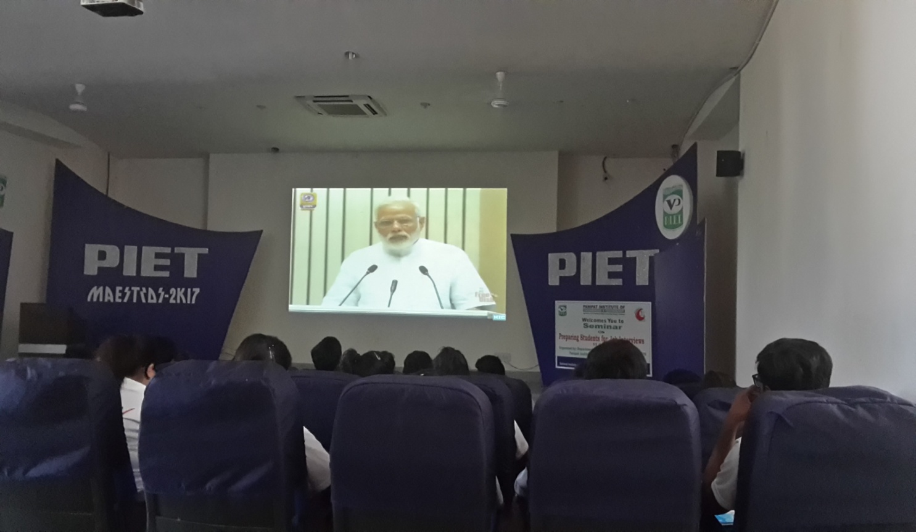
11 September 2017
On 11th september BBA students attended the virtual live session of the Prime Minister on ‘Young India, New India’

Slide 26
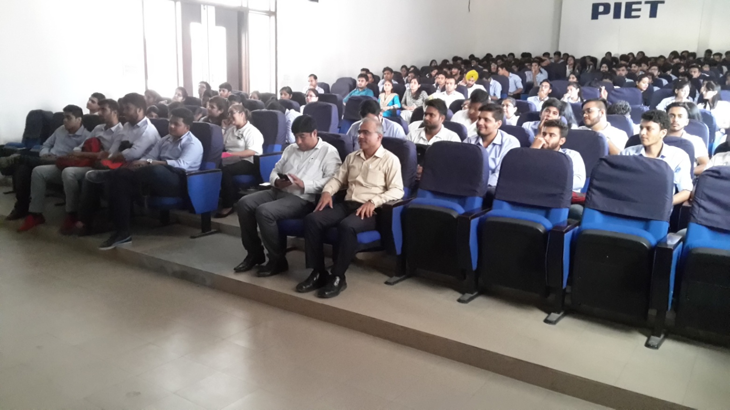
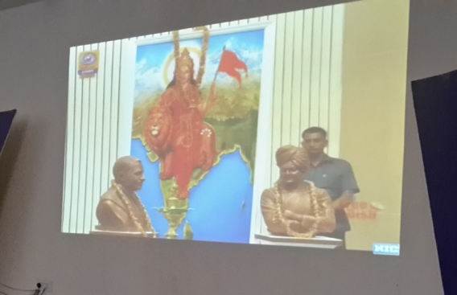
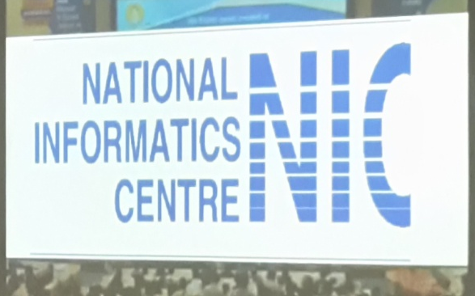
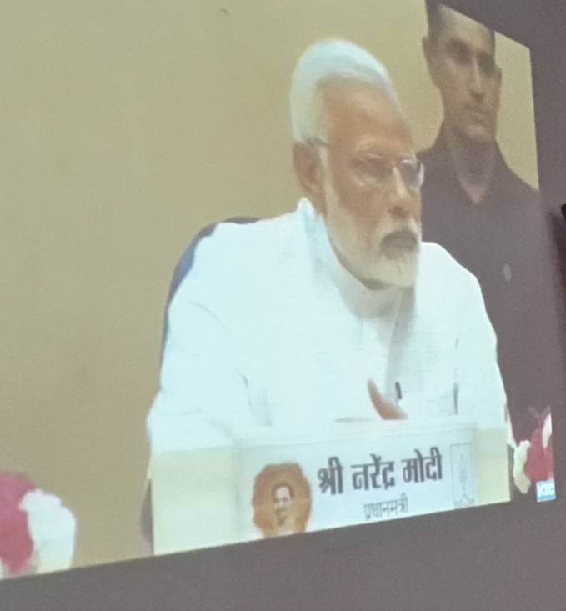
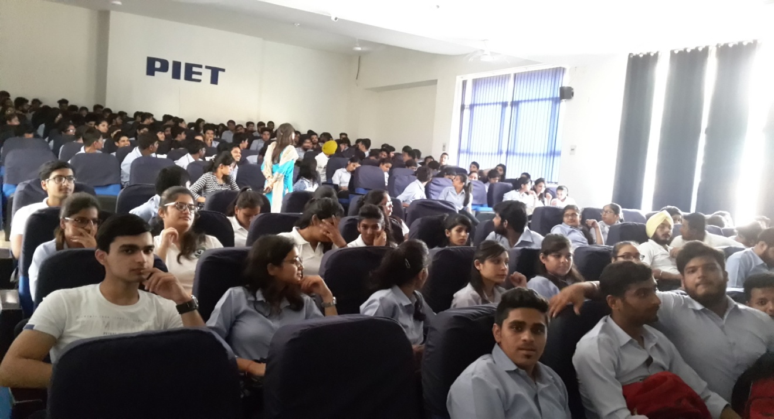

Slide 27

BBA STAR PROGRAMME

Slide 28
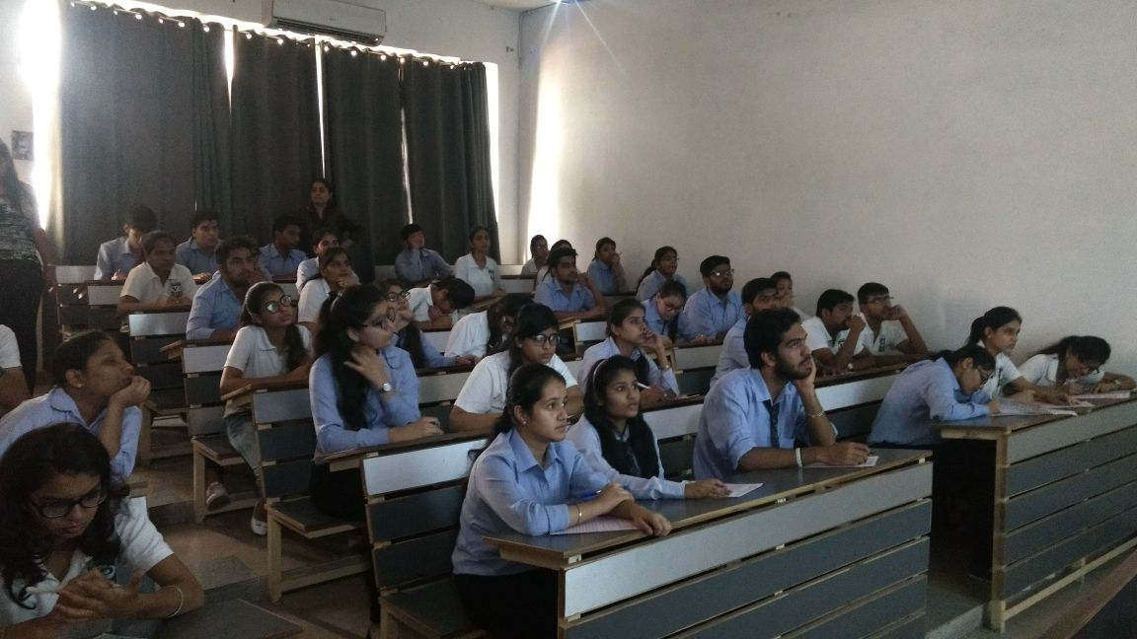
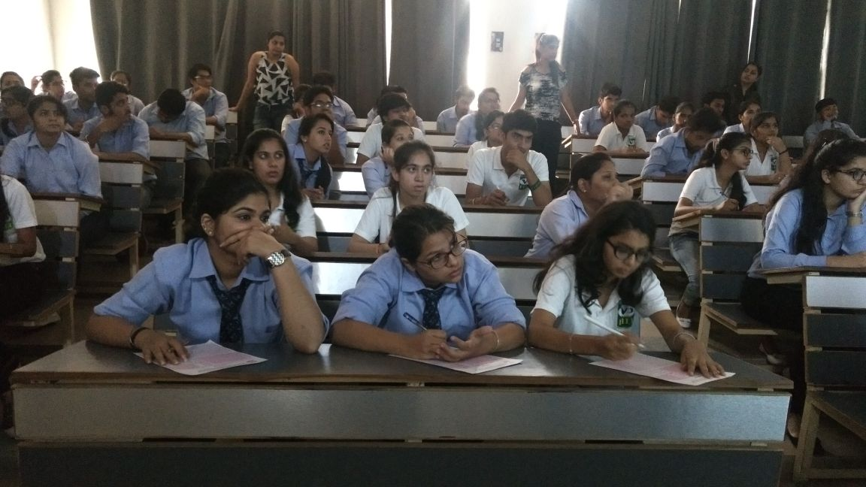
ROUND-1 Written Test
11 September 2017

Slide 29
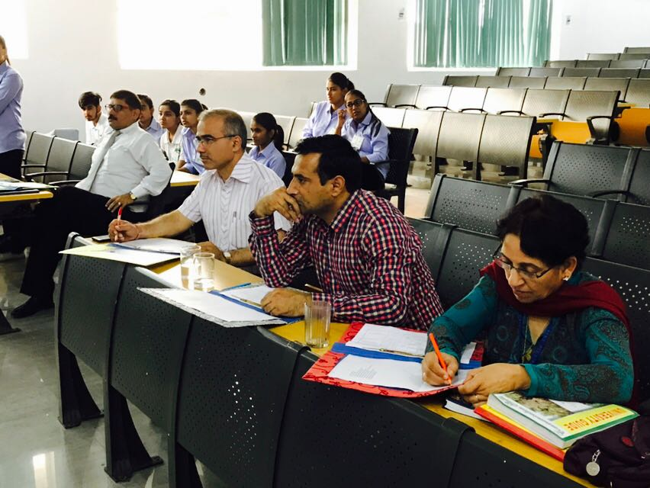

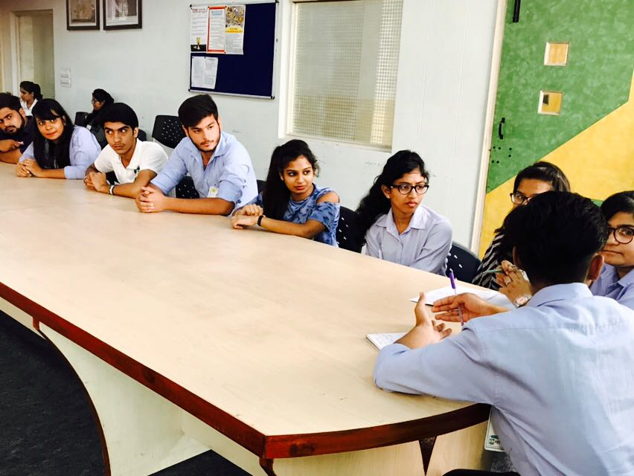
ROUND-2 Group Discussion
22 September 2017

Slide 30
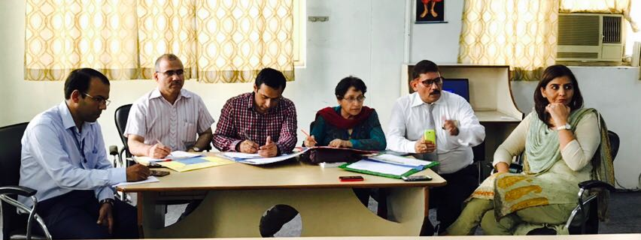
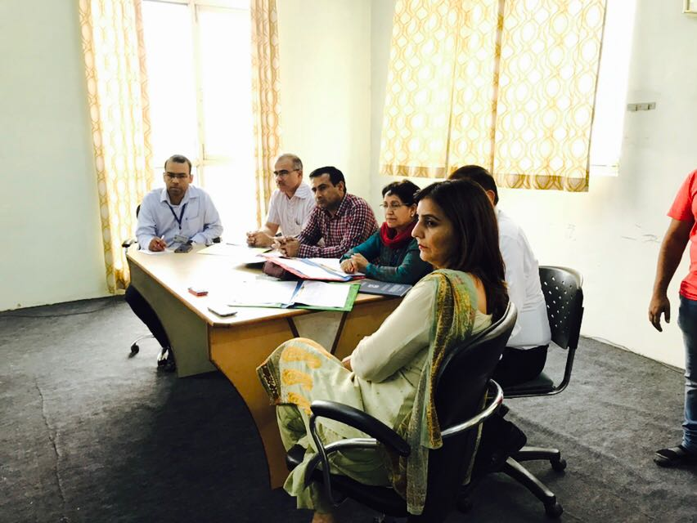
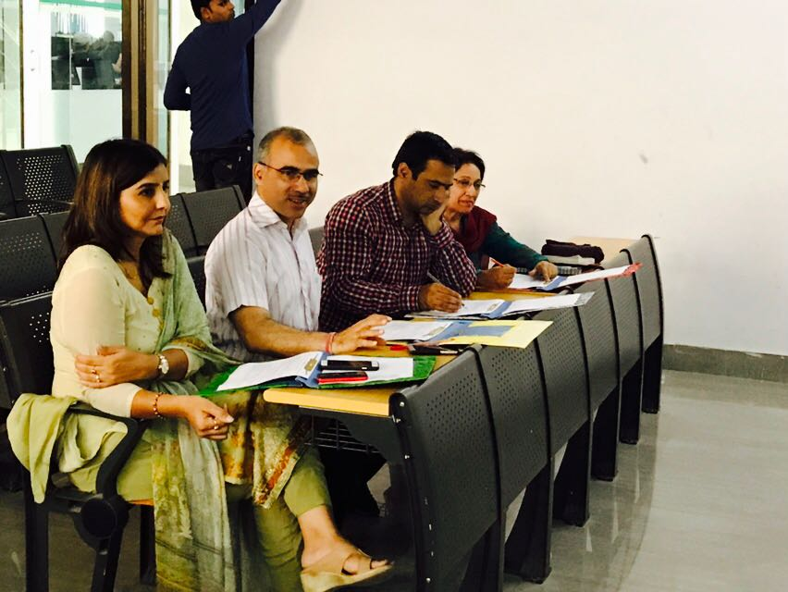

Slide 31
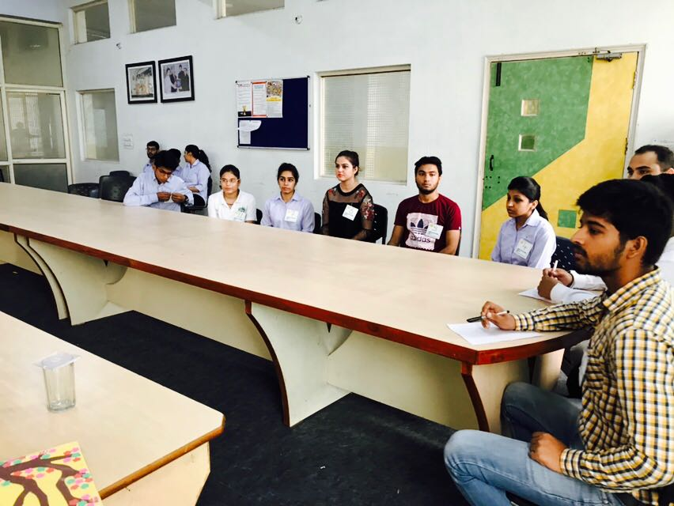
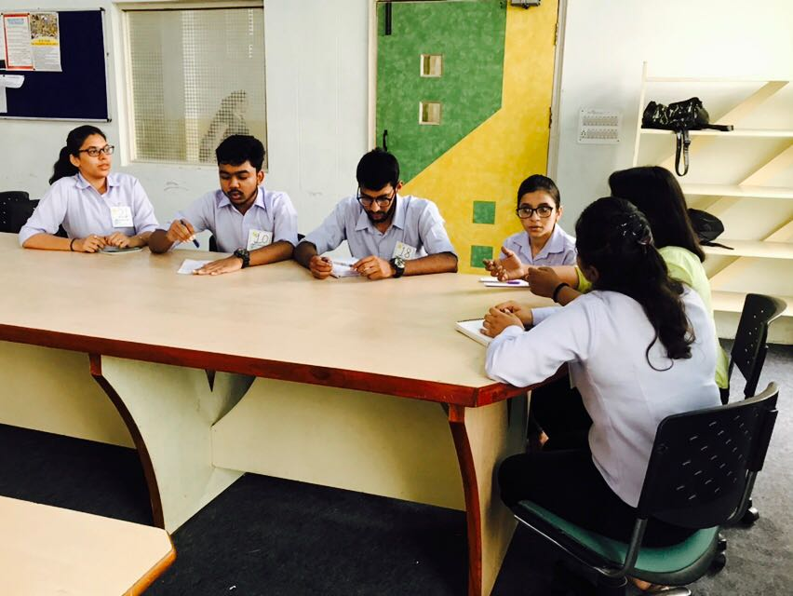

Slide 32


Slide 33


Slide 34
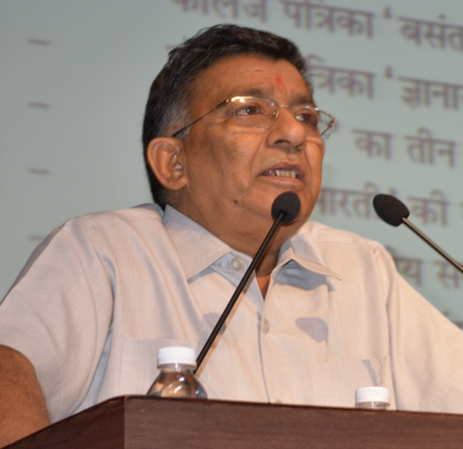
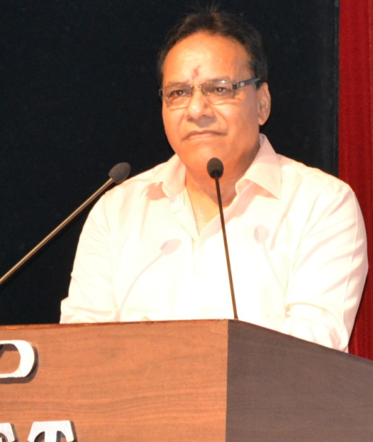
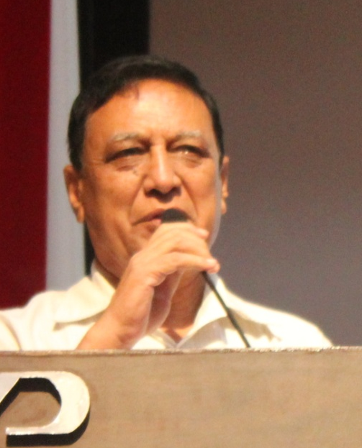
Abhiwyaqti 2017 was the name of Hindi Diwas celebration program which was held on 14th sept. the chief guest of the day was Dr. Vijay Dutt Sharma, Director, Haryana Literature Academy, Panchkula, who delivered valuable messages to students on manners, etiquettes, culture, environment and many more aspects of life, which were eye opening for the modern youth. All the students present there took an oath to sign in Hindi on that day.
Awards were given to the best performers in the field of speech, poetry, dance, extempore and skits.
The complete anchoring was carried out in Hindi and by BBA first year students viz Hardik, Anshuman, Priya, Nimmi, Reema and Rashi which was highly appreciated by the management.

Slide 35
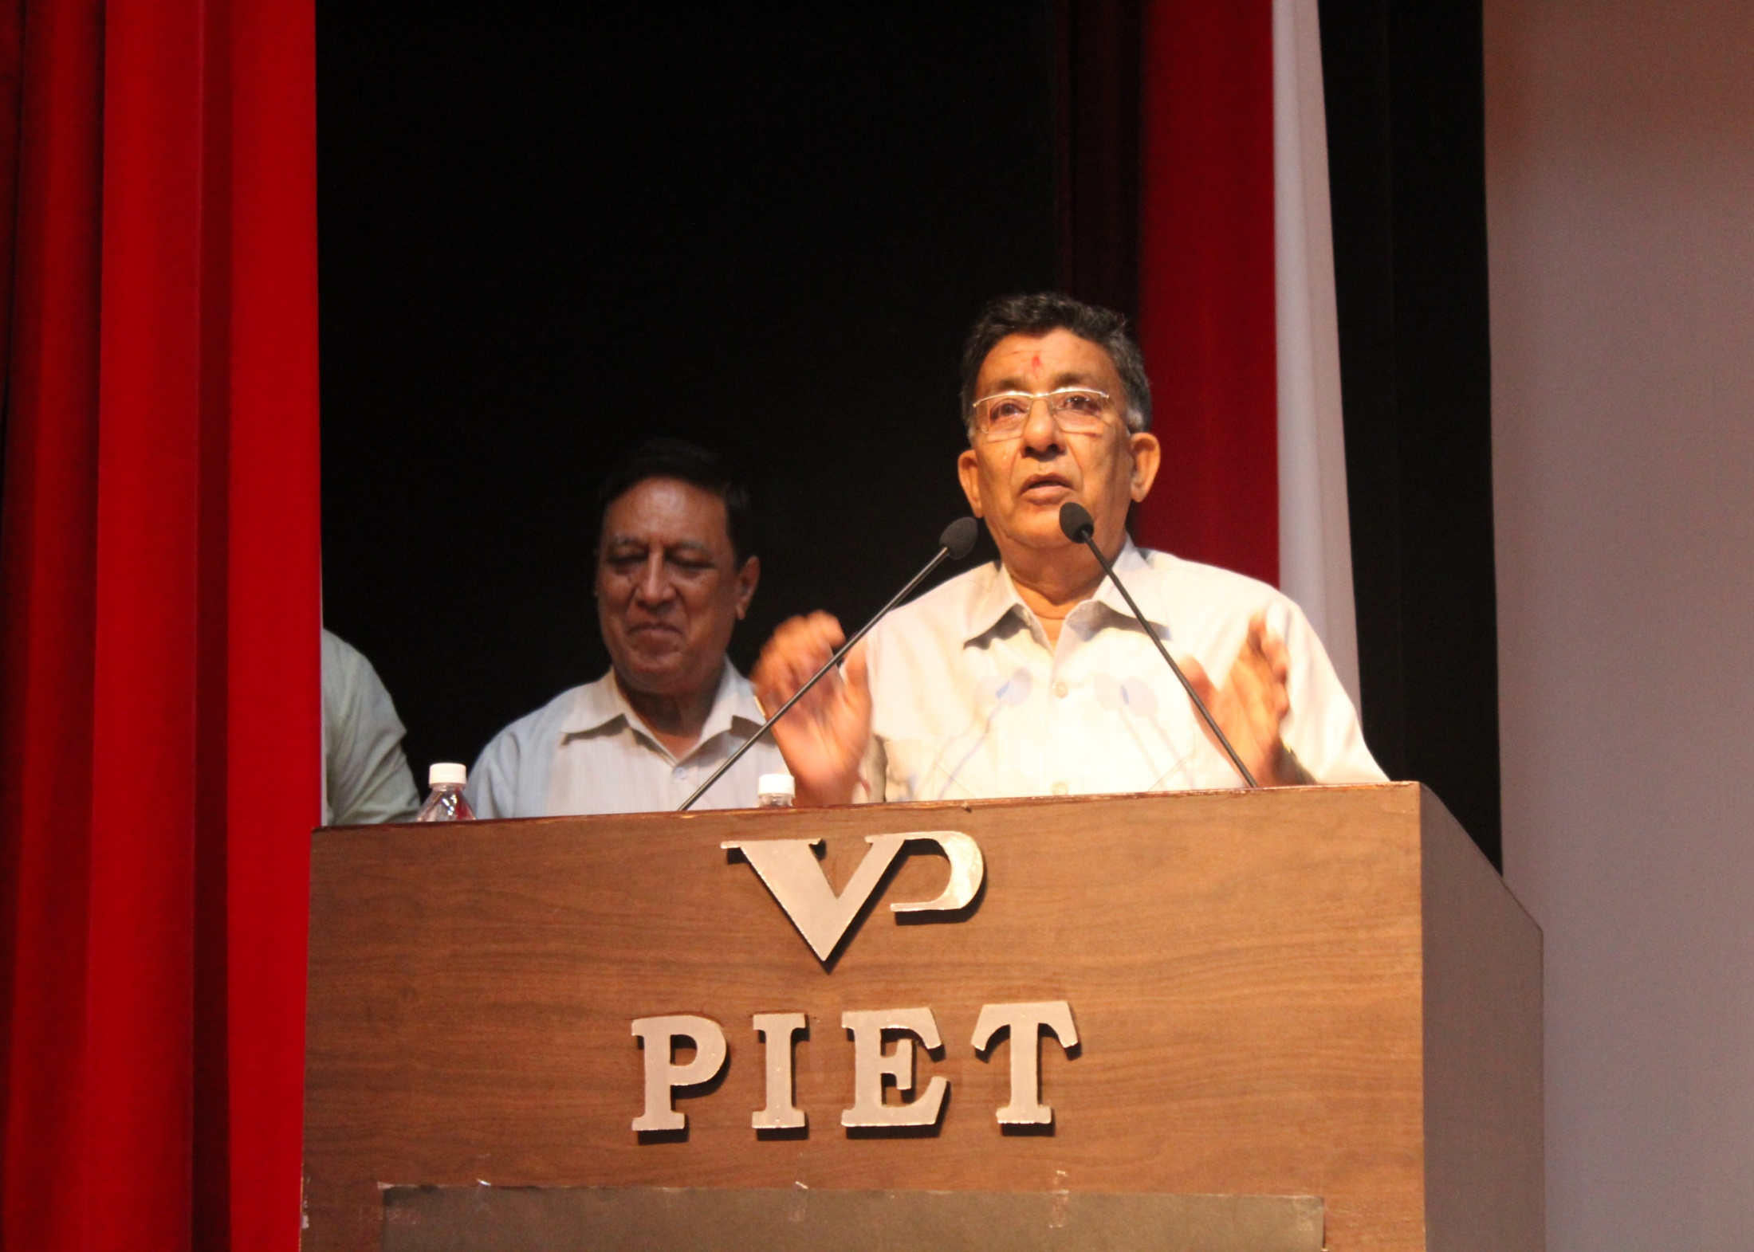
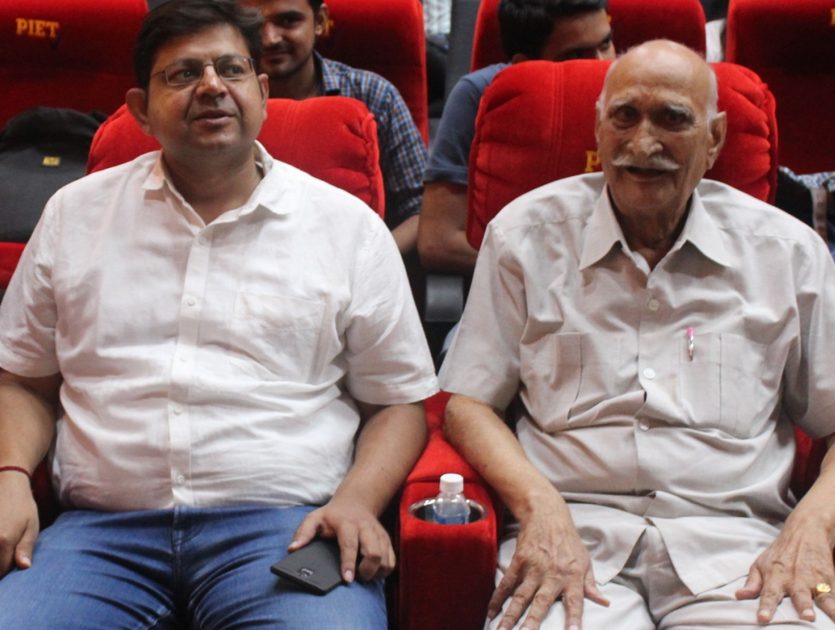




Slide 36




Slide 37





Slide 38


20/09/2017

Slide 39


TALKATHON-2K17
A National level oratory event was organized by Applied Science and Humanities Department on 20/09/2017.
Around 25-30 students across various streams of the college participated in this competition.
It is the matter of pride that among the top 10, BBA students grabbed 3 places.
While the event was cheered by Prof.(Dr.)K.K Paliwal, Director, PIET, and co-cheered by Dr. Vinay Khatri HOD(AS).
The judges for the event were Prof. Jagmohan Malhotra, Mrs. Rekha Mahajan and Dr. Nisha Dahiya.

Slide 40


Tanya Rajpal, Bba-2ND year
4th Position
DIKSHA ,
BBA-3RD YEAR,
1ST POSITION

Slide 41


Manya,
BBA-2nd Year, 6th Position
The Speeches of the selected orators have been video recorded and uploaded on youth talkathon site for a final selection at national level.

Slide 42




21/09/2017

Slide 43


On 21 September, 2017 NSS group of PIET held a road safety campaign headed by Mr Hawa Singh Sir along with student coordinators Hari Kishan ,Shivani, Kartik Gavish and Sanyam and other BBA students.
The main motive of this campaign was to tell the people about the importance of wearing helmet and to follow the traffic rules.
The NSS team went to Samalkha(Panipat)

Slide 44


The whole NSS team was divided into 3_4 groups headed by student coordinators .The Students pasted various stickers which gave the message of importance of wearing helmet on the 2 wheelers of the people who were not wearing helmet and also circulated brochures which gave the message of road safety to the people of Samalkha. Students of BBA did a great work as they were able to approach lot of people and were able to make them realize the importance of wearing protective gears while riding and that it's also important to obey traffic rules to avoid any kind of accident. Students of BBA were also appreciated by the local crowd .

Slide 45

Team after success of the Campaign.

Slide 46


21-22/09/2017

Slide 47


A Red Letter Day
21st and 22nd Sept are also marked as ‘Red Letter Days’ in the history of BBA because four students viz
Nasir and Paras from BBA 2nd section B
Abhinav from section A
Kartik from Section C
Participated in the International Conference on Indian Economic Transformation through revival of Manufacturing Sector and Start-Up Eco-system under the guidance of Dr. Sangeeta at Ramanujam College, University of Delhi.
The two presentations were made by them:
Start-up in Service Sector
Ease of doing Business
Which were greatly appreciated by the judges.
This initiative by Dr. Sangeeta has been greatly appreciated by the HOD, BBA.

Slide 48

Paras ,BBA-2B, Receiving Certificate of presentation

Slide 49

Research Paper Presentation at National Conference on “Changing Dimensions of Business Management and Corporate Social Responsibility in Globalised Era” at IMSAR, MDU, Rohtak
On 26th Sept it was another mile stone achieved when 23 students of BBA for the presentation of their Research Papers titled
Thanks to the initiative by the very innovative HOD Dr. Yoginder Kataria, all round efforts were put in Dr. Sangeeta, Dr. Ankur and Mr. Rajesh to encourage the young minds to shift their bent of mind towards research activities at the tender age because the group for students include students from 1st year as well.
Dr. Yoginder Kataria was highly appreciative about this gesture on part of the BBA faculty team to enhance the skills of their wards, which he said was the very right and desirable approach to make them true professionals.

Slide 50
Sr No. | TOPIC | AUTHORS
1. | A comparative study of public and private hospitals | Naina, Meenakshi and Dr. Sandeep Kumar
2. | Consumers attitude towards online shopping | Shristi Jain and Anshuman Sharma
3. | Consumer behaviour in the era of digitalisation | Dr. Sangeeta, Dr. Yogendra Kataria and Purva Batra
4. | E-Banking services:A case study of HDFC Bank | Bipul Vermani and Shilpa Sardana
6 | Indian education system :challenges and its opportunities | Mamta Pandey, Nidhi khurana and Heena
7. | Influence of social media on purchase of decision making | Vidhi and Prince
8. | Role of Social Communication in Changing Lives of People | Abhinav Dadhwal, Nasir Ansari and Paras Ahuja
9 | Consumer attitude towards retail sector | Shivani, Kritika and Dr. Ankur
10 | Customer satisfaction towards internet banking | Bharti, Deepika and Anjali
11 | Empirical study measuring the consumer perception for eco friendly packaging of product | Hari Krishan, Domita, Deepam Kapoor
12 | Employee satisfaction on LIC HFL | Mr. Atul and Nikita
13 | A comparative study of herbal and pharmaceuticals medicines | Kartik Chopra

Slide 51

Research Team at MDU (Rohtak)

Slide 52



28/29 September 2017

Slide 53

Lamp Lighting by Management

Slide 54




Bhangra by BBA Students.
Anchoring by BBA Students

Slide 55




BBA Students showing their Talent.

Slide 56




Slide 57



BBA Girls in various activities.

Slide 58


Group Dance by BBA Girls.

Slide 59

Students getting Award from Management

Slide 60


AKHIL Live at PIET (Star Night)

Slide 61




Slide 62


SC-world games 2017
(International soccer council, Canada )
1st match- “Bhutan” score 2-1
2nd match- “Bangladesh” Score 4-1
3rd match- “Nepal” Score 1-0
GOLD MEDAL HOLDER.
Shivam Digani
BBA 2nd Year
“Achieving heights worldwide in Football..”

Slide 63



Slide 64

My Idea about Happy Life..
Asst. Prof. Ms. Samriti

Slide 65

The word happiness is relative and it varies in terms of personal belief and experience. According to me a Happy Life is something that helps me to be content from my inner self. As depicted earlier, happiness varies in terms of personal belief, I believe in the happiness that not only satisfies me, but also makes my near and dear ones feel good.

Slide 66
An important object of happiness is sacrifice. We must sacrifice something or the other to see our closed ones happy. According to me it is very important to prioritize whom we want to make happy and how important it is to sacrifice something for that. For example, I love my mom and I also love to smoke, but my mom does not want me to smoke at all. In this case, I need to decide what can make me more happy- smoking, or my mom’s happiness that she gets if I quit smoking. For me, second option would make me happy. In this case, I need to sacrifice smoking. If someone opts to have the first option, he has to sacrifice his mom’s happiness to be happy.
A Happy Life, in a nutshell, is a life of our choice, and it’s our choice that makes us what we are.

Slide 67

BBA, HOD
(Dr. Yoginder Singh Kataria)
BBA, E-Committee
(Mr. Jagmohan Malhotra)
(Ms. Sakshi Garg)

