Slide 1

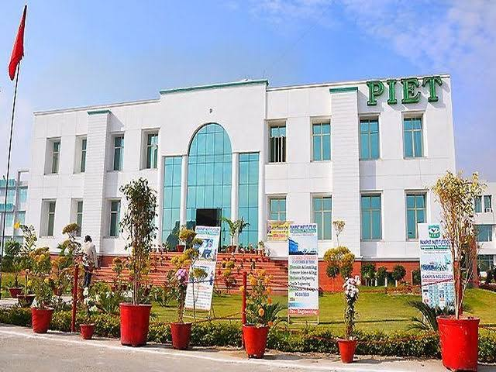

Slide 2


VISION:
To provide business and administration knowledge to individuals so as they learn to handle and manage the operations of business in competitive environment.
MISSION:
: to teach basic knowledge, skills and aptitude regarding business activities for running the business.
: to provide an opportunity of higher education in the field of business administration.

Slide 3
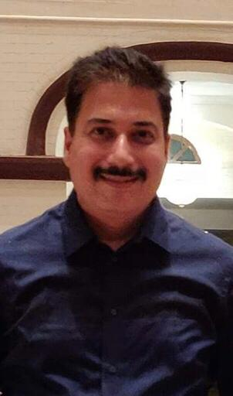
HOD’S MESSAGE
The purpose of education is to teach budding managers to think and develop a capacity to reason our facts. Learners should keep in mind the importance of planning and prioritizing their time and the effective use of it which are essential to achieve success. Learner’s should always think and review, discover the cause and effect of every event, in which they are involved. Do not surrender or become a salve to youthful fancies and indulgences. Be steady in your studies.
MR. ATUL GAUTAM
“ WE CANNOT ALWAYS BUILD THE FUTURE FOR OUR YOUTH, BUT WE CAN BUILD OUR YOUTH FOR THE FUTURE”. REMEMBER“ THE REWARD OF EVERY GOOD ACTION WILL BE GOOD ONLY”.
“Learn to enjoy hard work particularly your studies”.

Slide 4

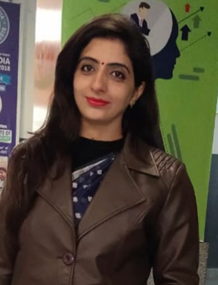
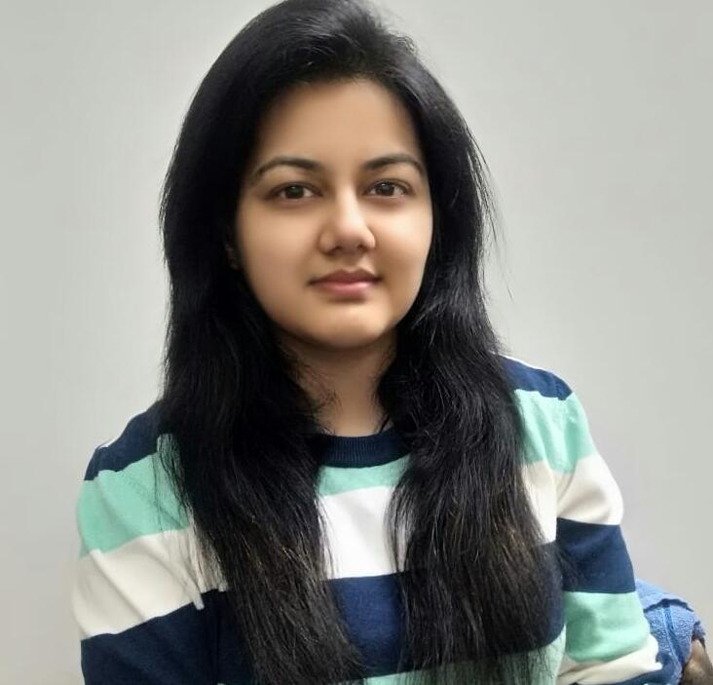
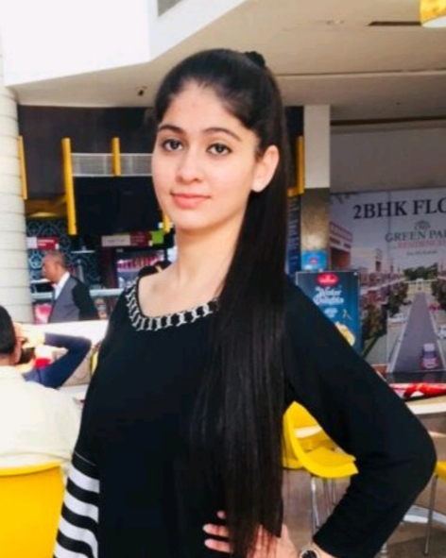
From Editor’s Desk
DR. NANCY ARORA
MS. SAHIBA SHARMA
AARUSHI
BBA 2ND YEAR

Slide 5



Remember that colleges are not closed. College buildings are closed. Teachers are working harder than ever.
“Stay Home Stay Safe”
“Online Classes No Academic Loss”. #PIET #StudentSafety

Slide 6

Everything is cancelled but,
ONLINE LEARNING
NEVER STOPS!

Slide 7
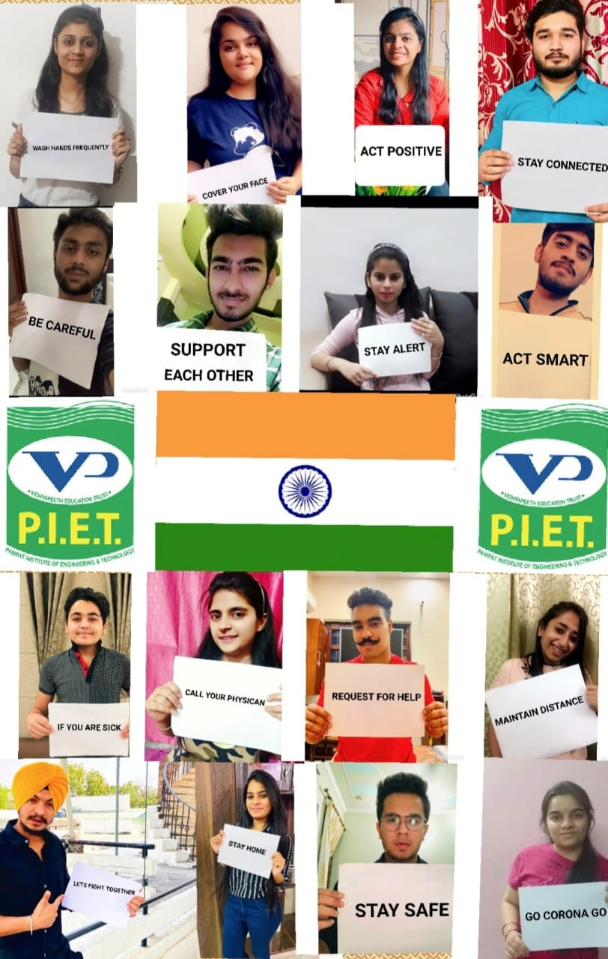
SHOW
KINDNESS

Slide 8


COMPANIES AT PIET FOR INTERNSHIP:
: UAS INTERNATIONAL
: INVESTOSURE

Slide 9

STUDENTS SELECTED FOR INTERNSHIP IN UAS INTERNATIONAL ARE:
PURVA BATRA - MBA
PRNAV VERMA - BBA
PAYAL - BBA
SACHIT KUBBA - BBA
ISHIKA - BBA
DEV - BBA
SHRUTI - BBA
SUSHANT RAWAL - BBA
ARAMDEEP - BBA
PIYUSH - BBA
HRISHIK LAKHINA - BBA
VIVEK SHARMA - BBA
YOGESH CHAUHAN - BBA
SONAM DOON - BBA
SARTHAK KUMAR - BBA
VIPUL JUNEJA - BBA
AMAN TYAGI - BBA

Slide 10

STUDENTS SELECTED FOR INTERNSHIP IN INVESTOSURE ARE :
PRERNA - BBA
RITIN AGGARWAL - BBA
KRISHAN MURTI - BBA
SARTHAK WADHWA - BBA
LAVISHA - BBA
KHUSHAL AHUJA - BBA
SHIV PADAM SHARMA - BBA
MAHAK - BBA
SHIVI GUPTA - BBA
MUKUL - BBA
RUBY - BBA
PRIYA - BBA
SHUBHANGI KATYAL - BBA
NARAYAN GROVER - BBA
SIMRAN - BBA
SANJUL - BBA
SNEHA - BBA
NIKITA - BBA
VANSHIKA - BBA
DIVYAM - BBA
PALLAVI - BBA
VIPUL GOYAL - BBA
VANSH - BBA
JYOTI - BBA
PARIDHI GOEL - BBA
YACHNA - BBA
YUKTA - BBA
KAPIL GUPTA - BBA
RITIKA GOEL - BBA
YOGESH GROVER - BBA

Slide 11

CRITICAL THINKING
INNOVATION
STRATEGISING
SUMMARISING
TEAM BUILDING
CONCEPTULISING

Slide 12
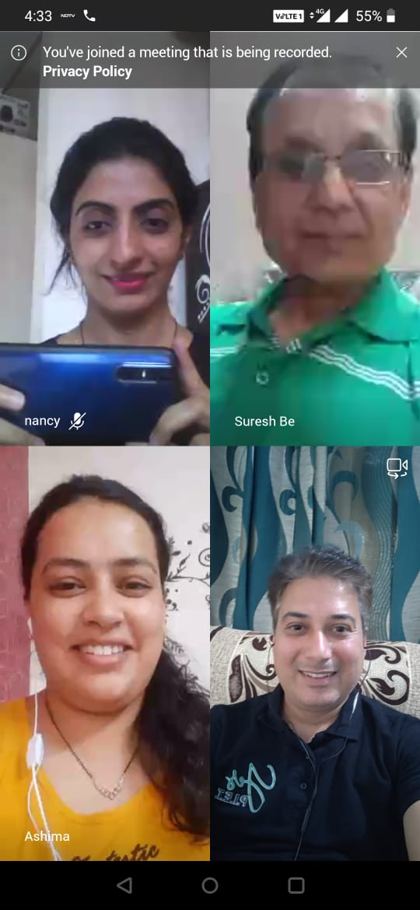
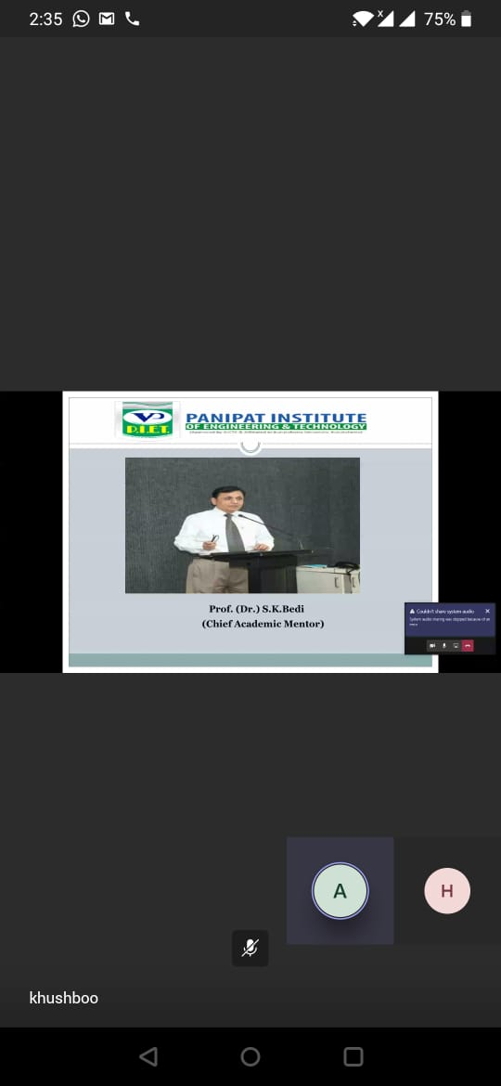
Faculties actively participated in the session leading to a more analytical approach towards problem solving. This session helped participants to enhance their teaching pedagogy and motivated them to replicate the same.

Slide 13

SKILLS
DEVELOPMENT
TRAINING
PERSONAL GROWTH

Slide 14

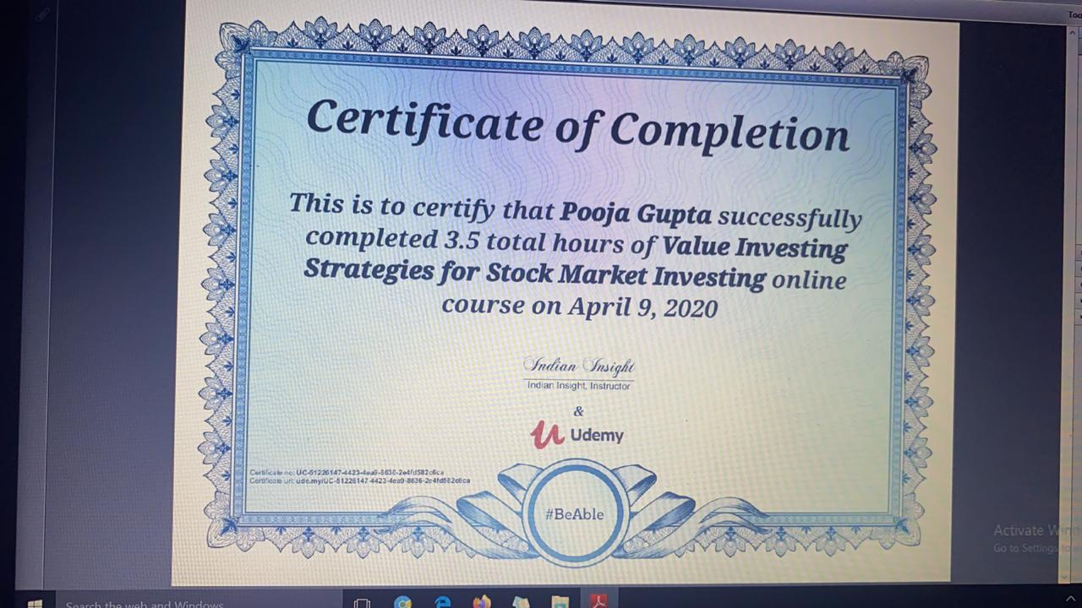


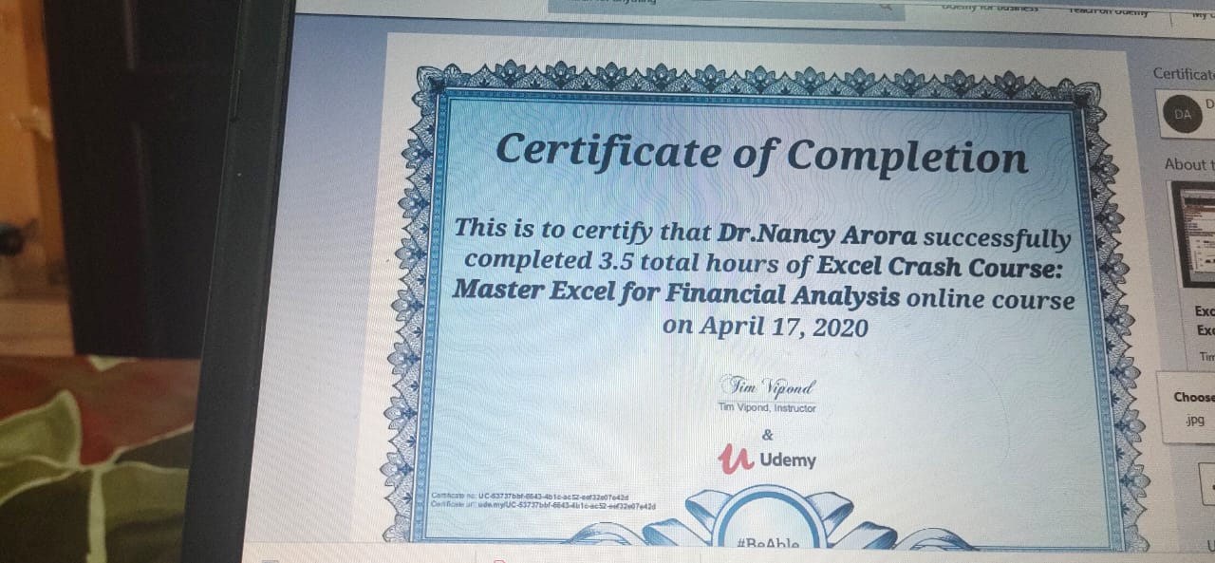

Slide 15


Slide 16

APRIL 2020

